Slide 1
v4 Launch Webinar
December 2024
With the PSADT and Patch My PC Team

Slide 2
Introductions
PSADTv3 - Overview
PSADTv4 - What’s New
Demos
Q&A

Slide 3
Introductions
Dan Cunningham
PSADT Co-Founder, Developer & Project Lead
Strategic Innovation Leader for PSAppDeployToolkit @ Patch My PC
@sintaxasn on Twitter / X / BlueSky

Slide 4
Introductions
Mitch Richters
Experienced with all things Microsoft
Apparently knows things about PowerShell
Consultant/Solutions Architect at @ Freelance
@MitchRichters on Twitter / X

Slide 5
Introductions
Dan Gough
Software deployment know-it-all
PowerShell nerd
Software Engineer @ Patch My PC
@packageologist on Twitter / X

Slide 6
Introductions
Sean Lillis
Co-Founder PS App Deploy Toolkit
EUC Architect @ Zurich Insurance
@seanels on X / @sean-lillis.bsky.social on BlueSky

Slide 7
Introductions
Mo Mashwani
20 years of experience in endpoint engineering / cybersecurity.
Besides PSADT, I spend most of my time with my two little boys.
Senior Technical Account Manager @ Axonius

Slide 8
PSADT v3
For those who don’t already know…

Slide 9
Overview
An open-source PowerShell framework for creating application deployment scripts
Consists of:
A standardized workflow for application install / uninstall / repair
encapsulate a pre-existing vendor install
add new steps to the install process
enhance the capabilities of the vendor install
standardize the process for deploying and supporting applications
A set of easy-to-use functions to simplify deployment tasks
Notes:
A PowerShell framework for ...
improving the experience of deploying software …
to Windows endpoints …
at scale
Opinionated workflow for app install / uninstall / repair.
Typically used to …
encapsulate a pre-existing vendor install, e.g., MyAppInstaller.msi / setup.exe
add new steps to the install process, e.g., performing tasks before / after install
provide enhanced installation capabilities, e.g., user interaction, automated logging
standardize all application deployments for any given organization
Backed by a collection of PowerShell functions to simplify common app deployment tasks

Slide 10
Overview
Integrated into many 3rd party tools such as:
Scappman (part of the Patch My PC family)
Master Packager, Flexerra AdminStudio, InstallShield
Robopack, Raynet RayPack Studio, Pace Suite
Windows Client Management AG, Apptimized, XOAP
SparkleFlow, and many others….
Notes:
A PowerShell framework for ...
improving the experience of deploying software …
to Windows endpoints …
at scale
Opinionated workflow for app install / uninstall / repair.
Typically used to …
encapsulate a pre-existing vendor install, e.g., MyAppInstaller.msi / setup.exe
add new steps to the install process, e.g., performing tasks before / after install
provide enhanced installation capabilities, e.g., user interaction, automated logging
standardize all application deployments for any given organization
Backed by a collection of PowerShell functions to simplify common app deployment tasks

Slide 11
Moving Forward
PSADT v3 was built in circa Windows 7
Initially built for PowerShell 2.0, only recently adopted PS 3.0 as a min requirement
Has maintained functional support for legacy operating systems up to today
Microsoft Extended Security Updates for Windows 7 ended in January 2023
Not been able to take advantage of newer capabilities in today’s systems
Not been able to take advantage of newer capabilities in PowerShell
e.g. still uses Get-WmiObject vs Get-CimInstance
… 😱

Slide 12
V4 Goals
Ditch legacy code that has been holding us back
Modernize the user experience to fit with the modern Windows look and feel
Add long-standing user requested features and capabilities
Enable Patch My PC to provide a commercial support offering for PSADT

Slide 13
PSADT v4
What’s New

Slide 14
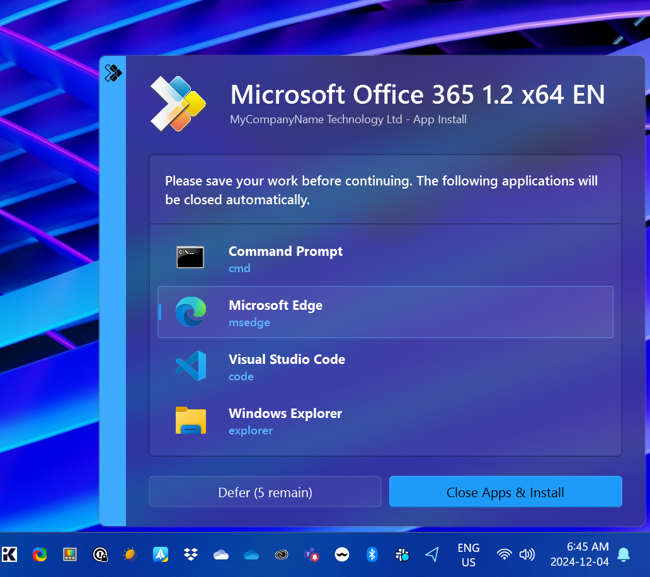
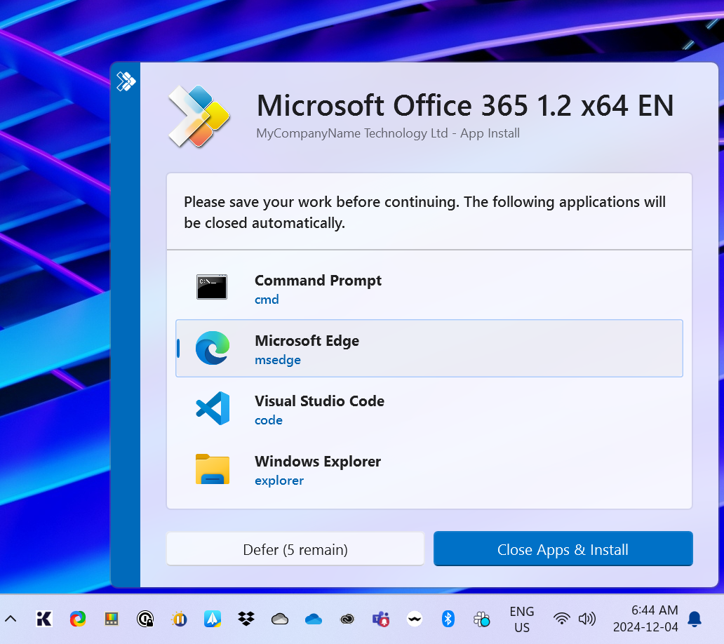
What’s New?
New Lightweight Modern Fluent User Interface (v4 only)
`

Slide 15
What’s New?
Digitally signed PowerShell module
Codebase completely refactored and optimized
Defensively coded to ensure security and reliability
Now provides PowerShell 7 and ARM support
Complete removal of VBScript code from the project
All C# code is now compiled and digitally signed
Integrated Zero-Config WIM file support

Slide 16
What’s New? (yes, there’s more!)
Support for overriding config via the registry - ADMX template to follow
Support for PowerShell standard error handling, such as -ErrorAction, etc
Support for PowerShell standard filtering like Where-Object, etc
Strongly typed and defined object types, no more PSCustomObjects, etc
Extensions supported as supplemental modules
Custom action support for extensions on deployment start/finish
Backwards-compatibility with v3 deployment scripts

Slide 17
Module Resiliency
Object-oriented Design encapsulates deployments, facilitating complex scenarios such as parallel operations
Immutable Command Lookup Table ensures functions cannot be spoofed or overwritten
PowerShell Strict Mode v3 compliance for code safety
Performance Optimizations using efficient object types
CI / CD Build System for code validation and linting, unit and integration testing, documentation generation, and more.
Already production-tested prior to the public release

Slide 18
What’s Changed?
Executable Entry point:
Deploy-Application.exe ➔ Invoke-AppDeployToolkit.exe
Config moved from XML to PSD1 format:
AppDeployToolkitConfig.xml ➔ Config\Config.psd1
Functions renamed to avoid collisions:
Copy-File ➔ Copy-ADTFile
Execute-Process ➔ Start-ADTProcess
Write-Log ➔ Write-ADTLogEntry

Slide 19
What’s Changed?
True/False Boolean values replaced with Switches:
v3 had many Boolean parameters, some default to true, and others to false
Now instead of:
-TopMost $true or -TopMost $false
We have a single optional switch:
-NotTopMost

Slide 20
What’s Changed?
The Remove-MsiApplications command in v3 had -FilterApplication and -ExcludeFromUninstall parameters that use a complex syntax:
FilterApplication @(, @('Publisher', 'Oracle Corporation', 'Exact')) -ExcludeFromUninstall @(, @('DisplayName', 'Java 8 Update 45', 'Contains'))
These have now been combined into a single FilterScript, familiar to anyone that has used PowerShell's Where-Object command:
-FilterScript {$_.Publisher -eq 'Oracle Corporation' -and $_.DisplayVersion -notmatch 'Java 8 Update 45'}

Slide 21
What’s Changed?
Many commands in v3 use a -ContinueOnError parameter
In v4, you just use the standard PowerShell -ErrorAction parameter
Instead of:
ContinueOnError $false or -ContinueOnError $true
You use:
-ErrorAction Stop or -ErrorAction SilentlyContinue

Slide 22
PSADT v4
Getting Started

Slide 23
Getting Started
Download the latest release from GitHub:
https://github.com/PSAppDeployToolkit/PSAppDeployToolkit/releases
then:
Import-Module <Path to PSAppDeployToolkit folder>
Or install via the PowerShell Gallery:
Install-Module PSAppDeployToolkit

Slide 24
Getting Started
Generate a standard deployment template:
New-ADTTemplate -Destination 'C:\Temp' -Show

Slide 25
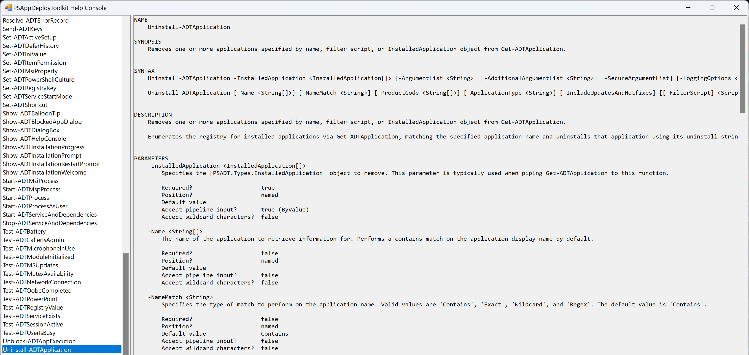
Getting Started
Display the built-in help console with Show-ADTHelpConsole:

Slide 26
Backwards Compatibility
A compatibility layer is provided to remap v3 functions through to v4!
To generate a template with v3 compatibility:
New-ADTTemplate -Name 'PSADT_Compat' -Version 3 -Destination 'C:\Temp'
Then simply drop in your existing Deploy-Application.ps1 script:

Slide 27
Backwards Compatibility
In addition, there are two additional commands to assist with migration:
Test-ADTCompatibility - produces a detailed report showing which functions, parameters and variables have changed
Convert-ADTDeployment - converts a v3 script or entire package folder to v4

Slide 28
Backwards Compatibility
Both of these commands are available in the companion module PSAppDeployToolkit.Tools, which is now available as a pre-release:
Download from GitHub: https://github.com/PSAppDeployToolkit/PSAppDeployToolkit.Tools/releases
Or install via the PowerShell Gallery: Install-Module PSAppDeployToolkit.Tools -AllowPrerelease

Slide 29
Demo time!
You’ll like this, no more slides 😁
Notes:
Install modules
Show intellisense working
Generate a v4 template
Show-ADTHelpConsole
Open and show v4 packages working (pre-install and open an old copy of WinSCP to demo closeapps)
Generate a v3 template
Drop in files/script from a v3 package
Demonstrate package working
Use Test-ADTCompatibility on a v3 script
Use Convert-ADTDeployment to convert a v3 package
Demonstrate converted package working
Show example of using a zero-config WIM file, plus WIM commands
Demonstrate Get-ADTApplication and Uninstall-ADTApplication for VLC - addparameters '/S'
Demonstrate -LoadProfilePaths on Get-ADTUser, and using it to copy a file to user's OneDrive desktops

Slide 30
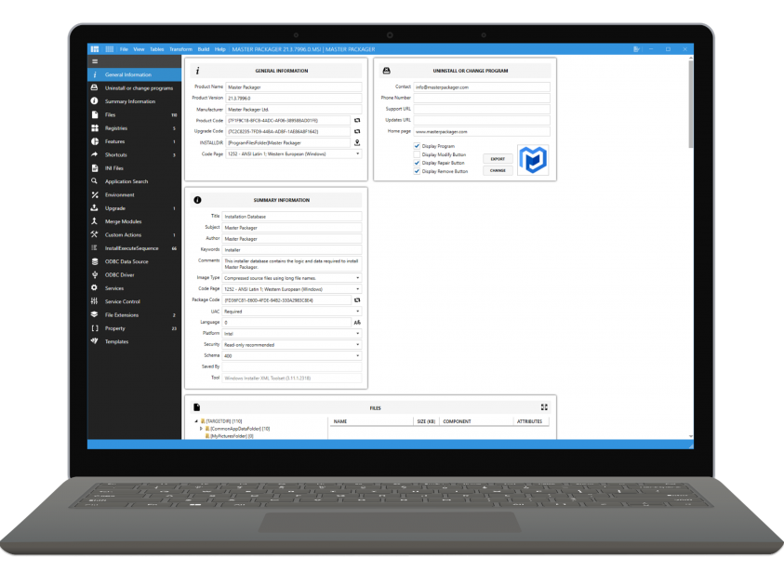
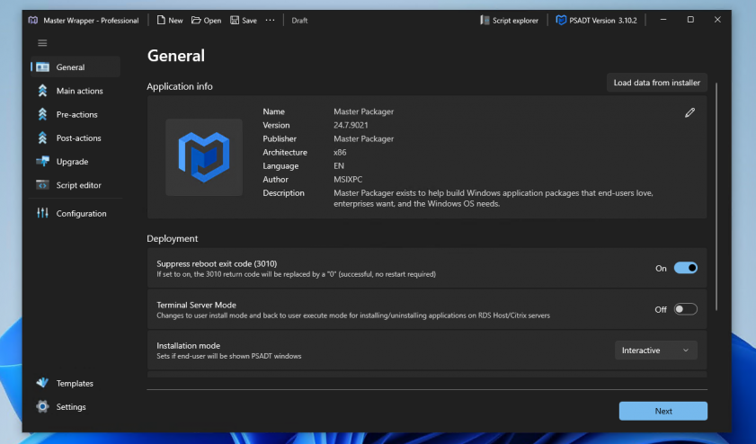
Friends of PSADT - Master Packager
Master Packager
Create and edit Microsoft Windows Installer (MSI) files for free
Helps you to become a Master Packager and save money
Master Wrapper
Create high-quality PSAppDeployToolkit scripts faster for free
PSADT GUI: Assisting Beginners and Empowering Pros in App Packaging
https://www.masterpackager.com/master-wrapper

Slide 31
Q&A

Slide 32
v4 Launch Webinar
December 2024
Thank you for attending

