Slide 1
Navigating Microsoft Graph API with the Microsoft Graph SDK
July 2024

Slide 2
Agenda
What is the Microsoft Graph
What is a REST API
Authentication & Authorization
What is the Microsoft Graph SDK
Lab Time

Slide 3
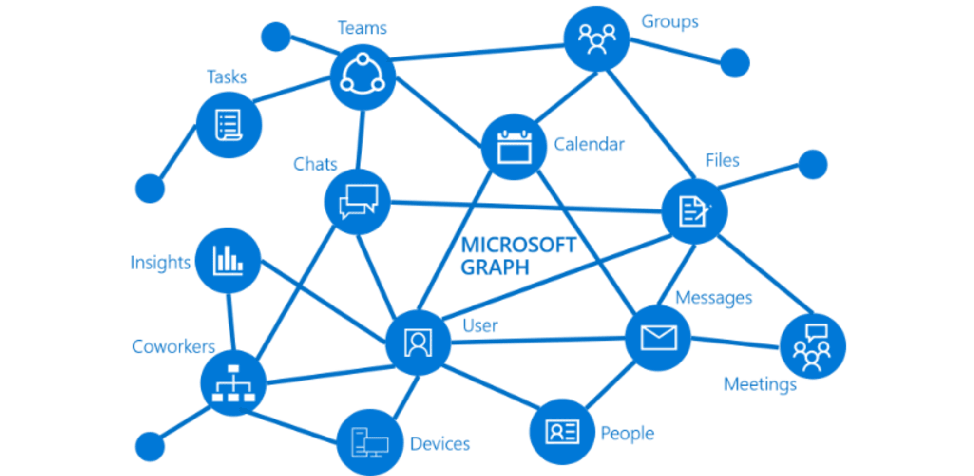
What is the Microsoft Graph
Released in November 2015, The Microsoft Graph is a single endpoint that exposes multiple Rest APIs and client libraries to access data in Microsoft 365 such as:-
Office 365
Outlook
SharePoint
Teams
Intune
Security
Entra ID
Purview
Windows Services
Devices
Notifications
Universal Print

Slide 4
Replaces multiple Microsoft endpoints
Wealth of learning opportunities at https://graph.microsoft.com
PowerShell Module / Service | API / Endpoint
ExchangeOnlineManagement | Outlook.office.com
MicrosoftTeams | Microsoft Teams API
AzureAD | Graph.windows.net
MSOnline | Azure AD Graph API, Office 365 tenant settings
Skype for Business Online Connector | Skype for Business Online API
Yammer | Yammer REST API
OneDrive / SharePointPnPPowerShellOnline | Sharepoint.com

Slide 6
Interacting with the Graph is similar to how we integrate with other REST APIs. The Microsoft Graph supports common HTTP CRUD methods:-
Create, Replace, Update, Delete (CRUD)
GET Read data from a resource (Idempotent)
POST Create a new resource or perform an action (non-Idempotent)
PATCH Update an existing resource with new values (non-Idempotent typically)
PUT Replace a resource with a new one (Idempotent)
DELETE Remove a resource (Idempotent)
GET and DELETE methods typically do not require a request body
POST, PATCH and PUT methods require a request body, typically in JSON format
Write requests to the Graph have a 4MB payload limit. This limit is lower when posting file attachments because base64 encoding adds extra overhead. You might get a 400 bad request or 413 payload too large response if the payload is too big

Slide 7
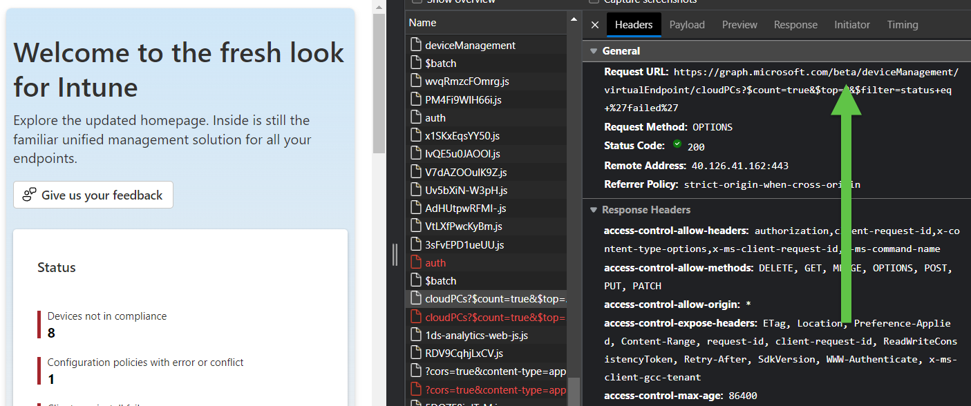
Microsoft Graph currently supports 2 API endpoint versions:-
1.0
Includes generally available APIs.
beta
Includes APIs that are currently in preview. Breaking changes ‘could’ be introduced and Microsoft recommends only using the beta endpoint for testing (Even though they use the beta endpoint in production)

Slide 8
How do we interact with the Microsoft Graph?
Postman Popular development tool that allows you to test Microsoft Graph API endpoints.
Graph Explorer A web-based tool provided by Microsoft to test and explore various Microsoft Graph APIs
SDKs Graph Ruby, Graph PHP, Graph Go, Graph Java, Graph Python, Graph .NET, Graph PowerShell https://learn.microsoft.com/en-us/graph/sdks/sdk-installation
Rest Method cURL, PowerShell, Azure CLI

Slide 9
What is a REST API
A REST API is a set of rules and conventions for building and interacting with web services.
A key point to understand is that a METHOD is used to communicate through an ENDPOINT to interact with a RESOURCE
Example of using the endpoint version in Microsoft Graph Explorer to interact with the Microsoft Graph

Slide 10
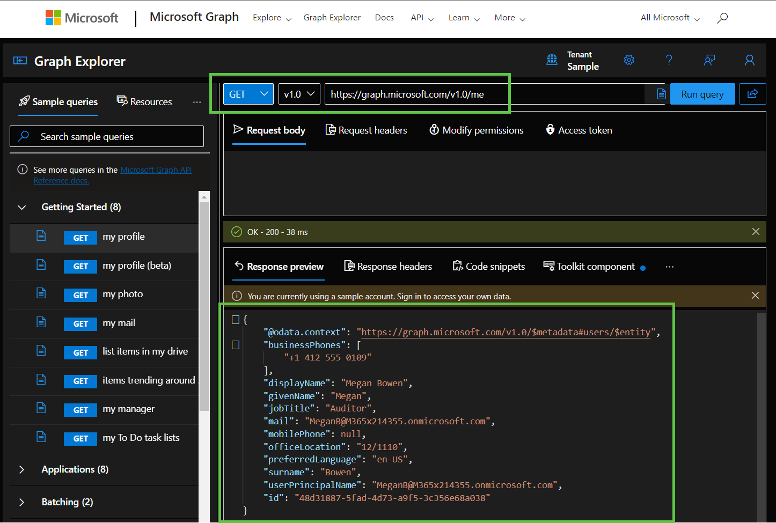
Using Graph Explorer is an easy way to familiarize yourself with how we can interact with a REST API
Aka.ms/ge

Slide 11
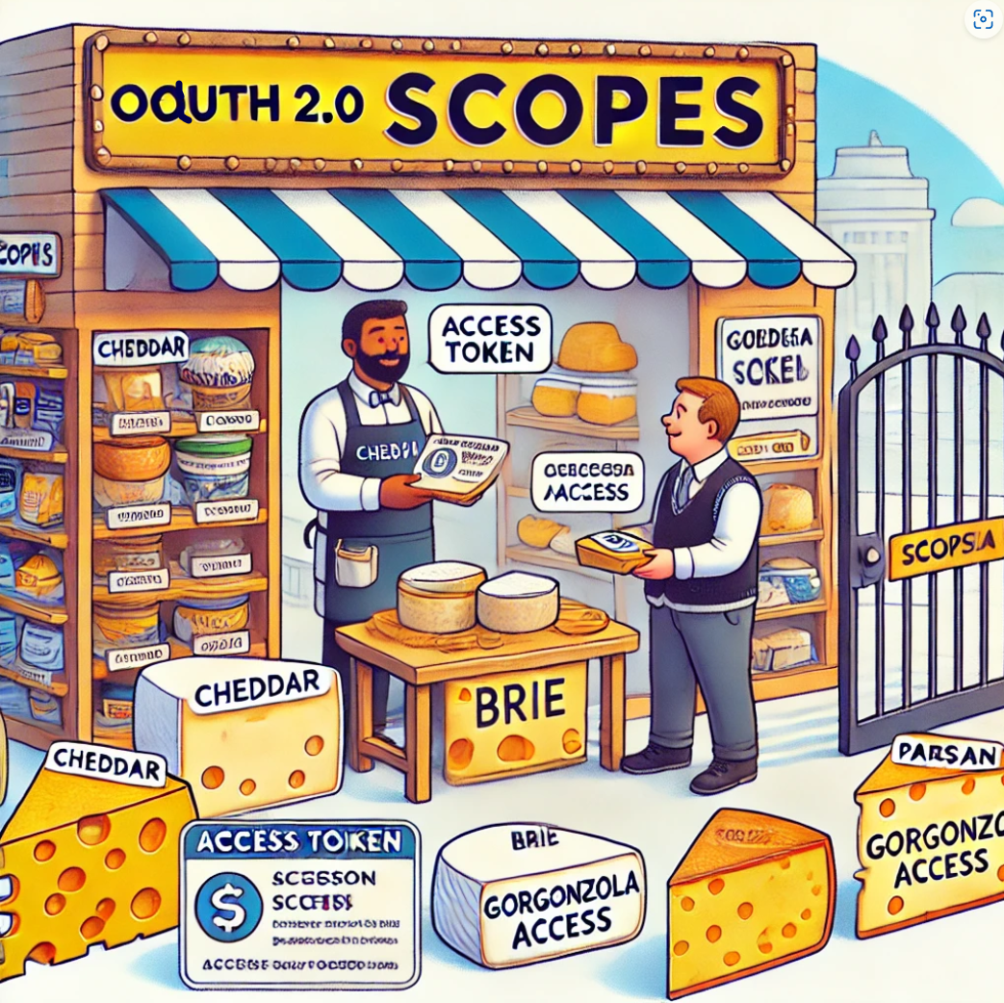
Authentication & Authorization
Scope as Cheese Types
Imagine you walk into a cheese shop with a ticket (your access token). This ticket allows you to request access to different kinds of cheese, but not all tickets give you access to everything in the shop.
In this analogy, the different types of cheese in the shop represent different scopes. Each type of cheese (scope) represents a specific set of permissions or access rights. Scopes is a mechanism in OAuth 2.0 to limit an application's access to a user's account. An application can request one or more scopes, this information is then presented to the user in the consent screen, and the access token issued to the application will be limited to the scopes granted.
When working with the Graph, we must ensure that all access is secure. This begins with authentication, where the identity is verified, followed by authorization, which grants permissions to specific resources based on roles and rights.
Authentication verifies who the connecting identity is. This step involves checking if the credentials used match the ones in Entra ID. It's essentially confirming the identity of the “thing” trying to access the Graph.
Authorization determines what resources can be accessed once authentication has taken place. It sets the level of permissions that control the actions that are allowed to be performed on the Graph.
Authentication
Authorization

Slide 12
Delegated Access
Typically used for interactive authentication scenarios where an application acts on behalf of a user.
Device Code Flow
UI Based
Application Access
An application uses its own service principal to authenticate.
Secrets
Certificates
Managed Identity
A Service Principal is automatically created and managed and used for authentication.

Slide 13
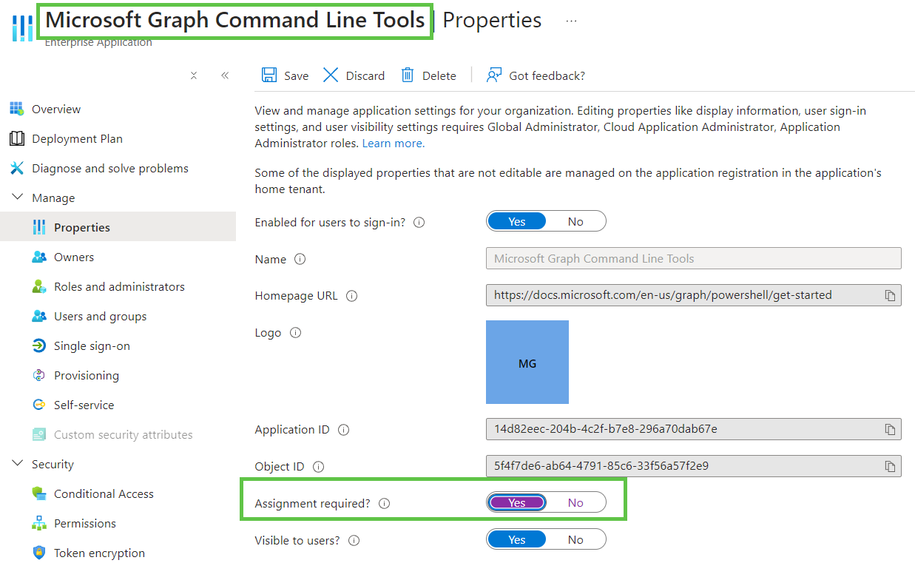
Consider who can sign in to the apps interactively in your tenant if you want to really lock down interactive authentication via tools such as Graph Explorer or the Microsoft Graph Command Line Tools

Slide 14
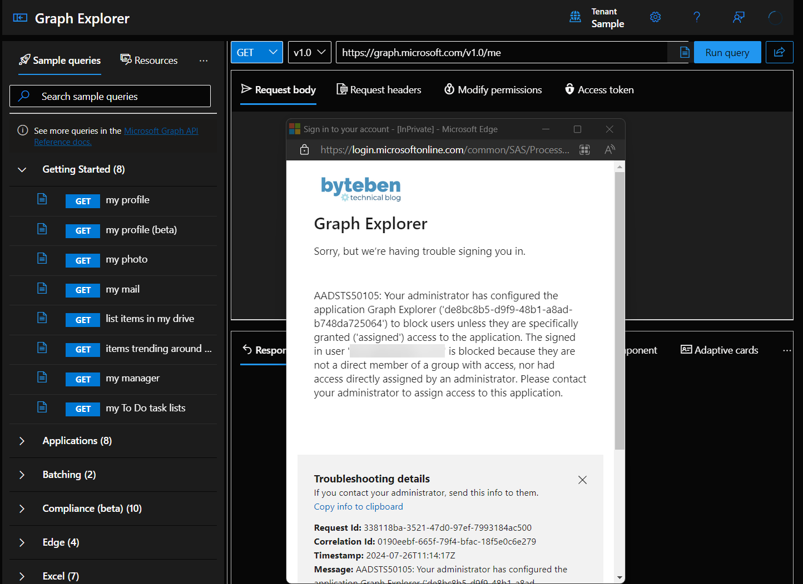

Slide 15
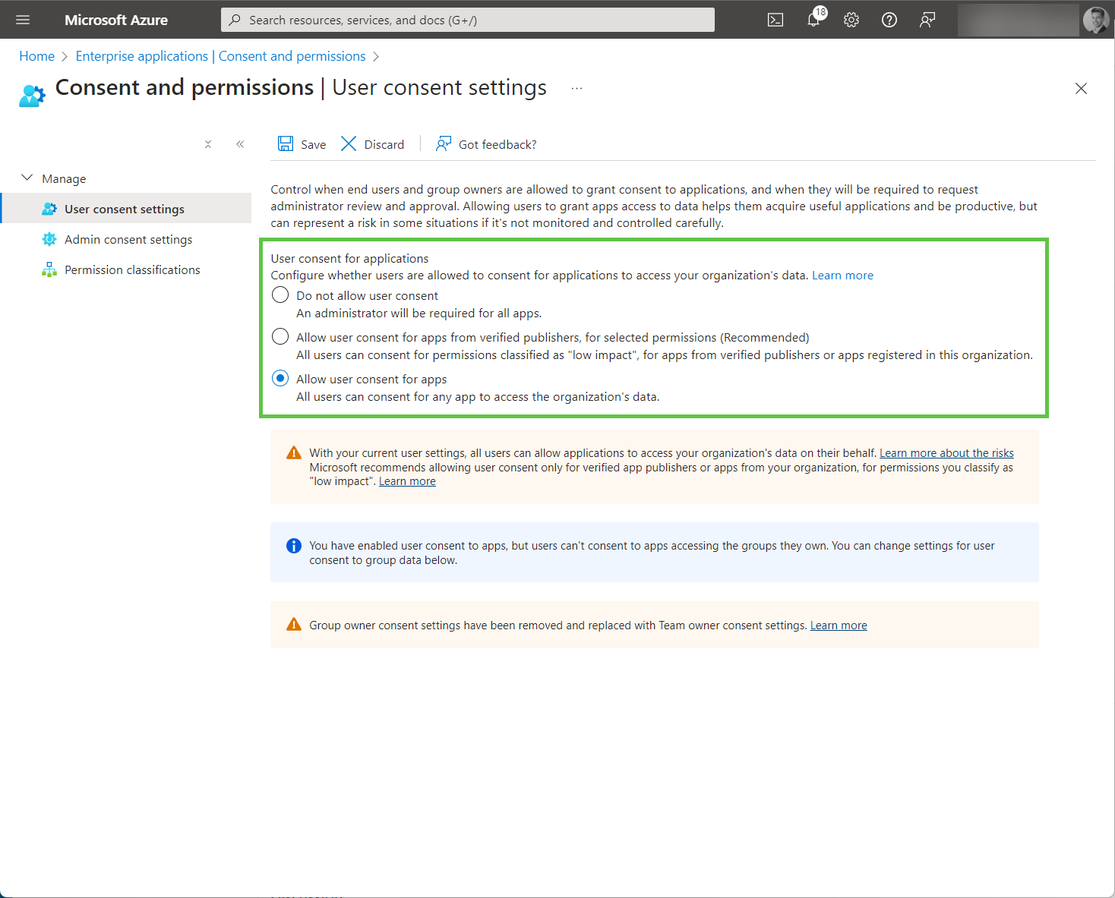
Also consider and review how you let users authenticate to Enterprise Applications in your tenant. This often gets overlooked and the default tenant permission is over-permissive

Slide 16
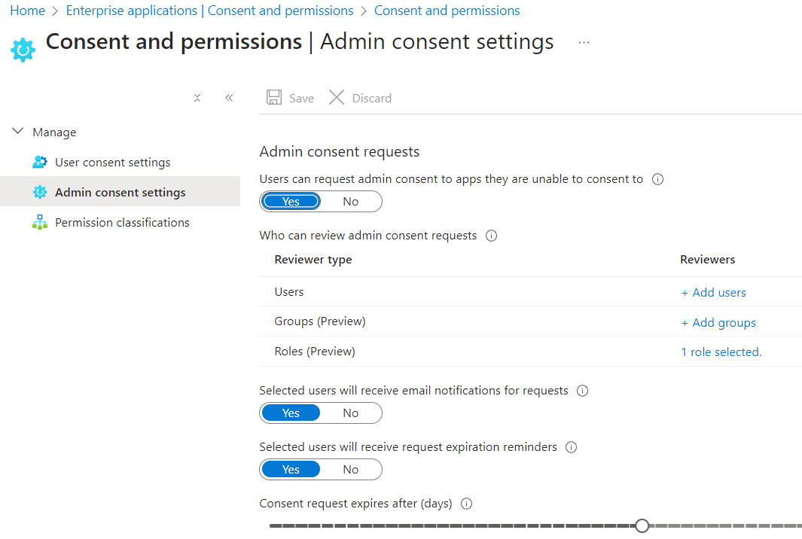
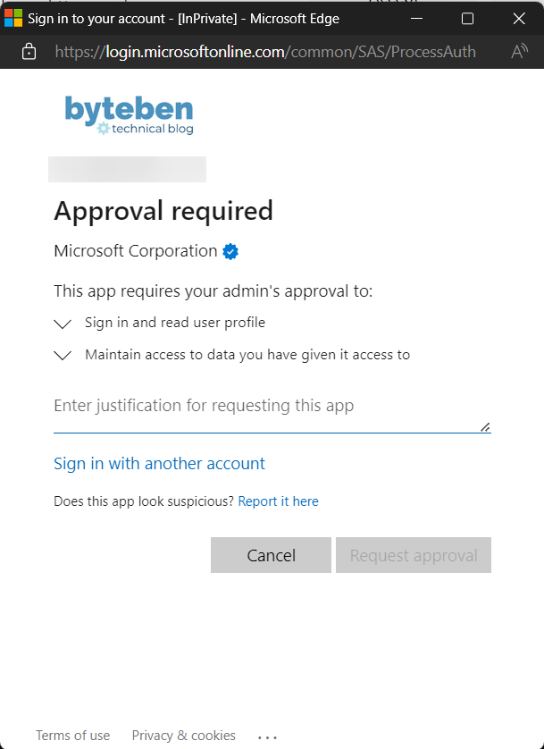

Slide 17
What is the Microsoft Graph SDK
The Microsoft Graph SDK provides pre-built methods to interact with the Microsoft Graph and abstracts away much of the complexity that comes with using native REST API calls
Graph Ruby
Graph PHP
Graph Go
Graph Java
Graph Python
Graph .NET
Graph PowerShell
https://learn.microsoft.com/en-us/graph/sdks/sdk-installation

Slide 18
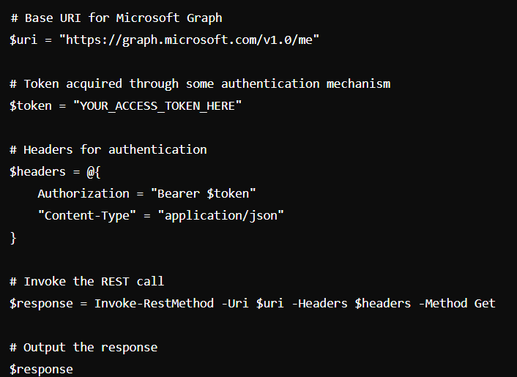
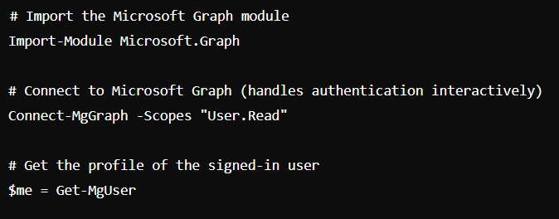
Simplicity is key and should not be understated
Big Advantage 1: SDK handles the token for you!
Native REST API Method
Graph SDK PowerShell Module

Slide 19
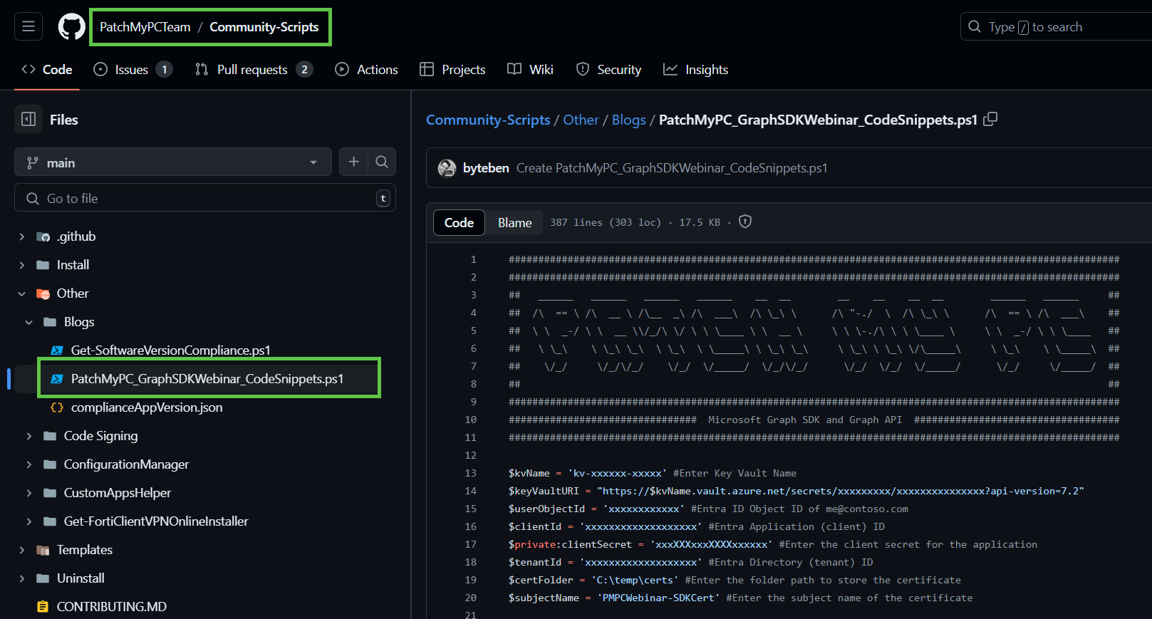
Lab Time
https://github.com/PatchMyPCTeam/Community-Scripts/blob/main/Other/Blogs/PatchMyPC_GraphSDKWebinar_CodeSnippets.ps1

