Slide 1
Introducing
Enterprise Premium with Advanced Insights
Patch My PC

Slide 2
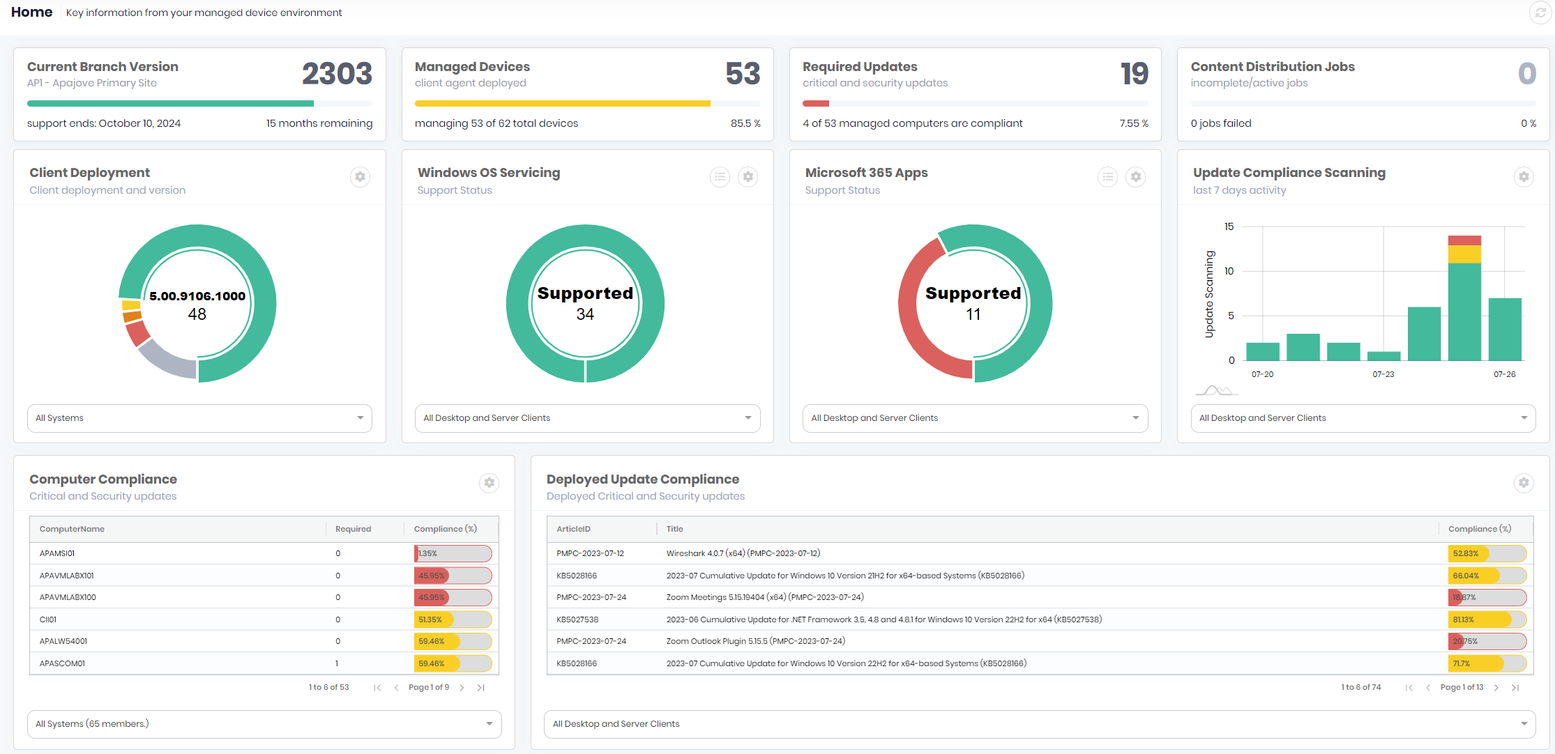
What is Advanced Insights?
A HTML 5 Dashboard Portal for everything in Configuration Manager

Slide 3
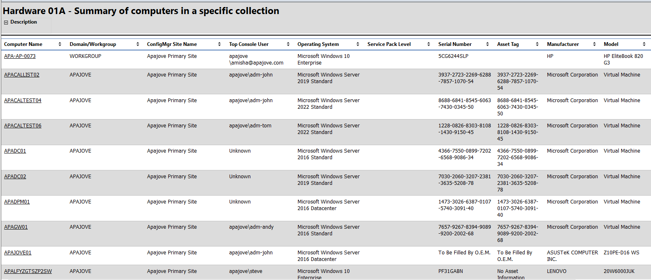
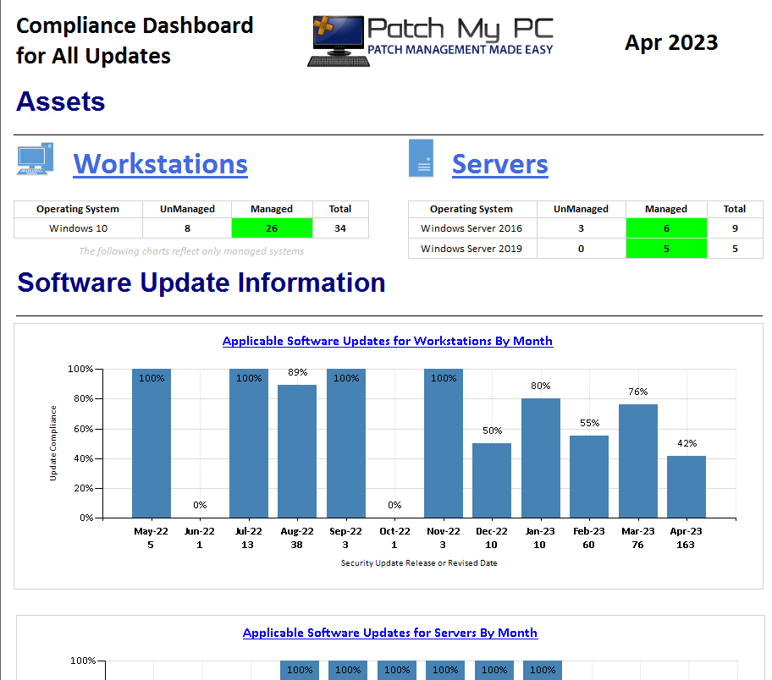
Why Advanced Insights?
ConfigMgr has great data, poor presentation
Unattractive, unintuitive, text only reports
Unsuitable for non-technical audiences
We have a promise to our customers to deliver reporting on updates.

Slide 4
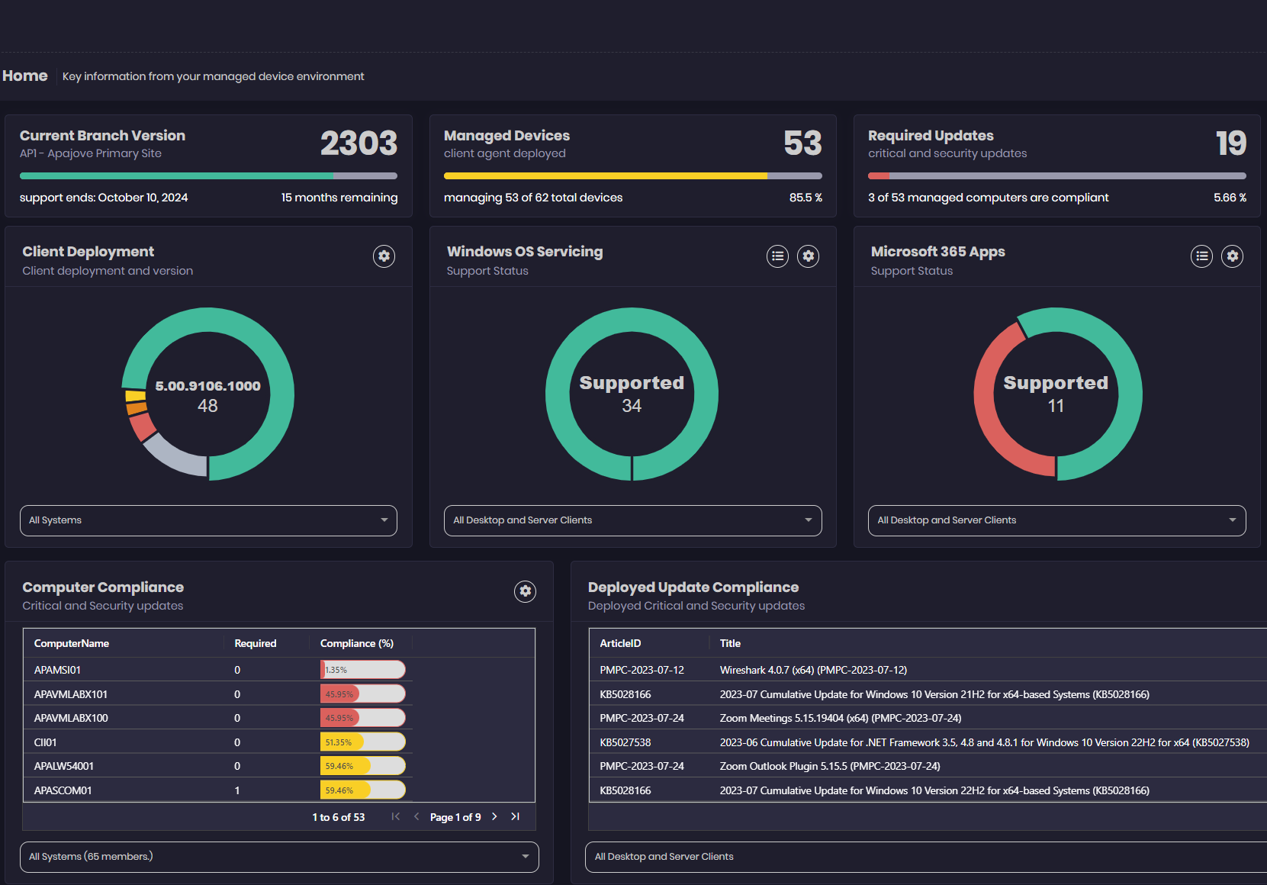
A Better Experience
Accessible, Attractive, Intuitive
Usable by technical and non-technical audiences
Dashboard summary views
Drill-through to deeper data
Global search
RBAC compliance

Slide 5
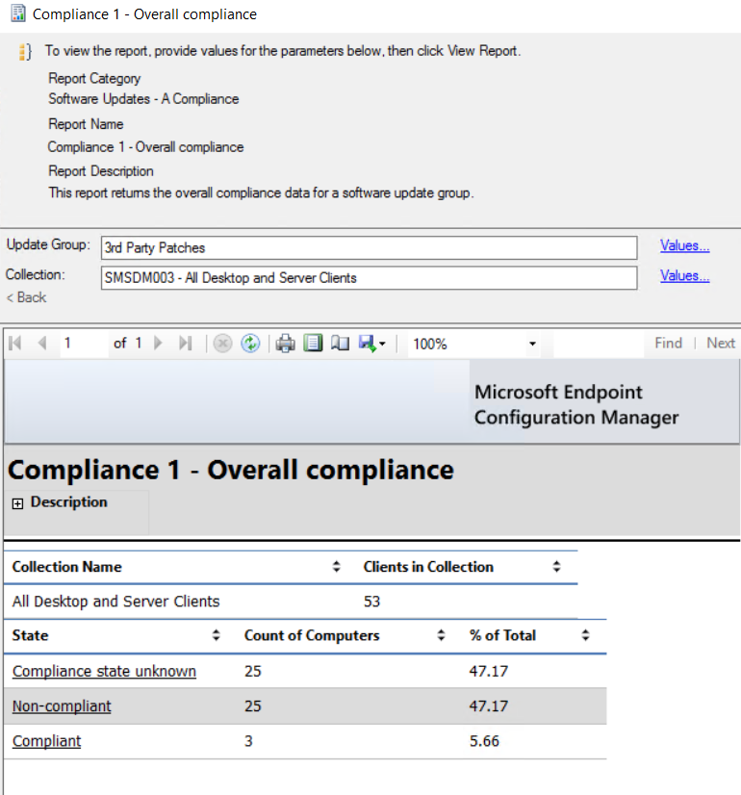
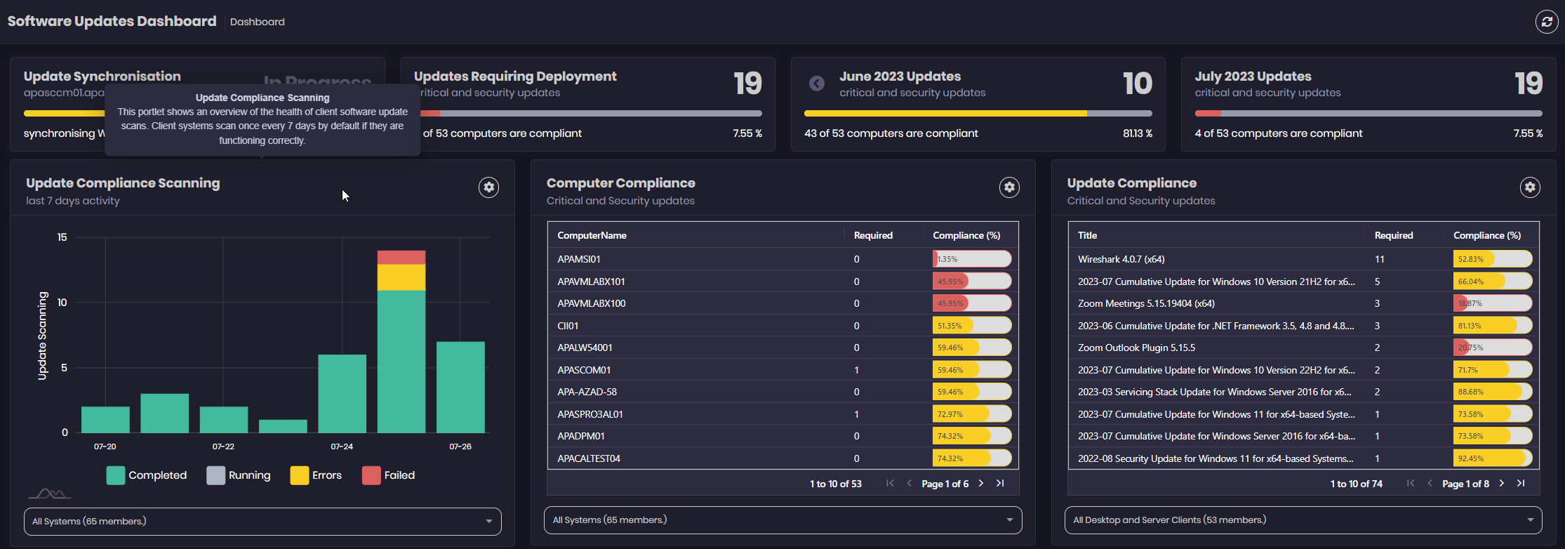
Demo 1
Pillar 1, Attractive, Intuitive, Responsive.
Let’s take a look at the Advanced Insights interface and user experience

Slide 6
Demo 2 Missed Opportunities
The current ConfigMgr inventory schema is old. It still includes CD ROM and Parallel Port reporting, (it has a PCMCIA class!).
The modern OS has dozens of important, useful classes but we can’t easily access them in ConfigMgr.
ConfigMgr doesn’t even report on user-based applications
By extending inventory we can add lots of useful info

Slide 7
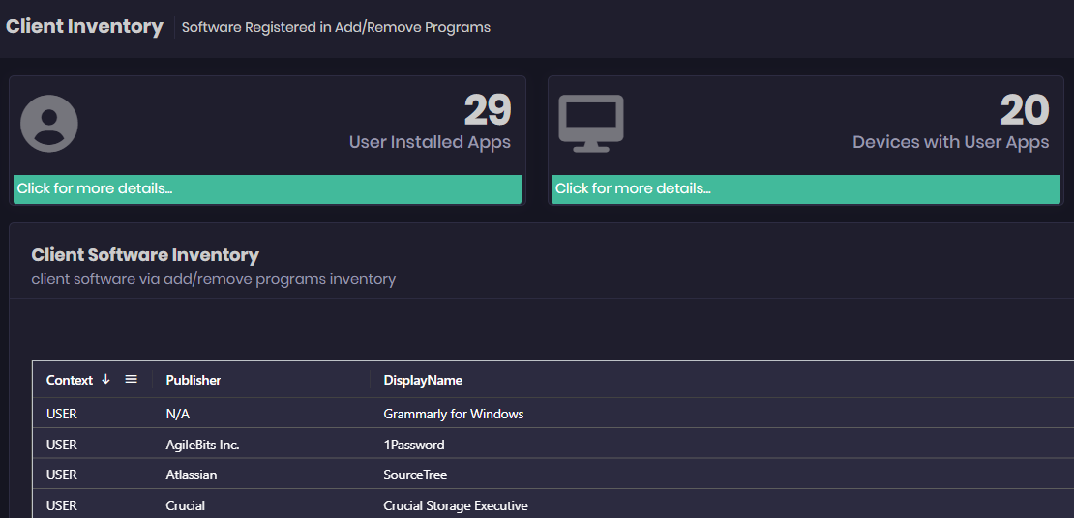
Demo 2
Pillar 2
Extend native ConfigMgr functionality to include new and useful inventory properties

Slide 8
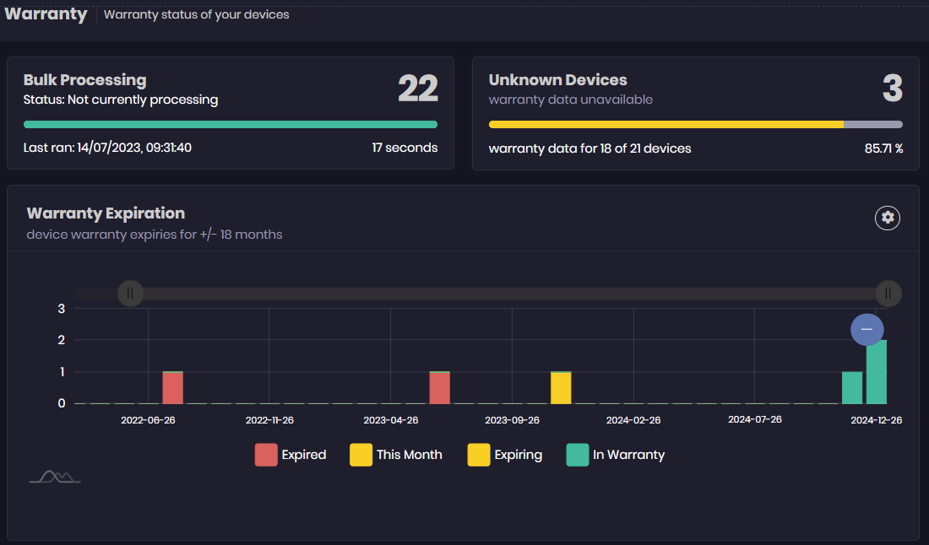
Demo 3
Pillar 3, build on the Configuration Manager dataset through API integration.
We will show Support, Warranty and Security information

Slide 9
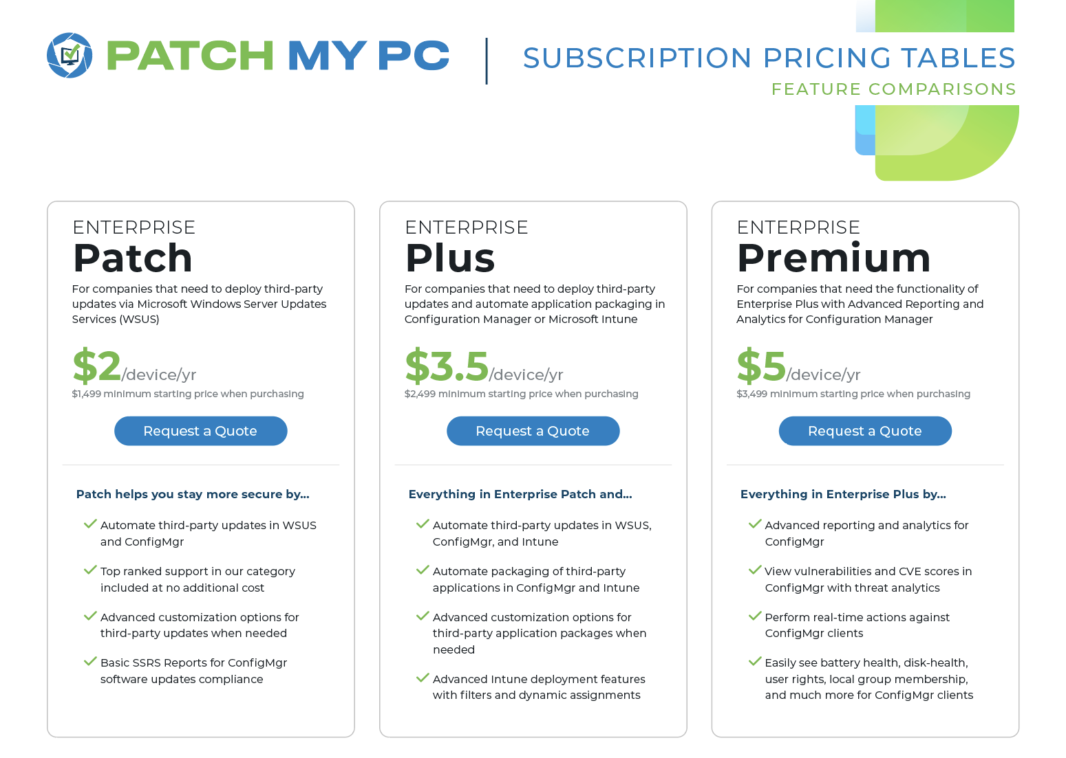
Licensing

Slide 10
Next Steps
Current Customer Register for Advanced Insights Showcase (6-month trial of Advanced Insights) https://patchmypc.com/advanced-insights
New Customers Register for a trial https://patchmypc.com/free-trial

