Slide 1
Cloud Management Gateway
Accessing Content and
WSUS from the Cloud
With the Patch My PC Team

Slide 2
Please Use the Raise Hand Feature
We will periodically switch between live Q&A and the slides/labs
If we have time for live questions, please use the raise hand feature and we will unmute you

Slide 3
Cloud Management Gateway
Agenda
What is a CMG?
CMG Components
Let’s talk Authentication
Known Configuration Gotcha’s
Lab Fun
Further thoughts
Q and A

Slide 4
Cloud Management Gateway
What is a CMG?

Slide 5
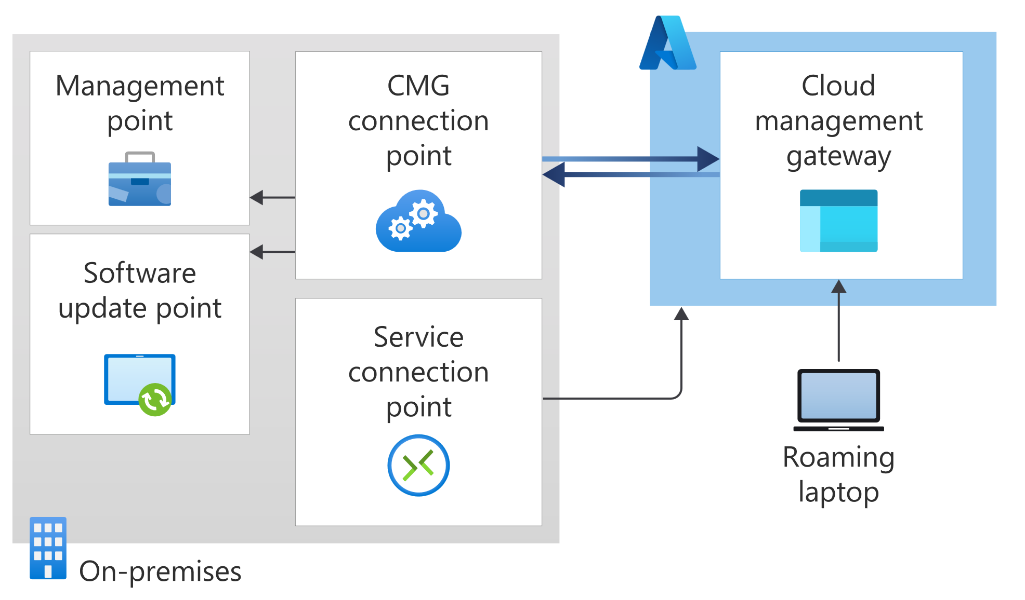
What is a CMG?
The Cloud Management Gateway (CMG) provides a simple way to manage Configuration Manager clients over the internet…
..without the need to expose your on-premises infrastructure to the internet.
Notes:
Introduced 1802 (March 2018)
Talk about CMG is a proxy service for the Management Point and Software Update Point
Supports 2 roles MP and SUP
Talk about components later

Slide 6
What is a CMG?
There are several scenarios for which a CMG is beneficial
Roaming devices such as laptops.
Remote/branch office devices that are less expensive and more efficient to manage over the internet than across a WAN or through a VPN.
Mergers and acquisitions, where it may be easiest to join devices to Azure AD and manage through a CMG.
Workgroup clients. E.g. DMZ Devices

Slide 7
What is a CMG?
Available Actions
Auto Client Upgrade
CMPivot Queries
Client Status/Notifications
Inventory
Run Scripts
Software Distribution (User targeted deployments requires AAD integration)
Software Updates
Task Sequences (without a boot image)
https://learn.microsoft.com/en-us/mem/configmgr/core/clients/manage/cmg/supported-configurations#support-for-configuration-manager-features
Notes:
https://learn.microsoft.com/en-us/mem/configmgr/core/clients/manage/cmg/supported-configurations#support-for-configuration-manager-features

Slide 8
What is a CMG?
Unavailable Actions
Automatic Site Assignment
Client Push
Console (Configuration Manager)
macOS Clients
Peer cache
Software Approvals
WOL
https://learn.microsoft.com/en-us/mem/configmgr/core/clients/manage/cmg/supported-configurations#support-for-configuration-manager-features
Notes:
https://learn.microsoft.com/en-us/mem/configmgr/core/clients/manage/cmg/supported-configurations#support-for-configuration-manager-features

Slide 9
Cloud Management Gateway
CMG Components

Slide 10
CMG Components
CMG Cloud Service
Authenticates and forwards ConfigMgr client requests over the internet to an on-premises CMG connection point

Slide 11
CMG Components
CMG Connection Point
Provides connectivity between the on-premise* ConfigMgr infrastructure and the CMG Cloud Service in Azure
Forwards client connection requests, from the CMG in Azure, to the Management Point (MP) and/or Software Update Point (SUP)
* You can build ConfigMgr in the Cloud!

Slide 12
CMG Components
CMG Service Point
Runs the cloud service manager component which handles all CMG deployment tasks.
It also monitors and reports CMG service health
* You can build ConfigMgr in the Cloud!

Slide 13
CMG Components
Management Point / Software Update Point
Site System roles used for client management and software updates*
*Both Microsoft and 3rd party updates

Slide 14
Cloud Management Gateway
What does this look like?
Notes:
Components in azure
Cmg config in configmgr
summary
Instance, b2 10, a2 6000, a4, 10,000
Here’s how to get into the cmg – don’t break it

Slide 15
Let’s talk Authentication
When we talk about CMG authentication, we can think about 3 different areas
CMG Server Authentication (Certificate)
Azure Active Directory Integration
Client Authentication

Slide 16
Cloud Management Gateway
CMG Server Authentication

Slide 17
CMG Server Authentication
The CMG server requires a server authentication certificate to build the secure channel.
PKI vs Public Provider
Apples vs Pears
The common name (CN) of this certificate defines the service name of the CMG.

Slide 18
Cloud Management Gateway
Azure AD Integration

Slide 19
Azure Active Directory Integration
This integration allows the ConfigMgr site to authenticate with Azure AD, which it uses to deploy and monitor the CMG service.
It also facilitates user based authentication method for clients
2 Apps are created in Azure:-
Web app (server app)
Native app (client app)
Notes:
The client app represents managed clients and users that connect to the CMG. It defines what resources they have access to within Azure, including the CMG itself.
The server app is used to facilitate authentication and authorization from managed clients, users, and the CMG connection point to the Azure-based CMG components.

Slide 20
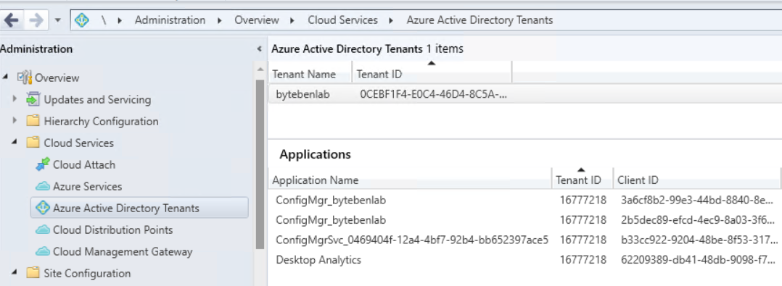
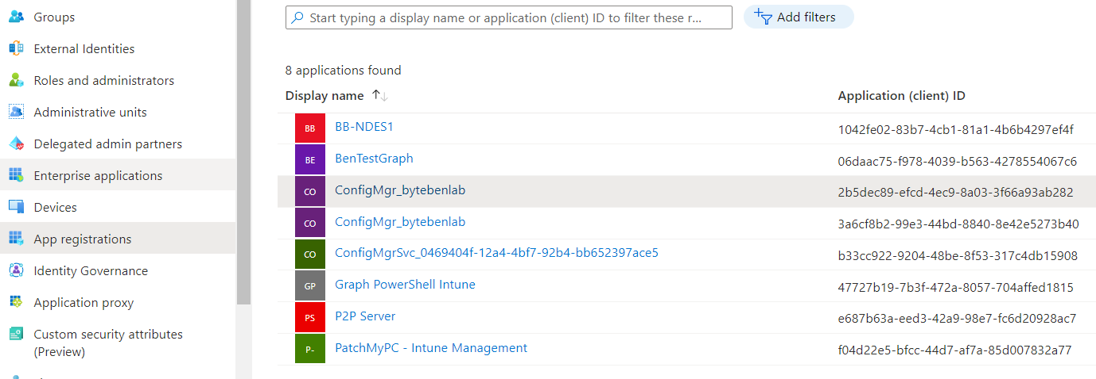
Azure Active Directory Integration
Notes:
The client app represents managed clients and users that connect to the CMG. It defines what resources they have access to within Azure, including the CMG itself.
The server app is used to facilitate authentication and authorization from managed clients, users, and the CMG connection point to the Azure-based CMG components.

Slide 21
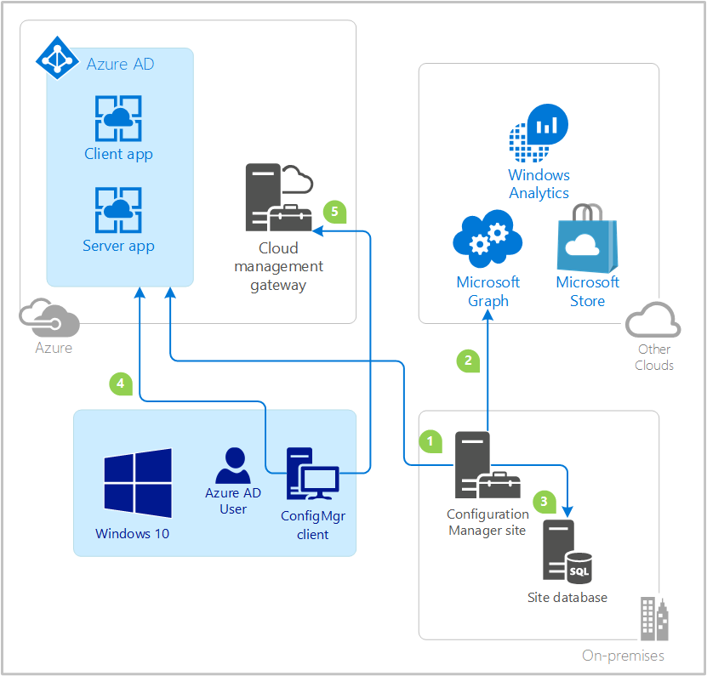
Azure Active Directory Integration
The Configuration Manager administrator creates the client and server apps in Azure AD.
Configuration Manager Azure AD user discovery method runs.
The site stores data about the user objects.
The Configuration Manager client requests the Azure AD user token.
The client authenticates with the site by presenting the Azure AD token to the cloud management gateway and on-premises HTTPS-enabled management point.
Notes:
https://learn.microsoft.com/en-us/mem/configmgr/core/servers/deploy/configure/azure-services-wizard

Slide 22
Cloud Management Gateway
Client Authentication

Slide 23
Client Authentication
When the client is communicating to the management Point or Software Update Point via the CMG, it can authenticate several ways:-
Client Certificate (PKI or EHTTP)
Azure AD Token (Requires Azure AD Integration)
Site Token (Leveraged via a Bulk Registration Token)
TRUST
This Photo by Unknown Author is licensed under CC BY
Notes:
If clients use PKI-issued client authentication certificates, then the two client apps aren't used for device-centric activity. For example, software distribution targeted to a device collection. User-centric activity always uses these two app registrations for authentication and authorization purposes.

Slide 24
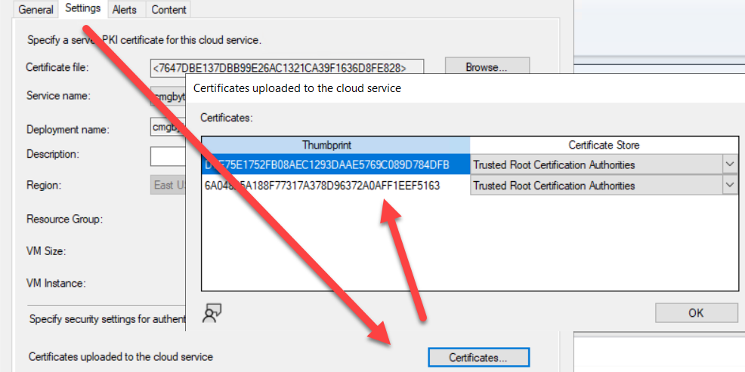
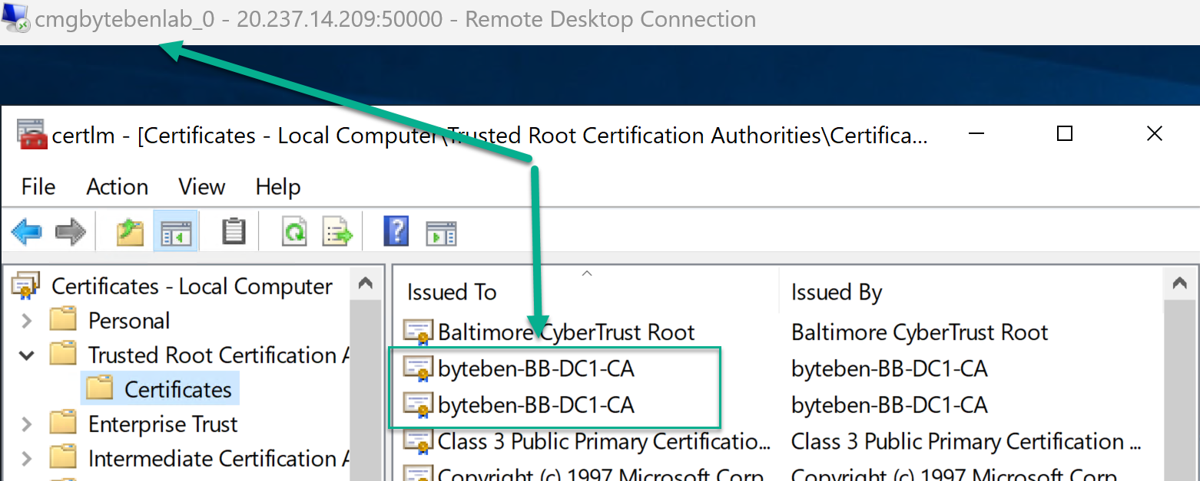
Client Authentication
Client Certificate
Typically issued from a PKI
CMG Connection Point requires the Root Certificate in order to trust the client (PKI).
Note: The CMG connection point doesn't require a client authentication certificate in the following scenarios:
Clients use Azure AD authentication.
Clients use Configuration Manager token-based authentication.
The site uses Enhanced HTTP.

Slide 25
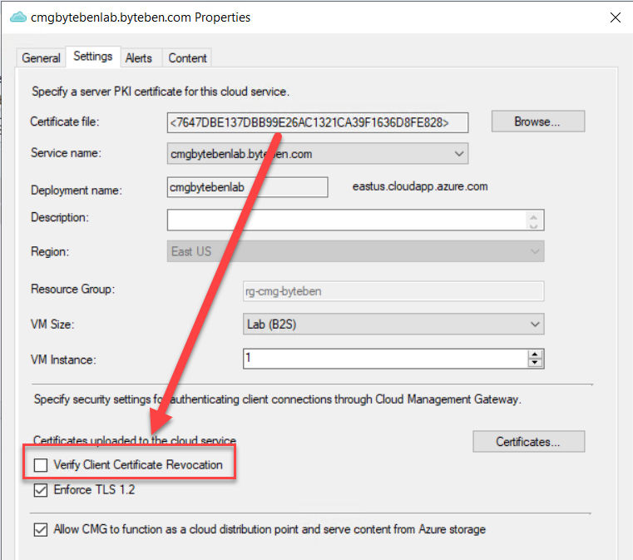
Client Authentication
Client Certificate
CRL Checking can be fun
You need a publicly accessible CRP if you intend to have the CMG verify certificate revocation for clients

Slide 26
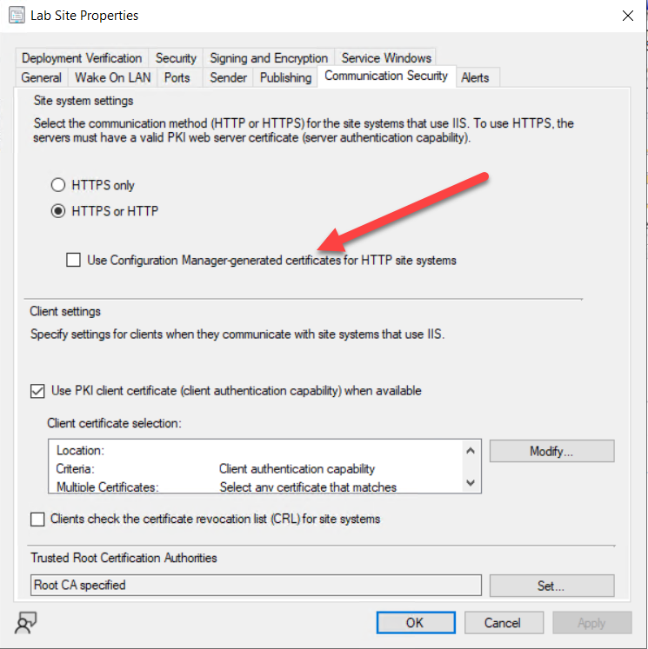
Client Authentication
Enhanced HTTP
You can secure sensitive client communication without the need for PKI server authentication certificates.
EHTTP is used to authenticate clients to the Management Point and Distribution Points.

Slide 27
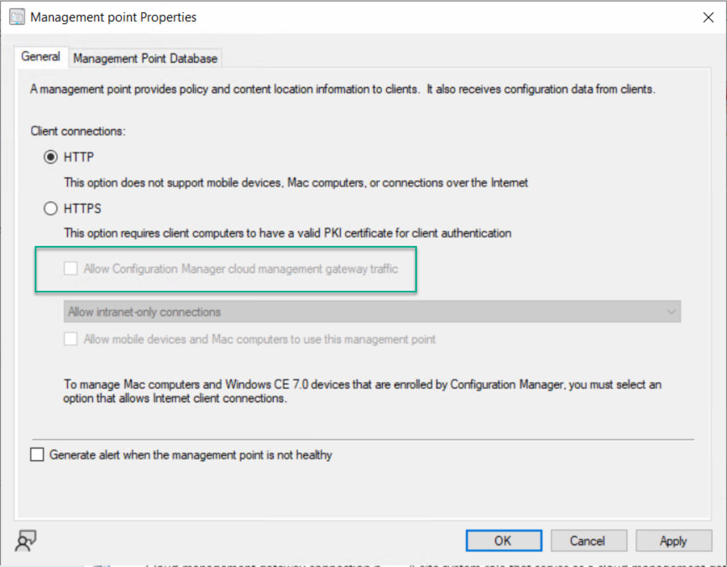
Client Authentication
Enhanced HTTP
The option to allow the Management Point to be used for Cloud Management Gateway traffic is disabled until you configure EHTTP at the site level

Slide 28
Client Authentication
Azure AD Authentication
The devices need to be either cloud domain-joined or hybrid Azure AD-joined, and the user also needs an Azure AD identity.
AAD authentication is the only client authentication method that allows user-centric scenarios
Windows clients get a workplace join (WPJ) certificate when they join an Azure AD tenant. If the certificate isn't found, the Configuration Manager client can't request Azure AD tokens. Without a token, the client can't use the Configuration Manager security token service (CCM_STS) communication channel for Azure AD authentication with Configuration Manager site systems
https://learn.microsoft.com/en-us/mem/configmgr/core/clients/deploy/deploy-clients-cmg-azure
Notes:
https://learn.microsoft.com/en-us/mem/configmgr/core/clients/deploy/deploy-clients-cmg-azure

Slide 29
Client Authentication
Site Token
Clients can authenticate to site systems using tokens that Configuration manager can issue.
Devices require an initial authentication to obtain the token. The bulk registration token can be used for this.
The bulk registration token is normally used when the client installs on an internet-based device, and registers through the CMG.
The bulk registration token has a short life-time but enables the client to initially install and communicate with the site in order to obtain a unique client authentication token.
Notes:
https://learn.microsoft.com/en-us/mem/configmgr/core/clients/deploy/deploy-clients-cmg-azure
https://learn.microsoft.com/en-us/mem/configmgr/core/clients/deploy/deploy-clients-cmg-token

Slide 30
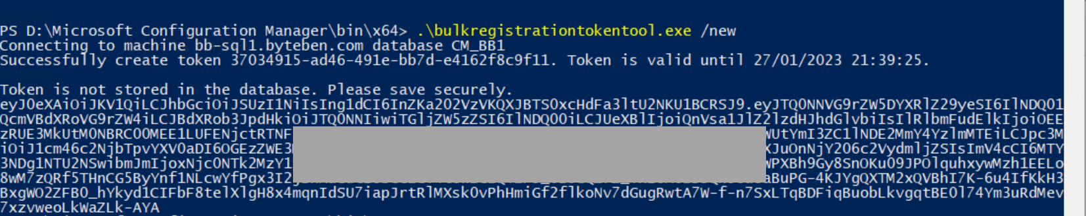
Client Authentication
Site Token
The bulk registration token tool can be used to generate the bulk registration token
At the top level site system, run the tool from the \bin\X64 folder of the Configuration Manager installation directory on the site server.
Use the token in the ccmsetup command with the /regtoken: switch
Notes:
https://learn.microsoft.com/en-us/mem/configmgr/core/clients/deploy/deploy-clients-cmg-azure
https://learn.microsoft.com/en-us/mem/configmgr/core/clients/deploy/deploy-clients-cmg-token

Slide 31
Cloud Management Gateway
Known Configuration Gotcha’s

Slide 32
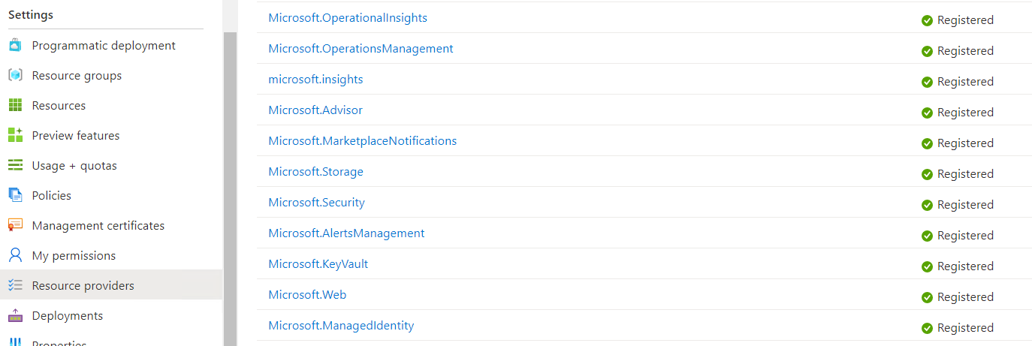
Known Configurations Gotcha’s
Resource Providers
On the Subscription, be sure to enable
Microsoft.KeyVault
Microsoft.Storage
Microsoft.Compute
Microsoft.Network

Slide 33
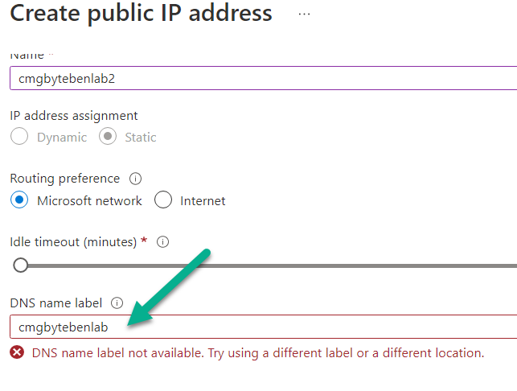
Known Configurations Gotcha’s
Valid Name space in Azure
Check:-
Public IP Address
Key Vault
Storage Account

Slide 34
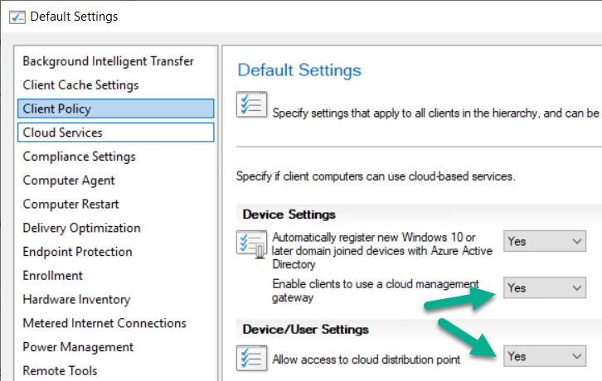
Known Configurations Gotcha’s
Client Settings
Make sure the following client settings in the Cloud services group are enabled for devices that will use the CMG:
Enable clients to use a cloud management gateway
Allow access to cloud distribution point

Slide 35
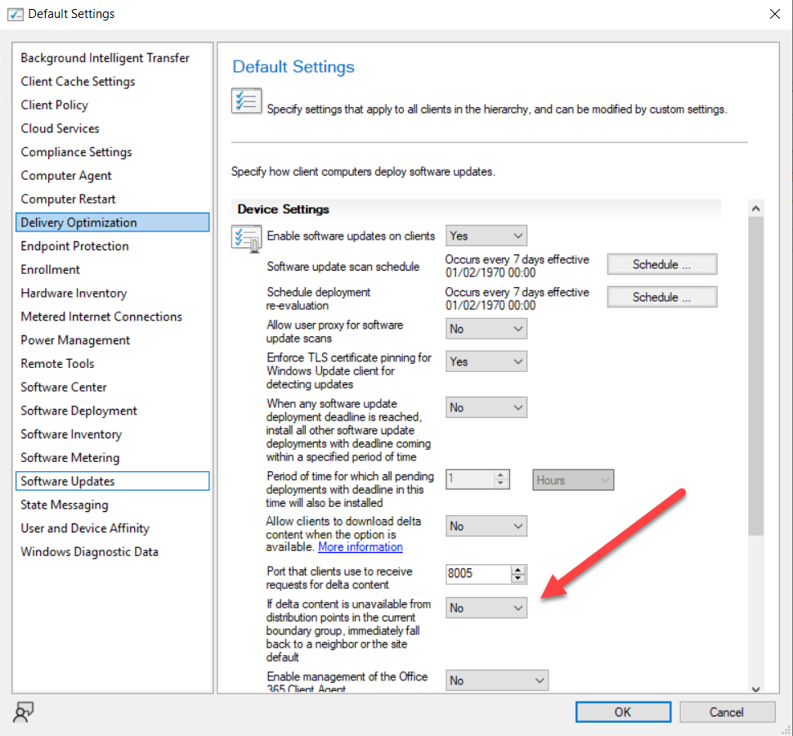
Known Configurations Gotcha’s
If you enable the client setting to Download delta content when available, the content for third-party updates won't download to clients

Slide 36
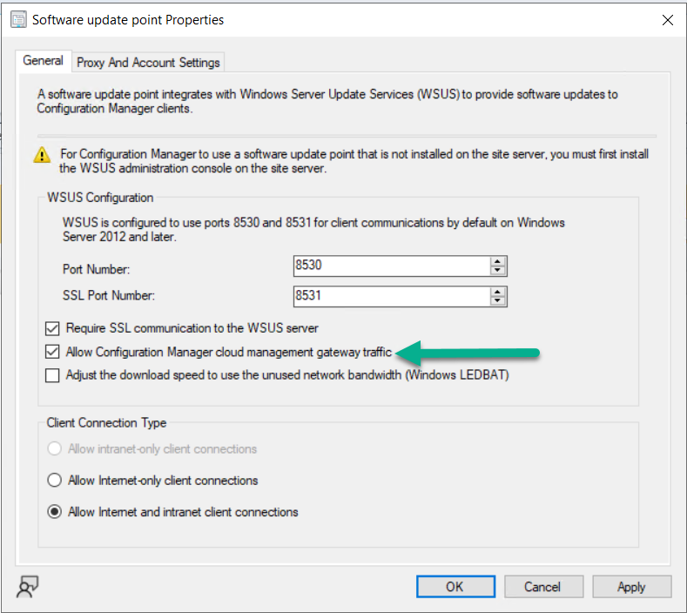
Known Configurations Gotcha’s
The Software Update Point should be configured to allow CMG traffic

Slide 37
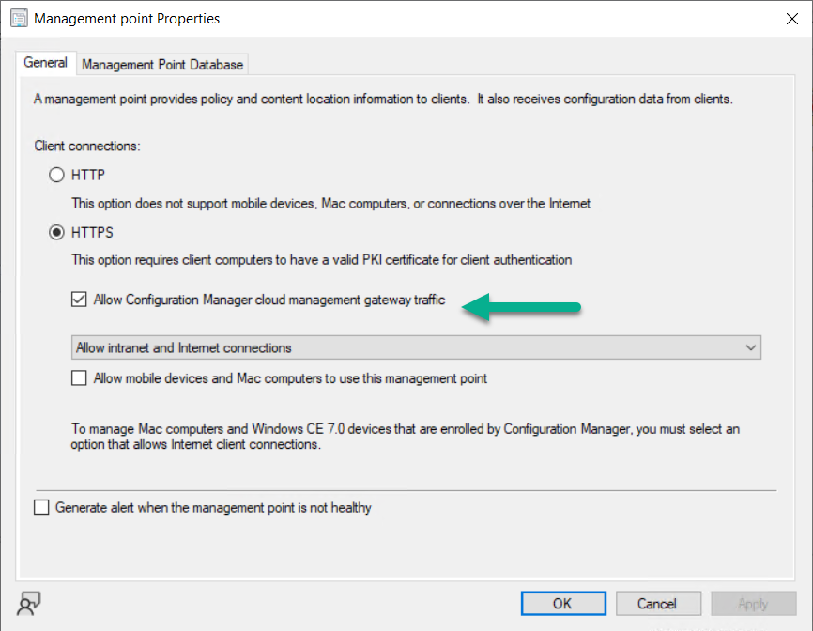
Known Configurations Gotcha’s
The Management Point should be configured to allow CMG traffic
Notes:
PKI screenshot

Slide 38
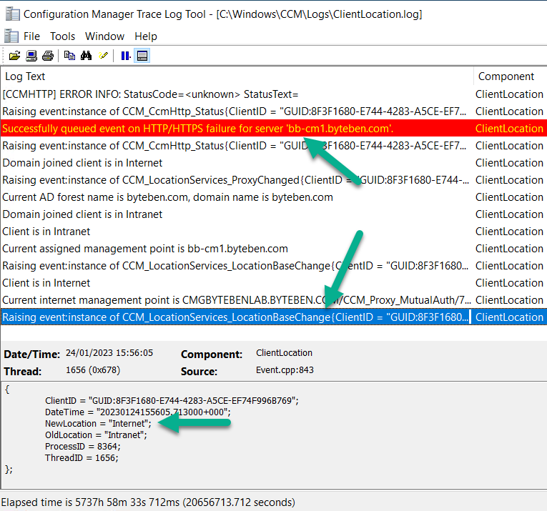
Known Configurations Gotcha’s
Force Internet Location for testing
Invoke-CimMethod -Namespace root\ccm -ClassName sms_client -Name TriggerSchedule -Arguments @{sScheduleId = "{00000000-0000-0000-0000-000000000023}"}
CCMSetup.exe /UsePKICert CCMALWAYSINF=1 CCMHOSTNAME=SERVER3.CONTOSO.COM SMSSITECODE=ABC
https://learn.microsoft.com/en-us/mem/configmgr/develop/reference/core/clients/client-classes/triggerschedule-method-in-class-sms_client
Notes:
Invoke-CimMethod -Namespace root\ccm -ClassName sms_client -Name TriggerSchedule -Arguments @{sScheduleId = "{00000000-0000-0000-0000-000000000023}"}
https://learn.microsoft.com/en-us/mem/configmgr/develop/reference/core/clients/client-classes/triggerschedule-method-in-class-sms_client

Slide 39
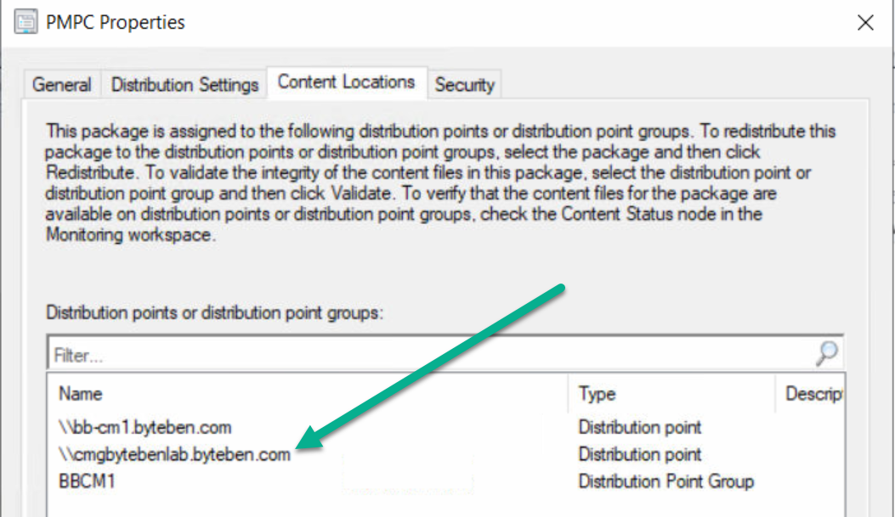
Known Configurations Gotcha’s
Distribute Content
Don’t forget to distribute content to the CMG
It is not necessary to distribute content for Microsoft Updates to the CMG, they will be downloaded from the CDN but you MUST distribute 3rd party updates

Slide 40
Cloud Management Gateway
Lab Time
Notes:
Ben Lab
UpdateDeployment
Cas
wuahandler
Client location
Location services
Updatesstore
Install notepad
Scan
Update notepad
Cody
Cmpivot
Token stuff, ccmsetup,

Slide 41
Cloud Management Gateway
Further Thoughts
Notes:
Intune for updates?
Co-mgmt

Slide 42
Further Thoughts
Logs
For troubleshooting deployments, use CloudMgr.log and CMGSetup.log
For troubleshooting service health, use CMGService.log and SMS_Cloud_ProxyConnector.log
For troubleshooting client traffic, use CMGService.log and SMS_Cloud_ProxyConnector.log
https://learn.microsoft.com/en-us/mem/configmgr/core/clients/manage/cmg/monitor-clients-cloud-management-gateway#monitor-logs
Notes:
https://learn.microsoft.com/en-us/mem/configmgr/core/clients/manage/cmg/monitor-clients-cloud-management-gateway#monitor-logs

Slide 43
Further Thoughts
Costs
Real-world costs for using a Cloud Management Gateway (CMG) with ConfigMgr https://www.deploymentresearch.com Credit: Johan Arwidmark

Slide 44
Further Thoughts
What Next?
Intune?

Slide 45
Cloud Management Gateway
Q&A
Notes:
Intune for updates?
Co-mgmt

Slide 46
Thank you for attending!

