Slide 1


Slide 3







Patch My PC
At a Glance
2011
9,000+
27 million
Start
customers
endpoints
150+
2,850+
6
people &
growing
public apps
in catalog
Microsoft MVPs

Slide 4






















Patch My PC
Some of our customers
At a Glance
2011
7500+
24 million
Start
customers
endpoints
120+
2000+
7
people &
growing
public apps
in catalog
MVPs

Slide 5


Importance of
patching

Slide 6





Why Patch?
Malware / ransomware
Vulnerabilities
Exploits by hackers
Data breach

Slide 7
To manage their operations, streamline processes and achieve their business goals
on average, companies use
Why our customers care about
Patching
Reduce Risk
Visibility
56% of data breaches were preventable with timely patching.
Teams need to know what’s patched, what’s not, and risk.
Compliance
Automation
Meet standards like ISO 27001, CMMC, Cyber Essentials, etc.
IT teams are tired of manual work and unreliable tools
Small
business
Midmarket
companies
Large
enterprises
172 applications
255 applications
664 applications

Slide 8

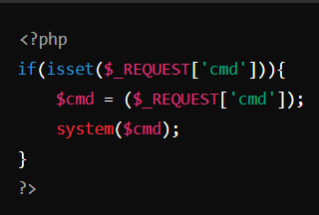

Equifax data breach
1
Identification of Vulnerability
148 million
2
Exploitation of Vulnerability
people’s personal
data exposed
Hackers exploited
unpatched software vulnerabilities
3
Installation of Malware
4
Exfiltration of Data
5
Covering Tracks
Why patching?
Malware / ransomware
Vulnerabilities
Exploits by hackers
Data breach

Slide 9


The biggest challenge is
TIME

Slide 10






Create a new package
Test the package
The biggest challenge is
TIME
Check for update
Deploy to pilot
Release
Validate

Slide 11

3 - 5 hours per update
X
applications
=
CHALLENGE

Slide 12
How we help
Automation and Security
keeping your apps installed and up to date

Slide 13
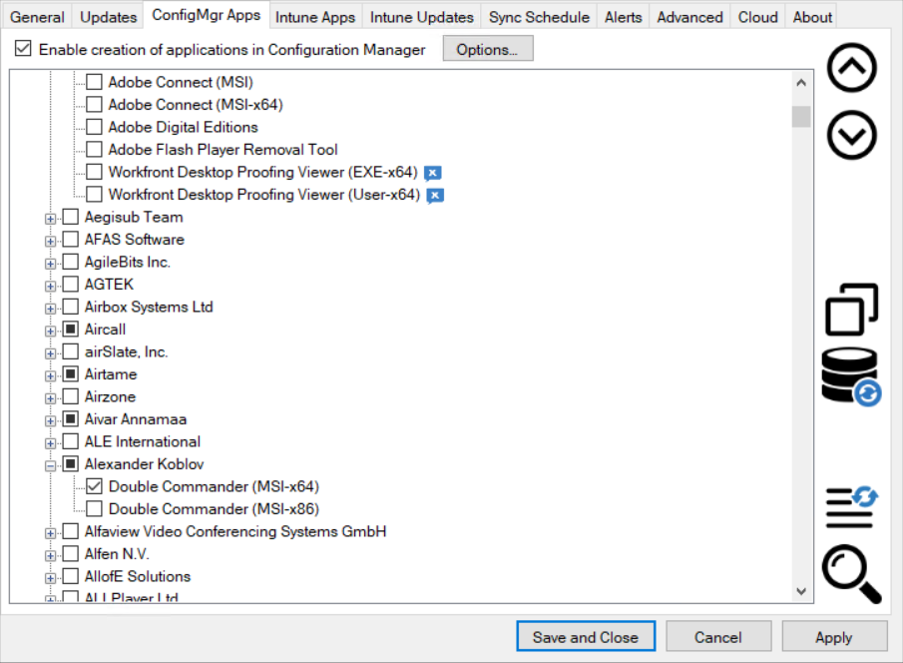
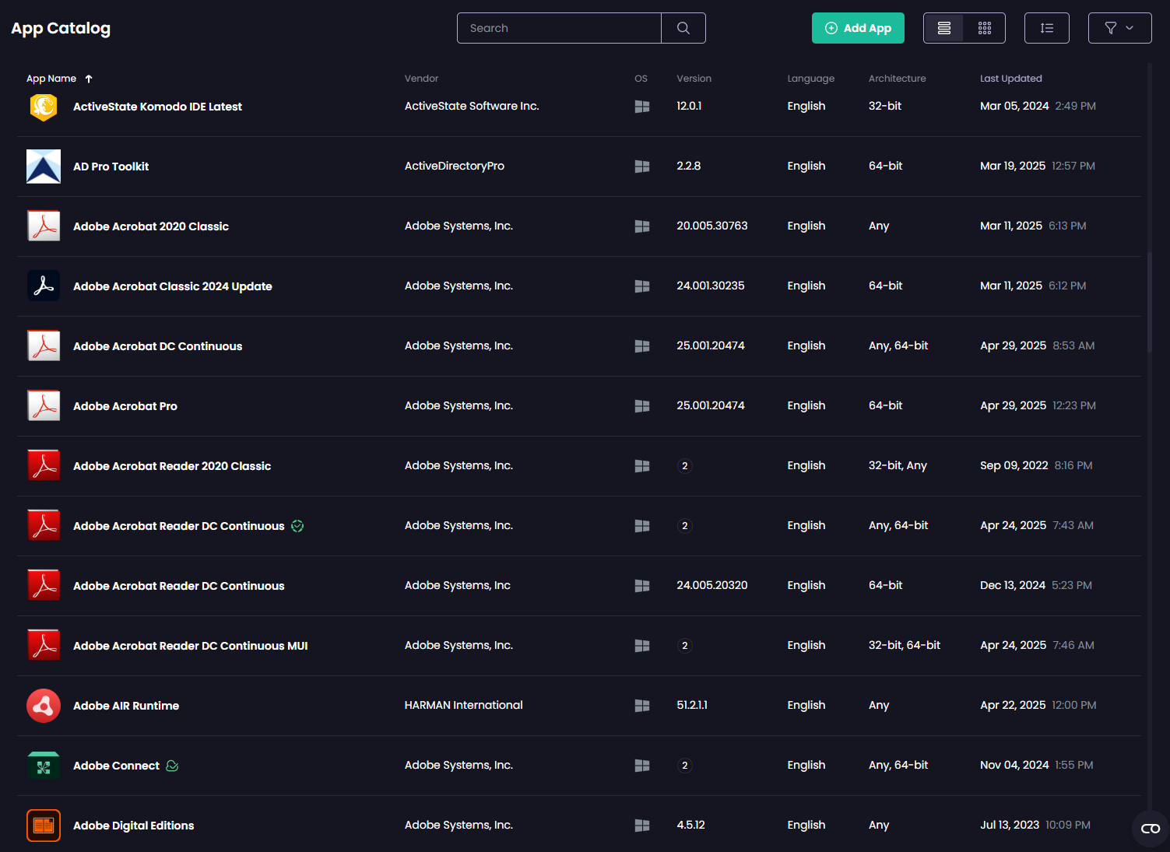
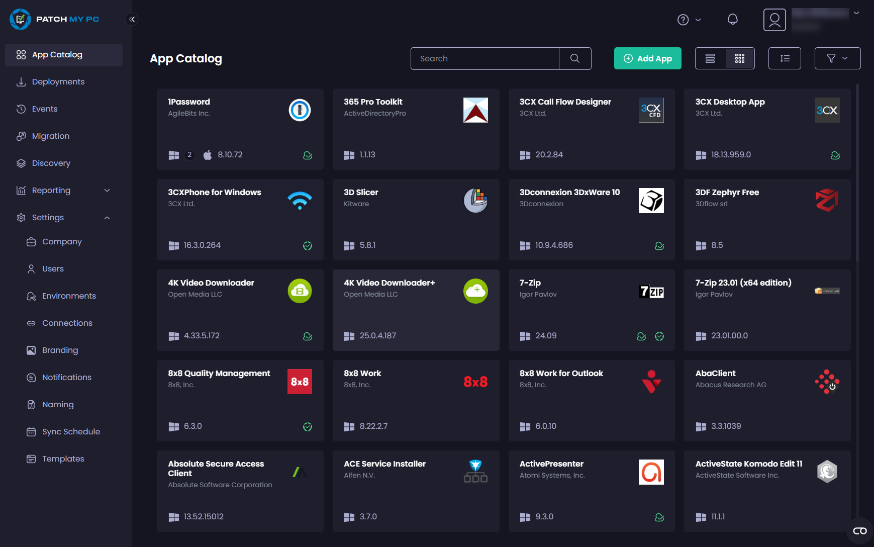
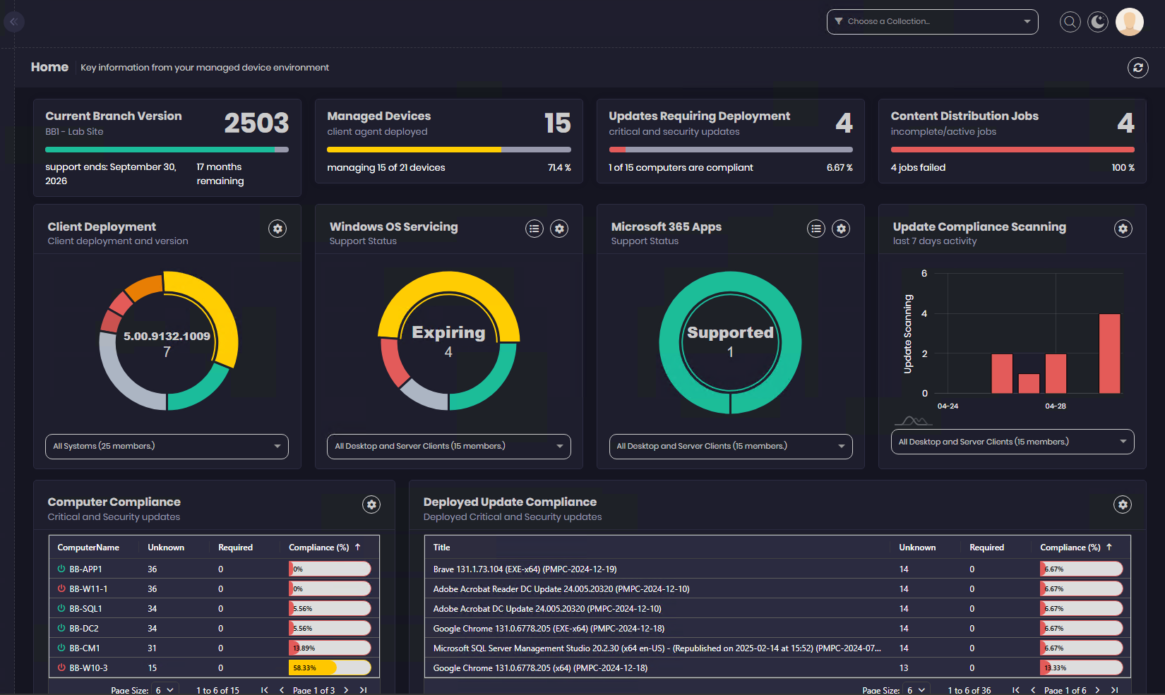

Solutions
Patch My PC Publisher
Patch My PC Catalog
Patch My PC Cloud
Advanced Insights

Slide 14
Solution Platform & Technology Overview
Solution | Purpose | ConfigMgr | Intune | WSUS | Technology
Patch My PC Publisher | Patching and Application Management | Yes | Yes | Yes | On-Prem
Patch My PC Cloud | Patching and Application Management | Partial * | Yes | No | SaaS
Advanced Insights | Insights and Compliance Reporting | Yes | Private Preview | No | On-Prem / SaaS
Patch My PC Catalog ** | App Catalog | Yes | Yes | Yes | -
* Patch My PC Publisher leverages the power of Patch My PC Cloud to allow customers to create Custom Apps in ConfigMgr
** Patch My PC Catalog is included with, and leveraged by, Patch My PC Publisher, Patch My PC Cloud and Advanced Insights

Slide 15













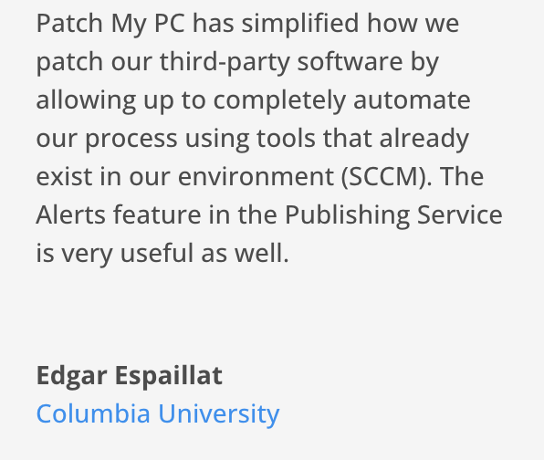
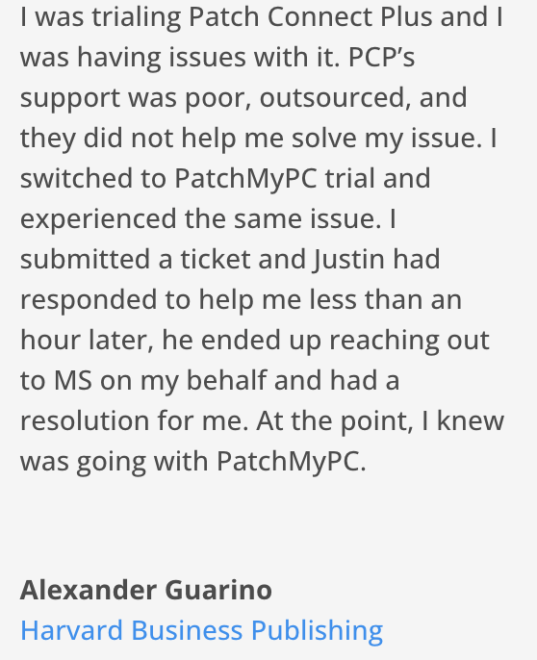
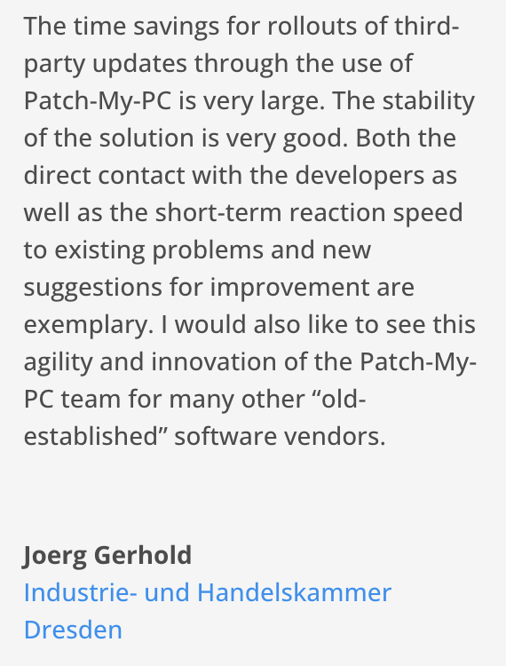







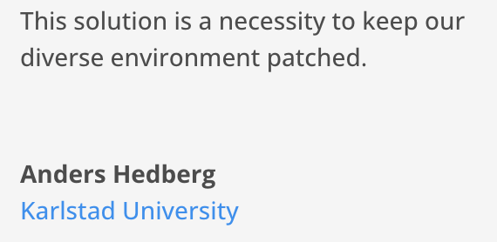
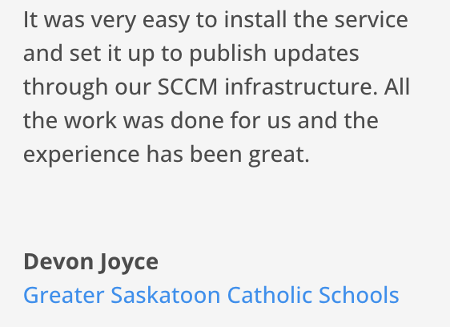
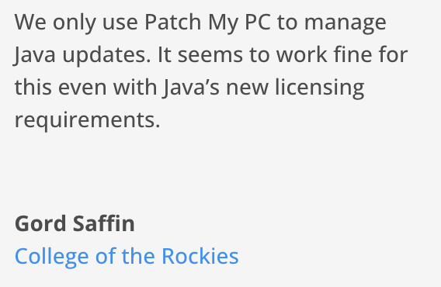
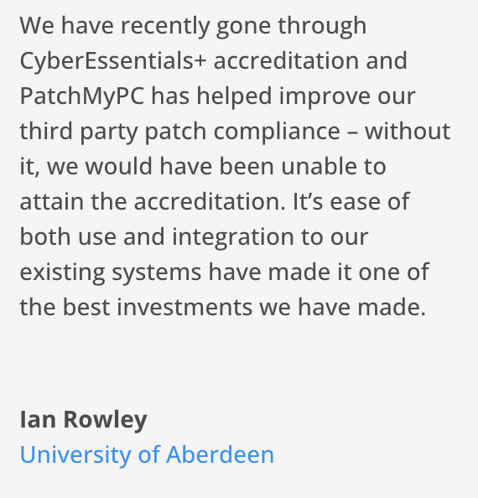
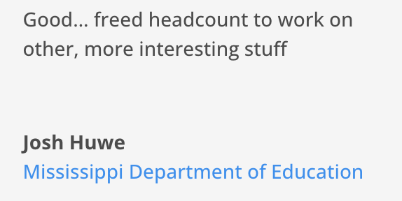

First Class Support
Support is included with all our products – our customers testify to it being fast, reliable and professional
With an ever growing, diverse, and highly skilled Customer Engineering team ready to help, you can be confident of the successful outcome of your third-party patching strategy
See all reviews

Slide 16
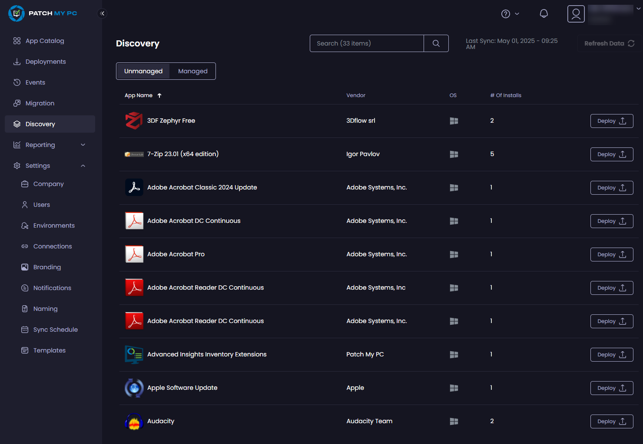
Patch My PC Cloud
is a powerful SaaS solution for managing third-party apps & updates in Intune for your enterprise
Best choice for:
Intune only environments

Slide 17
Patch My PC Cloud
Primarily designed for customers using Intune
Patch My PC Cloud automates the packaging, deployment, and updating of thousands of third-party applications across devices, ensuring security, compliance, and consistency with minimal IT effort.
While it’s primarily designed for customers using Intune, ConfigMgr also leverages Patch My PC Cloud to unlock new features and capabilities, bridging the gap between on-premises and cloud-based management.

Slide 18
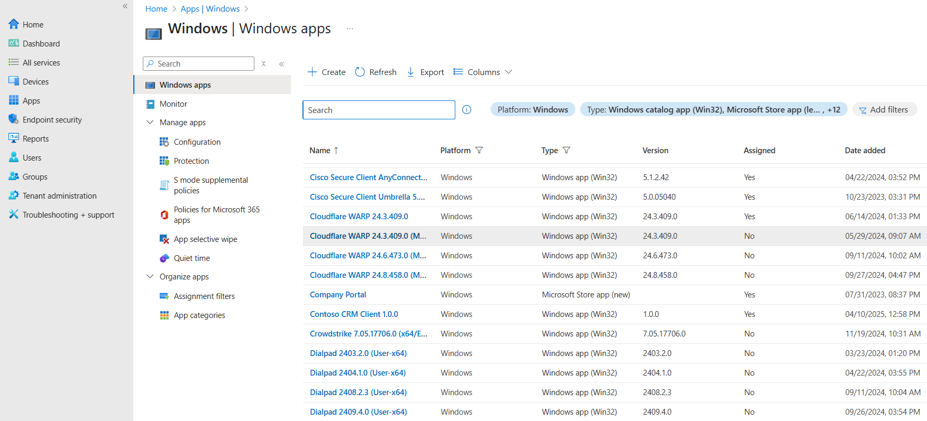
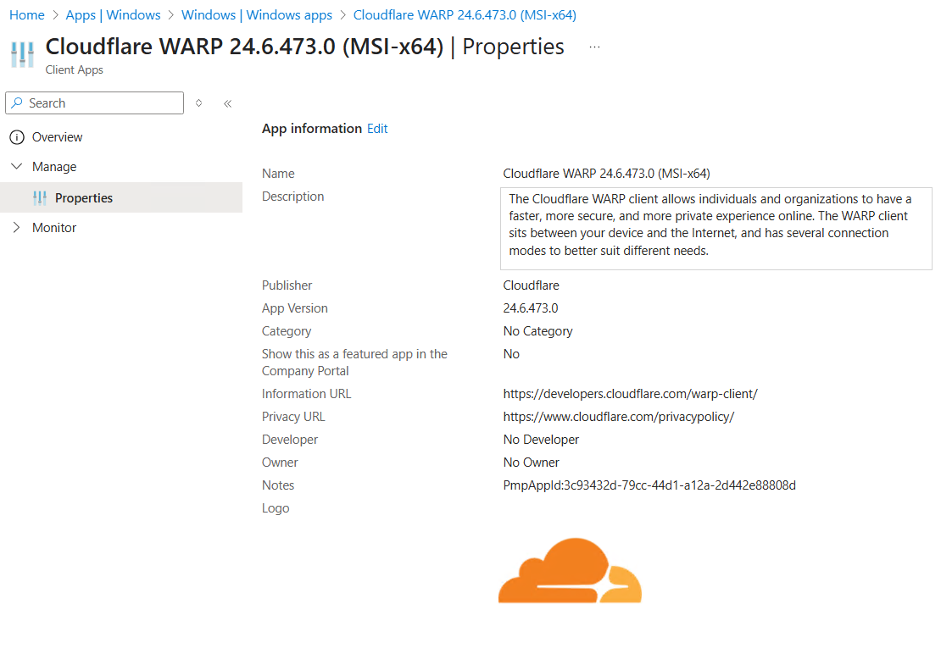
Intune
Native integration with Intune. Deploy Win32 apps AND
updates in a way your team are already familiar with.
No need to upskill on a new deployment tool

Slide 19

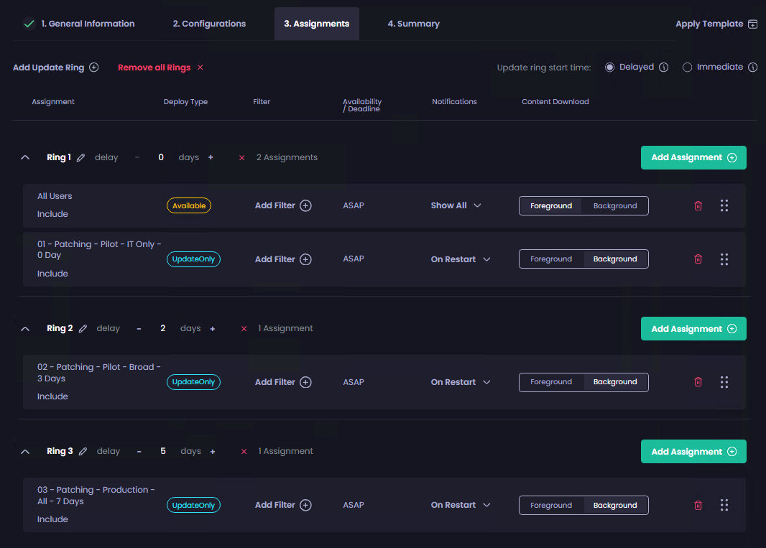
Feature Spotlight
The Update Rings feature of Patch My PC Cloud allows you to deploy apps and updates in a phased manner across your Intune estate.
Update Rings
For example, you may want to deploy software to a pilot group of users/devices to ensure it functions as expected.
Then after a set period, you want to deploy the update to wider group of users/devices or production.
Update rings gives you the flexibility, control and confidence with your app & update deployments.

Slide 20




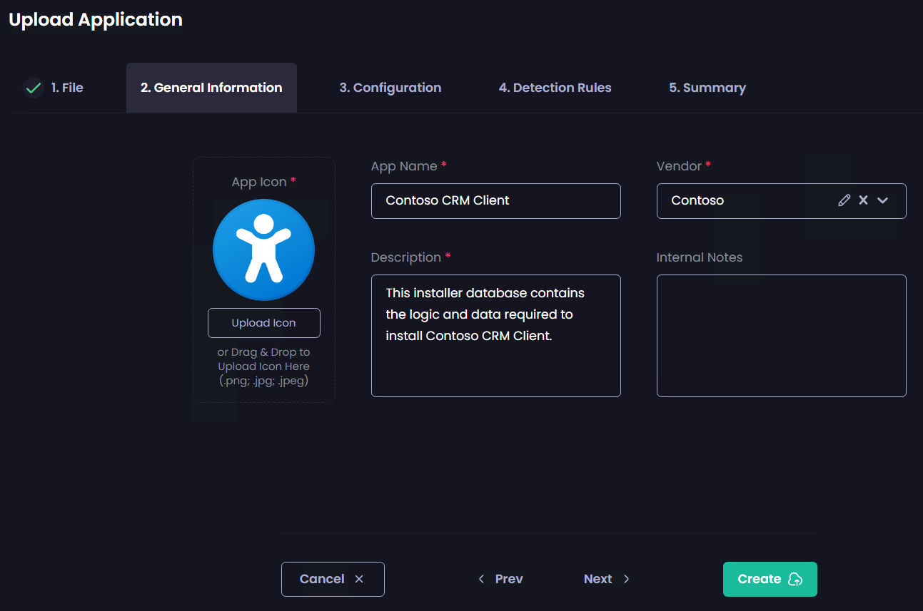
Patch My PC Cloud – More Features
Automated Patching
Extensive
Catalog
Multi-
Tenancy
No need for manual application packaging—enjoy enhanced security with accelerated vulnerability patching
Access a robust catalog of thousands of applications, all consistently updated and managed by our team
MSP’s can manage updates for multiple tenants from a single location.
Application Discovery
Bring Your Own Applications
We detect which applications are already running in your environment
Need more applications? Add. your own business applications to your own private catalog

Slide 21





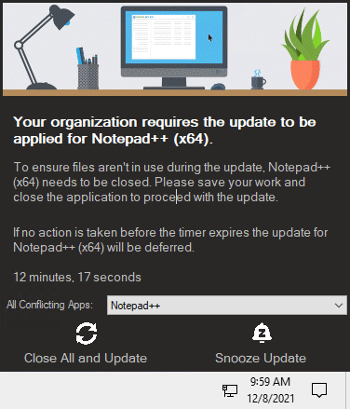
Notify Users When Installing Applications
Add Scope Tags
to Applications
in Intune
Save Application Install Logs to a Central Location
With our manage conflicting process feature, you can interactively notify the user to close the application with custom branding and options such as snoozing the notification
Configure scope tags for applications to limit what administrators can see applications created by Patch My PC in Intune
Automatically save installation logs for EXE and MSI-based product installers to a (Local folder or UNC folder)
Add MST Transform Files to Applications
Use Intune Filters
for Assigning Applications
You can add MST Transform files for MSI-based application installers to ensure you can customize the application install when needed
Adds support for Entra ID filters to applications and update assignments in Microsoft Intune

Slide 22




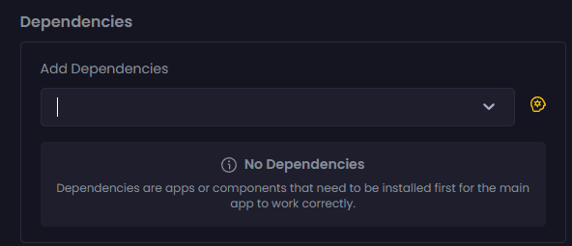
Pause Application Creation for Specific Products
Add Categories to Applications for Easy Sorting
Add Applications to ESPs for Autopilot in Intune
Adds the ability to delay the processing of new updates. This feature can help delay specific products from updating due to business requirements
Add categories to your applications in both ConfigMgr and Intune to allow end-users to easily sort in Software Center or Company Portal for applications
Automatically add apps to Enrollment Status Pages in Microsoft Intune so they can automatically install during Windows Autopilot
Disable Self-Update Feature for Applications
Add a Dependency to a Deployment
Automatically turn off the self-update feature for products
Create dependencies within a deployment, whereby the app being deployed requires one or more other apps to have already been installed

Slide 23
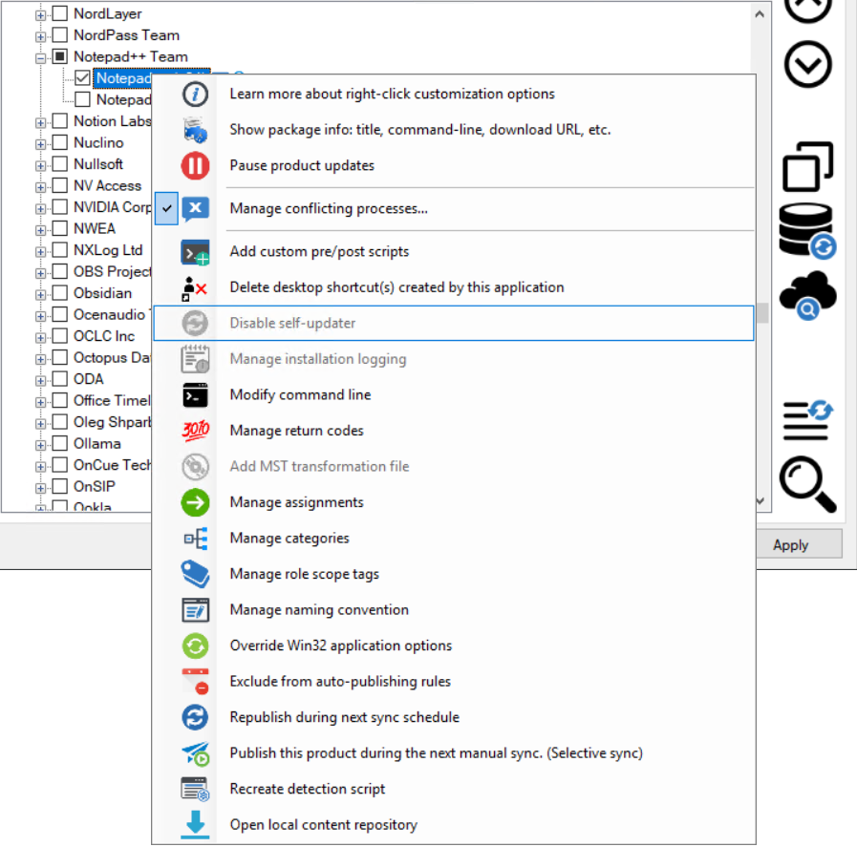
Patch My PC Publisher
is a powerful on-premises solution for managing third-party apps & updates in WSUS, ConfigMgr & Intune
Best choice for:
With seamless integration into ConfigMgr, Intune, and WSUS, it transforms the traditionally complex update process into a streamlined, automated experience that keeps your applications secure and up to date.
Microsoft ConfigMgr environments
WSUS environments
Combined Intune and ConfigMgr environments

Slide 24
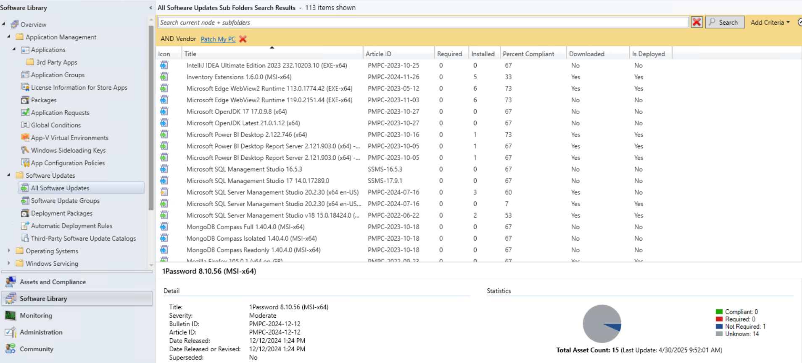
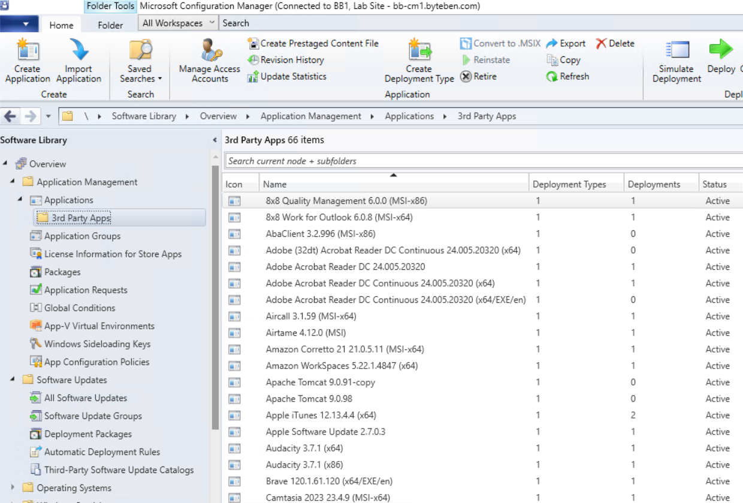
Configuration Manager
Patch My PC Publisher automates app & update creation
with native SDK integration in ConfigMgr. Deploy apps AND
updates in a way your team are already familiar with.
No need to upskill on a new deployment tool.

Slide 25
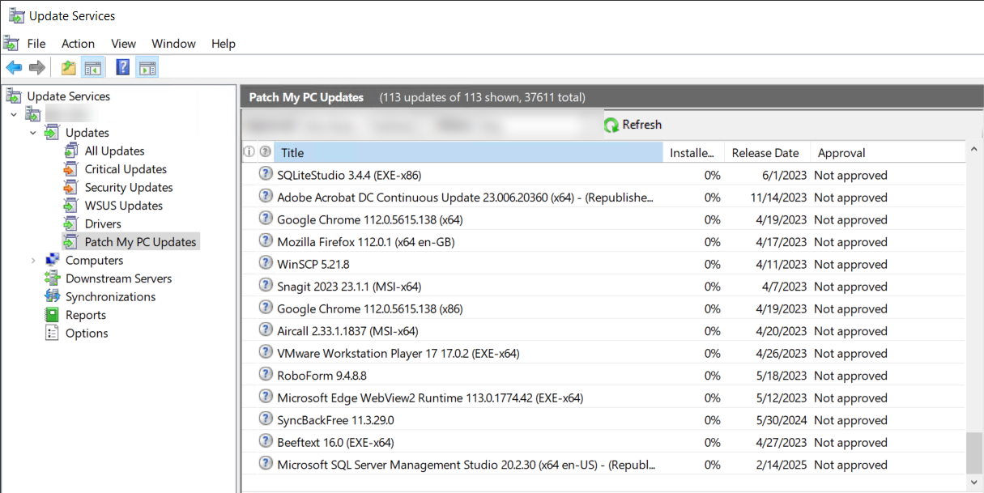
WSUS Standalone
No need to change your existing update approval process in WSUS Standalone Mode. Third party updates appear in WSUS the same way as Microsoft Updates.

Slide 26
Intune
Native integration with Intune. Deploy Win32 apps AND
updates in a way your team are already familiar with.
No need to upskill on a new deployment tool.

Slide 27



Patch My PC Publisher - Features
Automated Patching
Extensive
Catalog
Agentless
No need for manual application packaging—enjoy enhanced security with accelerated vulnerability patching
Access a robust catalog of thousands of applications, all consistently updated and managed by our team
By integrating with Microsoft Intune and ConfigMgr, we operate how a security solution should—noninvasive and hassle-free
First Class Support
Bring Your Own Applications
Application Discovery
Ask any customer: our support is fast, reliable and professional
Need more applications? Add your business application to your private catalog
We detect which applications are already running in your environment

Slide 28
Notify Users
When Installing Applications
Add Scope Tags
to Applications
in Intune
Save Application Install Logs to a Central Location
With our manage conflicting process feature, you can interactively notify the user to close the application with custom branding and options such as snoozing the notification
Configure scope tags for applications to limit what administrators can see applications created by Patch My PC in Intune
Automatically save installation logs for EXE and MSI-based product installers to a (Local folder or UNC folder)
Add MST Transform Files to Applications
Use Intune Filters for Assigning Applications
You can add MST Transform files for MSI-based application installers to ensure you can customize the application install when needed
Adds support for Entra ID filters to applications and update assignments in Microsoft Intune

Slide 29
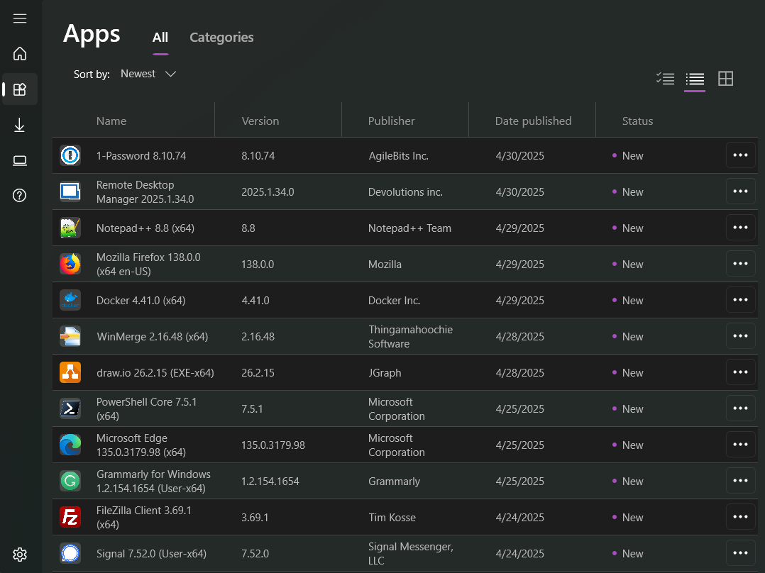
Pause Application Creation for Specific Products
Add Categories to Applications for Easy Sorting
Add Applications to ESPs for Autopilot in Intune
Adds the ability to delay the processing of new updates. This feature can help delay specific products from updating due to business requirements
Add categories to your applications in both ConfigMgr and Intune to allow end-users to easily sort in Software Center or Company Portal for applications
Automatically add apps to Enrollment Status Pages in Microsoft Intune so they can automatically install during Windows Autopilot
Disable Self-Update Feature for Applications
Set Applications as Featured in ConfigMgr and Intune
Automatically turn off the self-update feature for products
Set applications as featured that you want to display first in Software Center or Company Portal

Slide 30



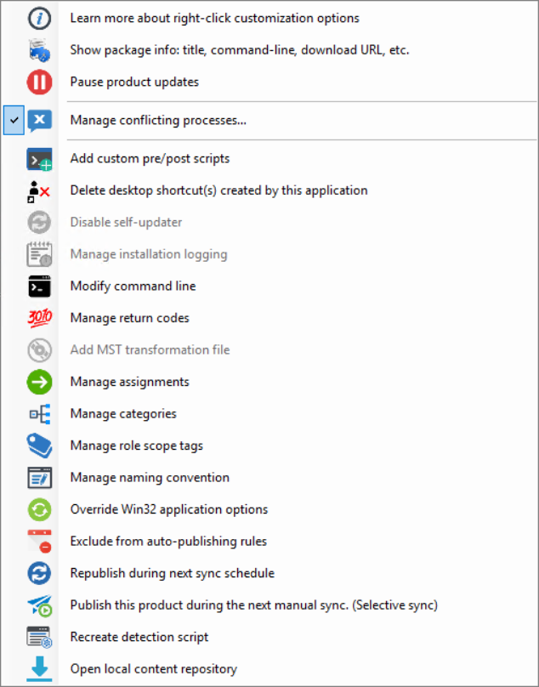

Customize
Application Packages
Remove Public
Desktop Shortcuts
Post Install
Add Custom Pre/Post Scripts
Leave the commands behind–use our improved graphical interface to customize packages
Configure scope tags for applications to limit what administrators can see applications created by Patch My PC in Intune
If you ever need to configure environment-specific configurations when installing or updating a product, you can use add custom pre/post scripts
Add Security Scopes to Apps in ConfigMgr
Modify Installation Commands for Applications
Configure security scopes for apps to limit which admins can see apps created by Patch My PC in ConfigMgr
Easily adjust installation command-lines to configure license keys or other environment-specific options

Slide 31
Patch My PC
Curated Catalog
The
is unequaled in the industry
for quality assurance of
vendor applications
Used In:
Every patching solution on the market has a source of truth – a catalog. Few in the industry use a curated catalog where every single update is tested and vetted using both automation and human tribal knowledge that has been built over decades
Patch My PC Publisher
Patch My PC Cloud
Advanced Insights

Slide 32

Our catalog is the result of years of specialized engineering, customer-driven development, and a relentless focus on real-world reliability
We don’t just package apps, we build trust into every release
Our app catalog gives customers the assurance that every application has been vetted, tested, and validated by our team of professionals who understand the nuances of enterprise application deployment
Crowdsourcing apps from community catalogs has a place, but it shouldn’t be the
first choice for deploying apps
in your organization

Slide 33
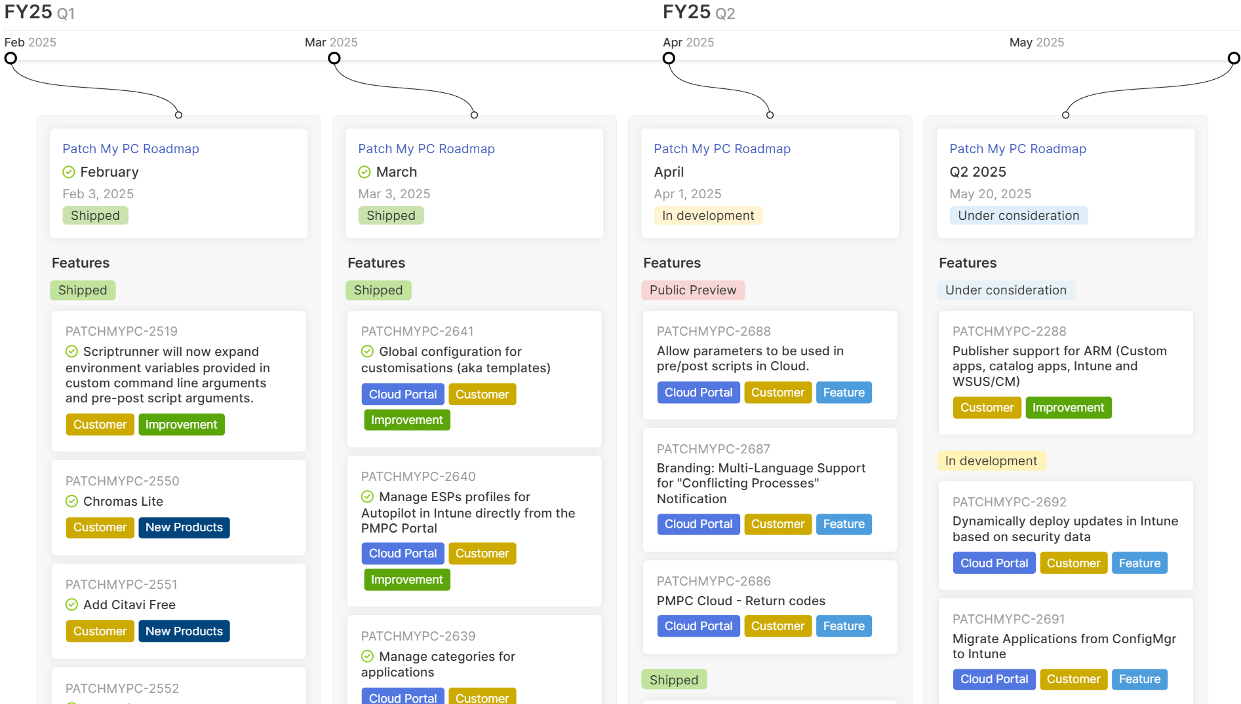
Adding 50-100 new, customer requested, apps per month
Adding updates to our catalog the same day the vendor releases a newer version of an app
Human and automation testing to ensure new apps update as expected
Dedicated catalog team ensuring a level of quality and confidence that crowdsourced catalogs cannot provide

Slide 34
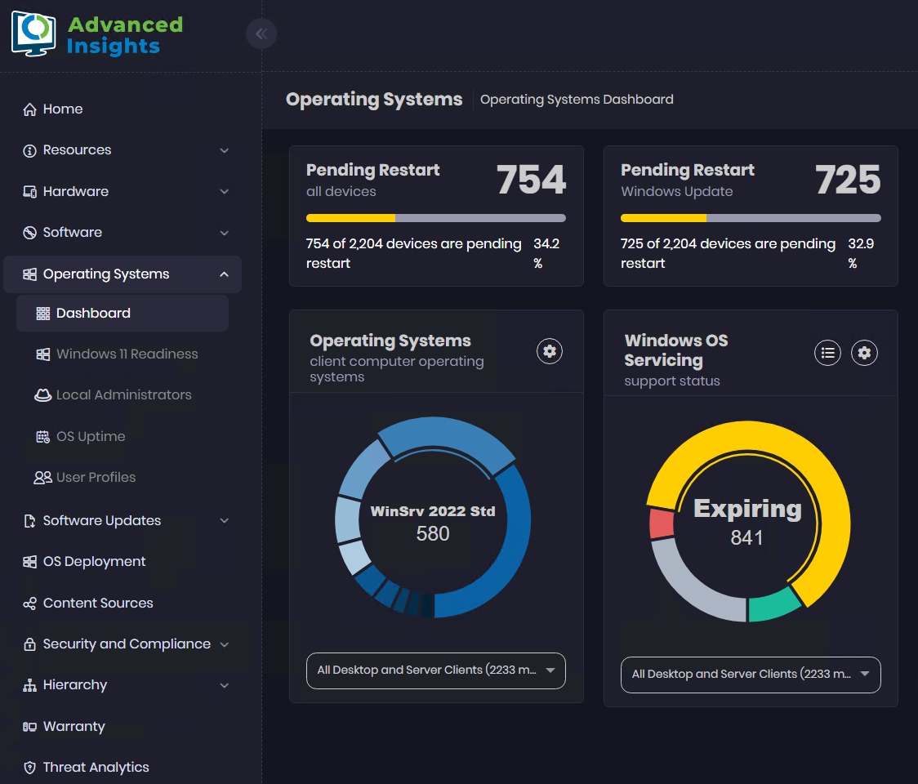
Advanced Insights
is a powerful solution designed to give you invaluable insights and compliance reporting for your organization
Best choice for:
Beautiful data & streamlined reporting
Better insights on your data,
including inventory management
Microsoft ConfigMgr environments
Clear software update compliance reporting
Threat analytics dashboard & CVE reporting

Slide 35
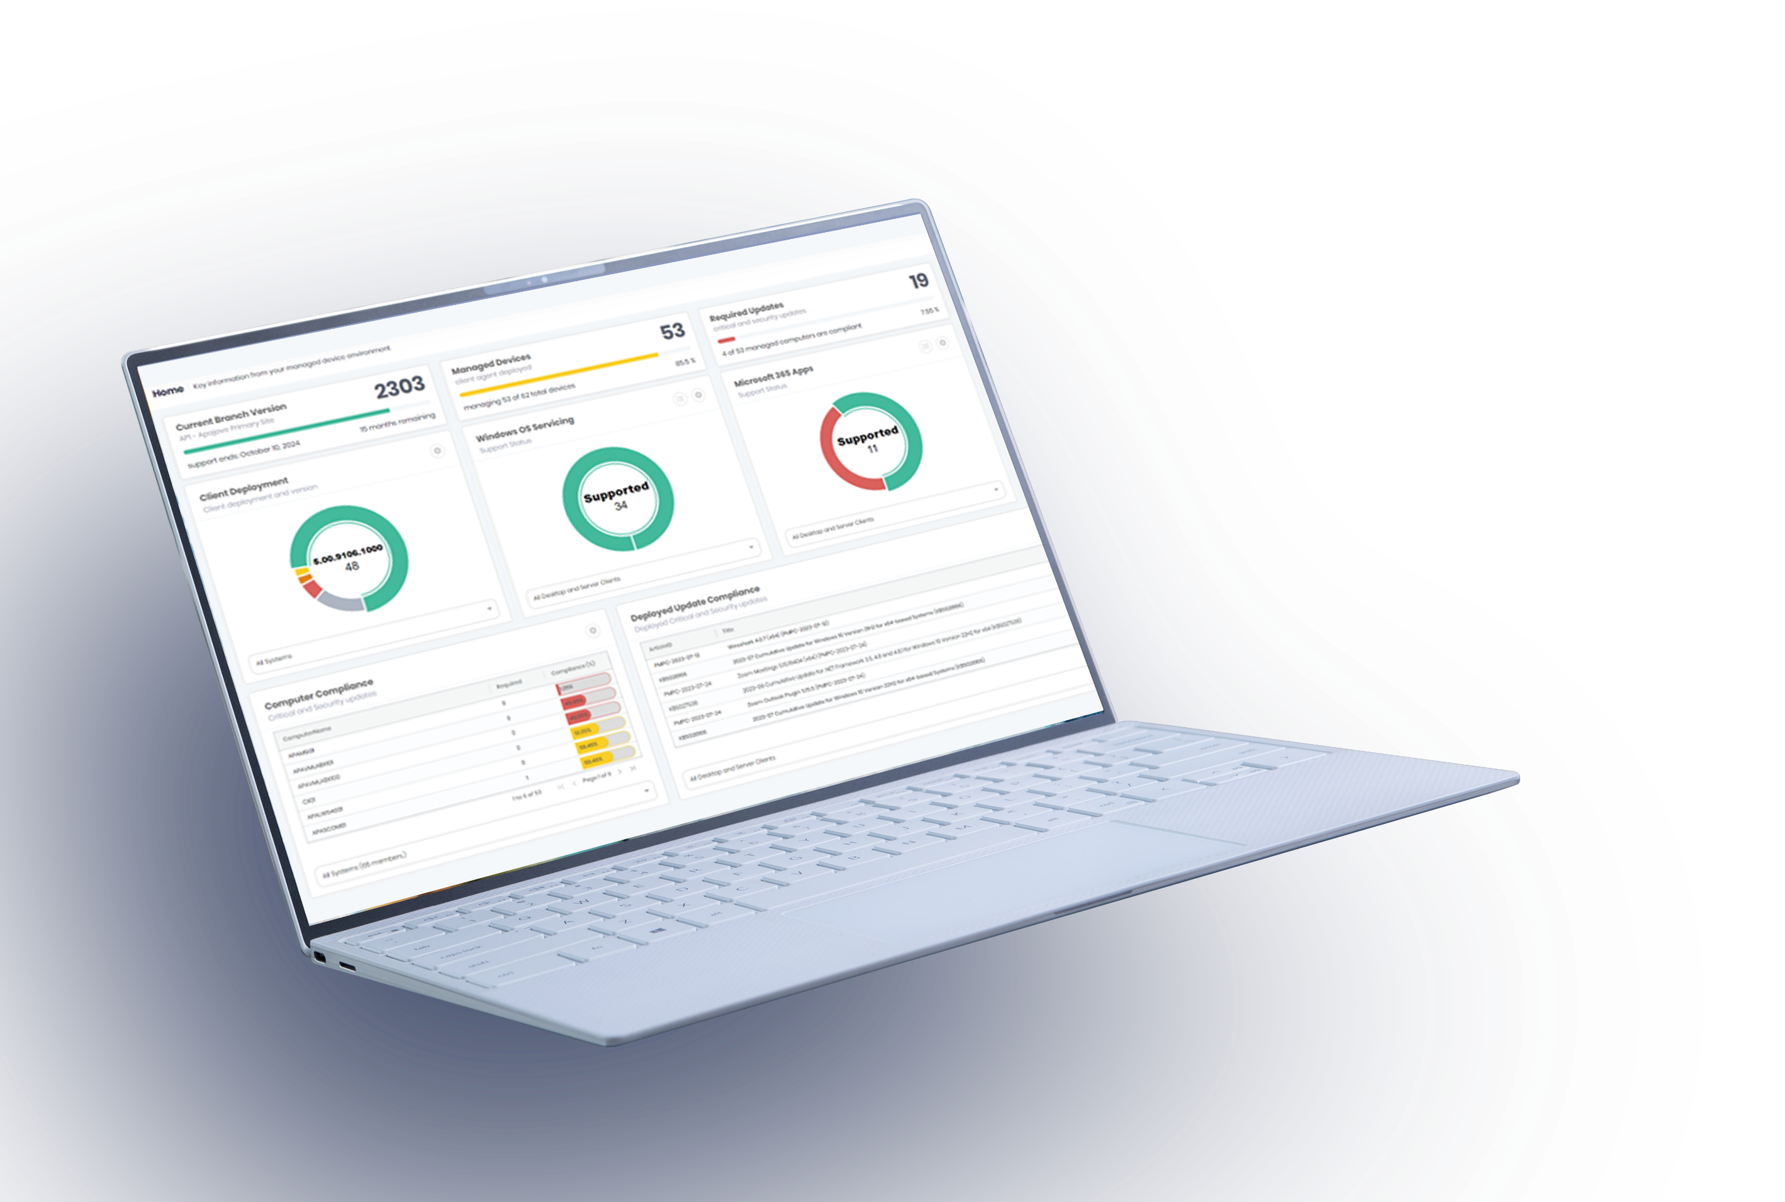
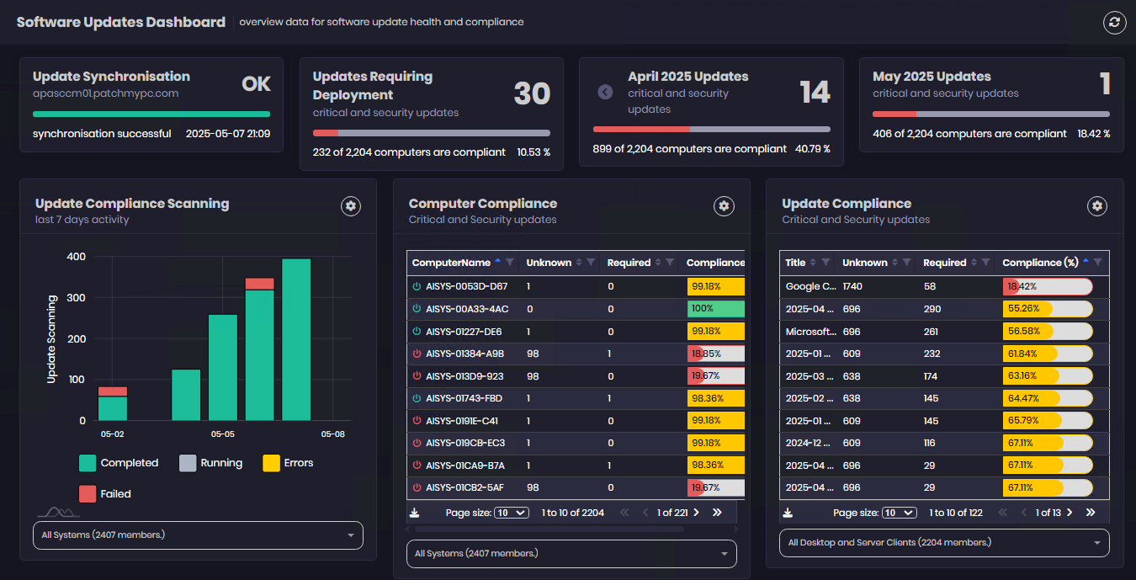

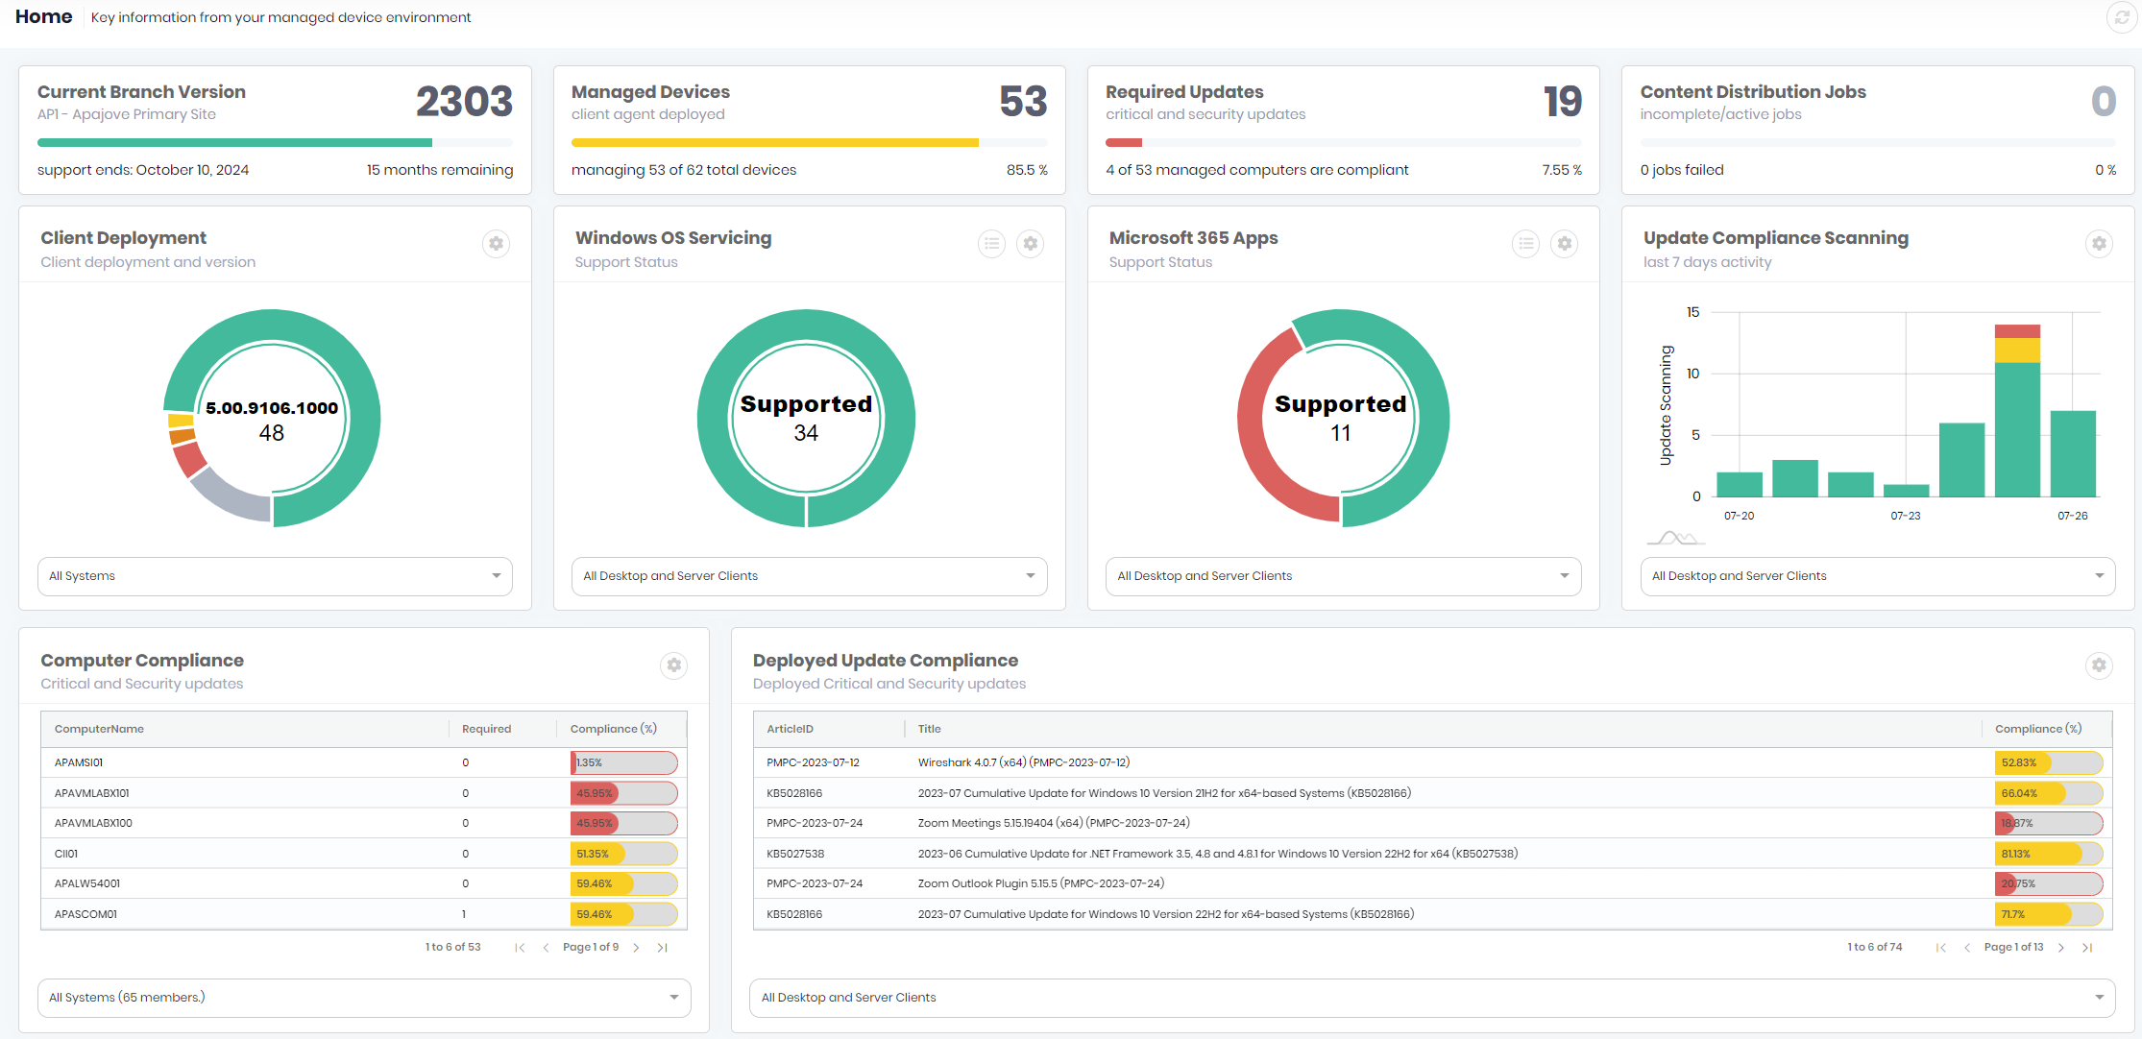
Valuable and accessible data
through intuitive reporting
This powerful tool transforms your data into dynamic, visually rich dashboards, offering everything from software and update compliance to detailed hardware and device insights, trend analysis, and threat detection

Slide 36


Advanced Insights - Features
Software Updates
OS Deployment
Security & Compliance
Effortlessly track and manage application update statuses
Simplify and monitor OS deployment progress across your organization
Easily check compliance levels and security statuses in one place
Software & Hardware
Threat
Analytics
Warranty
Drill down into device warranties from HP, Dell, Lenovo, and other vendors for proactive replacement insights
Gain comprehensive visibility into installed applications and hardware health to enhance compliance, control, and strategic asset management
Instantly identify risks from outdated software to strengthen security

Slide 37
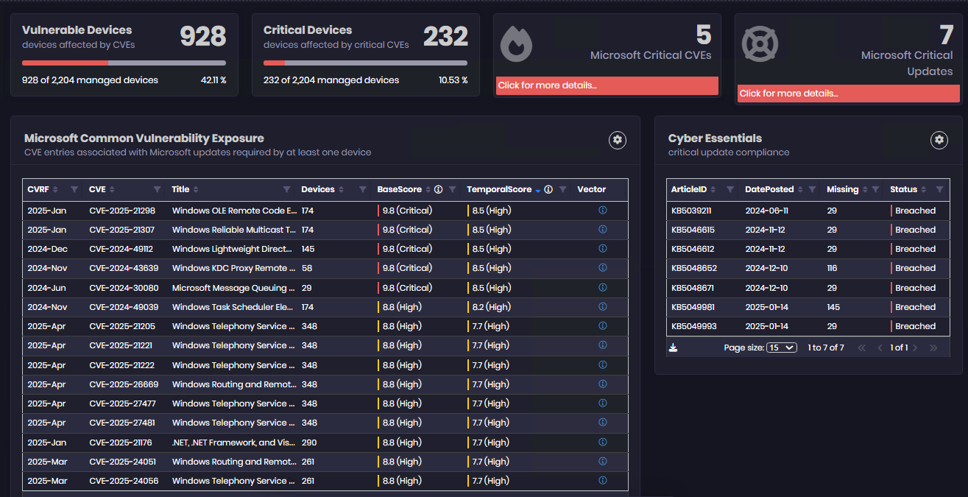
Feature Spotlight
Threat Analytics
The dashboard highlights the specific CVE risks in the software update environment

Slide 38
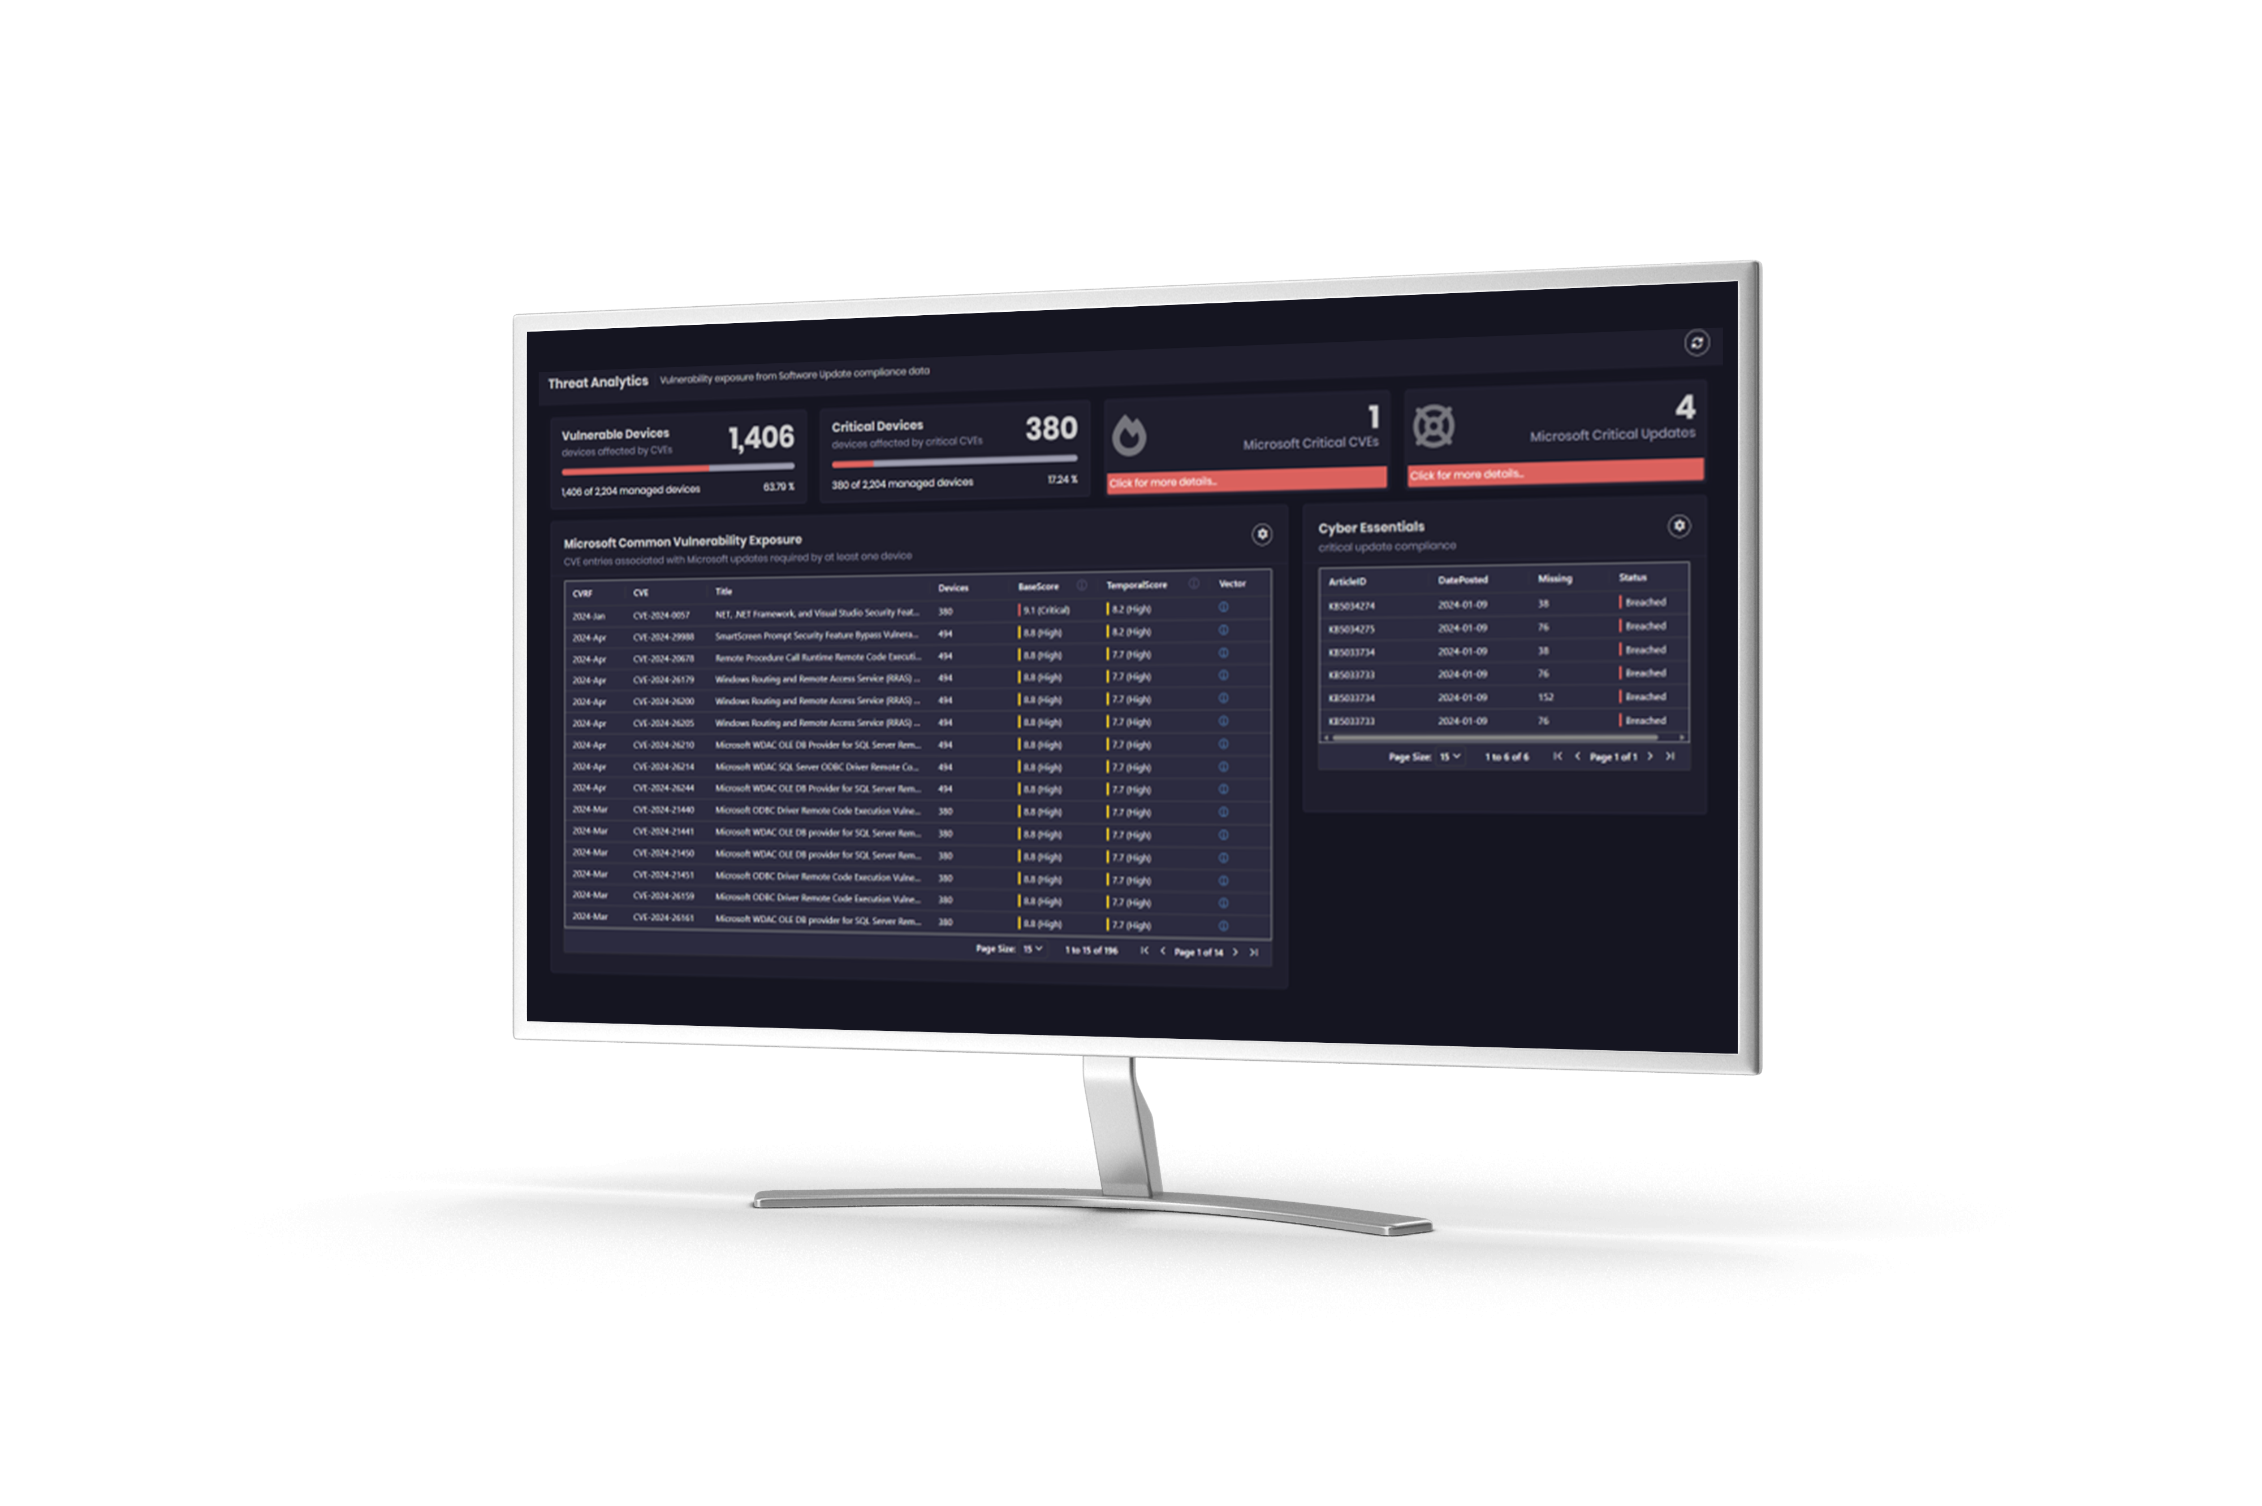
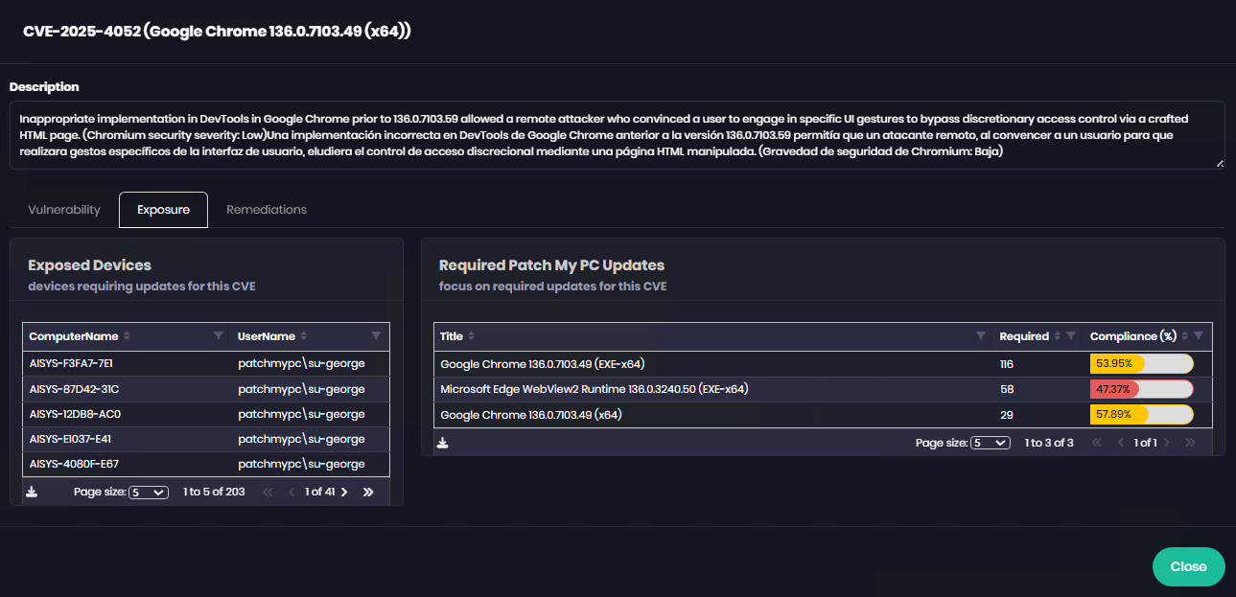
Specific remediation actions are shown for vulnerabilities

Slide 39
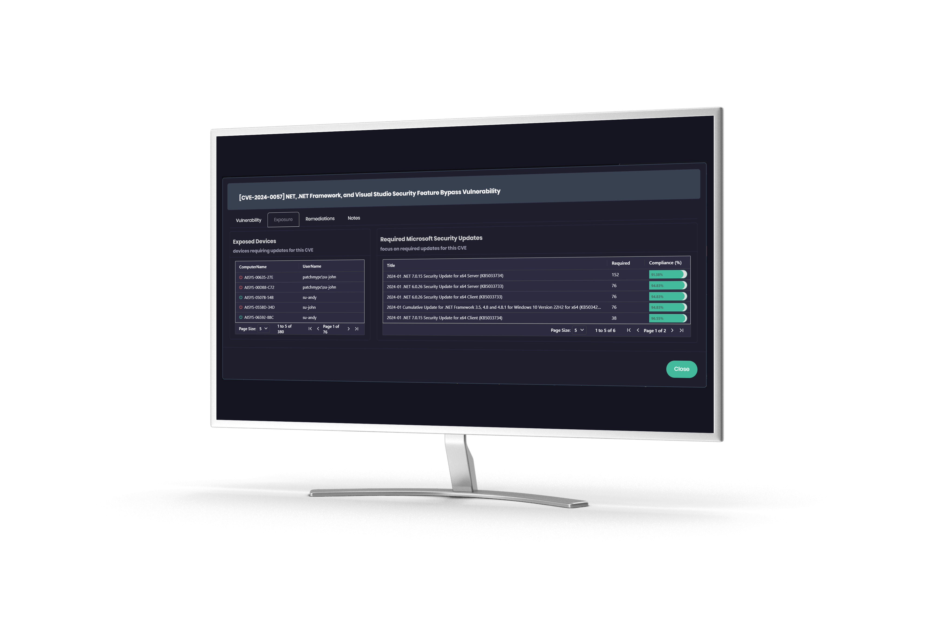
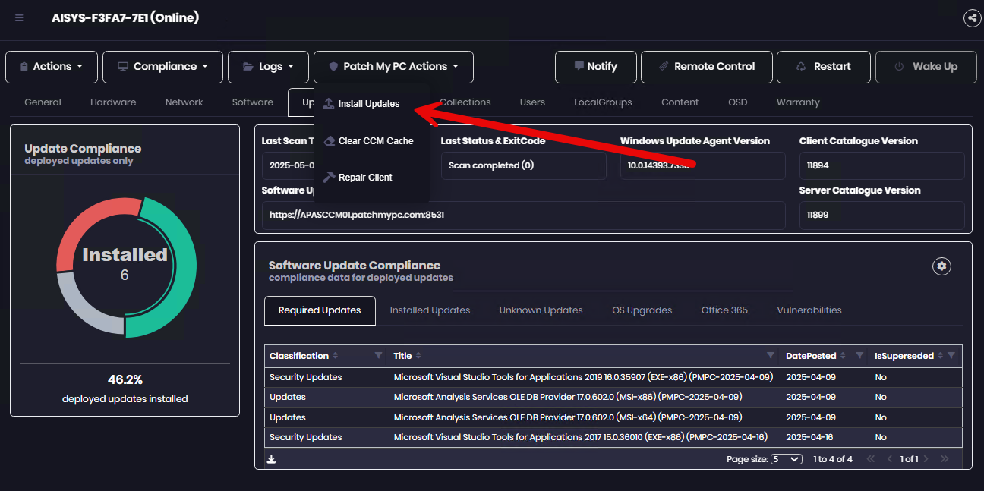
Execute remediation in the console

Slide 40
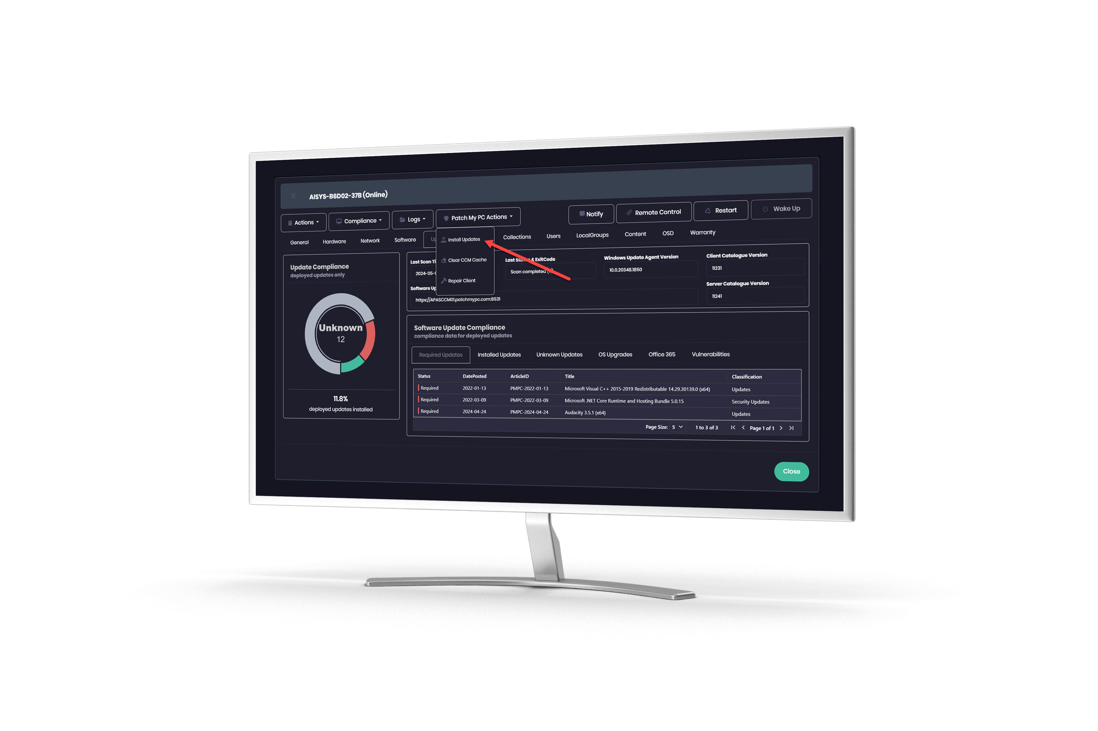
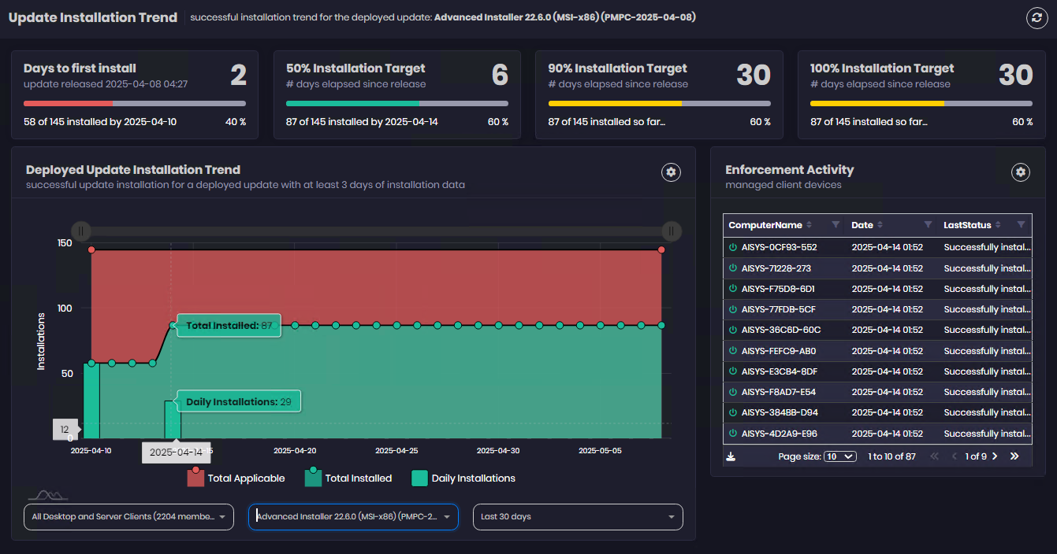
Track progress of bringing machines into compliance

Slide 41
Hot New Capabilities

Slide 42
Hot New Capabilities
1
2
3
App Migration from ConfigMgr to Intune
Advanced Insights
for Intune
macOS Apps for Intune
4
5
PSADT Commercial Support
CVE
Insights

Slide 43
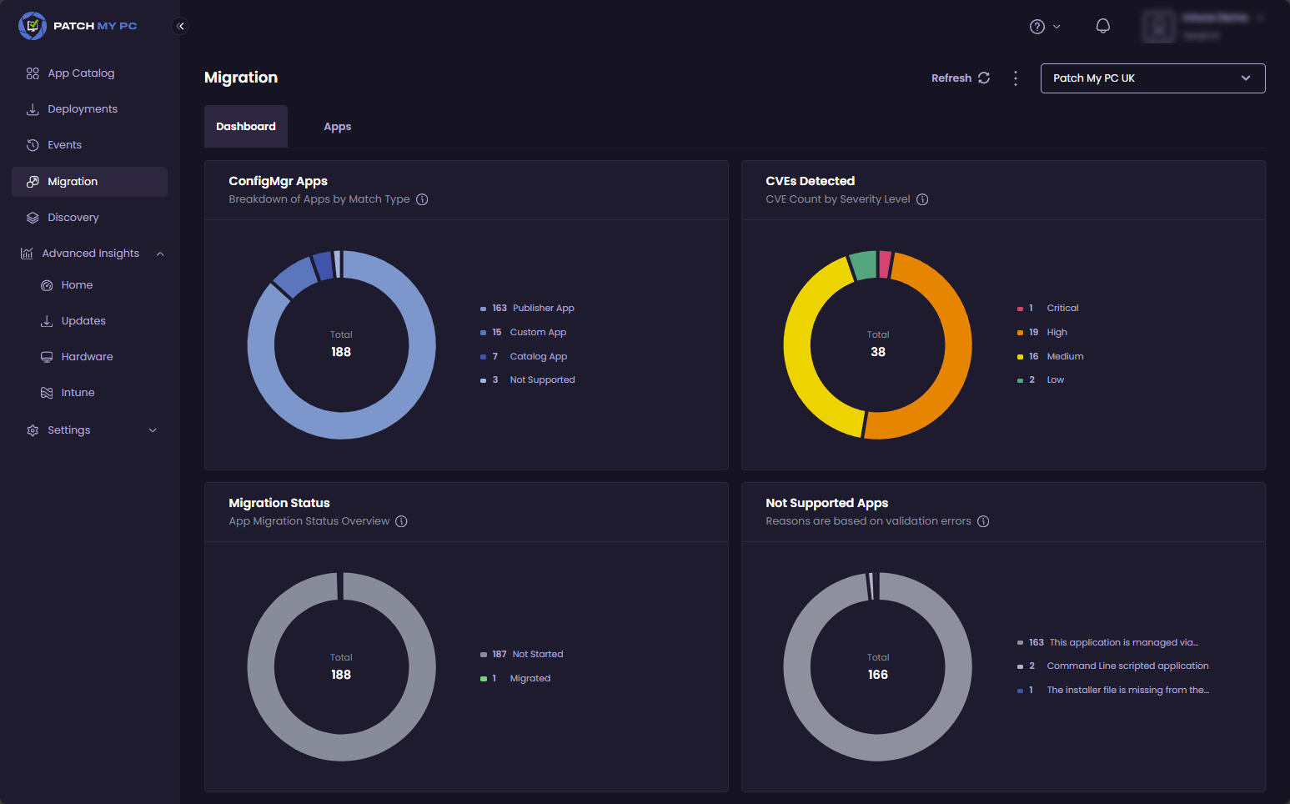
App Migration from ConfigMgr to Intune
Current Status:
Private Preview
We are working on a solution to help customers migrate applications from ConfigMgr to Intune to help expedite the moving of workloads to the cloud
Concept Image. Not final.

Slide 44
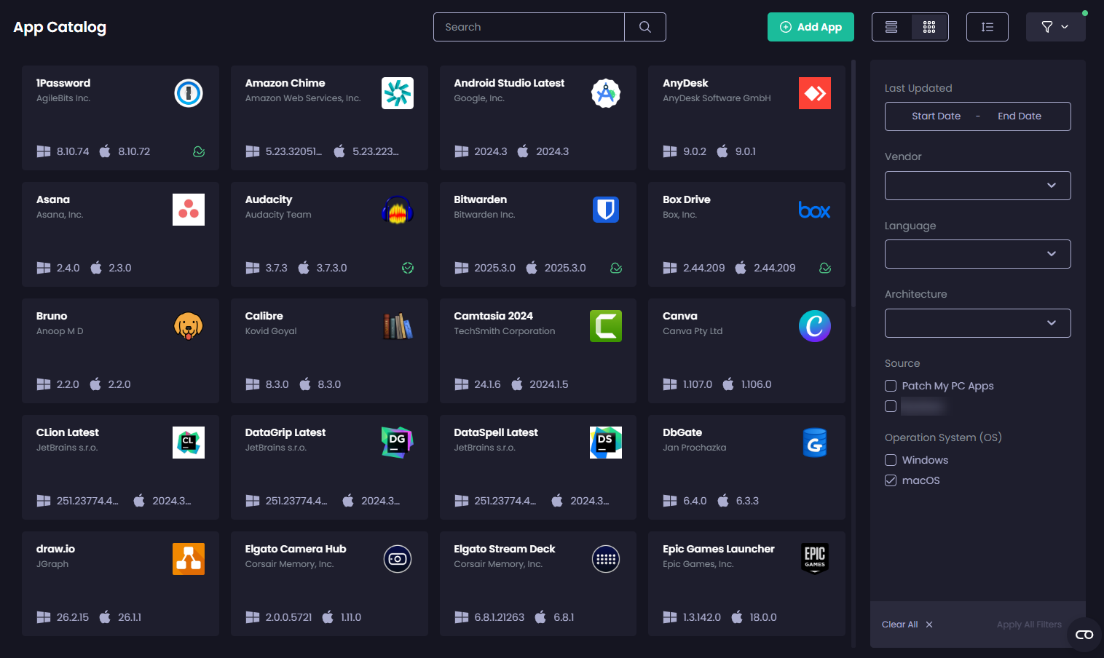

macOS Apps to Intune
We’re releasing a catalogue of macOS apps for you to package and deploy to Intune Deploy apps, automate updates, and simplify macOS management through Intune. Discover smoother and smarter patching for mixed environments
Current Status:
General Availability
Concept Image. Not final.

Slide 45
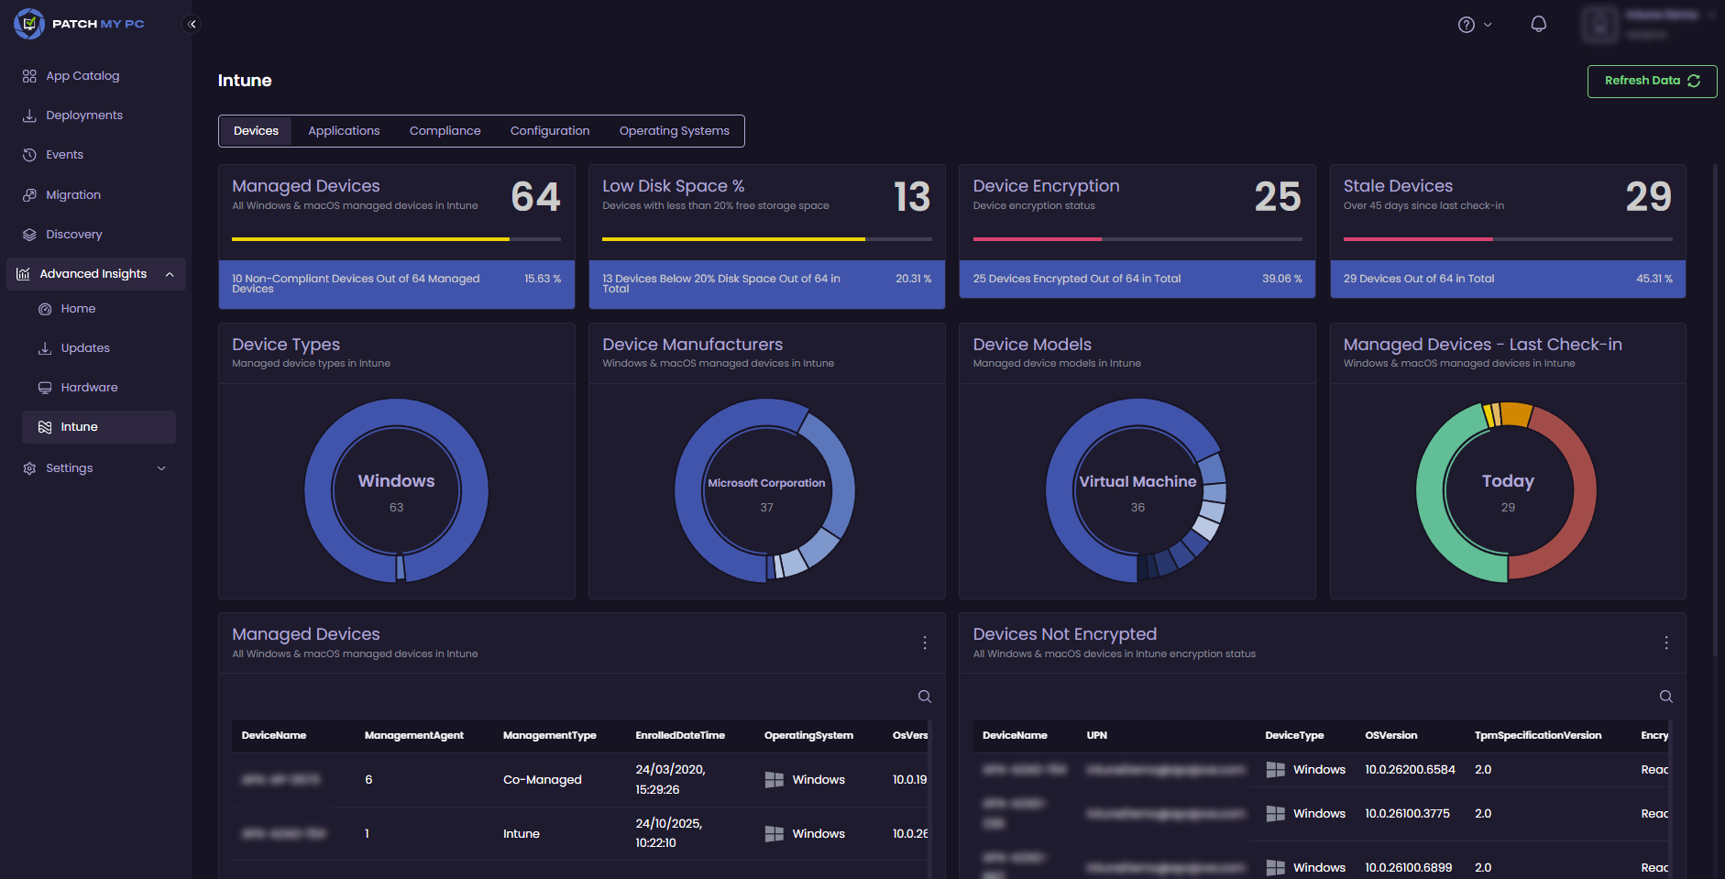
Advanced Insight
for Intune
Building on our much-loved reporting solution for ConfigMgr, we are working to bring our Advanced Insights solution to Intune
Advanced Insights for Intune gives you the power to finally make sense of your Intune data without the overhead of data exports, workarounds or guesswork
Additionally, it will bring patch compliance, inventory and beautiful dashboards inside the Patch My PC Cloud Portal
Current Status:
Private Preview
Concept Image. Not final.

Slide 46
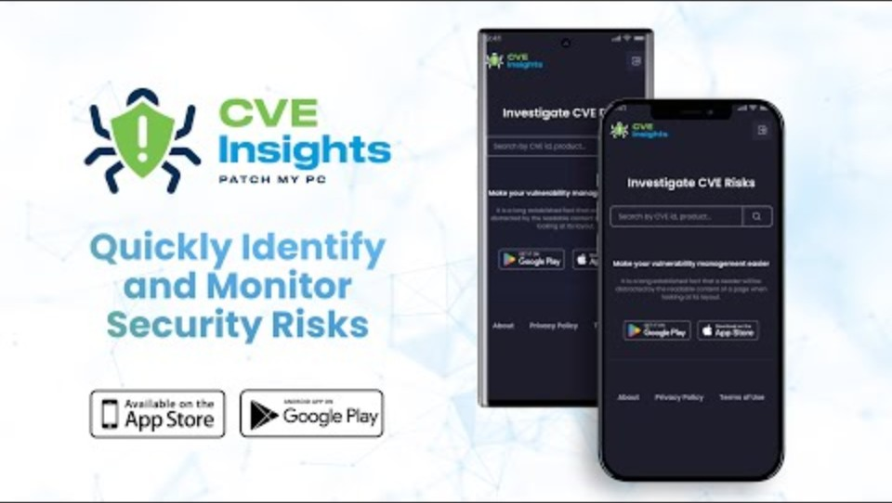
CVE Insights
Bridge the gap between Security and IT teams
Customize alerts based on your environment
Get notified of new vulnerabilities AND whether you're already deploying the patches
Executive summaries curated for your environment to drive smarter decisions
CVE Insights highlights new and emerging threats, shows when Patch My PC has a fix, and tells you if it applies to your environment - so you can patch what matters, faster.
CVE Insights is our mobile 1st application that will provide IT & Security leadership personas a real-time assessment of CVEs impacting their organization and remediation status of those CVE's in their Org.
Current Status:
General Availability
Concept Image. Not final.

Slide 47

Commercial Support
Enterprise Premium customers will be able to reach out to Patch My PC Support for assistance with the PowerShell App Deployment Toolkit.
Current Status:
General Availability

Slide 48


Next steps
1
2
Start a trial
Book a setup call
3
Enjoy your extra time!

Slide 49

For less than a
Enterprise Patch
Enterprise
Plus
Enterprise
Premium
$2 per device per year
$3.5 per device per year
$5 per device per year

Slide 50






Automating and securing
your application installs and updates
Keeping your organization secure
Saving lots of time
Let’s keep in touch!
sales@patchmypc.com
+1 800 250 2334
www.patchmypc.com

