Slide 1
The solution for you

Slide 2





Keeping apps updated is harder than it should be
3-5 hours per update per app
56% of data breaches are preventable with timely patching
(Discover, Package, Test, Deploy)
IT teams are burned out with manual work – always playing catchup –
slow to react to vulnerabilities
500+ apps on average
in large enterprises

Slide 3
Automated patching that saves time, reduces risk, and keeps you secure.
Installs & updates over 2,400 apps
Fully automated
patching –
set and forget
Work with MVPs and former Microsoft pros who’ve built the tools you use today
No more reporting gaps - Insights and Analytics at your fingertips
Integrates natively with ConfigMgr, Intune, and WSUS

Slide 4







Patch My PC
At a Glance
2011
9,000+
27 million
Start
customers
endpoints
150+
2,850+
6
people &
growing
public apps
in catalog
Microsoft MVPs

Slide 5
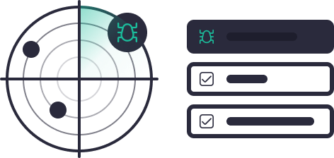



How We Can Help
One Unified Solution
Security
Automation
Visibility
Save Time
Increase Security
Mitigate Risk
Simplify Complexity
Quick App Creation
Seamless Integration
Minimal Training Required
Fast Deployment
User-Friendly Dashboards
Advanced Device Insights
Real-Time Patch Compliance
Actionable Risk Mitigation
Vulnerability/Threat Analytics
Learn more
Learn more
Learn more
Keeping your apps installed and up to date

Slide 6
”
Loved by teams who used to hate patching
Reliable, seamless patching integration with low management overhead.
Our solutions integrate natively with ConfigMgr, WSUS and Intune. The upskill curve for our products is shallow.
”
Patch My PC has made our Software catalog simple to maintain and up to date.
We do all the hard work to ensure patch reliability and quality, saving you hundreds of hours each year.
98% customer satisfaction with support
”
The best third-party patching service and SCCM guidance.
Our support team consists of ConfigMgr and Intune experts to ensure your patching success.

Slide 7
Enterprise-
Ready By
Design
Security & Compliance You Can Trust
Built for Enterprise Environments
Cloud services hosted in Azure, supporting regional US/EU data residency
SOC 2 Type II, GDPR, and ISO 27001 aligned practices
Zero trust mindset:
curated app catalog,
no crowdsourcing *
Native integration with Intune, ConfigMgr & WSUS
Leverages trusted vendor APIs for real-time compliance and insight (MSRC, NIST, Dell, Lenovo, Red Hat)
Enterprise onboarding with a dedicated engineer and account manager
Environment Reviews to keep you up-to-date on new features and best practices
Follow-the-sun support from experienced system admins, architects and Microsoft MVPs
Scales With You
Proven in large customer environments with 150K+ endpoints
Designed for flexibility to support on-premises, hybrid, or cloud-first strategies
Supports co-management for phased cloud adoption (ConfigMgr + Intune)
* Patch My PC maintains its own enterprise-grade catalog of third-party apps, ensuring reliability and control. While community sources like WinGet have their place, they shouldn’t be the primary source for enterprise updates. Would you trust your Microsoft updates to come from a community-maintained repository?

Slide 8

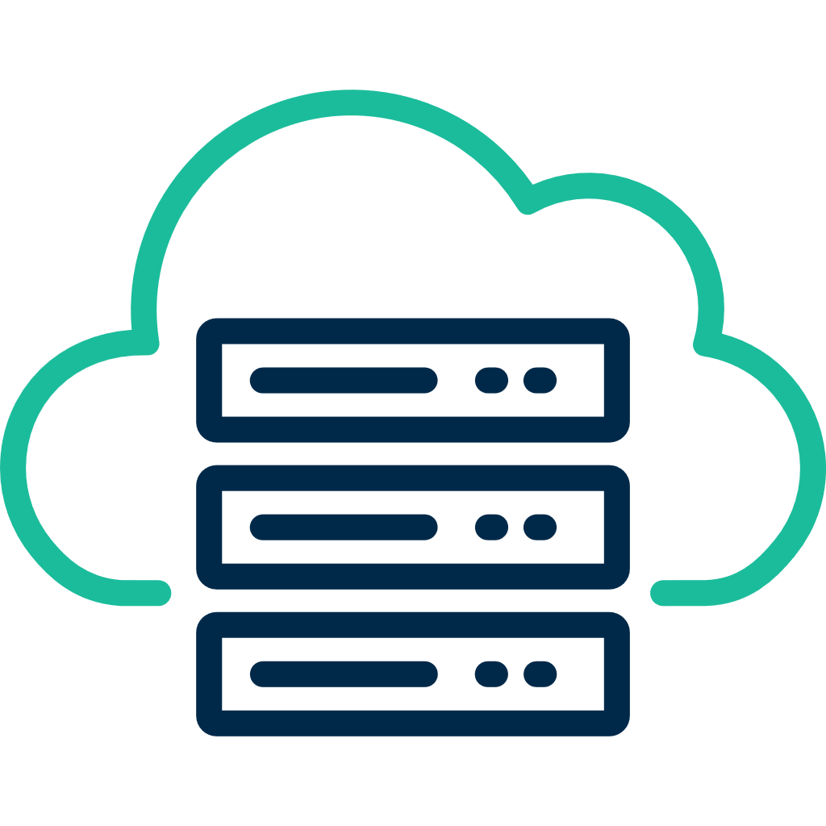

Works
Wherever
You Do
On-Prem
(Patch My PC Publisher)
Supporting Microsoft ConfigMgr and WSUS
Hybrid
(Patch My PC Cloud & Publisher)
+
Your environment
Supporting Microsoft ConfigMgr, WSUS and Intune
We support the
full journey whether
on-prem, cloud, or both
Cloud
(Patch My PC Cloud)
Supporting Microsoft Intune
Reporting & Insights
(Advanced Insights)
Supporting Microsoft ConfigMgr and Intune
Notes:
Added microsoft

Slide 9
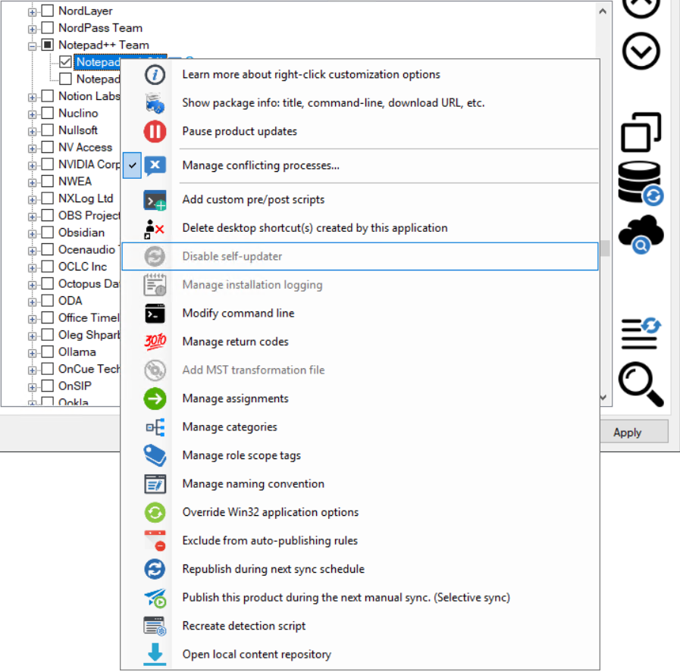
Patch My PC Publisher —
A powerful on-premises solution for managing third-party apps & updates in ConfigMgr, WSUS & Intune
With seamless integration into ConfigMgr, WSUS and Intune, it transforms the traditionally complex update process into a streamlined, automated experience that keeps your applications secure and up to date.
Best choice for:
Microsoft ConfigMgr and WSUS environments
Combined Microsoft Intune and ConfigMgr environments

Slide 10
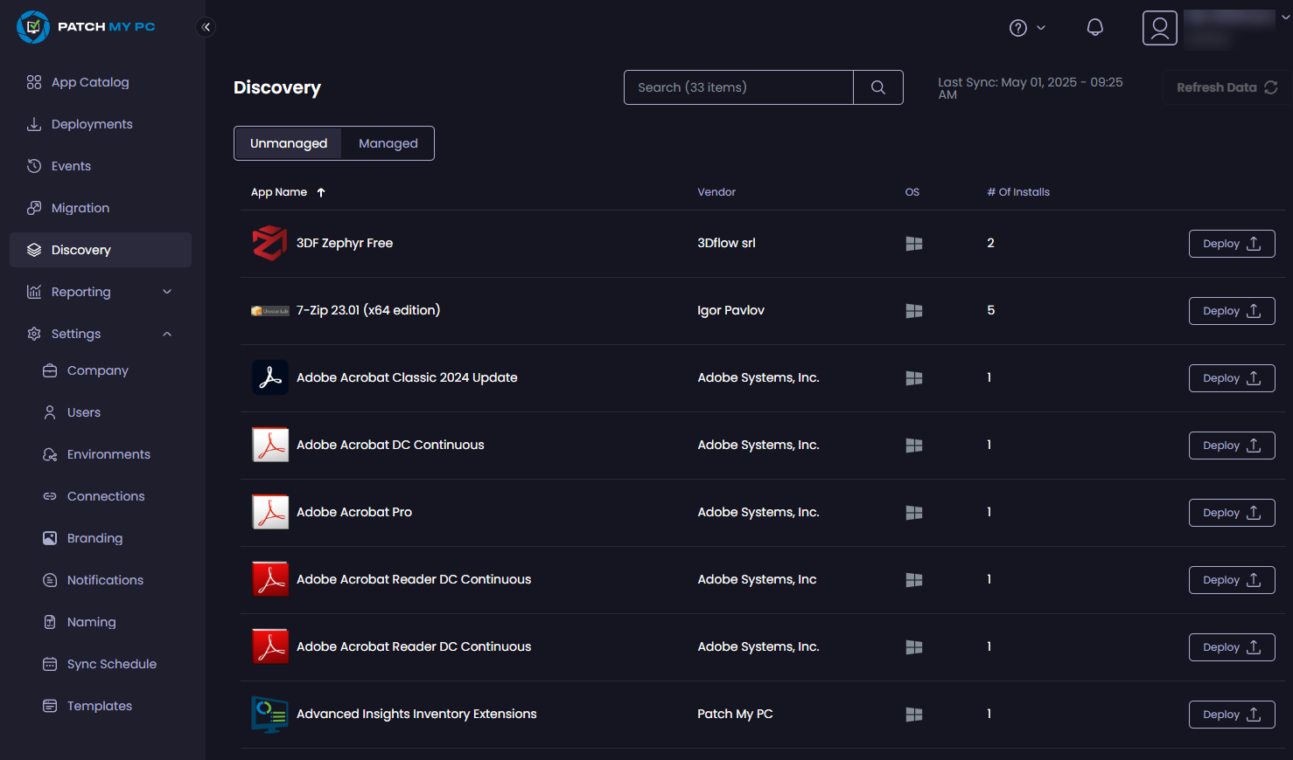
Patch My PC Cloud —
A powerful SaaS solution for managing third-party apps & updates in Intune for your enterprise
Best choice for:
Microsoft Intune environments

Slide 11
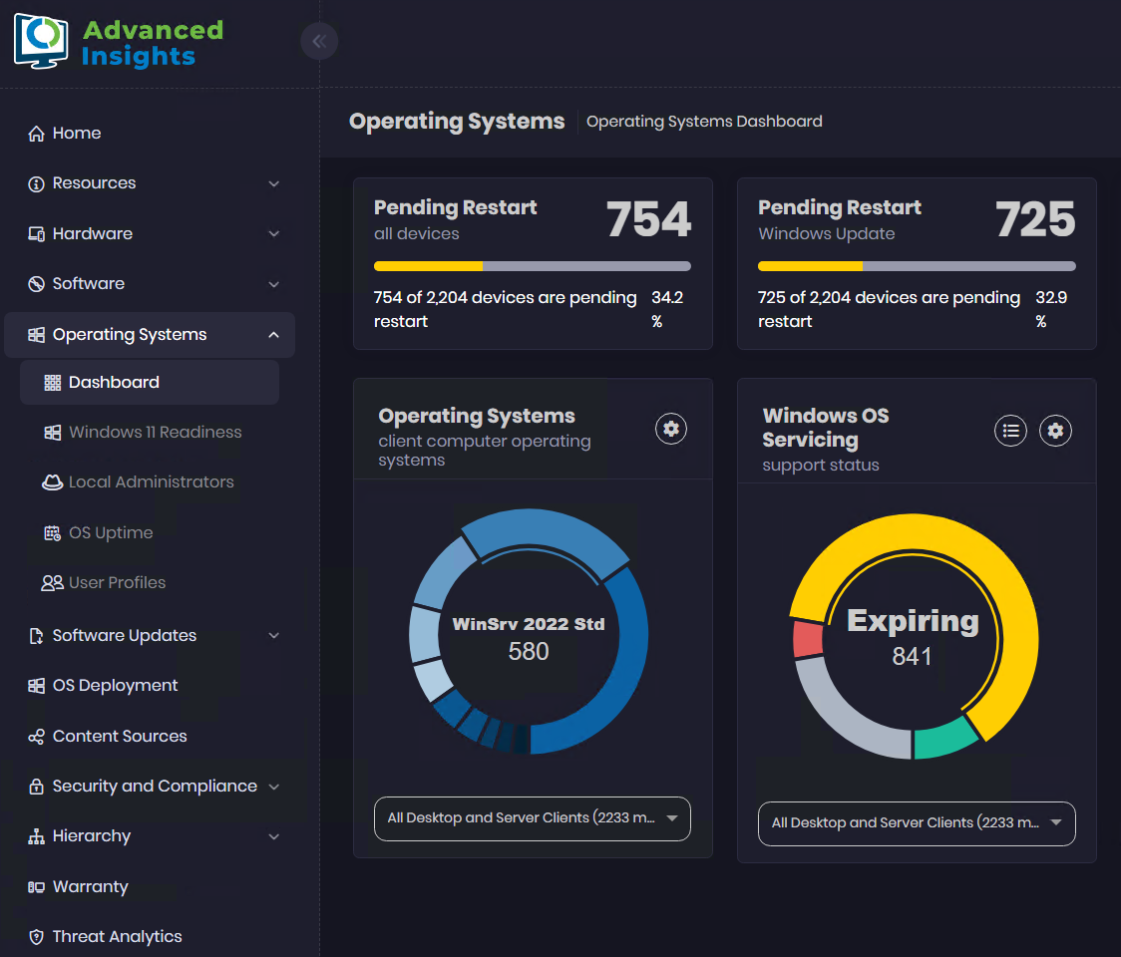
Advanced Insights —
A powerful solution designed to give you invaluable insights and compliance reporting for your organization
Beautiful data &
streamlined reporting
Better insights on your data,
including inventory management
Clear software update compliance reporting
Threat analytics dashboard
& CVE reporting
Best choice for:
Microsoft ConfigMgr environments
Microsoft Intune environments (In Public Preview)

Slide 12
Customers Asked
Patch My PC Listened
Hot New Capabilities
1
2
3
App Migration from ConfigMgr to Intune
Advanced Insights
for Intune
macOS Apps for Intune
4
5
PSADT Commercial Support
CVE
Insights

Slide 13

For less than a
Enterprise
Patch
Enterprise
Plus
Enterprise
Premium
$2 per device per year
$3.5 per device per year
$5 per device per year

Slide 14




Get ready to save time and
be secure with Patch My PC
Next steps
1. Start
a trial
2. Book a setup call
3. Enjoy your extra time!
https://pmpc.link/trial-se-deck
https://pmpc.link/setup-se-deck

