Slide 1
Secure Boot Certificate Expiration 2026:
Are You Actually Covered?

Slide 2
What is Secure Boot
Why Did This Suddenly Become Urgent?
LISA (Lost in Silly Acronyms): PK … KEK… DB…?!
There Is No Easy Button: It’s a Project
      Step 1: Firmware Readiness
      Step 2: Deploy/Update the Certificate
      All the Knobs and Dials and How to Set Them
      Step 3: Reporting... Deploying is one thing… knowing what is happening is everything
What we Did!!
Demos

Slide 3
What is Secure Boot?

Slide 4
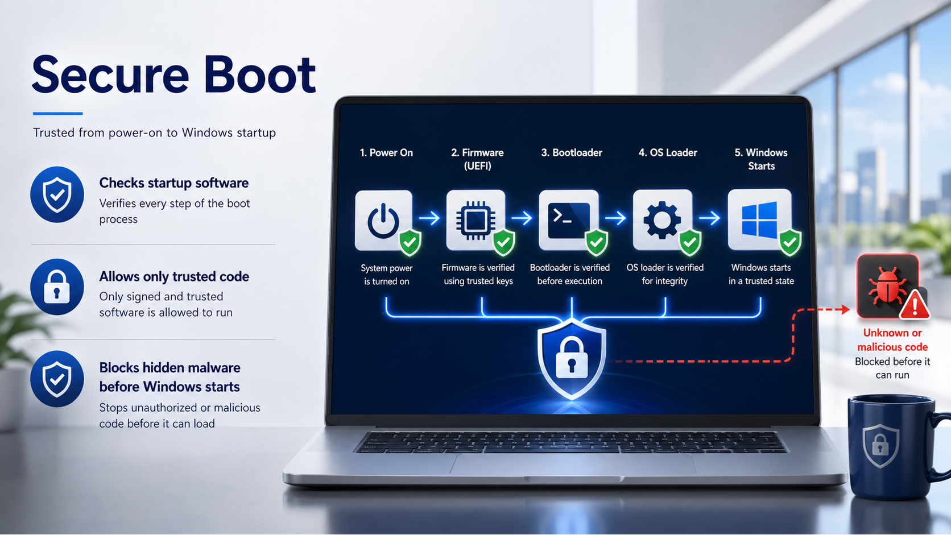
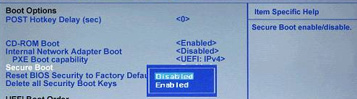
What is Secure Boot
Checks Windows before it starts
Allows only trusted startup code
Blocks changed or unknown boot files
Helps stop hidden malware
Starts Windows from a trusted state

Slide 5
Why Did This Suddenly Become Urgent?

Slide 6
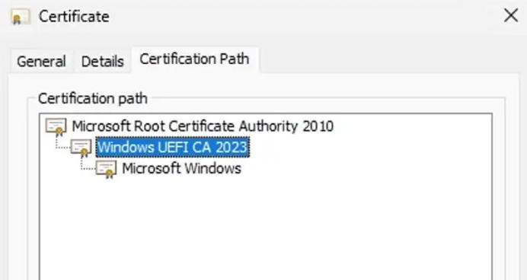
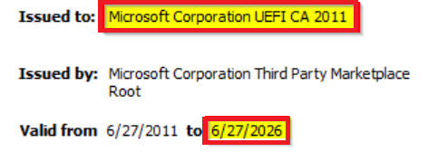
Secure Boot Certificate Is Going to Expire
The 2011 Microsoft Secure Boot certificates begin expiring in June 2026 and complete by October 2026. Devices need the 2023 certificate chain before then.
The old 2011 (15 years) Secure Boot trust is being replaced by the newer 2023 trust.
That includes the KEK, DB, DBX, and the Windows boot manager.
“Secure Boot is hitting a certificate life cycle moment.
That is why this is urgent.”

Slide 7
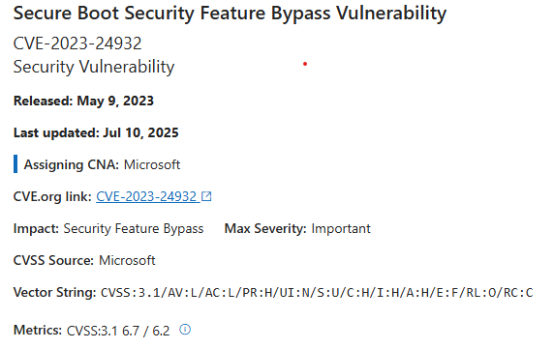
BlackLotus: Was the Warning shot in 2023
How to manage the Windows Boot Manager revocations for Secure Boot changes associated with CVE-2023-24932
UEFI bootkit targeting Secure Boot (pre-OS execution)
Exploits CVE-2023-24932 – bypasses Secure Boot protections
Boot-level persistence – survives OS reinstall, hard to detect/remove
Uses signed, vulnerable bootloaders trusted by older Secure Boot configs
2023 Secure Boot certs required – enforce updated trust chain
OS patching alone insufficient – Secure Boot updates mandatory
Mitigation requires DBX update to revoke bootloaders signed with 2011 certs
  This is an extra step that must be taken after you update the SecureBoot certs.

Slide 8
LISA: PK… KEK… DB…?
*AKA Explaining the Acronyms first

Slide 9
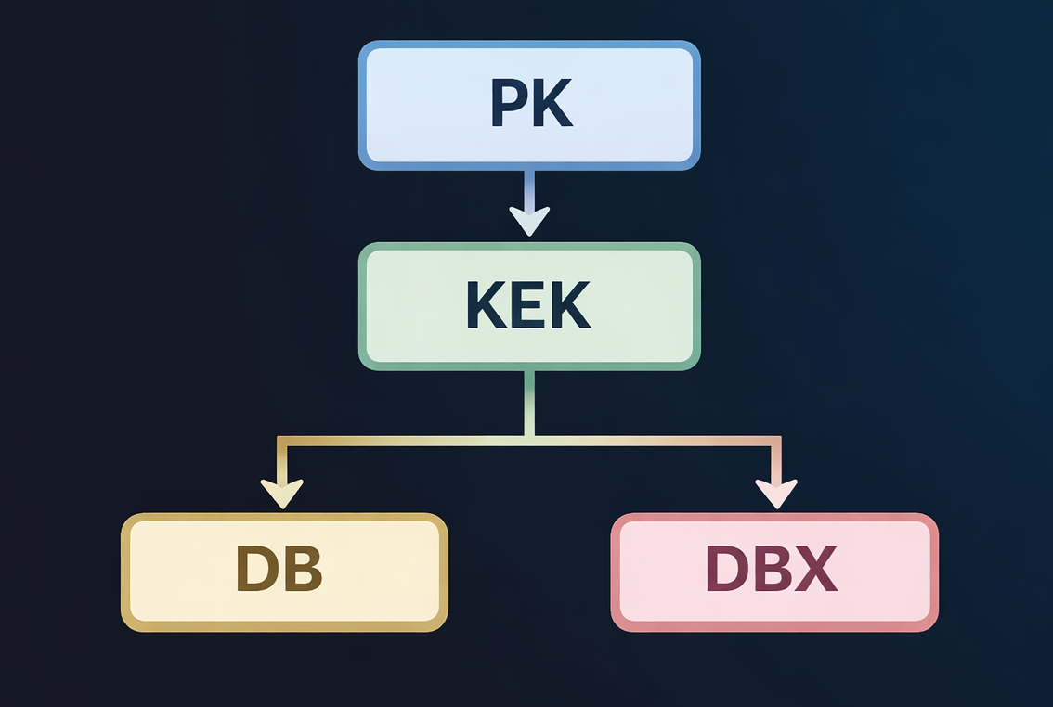
Trust hierarchy: PK, KEK, DB, and DBX
Before we continue … We need to explain these acronyms… because they matter…?
Platform Key (PK)
This is a key typically owned by the OEM. It controls the list that says who can change the device's Secure Boot allow list and block list .
Key Exchange Key (KEK)
This key signs updates to the Secure Boot allow and block lists. If the right KEK is missing, later updates to the two lists may fail.
Allowed Database (DB)
This is the allow list. It says which signatures are trusted by Secure Boot and allowed to run code before the OS layer. This can also identify individual files by hash rather than certs.
Blocked database (DBX)
This is the block list. It contains certificates and files the firmware should no longer trust.
This is why “certificate deployment” is not just copying one file. It is updating the rules the firmware uses to trust or reject boot content.

Slide 10
There Is No Easy Button
It’s a Project

Slide 11
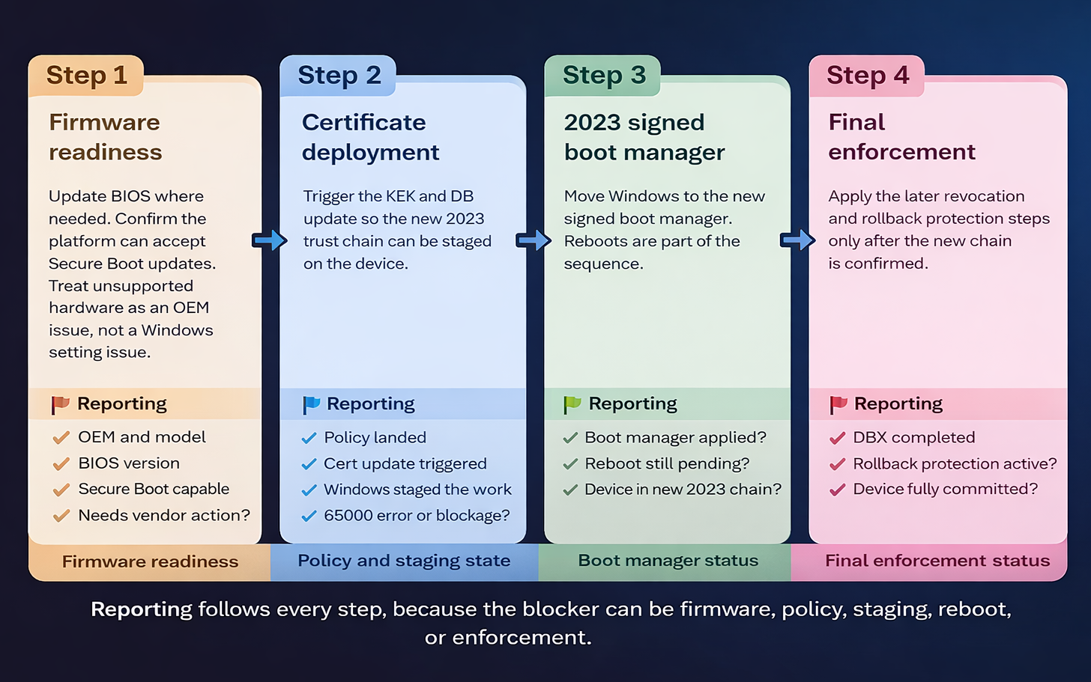
Remediation flow: OEM first, Microsoft second,
validation throughout
This is the sequence we need to follow, but success still depends on both Microsoft and the OEM doing the right part at the right time.
“Policy is only the trigger. Updating the Cert is a staged interaction between Windows servicing, reboots (just a couple and more), & firmware.”

Slide 12
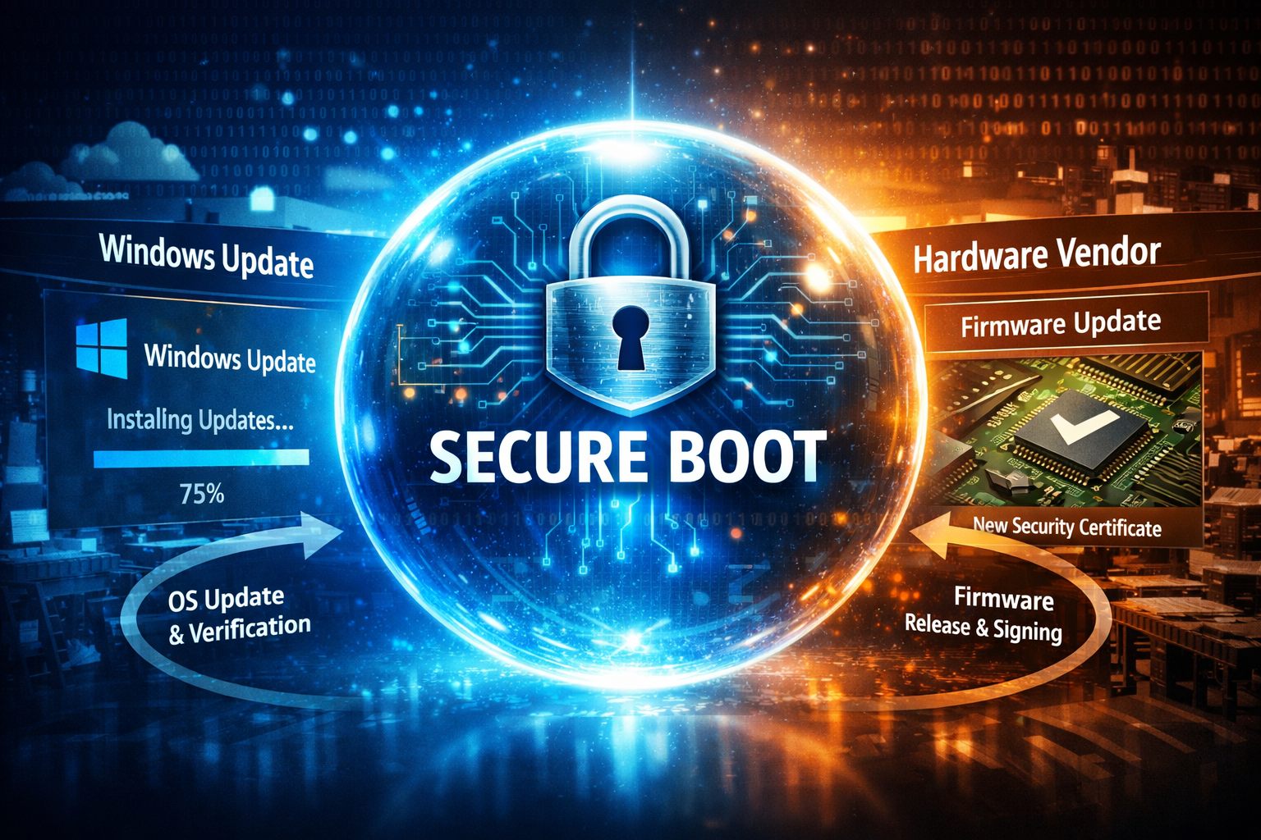


One deadline, two “trust” owners
Microsoft Side
OEM Side
Windows delivers and stages the Secure Boot update flow
Monthly (2026-02) updates bring the required files
Policy can trigger the scheduled task
Windows stages the work and retries if needed
Boot manager updates are only one part of the fix
Firmware must safely accept the new Secure Boot trust chain
Accepts new KEK and DB updates
Some devices need a BIOS update first
Older models may not get support
Firmware bugs can block or delay rollout
“Microsoft can move its side forward. Firmware still decides whether the platform can complete the trip and not break apart.”

Slide 13
Step 1:
Firmware Readiness

Slide 14


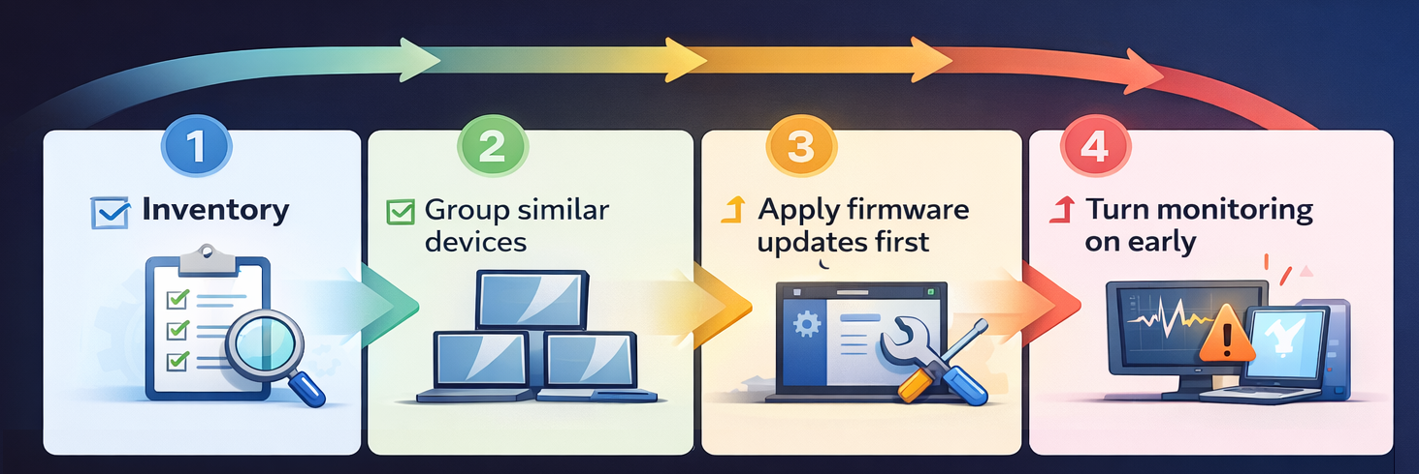
Two paths: new devices versus in-market devices
NEW DEVICES
IN-PRODUCTION
(OLD?) DEVICES
This is where the real work needs to happen. Inventory the fleet, group devices by OEM, model, and firmware line, engage OEMs early, apply BIOS updates first where required, then pilot the Secure Boot transition in safe rings/waves with monitoring turned on.
On top of that ensure you have access to the Bitlocker Recovery Keys
OEMs are expected to ship current platforms with the newer trust anchors already present. That does not mean you skip validation. It means the trust refresh is more likely to align with the platform as shipped.

Slide 15
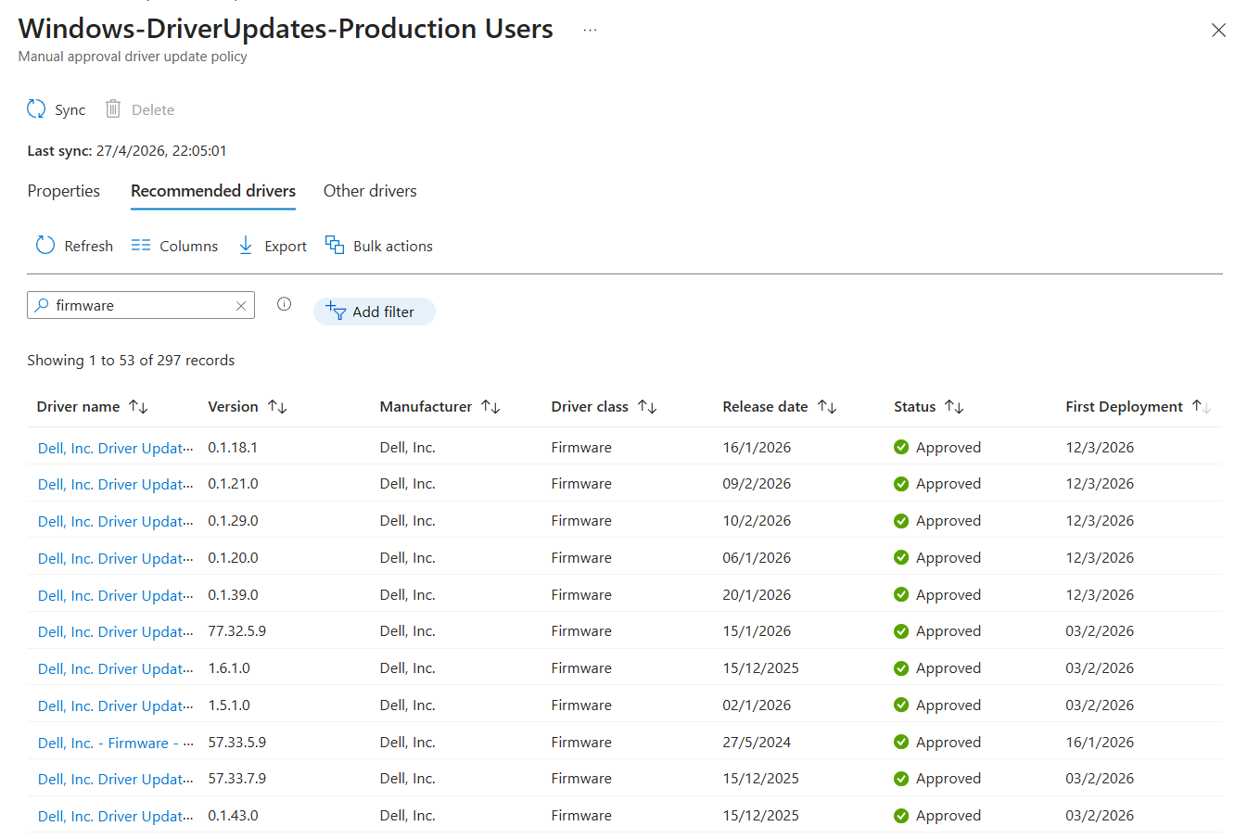
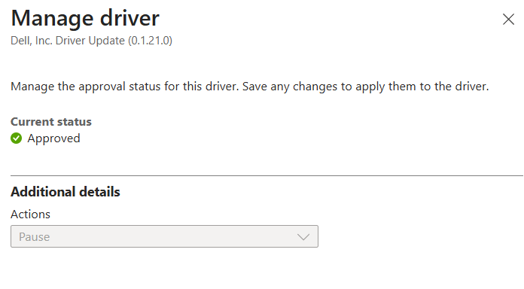
Windows Autopatch to the rescue..*
* Stay tuned for how we actually ended up fixing things

Slide 16
Step 2:
Deploy/Update the Certificate

Slide 17
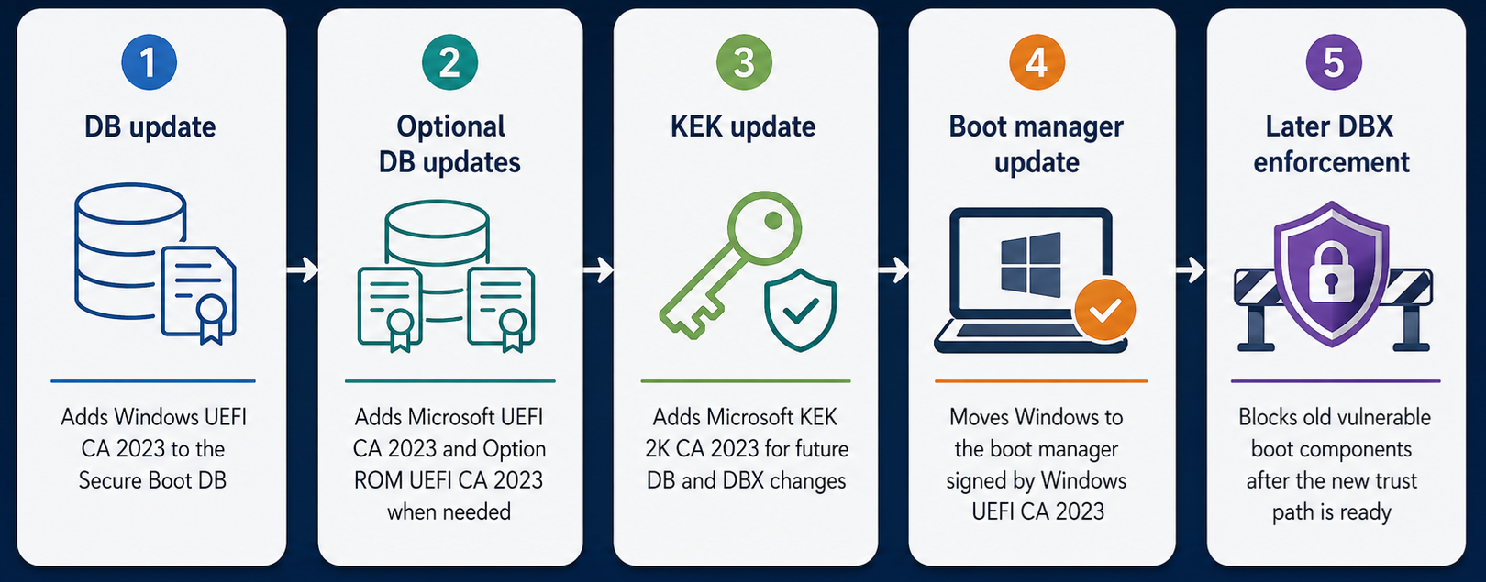
What the certificate steps are really doing
SECURE BOOT 2023 CERTIFICATE UPDATE FLOW
With the Hardware Readiness checks done, we need to start updating the DB/KEK….
How Is Microsoft helping us with this also important step?

Slide 18
All the Knobs, Dials and How to Set Them

Slide 19
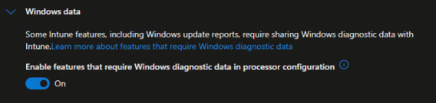
How Microsoft stages the rollout
Microsoft uses staged assists and observed confidence.
Controlled Feature Rollout (CFR)
High confidence in monthly updates
Opt in and opt out controls
A Microsoft-managed assist for earlier deployment. Devices opt in through policy or registry, and required diagnostic data must be available.
When Microsoft has enough observed success for a hardware and firmware bucket, the confidence data can let Windows monthly updates move faster on those configurations.
Admins can opt in to Microsoft managed rollout earlier, or opt out of the automatic high confidence path if they need tighter local control.
CFR lets devices join the Microsoft managed rollout. Microsoft controls the pace, but firmware readiness still matters.

Slide 20
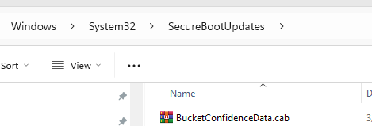
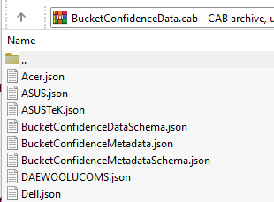
How Microsoft stages the rollout
Microsoft uses staged assists and observed confidence.
Controlled Feature Rollout (CFR)
High confidence in monthly updates
Opt in and opt out controls
A Microsoft-managed assist for earlier deployment. Devices opt in through policy or registry, and required diagnostic data must be available.
When Microsoft has enough observed success for a hardware and firmware bucket, the confidence data can let Windows monthly updates move faster on those configurations.
Admins can opt in to Microsoft managed rollout earlier, or opt out of the automatic high confidence path if they need tighter local control.
The JSON files describe the kinds of hardware and firmware combinations Microsoft has grouped into buckets.
The device side data that represents that high confidence knowledge. It is the file Windows checks locally to see whether this machine matches one of those trusted buckets.

Slide 21
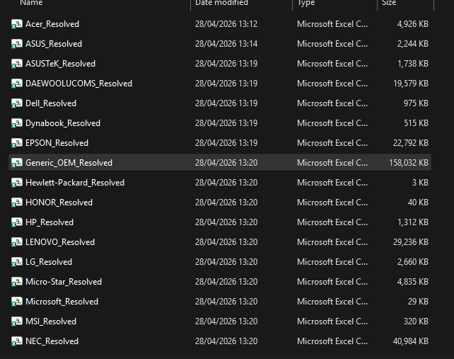
How Microsoft stages the rollout
Microsoft uses staged assists and observed confidence.
High Confidence when:
The firmware supports authenticated Secure Boot variable updates correctly.
The DB and KEK update succeeds on enough matching devices.
Microsoft has not seen failures for that bucket.
The device model is common enough to provide enough telemetry.

Slide 22
How Microsoft stages the rollout
Microsoft uses staged assists and observed confidence.
Controlled Feature Rollout (CFR)
High confidence in monthly updates
Opt in and opt out controls
A Microsoft-managed assist for earlier deployment. Devices opt in through policy or registry, and required diagnostic data must be available.
When Microsoft has enough observed success for a hardware and firmware bucket, the confidence data can let Windows monthly updates move faster on those configurations.
Admins can opt in to Microsoft managed rollout earlier, or opt out of the automatic high confidence path if they need tighter local control.
Opt-In Enabled:
This will let Microsoft help decide the timing through CFR and confidence data
Leave it to the default setting (Disabled)
Opt-Out Enabled:
Microsoft’s CFR will NOT apply the certificate updates on devices targeted for the managed rollout.
Leave it to the default setting (Disabled)

Slide 23
How we (IT Admins) can control the rollout

Slide 24
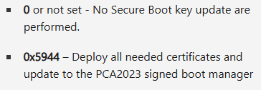
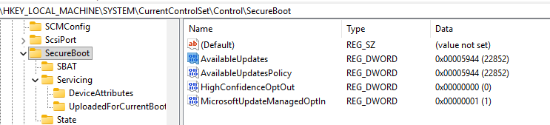


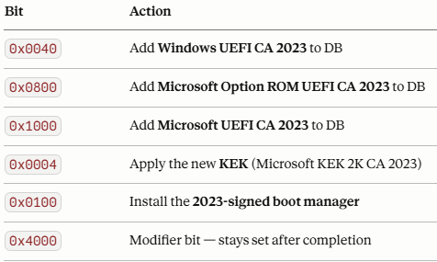
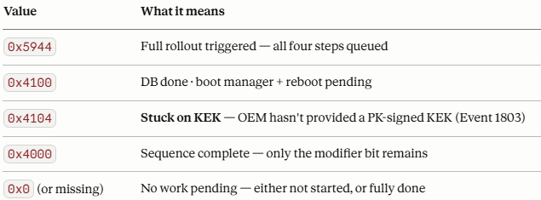

How we (IT Admins) can Control the rollout
So now that we understand how Microsoft decides when and where to move, let’s look at what we as admins can actually trigger
Registry
The direct control layer: AvailableUpdates
+
+
+
+
+

Slide 25
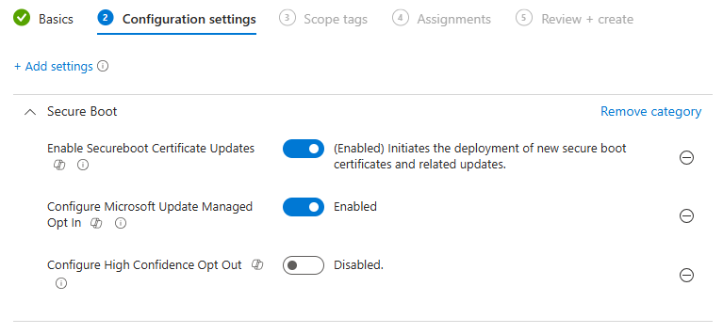
How we (IT Admins) can Control the rollout
Intune
Settings Catalog exposes the same Secure Boot controls centrally. Good for managed rollout, but it has had it flaws….

Slide 26
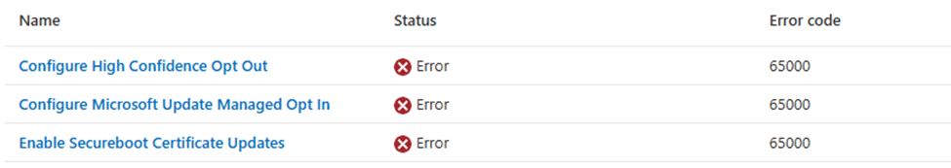
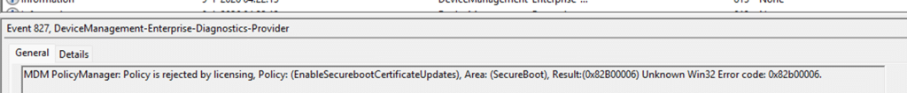
How we (IT Admins) can Control the rollout
Intune: 65000
Subscription Activation and Hotpatch caused the policy to be rejected
So back to deploying Remediations to configure those registry keys? → Yes….

Slide 27
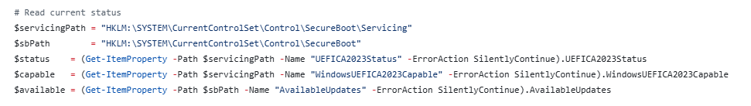
How we (IT Admins) can Control the rollout
Intune: Remediations
Key to check the status
Most important steps are configuring the AvailableUpdates Registry key to 05944 and kickstarting the Secure Boot Scheduled task
Key to check if the Device is Capable
Secure Boot Certificate Update - Making It Happen with Intune Remediations - Mindcore Techblog

Slide 28
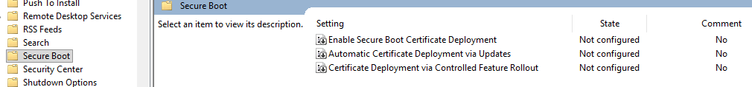

How we (IT Admins) can Control the rollout
GPO
An enterprise friendly control plane for domain managed systems. It configures the same behavior but monitoring still comes from registry and event state.

Slide 29
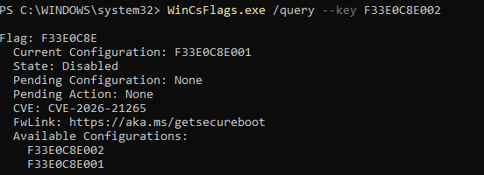
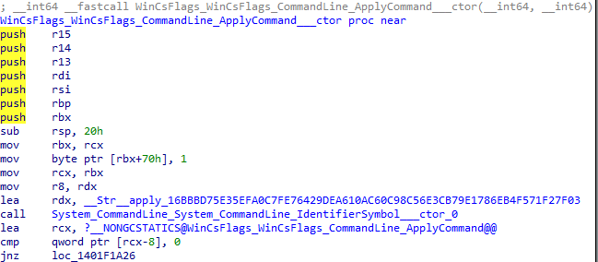
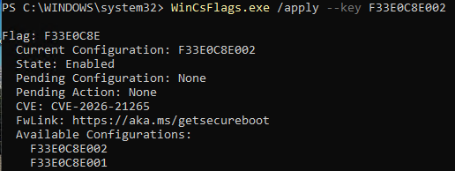
How we (IT Admins) can Control the rollout
WinCS
WinCS is the Windows interface behind the feature. WinCSFlags is the local command line tool that talks to that interface and lets us query or apply the Secure Boot setting.
Don’t mix different methods to configure the secure boot policy

Slide 30
How Do You Know Your Devices Status?
Detecting Secure Boot Status

Slide 31

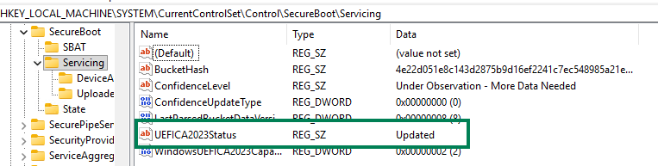
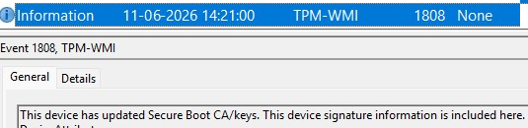
The Registry keys and Logs that could tell us something
AvailableUpdates
Setting AvailableUpdates to 0x5944 signals Windows to execute the Secure Boot key update and installation sequence. As each bit succeeds, Windows clears it from the value.
UEFICA2023Status and UEFICA2023Error
Status moves from NotStarted to InProgress to Updated on success. If a step fails, the first error is recorded and the status remains InProgress.
Secure-Boot-Update task
The processing task runs every 12 hours by default. The boot manager step may not complete until after a restart, which is why staged progress and retries are normal.
The Event logs
Besides the SecureBoot registry keys, the Event log also contains information if the Secure Boot Certificate was updated. For example:
1801 (Need Updating) 1808 (Updated)

Slide 32
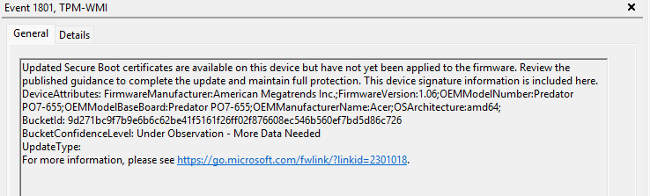
The Registry keys and Logs that could tell us something
The Event logs
Besides the SecureBoot registry keys, the Event log also contains information if the Secure Boot Certificate was updated. For example:
1801 (Need Updating) 1808 (Updated)

Slide 33
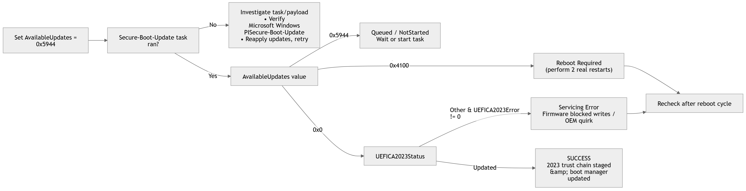
The Secure Boot Update Progress and What we need to check (Windows Side)

Slide 34
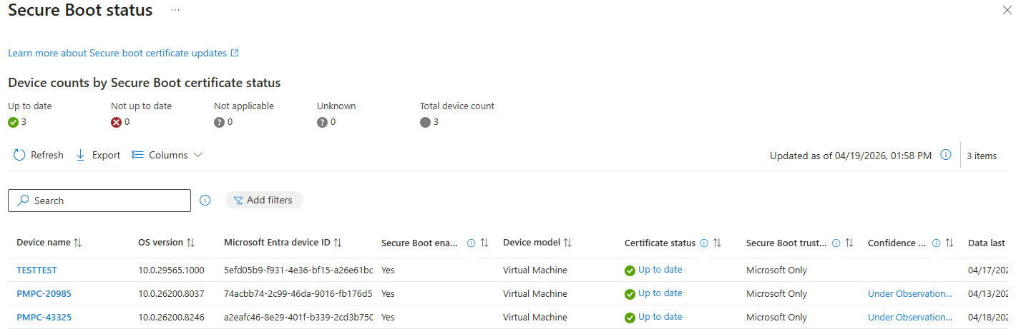
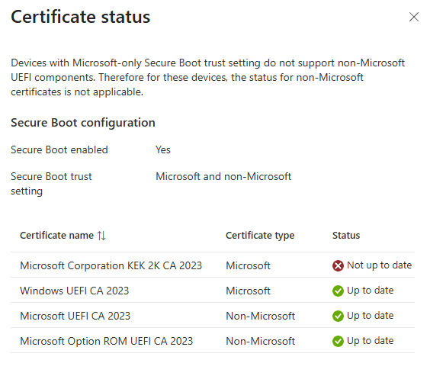
How Would we Detect the Secure Boot Updates Progress
Are we going to trust the Secure Boot Status Report in Intune?

Slide 35
What we did!!!

Slide 36
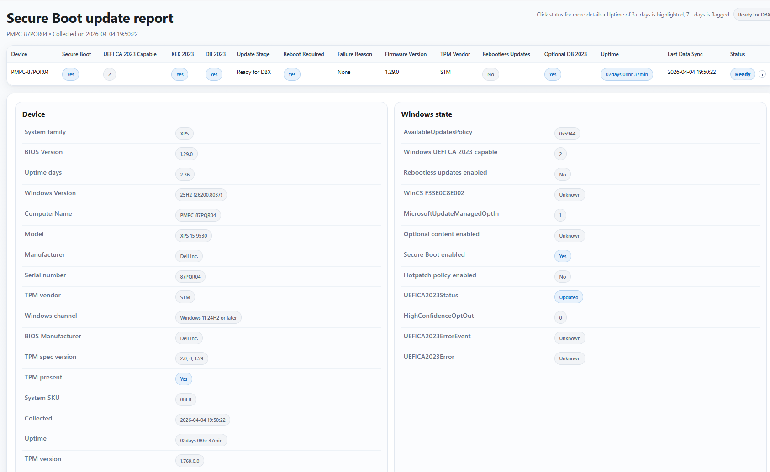
From script to dashboard to product
How its started…

Slide 37
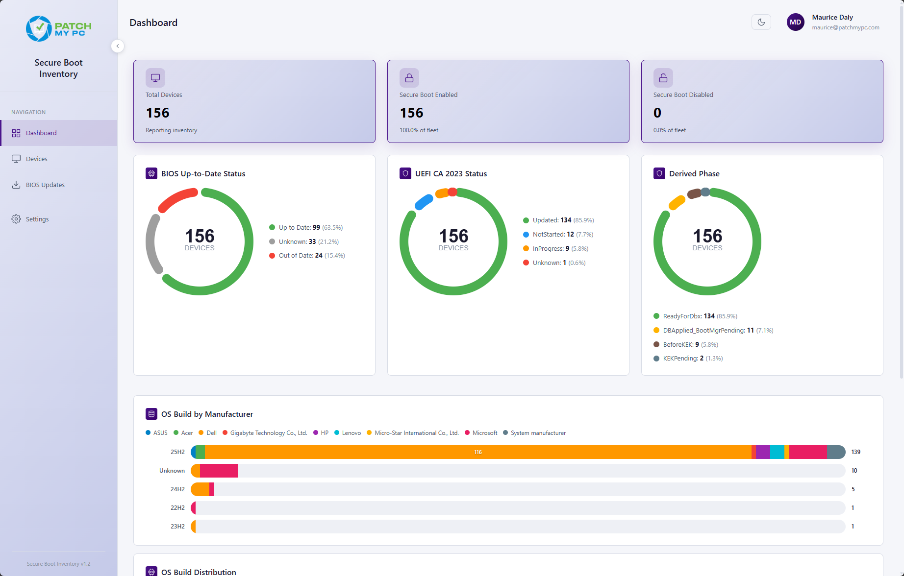
From script to dashboard to product
How its started…
Fun with..
Remediation scripts
Azure storage tables
Azure function apps
PowerShell web scrapers

Slide 38
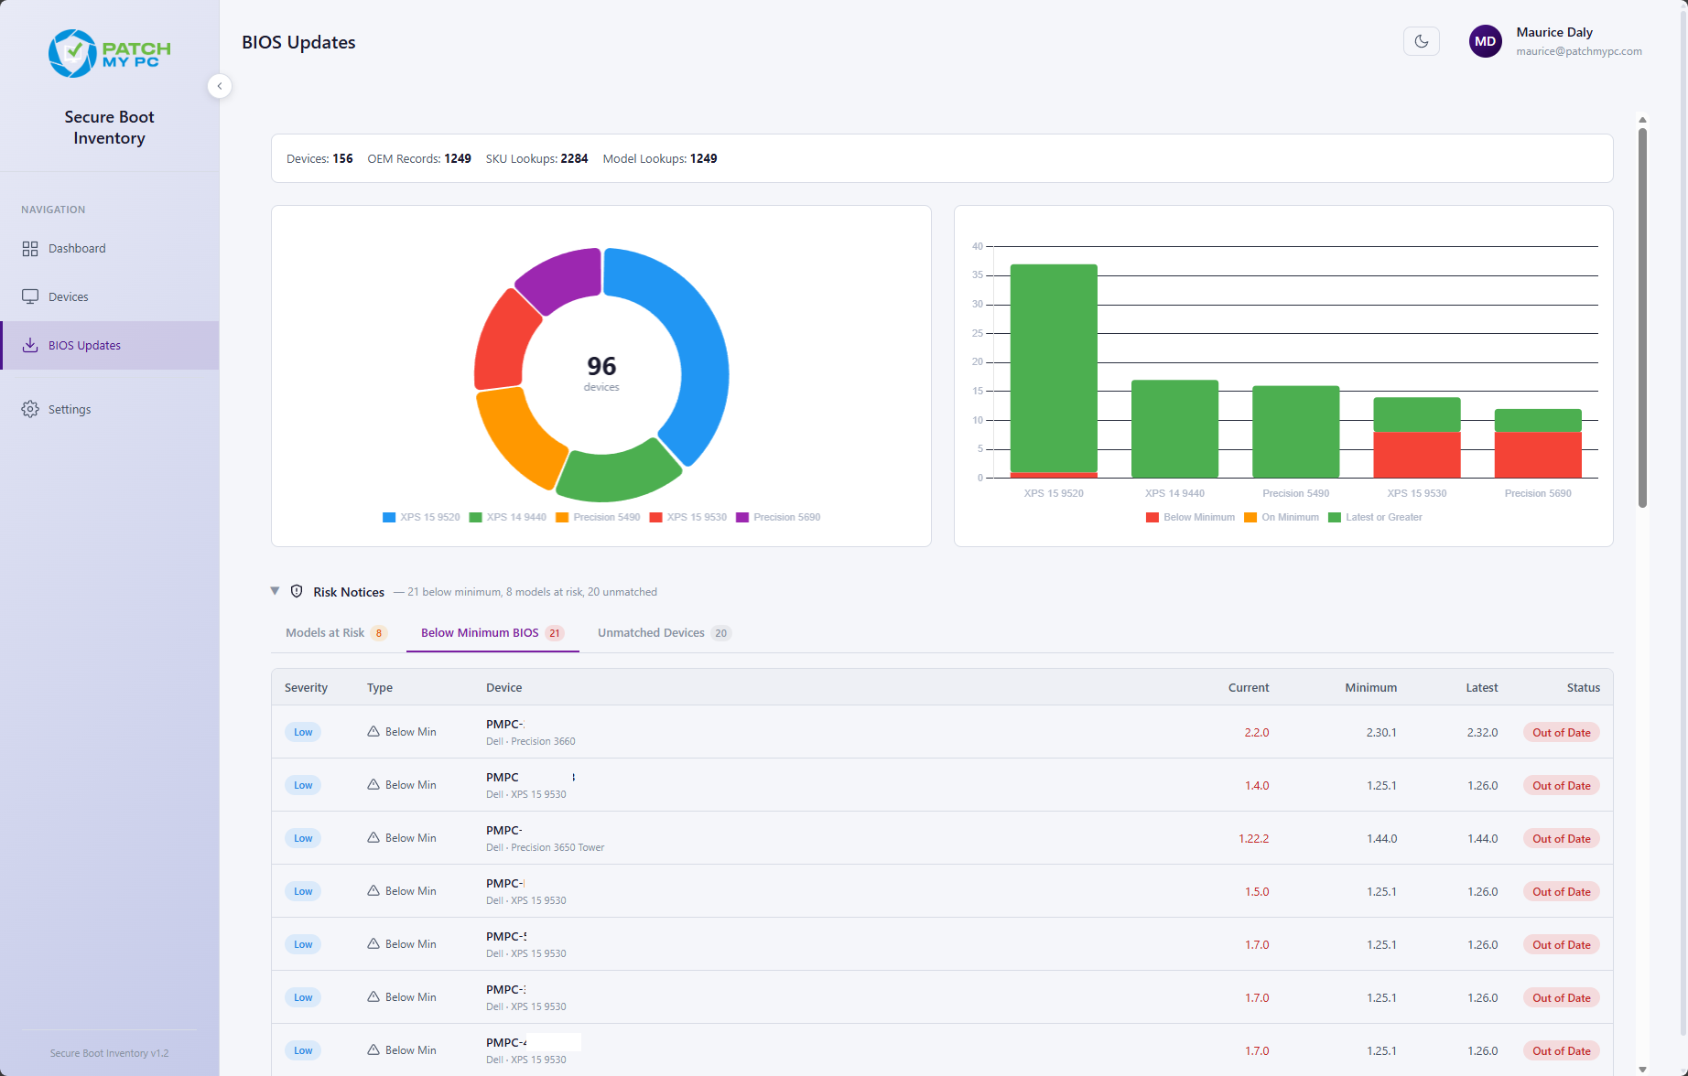
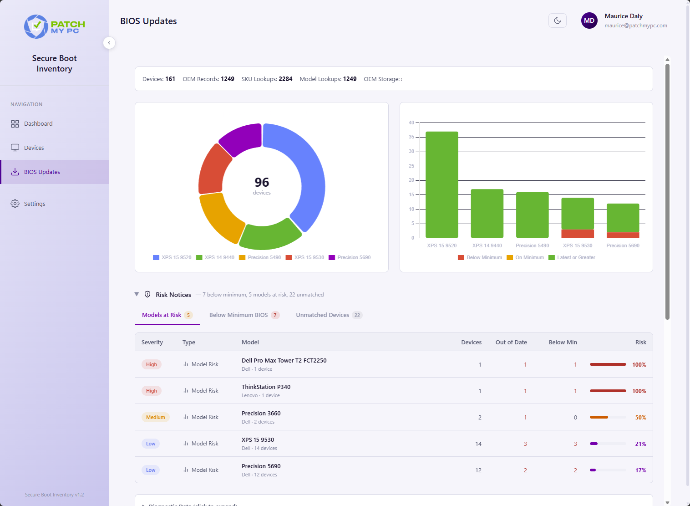
From script to dashboard to product
How its started…
Fun with..
Remediation scripts
Azure storage tables
Azure function apps
PowerShell web scrapers

Slide 39
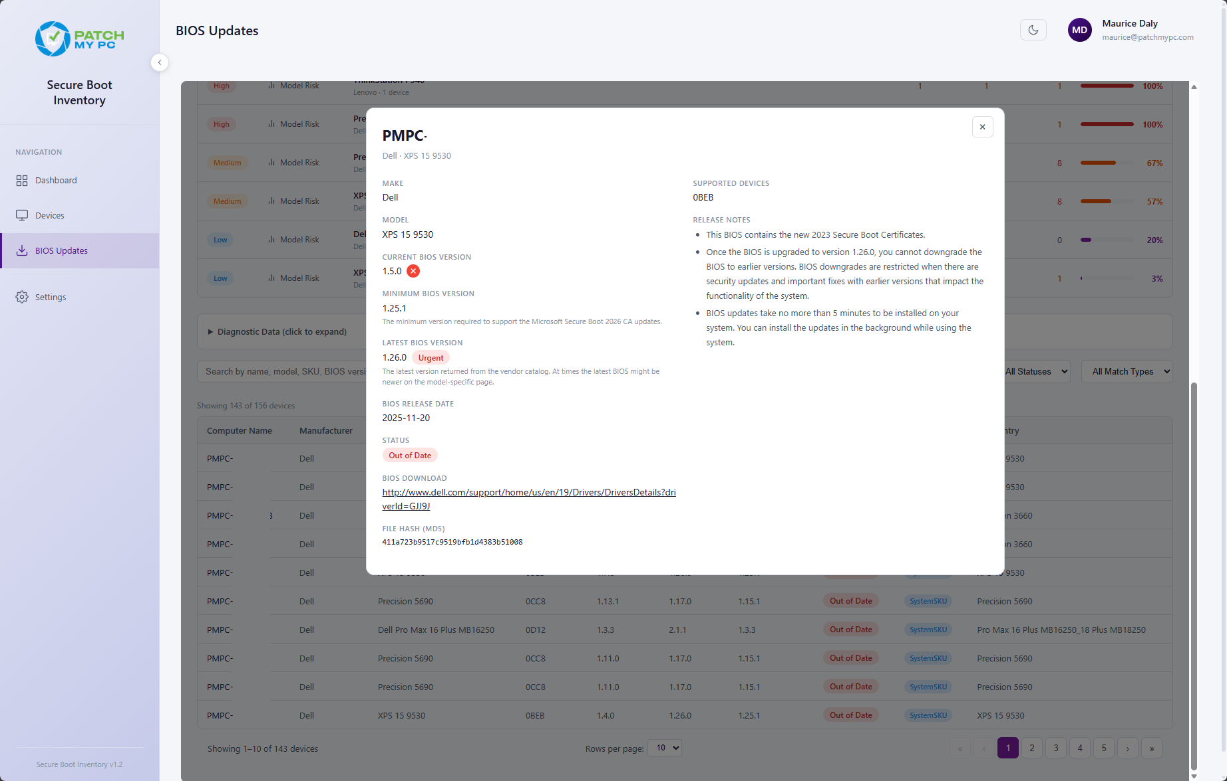
From script to dashboard to product
How its started…
Fun with..
Remediation scripts
Azure storage tables
Azure function apps
PowerShell web scrapers

Slide 40
From script to dashboard to product
How its going…
Maurice dashboard
Minimum Required Version
This is where things get interesting. Microsoft have a minimum required version, but often we see conflicting reports from the vendor as to their minimum version..
Who do we trust?
Typically the OEM

Slide 41
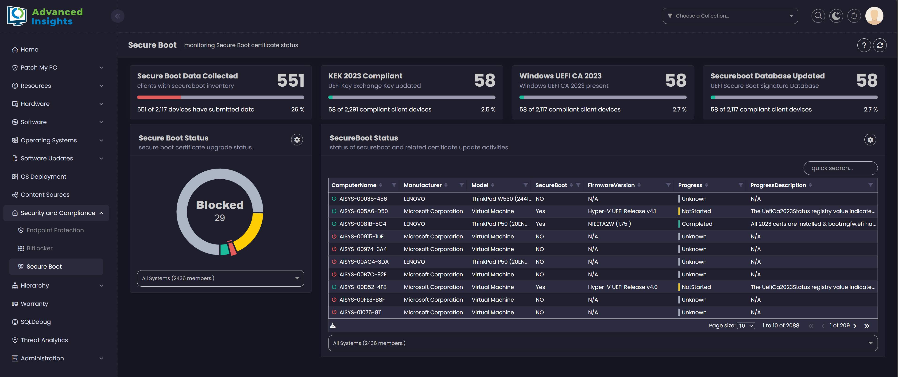
From script to dashboard to product
How its going…
Advanced Insights 2.5.5
Secure Boot report added!

Slide 42



Updating Firmware - OEM Solutions
How its going…
HP Connect
Dell Command Update
Lenovo System Update

Slide 43
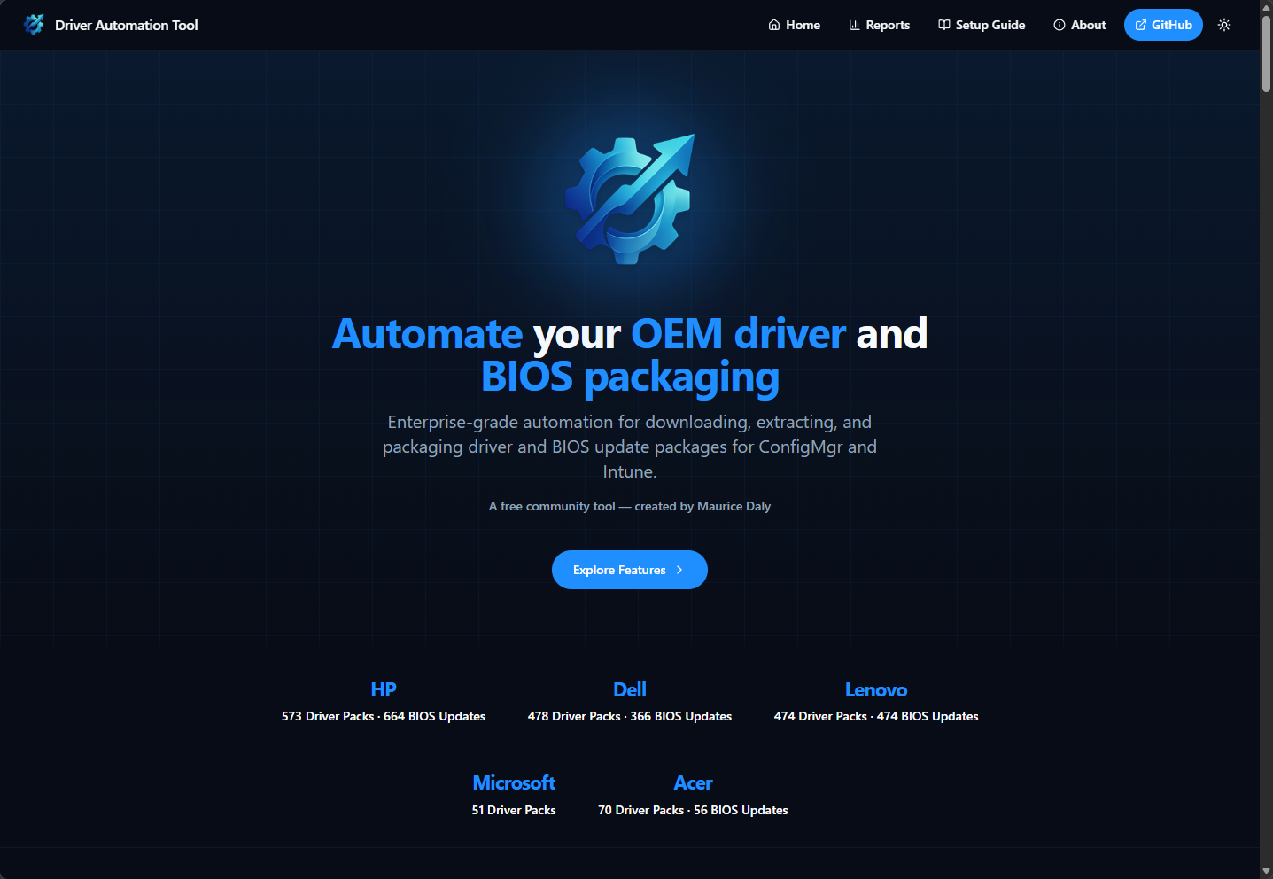
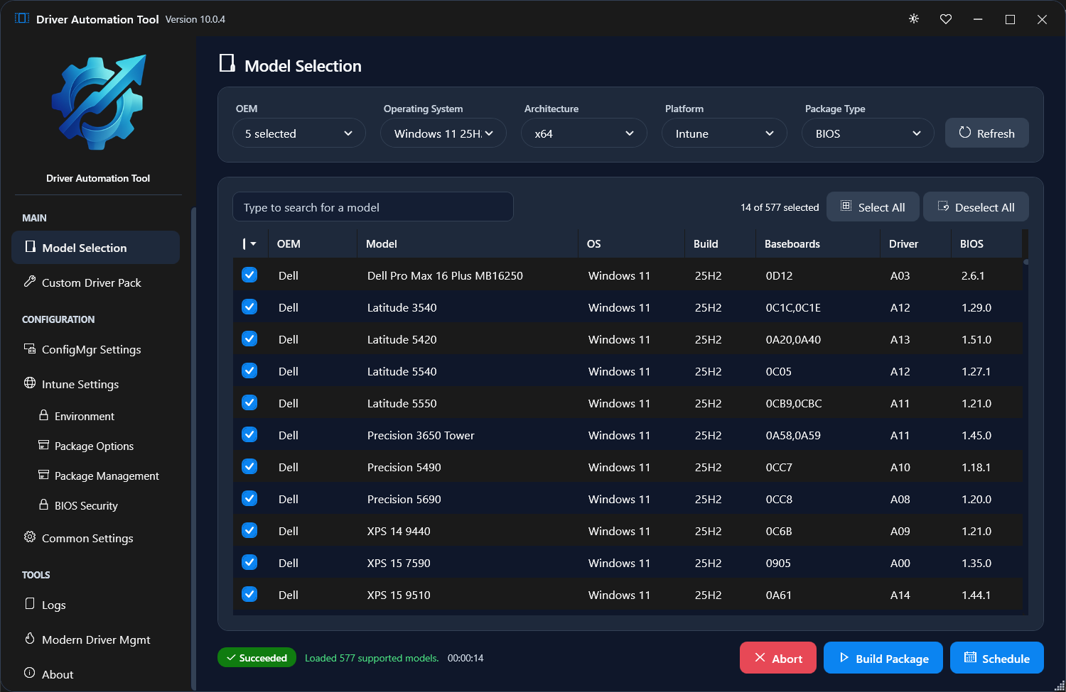
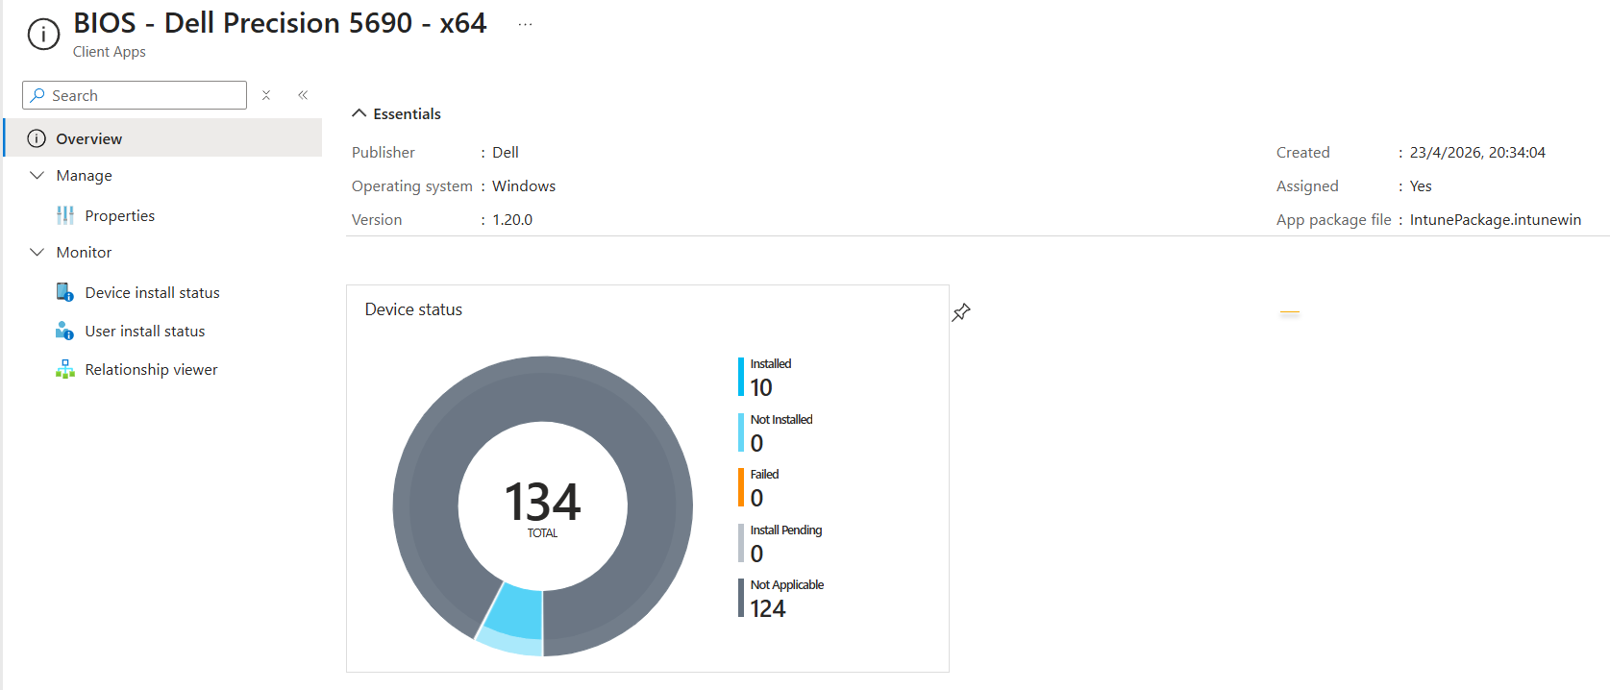
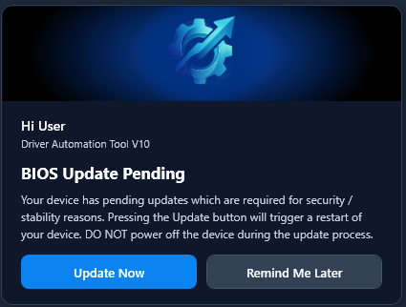
How we updated our firmware?
How its going…
https://www.driverautomationtool.com

