Slide 1


Intune Intermediate Certificate Expiration:
Which devices missed the renewal?

Slide 2



Speakers for today
Rudy
‘DLL’ Ooms
Michael Escamilla
Ben ‘Cheese’
Whitmore

Slide 3
Introduction
The Certificate Basics
Walking the Cert Chain
The Certificate and the 5th of May
OLD vs NEW Certificate Renewal Flow
Renewal Issues and Fixes

Slide 4
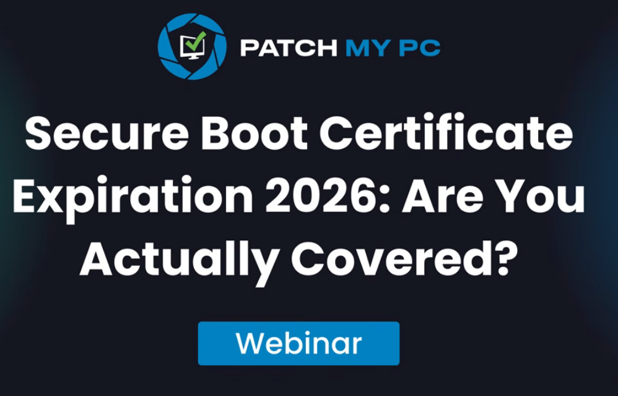
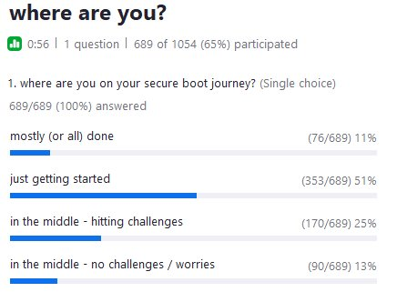
Secure Boot Webinar
Last month we talked about the Secure Boot Certificate that is going to expire…
If you missed it… you need to check it out!
Secure Boot Certificate Expiration 2026: Are you Actually Covered? | Patch My PC Webinar

Slide 5
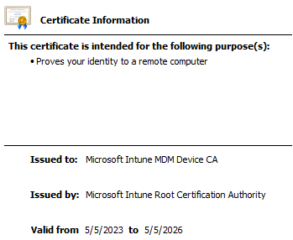
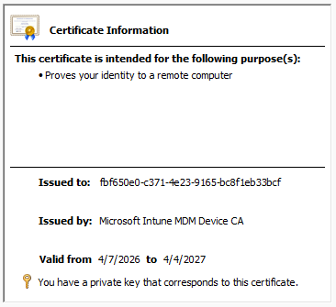
Another Certificate?
This time we are going to talk about some other Important certificates:
The Intune Leaf Certificate
The Intermediate Certificate
(Microsoft Intune MDM Device CA)
“Certificates Scare me”

Slide 6
The Certificate Basics

Slide 7
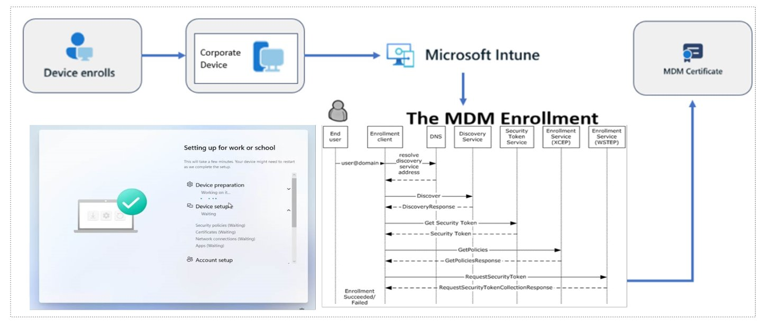
What is the Intune Device certificate?
04
The Intune Leaf Cert is Issued during the last step of the Intune/MDM enrollment (RequestSecurityToken → Base64 Encoded)
It also needs to be renewed each year Which should happen automatically….

Slide 8

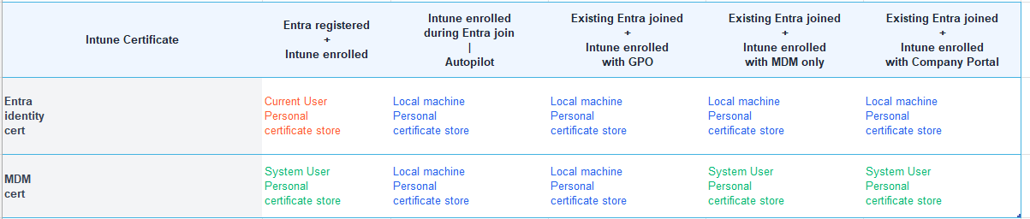
What is the Intune Device certificate?
It will be Stored in the local machine certificate store OR System user store…(PSEXEC) depending on the type of enrollment

Slide 9
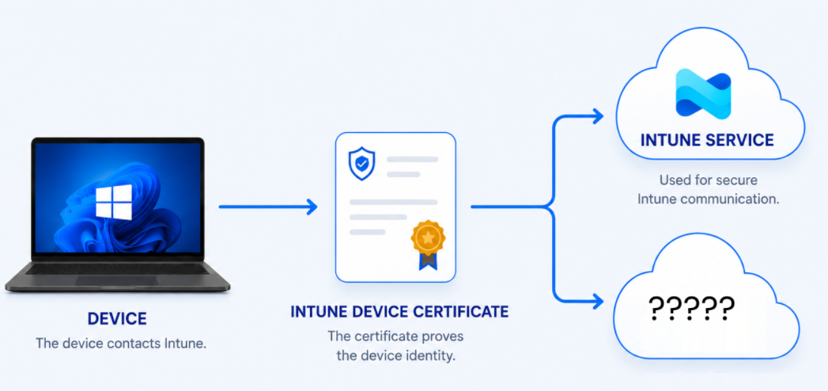
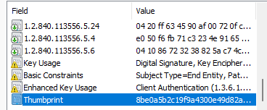
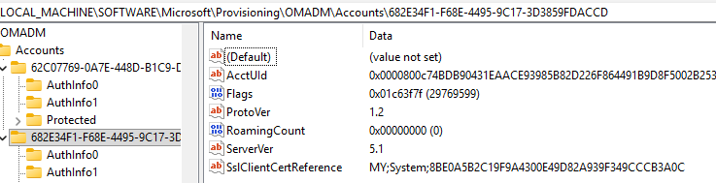
How the Intune Device Certificate is used (Policies)
The Intune Device Certificate (leaf certificate), is required to prove the device identity and establish a trusted connection with Intune.
Only after *establishing the secure connection and proving its identity, it can receive the Policies
No Valid Certificate = No Policies
Good to know is that: The OMA-DM Client AKA Windows Phoneprovider will try to find the right certificate to communicate with the service (using the sslclientcertreference)

Slide 10
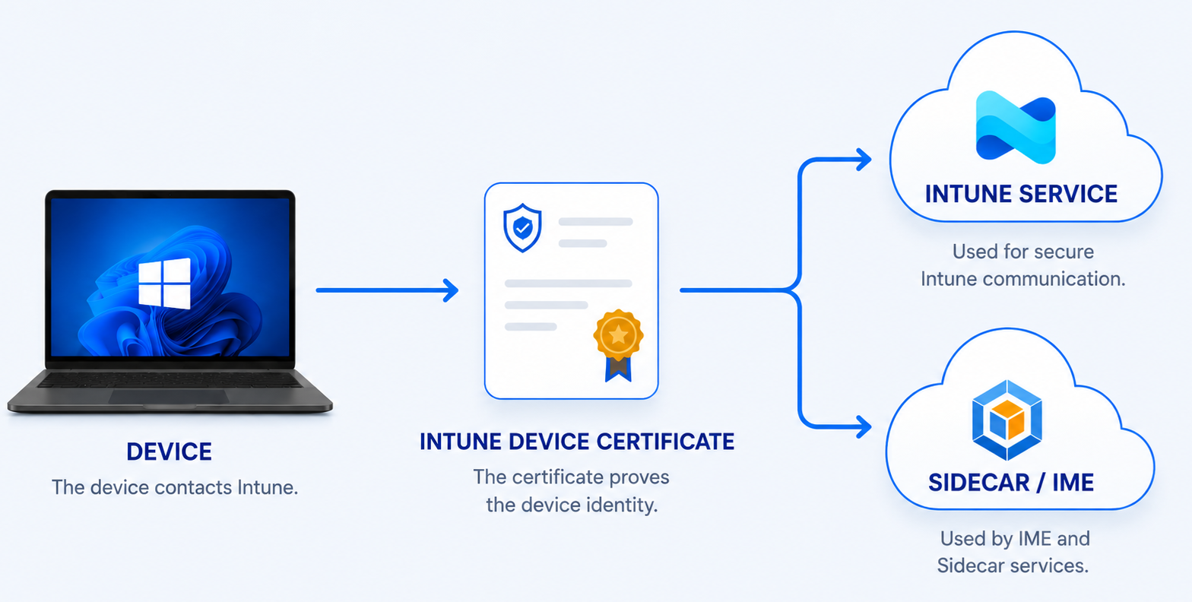

How the Intune Device Certificate is used (IME)
The Intune Device Leaf Certificate is also required when reaching out to the SideCar Service (IME) to get the latest Applications/PowerShell Scripts
No Valid Certificate = No App/Scripts
When the IME needs to contact the service, it adds the certificate to the web request.

Slide 11
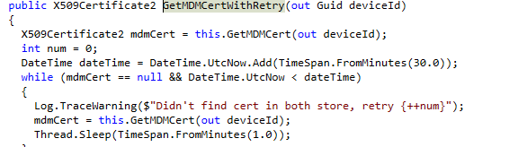
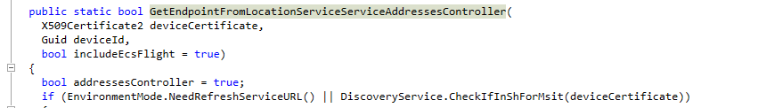
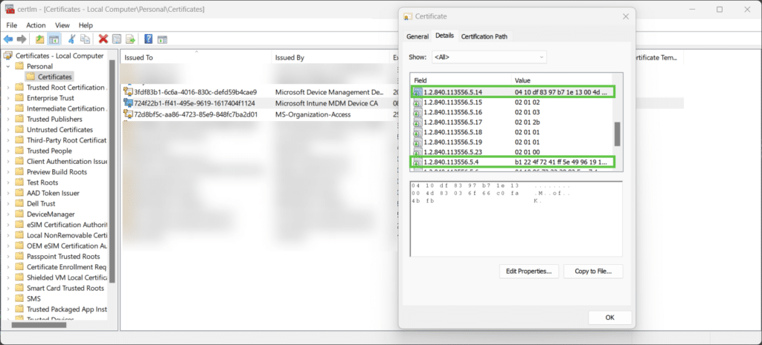
How the Certificate is used to find the ASU
Get Intune MDM device certificate LocalMachine My store
The Intune Management Extension (IME) also needs to find the right *ASU/Tenant to communicate with.
To find the ASU...It needs the Leaf Certificate. It will check the OIDs of this certificate, for the tenant information
Query Discovery Location
The OIDs contain
your tenant info
Querying Discovery Endpoint for your ASU
(based on Cert)
*ASU: Depending where you are based your tenant is in the closest Azure Scale unit

Slide 12
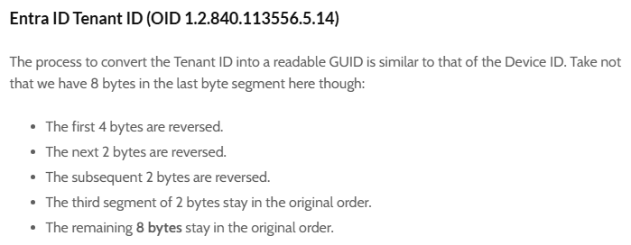
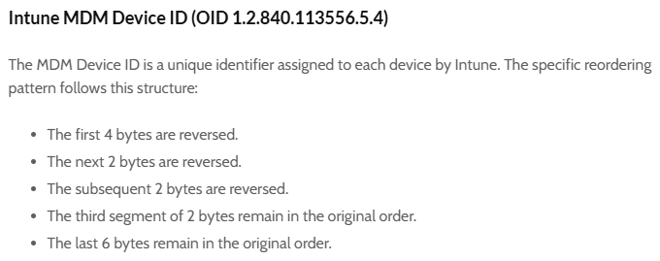
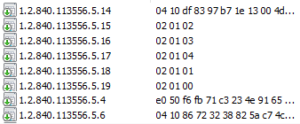
The Intune leaf Certificate and the OIDs (part 1)
The OIDs (object identifiers) they have a purpose
They contain the Intune and Entra tenant ids
(yes.. You have 2 tenants… not one!)

Slide 13


The Intune leaf Certificate and the OIDs (part 1)
With a simple PowerShell script you can decode these OIDs to something readable.
It’s a bit scrambled but you can put it back together
Unpacking the Microsoft Intune MDM and Entra ID Certificate - MSEndpointMgr

Slide 14
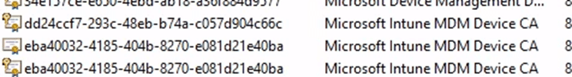
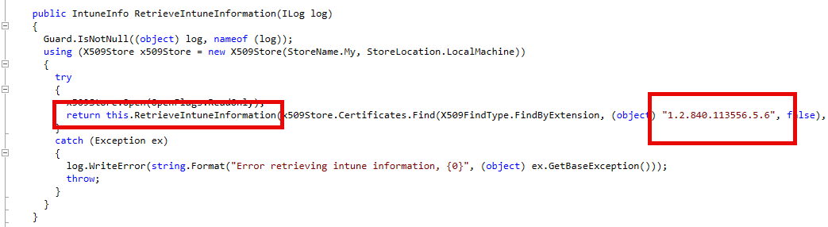
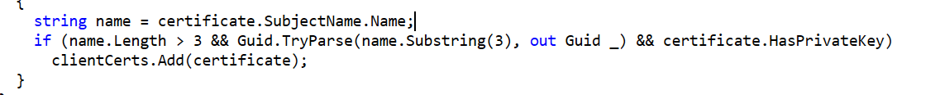
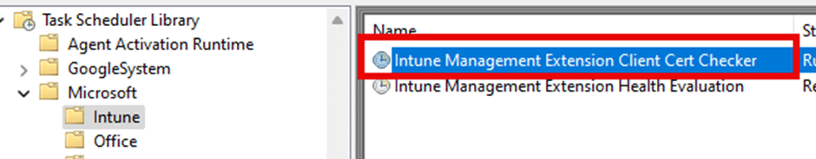
The Intune leaf Certificate and the OIDs (part 2)
Another OID (5.6) is used as well.
This OID ensures the “*right and working certificate" is used for IME communication...
This task sends the right certificate details (based on that 5.6 OID and if it has a private key) to the service, which then checks its validity.
*Only the Intune Leaf Certificate has this 5.6 OID

Slide 15
Walking the Cert Chain

Slide 16
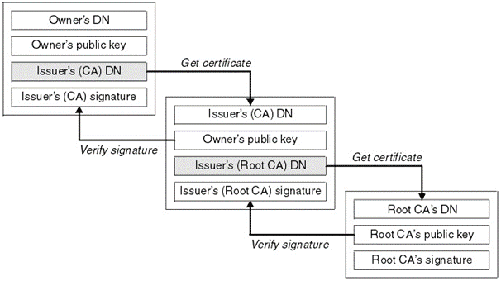
Why the certificate chain matters
A cert chain walk exists to answer one simple question:
Can I trust this certificate?
Windows starts with the certificate it received, then walks upward:​
At every step it checks:
is it expired
is it revoked
is the purpose allowed
is it signed by the next certificate
does it end in a trusted root
05

Slide 17
Why the certificate chain matters
🥛
Root CA
The Intune Certificate Chain
trust anchor
🧑‍🍳
The device certificate is the leaf certificate
The issuing intermediate CA signs the leaf
The root CA is the trust anchor
Windows and the service validate the complete path (walking the chain)
If something in the chain is not valid....
the trust will fail! 😭
Intermediate / Issuing CA
signs device certificates
🧀
Intune Device certificate
leaf certificate
Managed Windows device
presents the leaf
Intune services
The leaf certificate is only trusted because of the chain
Please Note: The Entra certificate (ms-org) is self-signed

Slide 18
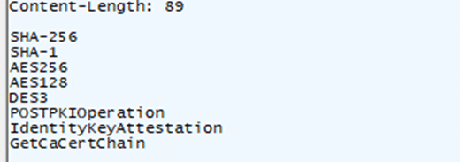
Why the certificate chain matters
Good to Know:
The Cert Chain Walk is also used in TPM attestation during Autopilot
If the intermediate cert needed to be renewed and msft didn’t do so… TPM Attestation would fail… because the cert chain walk failed

Slide 19

Why the certificate chain matters
Summary:
If the Intermediate Certificate needs to be renewed, the leaf needs to be renewed as well.
This means:
If the Microsoft Intune MDM Device CA needs to be replaced, the leaf 3d3ab (in this example) ALSO need to be renewed

Slide 20
The Certificate and the 5th of May

Slide 21
The Intune MDM Device CA expired
The Intune Intermediate CA changed on May 5 (was valid for 3 years)
The device leaf certificate needed to renew to follow that chain.
This means ALL… Yes ALL.. Intune enrolled Devices worldwide needed to renew it…
A small subset could have missed this renewal…. while still looking healthy
Most devices renewed. Some maybe didn’t?.

Slide 22
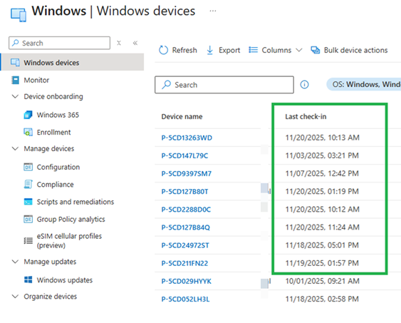
What happens when it expires?
Normally, When the leaf certificate expires there is NO device management communication possible anymore.
The funny thing: In practice, the portal will still show recent activity (Last Check-in)
Which is weird???

Slide 23
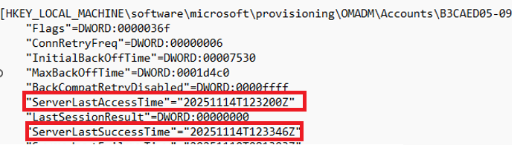
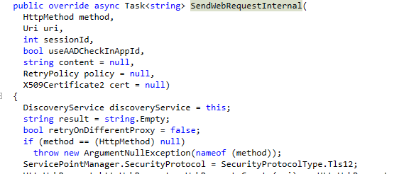
Where the Last check in timestamp comes from
When the device starts the sync, the OMADM account information is loaded (registry)
From there on the OMA-DM session can “say hi” to the service and receive a server response (ACK)...
With it, the server Last Access time will be updated on the device….
There is no real expired cert check on the client-side (OMA-DM)

Slide 24

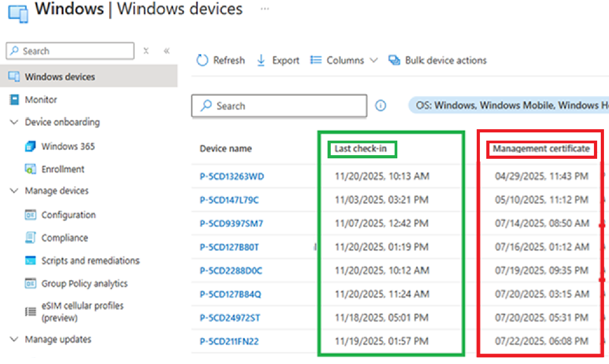
Why Last check in can mislead you
Add this column (not shown by default)
The device can still reach the service far enough to update timestamps (last checkin)
(even when the certificate is expired)
But…..The real device management (Policies/Apps/Scripts) will fail!
Last check in shows activity, even while the certificate could be expired for months

Slide 25
OLD vs NEW Renewal

Slide 26
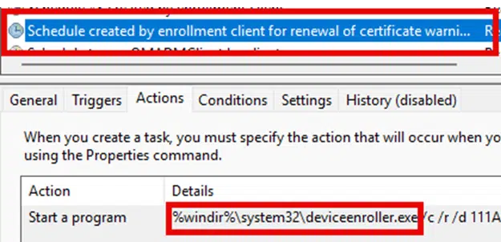


How Cert Renewal worked in the past (part 1)
Back in the day… A dedicated scheduled task was responsible for the cert renewal
The Renewal automatically started inside the renewal window (41 days)
ONLY If the device is eligible (is in renewal period)
It uses the deviceenroller to renew the cert
Please Note: Playing around (I tried) with these keys doesn’t make the device eligible…there is also the timestamp on the certificate itself…

Slide 27

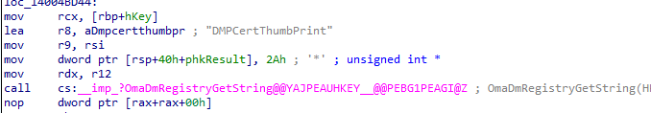
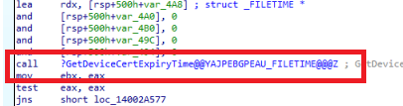
How renewal normally worked (part 2)
When the device was eligible it would silently (ROBO) send a renewal request with the OLD certificate attached, to the service.
From there the service checks the Device Cert Expiry Time and issues a new Certificate if its indeed eligible.
ROBO = Renew On Behalf Off

Slide 28
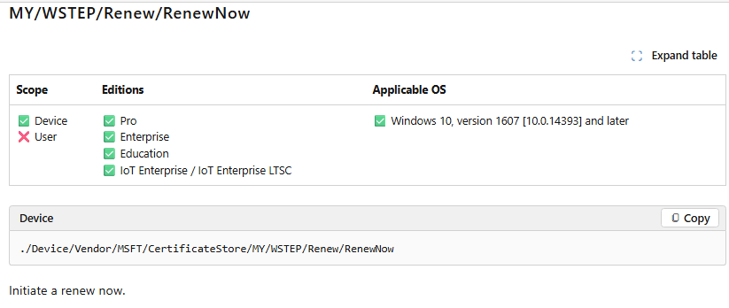
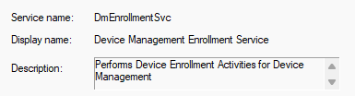
What seems to have changed with the renewal flow?
From local PULL to enrollment service guided PUSH renewal?
Old Pull model: Device initiated renewal using local timing and a scheduled task
New Push model: The enrollmentservice “guides” when renewal is needed
When a device is checking in, the service can determine if the certificate was up for renewal (eligible)
If its eligible, it will send out a RenewNow CSP to the device.
The device responds to renewal request and starts renewing the certificate using the DMEnrollmentService

Slide 29
Renewal Issues and Fixes

Slide 30

Why some devices miss renewal
Most renew automatically. The exceptions are what matter.
Stale or incorrect UPN in enrollment state
Third party KSP issues
Private key missing or inaccessible
Proxy or network behavior blocking the renewal path (don’t enable ssl inspection)

Slide 31
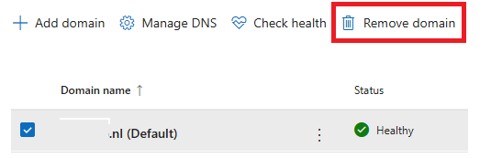
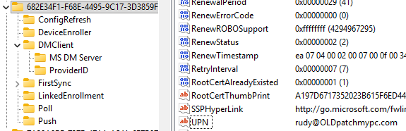
FAILURE 1 : stale UPN in enrollment state
During the FIRST Intune enrollment the UPN is set to the enrolling user
If A domain rename or merger occurred and they removed the domain…
Prepare for fun if you didn’t re-enrolled all of your devices
Even if the users will get a new domain name / upn it does NOT up date the UPN on the device!

Slide 32
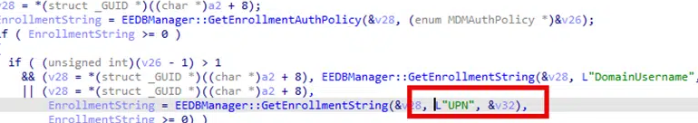
FAILURE 1 : stale UPN in enrollment state
The user changed, but the enrollment record did not
When the Intune Certificate needs renewal… it will still use that same stale UPN to kick off the renewal
If you removed that domain as accepted domain
The service then validates the wrong user identity
Guess what happens….
The Service will not recognize the user

Slide 33
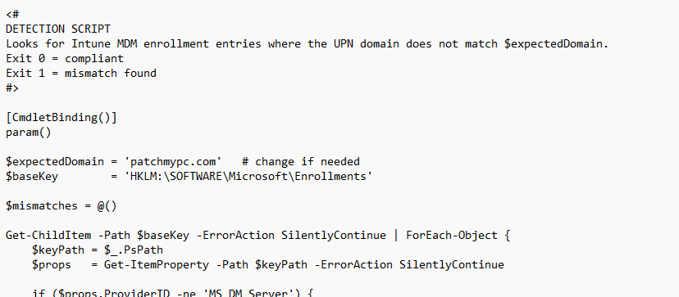


FAILURE 1 : How to fix the UPN issue
You may want to fix this issue *BEFORE the cert expires:
REMEDIATION SCRIPTS
CHECK HKLM\SOFTWARE\Microsoft\Enrollments\{EnrollmentID}\UPN
COMPARE it with the current Entra ID user UPN
Check whether the old domain still exists
FUN FACT:
Renewal will be attempted after the UPN is valid..
Even when the Certificate is expired!!!
https://patchmypc.com/app/uploads/2025/11/detection.txt
https://patchmypc.com/app/uploads/2025/11/remediation.txt
*The IME can’t communicate with the service if the cert has expired. But we need to deploy the remediation to fix this issue

Slide 34

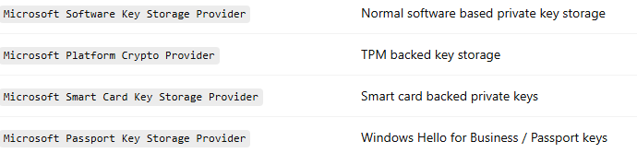
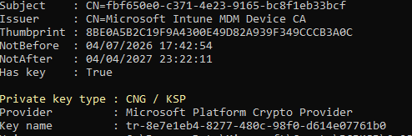
FAILURE PATH 2 : The KSP problem
Let’s explain what a KSP first…
KSP: A Key Storage Provider is the Windows component that creates, stores, protects, and uses the private keys linked to certificates.
The Intune Leaf Certificate private key is protected by the Microsoft Platform Crypto Provider (TPM)
KSP EXAMPLES:

Slide 35
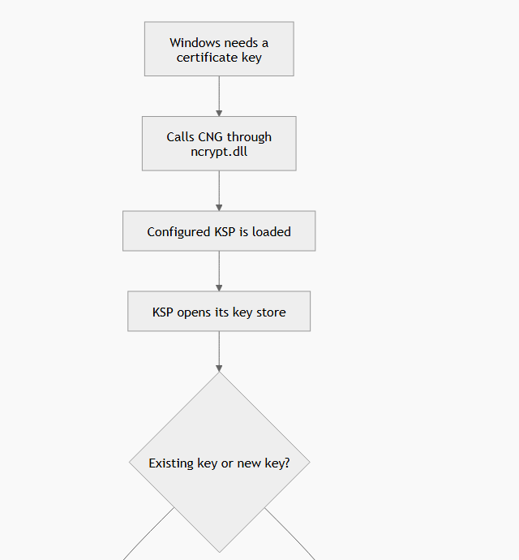

FAILURE PATH 2 : The KSP problem
The first step in the certificate renewal flows is loading the KSPs and to check which KSP is protecting the private key of the Intune Certificate
But….The Renewal flow initiated ALL installed KSPs on the device…. ALL… NOT only the TPM/Software KSP
(which are the ones that would normally be used)

Slide 36
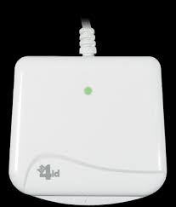
What Caused the KSP issue
Some systems had a third party smart card KSP
Certificate Renewal
KSP A
KSP B
Third party KSP
(Bit4ID)
When that Bit4ID ksp was installed, the full certificate renewal Crashed the moment it needed to initiate the KSP
With it the certificate renewal failed, without information or any logs
Renewal stops
before real renewal
Old flow could get blocked by a provider that was not even the Intune key.

Slide 37
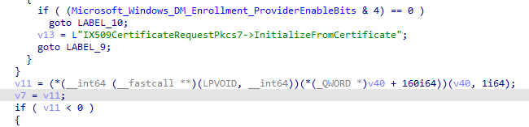
What changed in newer KSP handling
Luckily MSFT managed to fix this bug before the global certificate renewal needed to happen!!
The newer Certificate Renewal flow now limits the certificate request path (bypass 3rd party)
It now only focuses on the Key Storage provider tied to the Intune certificate
With it the Certificate can be successfully renewed

Slide 38
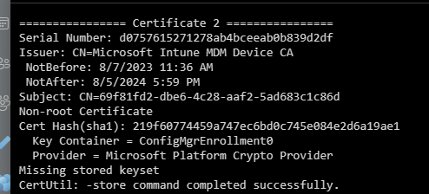
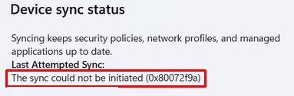
FAILURE PATH 3 : private key issues
The MDM certificate must have a usable private key
If it doesn’t have a private key attached
(Example: You wiped the TPM or Replaced Mobo)
it will fail to communicate with the server/service (0x80072f9a) with it no cert renewal will happen!

Slide 39
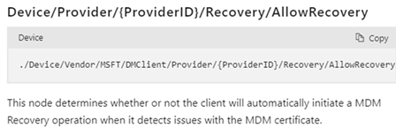

AllowRecovery: the safety net
The *AllowRecovery will allow an MDM renewal
It requires the TPM private key to perform the recovery…
(it needs to prove the device it’s the same device)
If you delete the Certificate itself…. It will be brought back to life when you sync the device
Which was useful with the HP OneAgent issue…… as long as it didn’t deleted the Entra MS-ORG Certificate
It is a recovery path, not the standard renewal path… but it can fix almost ANY issue with the Intune Certificate
*IsRecoveryAllowed = 1 is now set by default on all devices

Slide 40
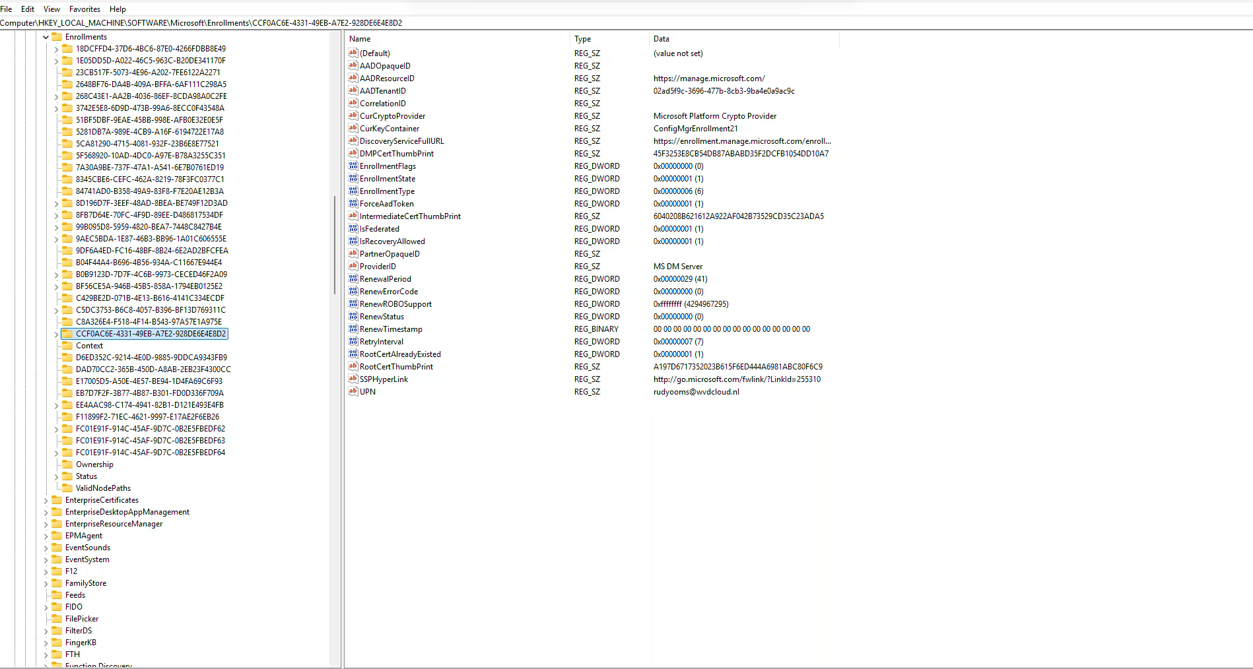
AllowRecovery: Demo

Slide 41
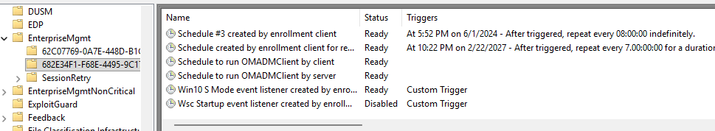
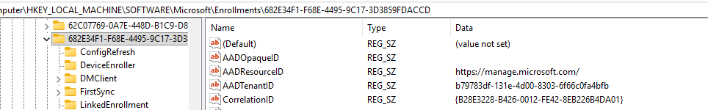
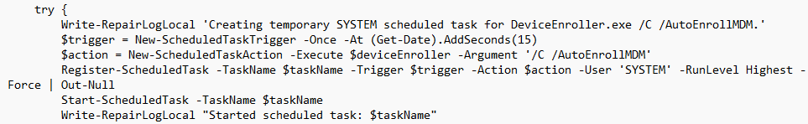
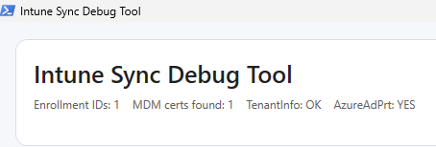
Hard Recovery
When the Easy option doesn’t work:
-Remove All scheduled tasks
-Remove All lingering registry keys
-Check for lingering certs
-kick off the deviceenroller
This will ensure the device will get re-enrolled with Intune..
If the device has a valid PRT of course…
Or run a *PowerShell script to do so
*Intune-Sync-Debug-Tool-V2: Intune Sync Debug Tool V2

Slide 42
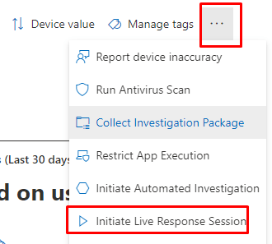


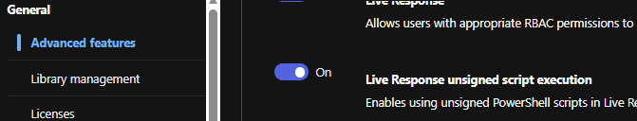

Recovery
But what if the device lost his management channel?
With the Intune Certificate NOT trusted, deploying a remediation / PowerShell script is not going to work!
You need a backup plan →
A second management Channel
With MDE you can use live response to make changes (deploy a script) to a device even when the device lost communication with Intune

Slide 43

Conclusion and Key take away
Check if the Management Certificate is showing an up-to-date timestamp
Microsoft started forcing the renewal of this intermediate (and leaf) before the 05/05/26
And… Don’t trust the last check-in

