Slide 1
Intune Management Extension
Deep Dive
with the Patch My PC team

Slide 2
Agenda
What is the IME?
How is the IME installed?
How does the IME process app policy?
How does the IME process scripts?
Digging into win32app policy event state messages
Try again, how the IME handles failures and retries
Invoke IME actions remotely like a boss
Inventory
Q&A

Slide 3
What is the IME?

Slide 4
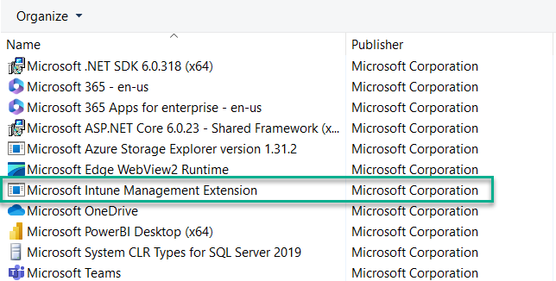
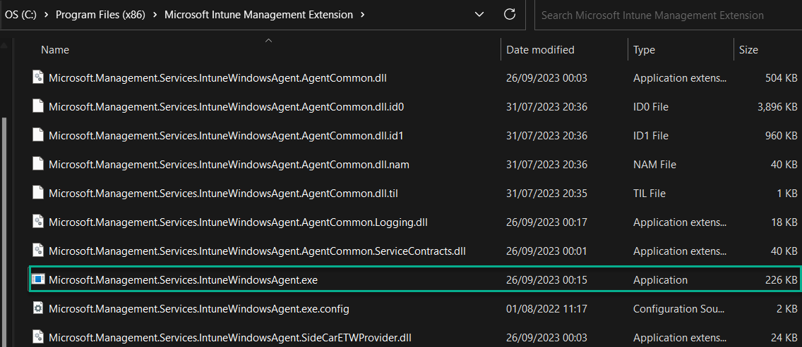
What is the IME?
A component installed in Windows, by Intune and leveraged by Intune
Mainly used to deploy and execute PowerShell scripts or Win32 applications on Windows devices that are enrolled in Intune

Slide 5
What is the IME?
Where does the IME sit in the Microsoft RMM agent stack?
ConfigMgr Client (MSI)
ConfigMgr Apps, Policy, Scripts
Intune (Win32 / MSStore / WinGet) apps, Scripts, Custom Compliance Policies
IME (MSI)
Windows MDM Agent (Built in to the OS)
Intune Config, Apps (LOB)

Slide 6
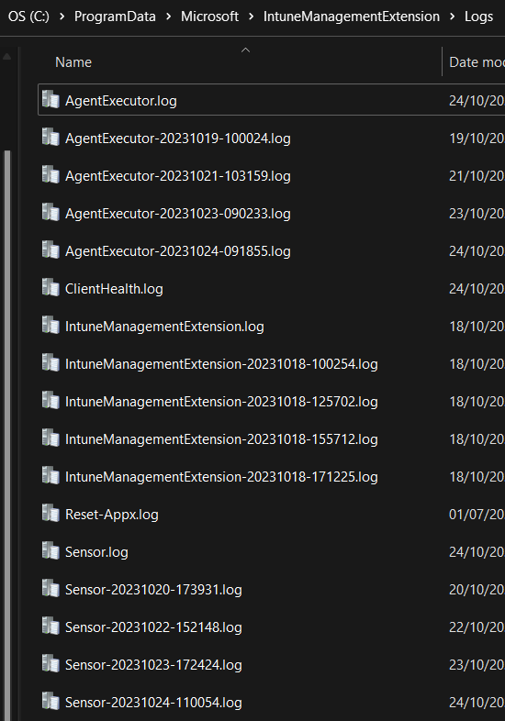
What is the IME?
IntuneManagementExtension.log
Contains information about the activities and processes related to the execution of scripts and installation of apps deployed through Microsoft Intune. It provides insights into how the IME is functioning on the device and can be useful for troubleshooting and monitoring purposes
AgentExecutor.log
Contains information about the execution of scripts deployed through Microsoft Intune
HealthScripts.log
Contains information about proactive remediation scripts deployed through Microsoft Intune
ClientHealth.log
Contains client health activities for the IME (Check service is running, send agent status reports to Intune)
C:\ProgramData\Microsoft\IntuneManagementExtension\Logs

Slide 7
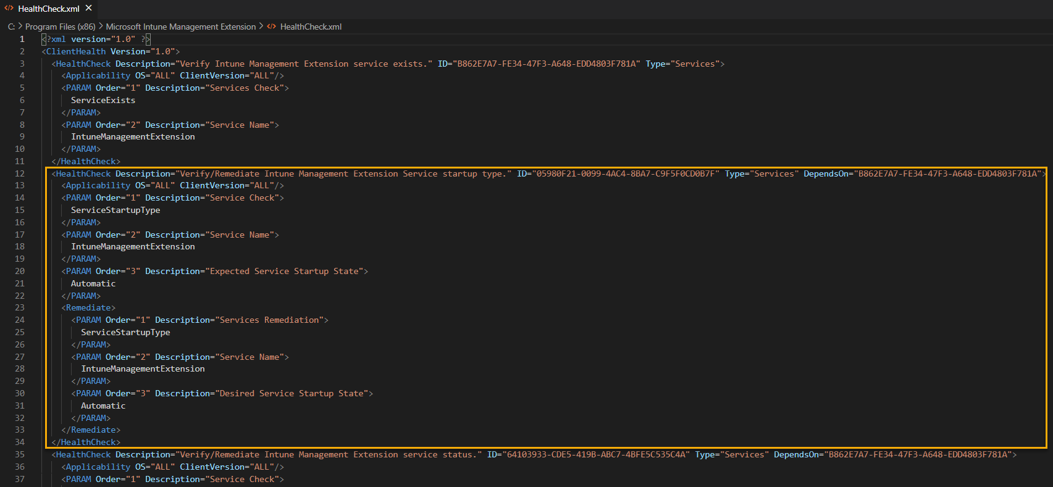
What is the IME?
Clienthealth.log
"C:\Program Files (x86)\Microsoft Intune Management Extension\HealthCheck.xml"

Slide 8
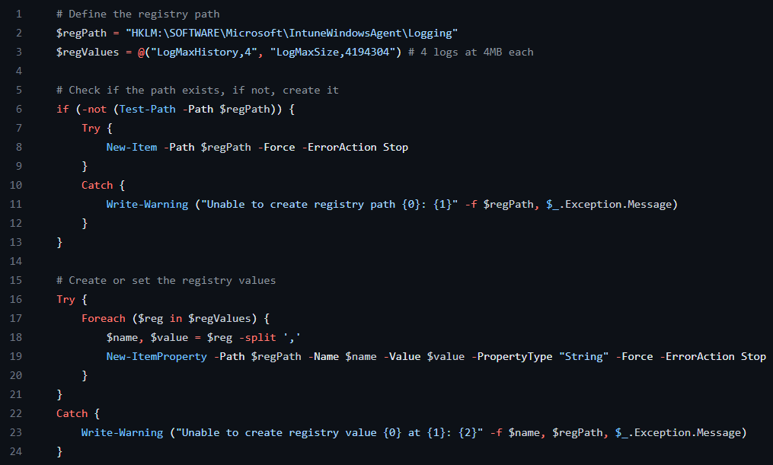
What is the IME?
Logs rolling over? No problem

Slide 9
How is the IME installed?

Slide 10
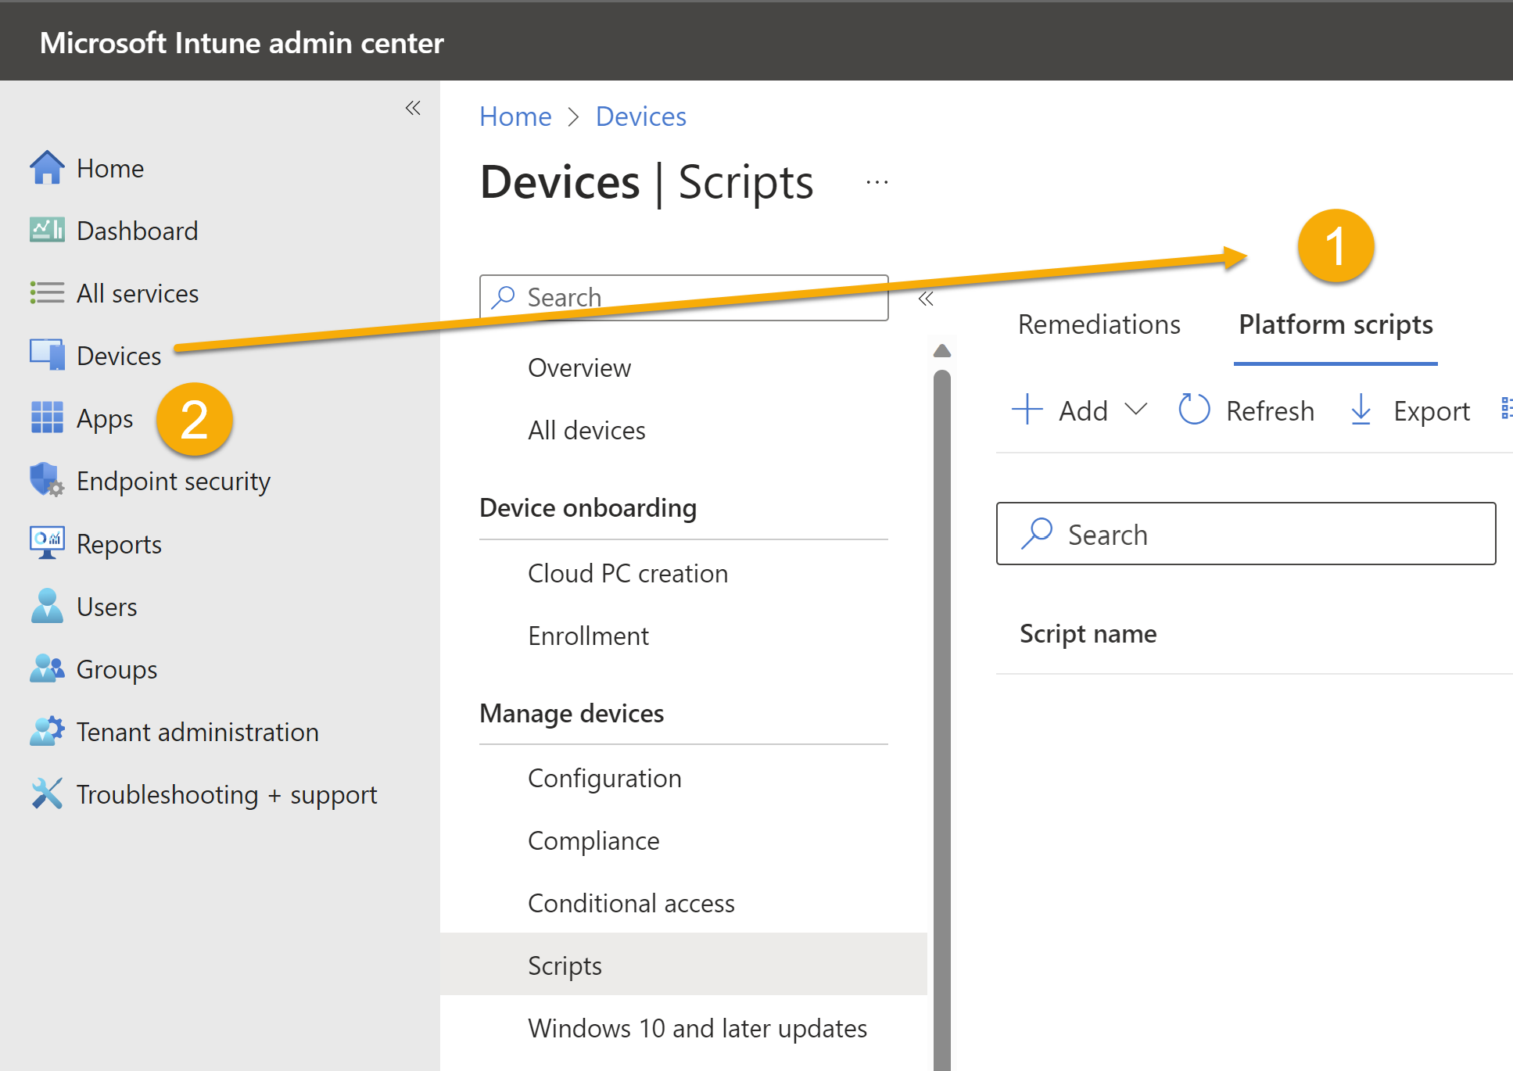
How is the IME installed?
The IME is installed when a managed device is targeted with either a:-
PowerShell Script or Proactive Remediation
Win32 app or Microsoft Store app
(New) Custom compliance settings

Slide 11
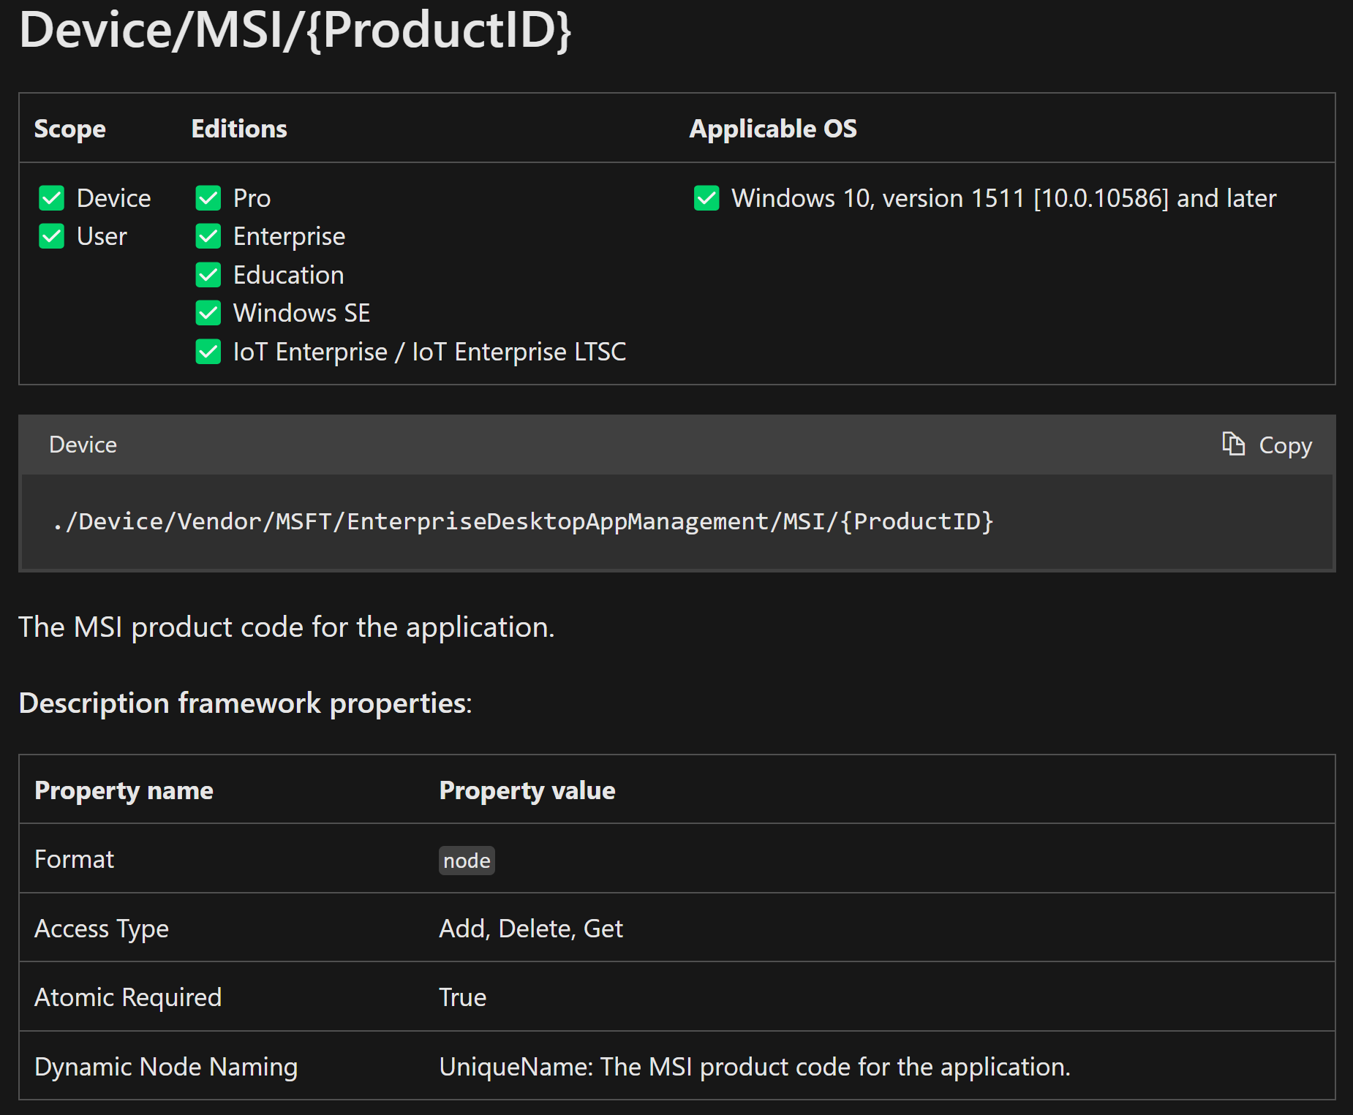
How is the IME installed?
The IME is installed, from an MSI, via the OMA-DM channel using the:-
EnterpriseDesktopAppManagement Configuration Service Provider (CSP)
This CSP is used to handle enterprise desktop application management tasks, such as querying installed enterprise applications, installing applications, or removing applications.
https://learn.microsoft.com/en-us/windows/client-management/mdm/enterprisedesktopappmanagement-csp

Slide 12
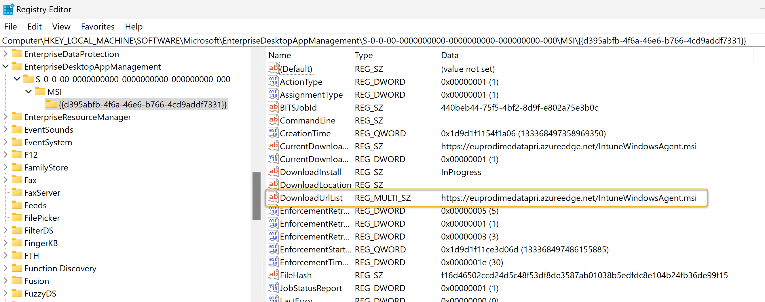
How is the IME installed?
You can track the install via the local registry
HKEY_LOCAL_MACHINE\SOFTWARE\Microsoft\EnterpriseDesktopAppManagement\ S-0-0-00-0000000000-0000000000-000000000-000\MSI
New versions are rolled out automatically
Snapshots are a curse
https://euprodimedatasec.azureedge.net/IntuneWindowsAgent.msi

Slide 13
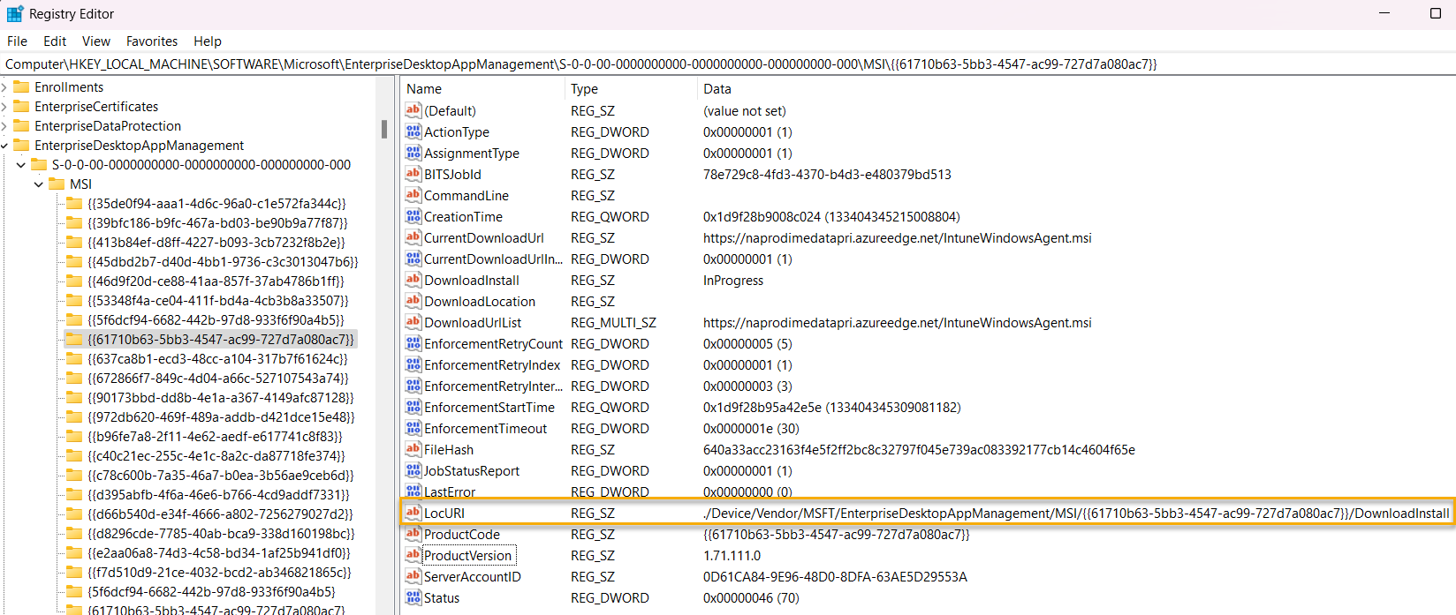
How is the IME installed?

Slide 14
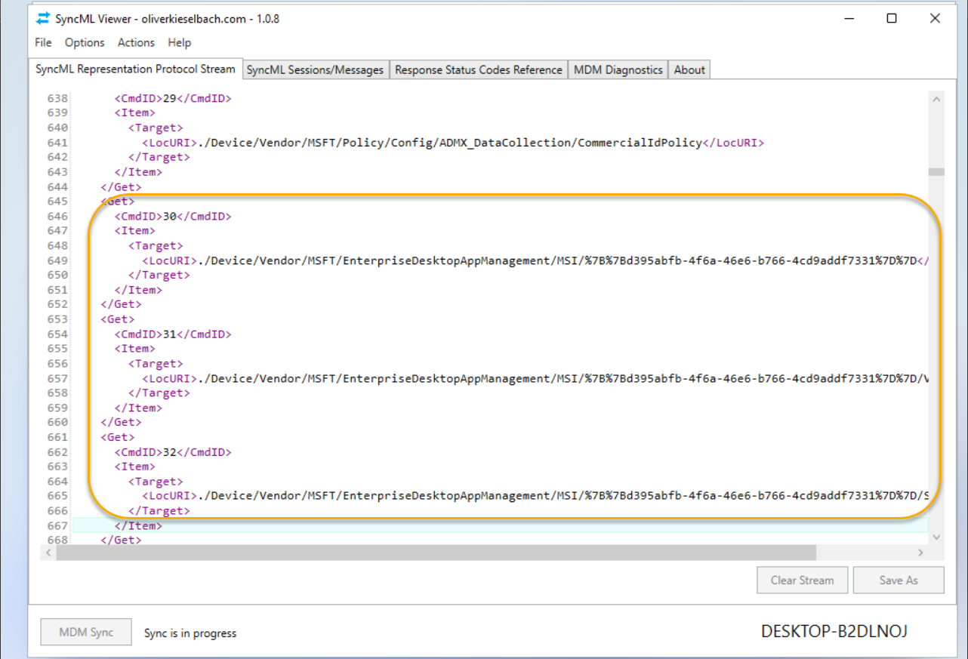
How is the IME installed?
View the SyncML message where OMA-DM initiates the MSI install for the IME
https://github.com/okieselbach/SyncMLViewer

Slide 15
How is the IME installed?
LAB Time
BW-W11-5
Snapshot: PreAADJoin Shift F10 during OOBE and install SyncML/View Registry
https://github.com/okieselbach/SyncMLViewer/blob/master/SyncMLViewer/dist/SyncMLViewer-v108.zip

Slide 16
How does the IME process app policy?

Slide 17
How does the IME process app policy?
Policy is deployed
Policy reaches the device
Dependencies checked
Detection rule checked
Applicability and requirements checked

Slide 18
How does the IME process app policy?
IME begins content download (content phase 1)
IME validate the package and decrypts content (content phase 2)
Content cleaned up and moved (content phase 3)
App install begins (Detection run again)
App install continues

Slide 19
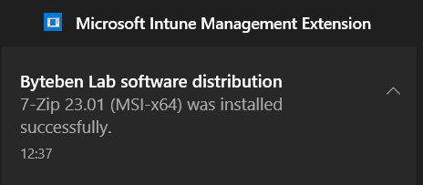
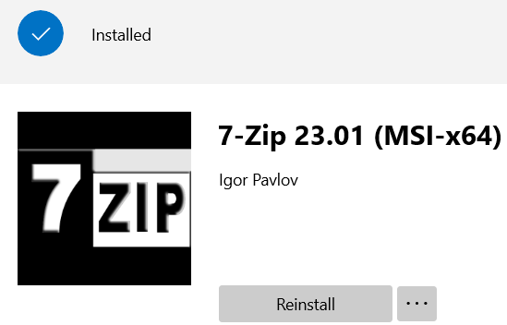
How does the IME process app policy?
Reboot Manager checks exit code for reboot requirement and content cleaned up
Detection reevaluated
Compliance state set in registry and sent to the Intune service
Toast Success or Company Portal update
Drink Coffee

Slide 20
How does the IME process scripts?

Slide 21
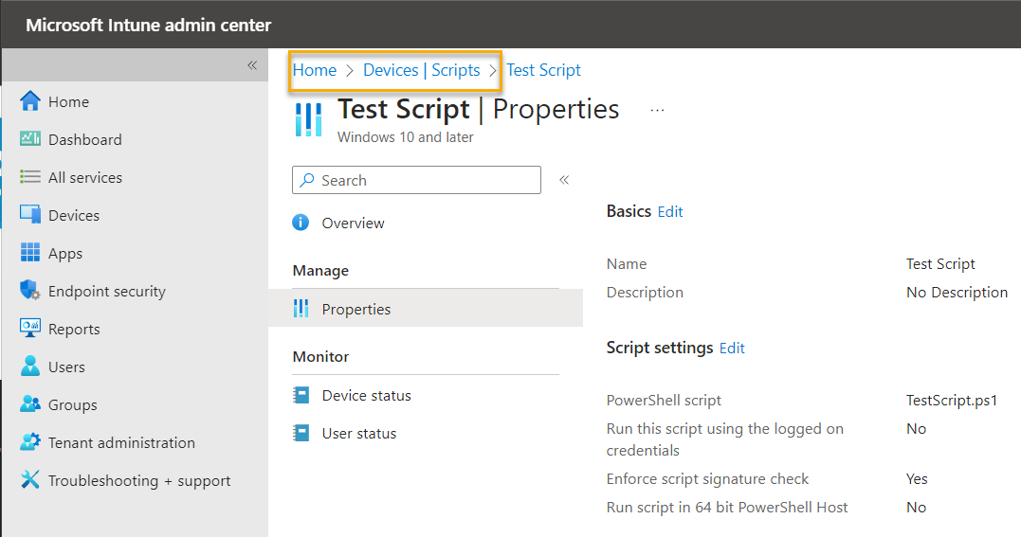
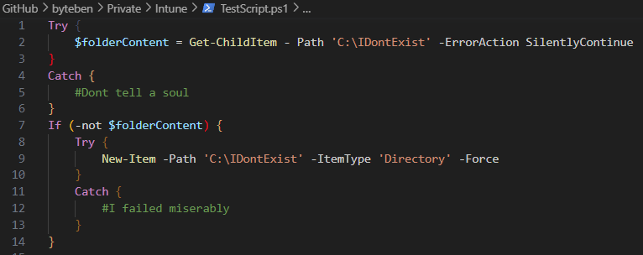
How does the IME process Scripts?
Simple Platform Script Deployed From Intune

Slide 22
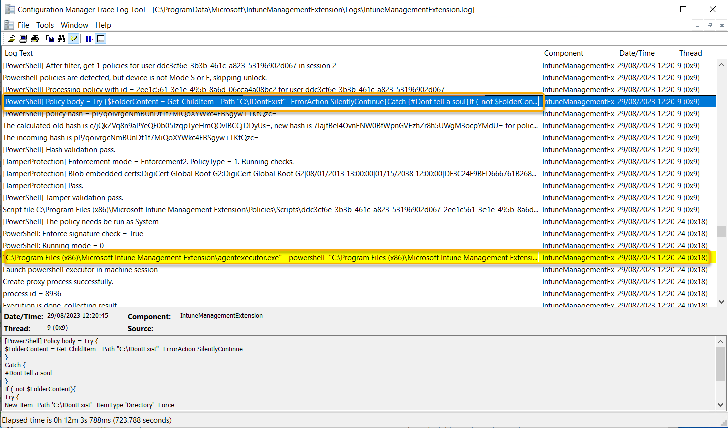
How does the IME process scripts?

Slide 23
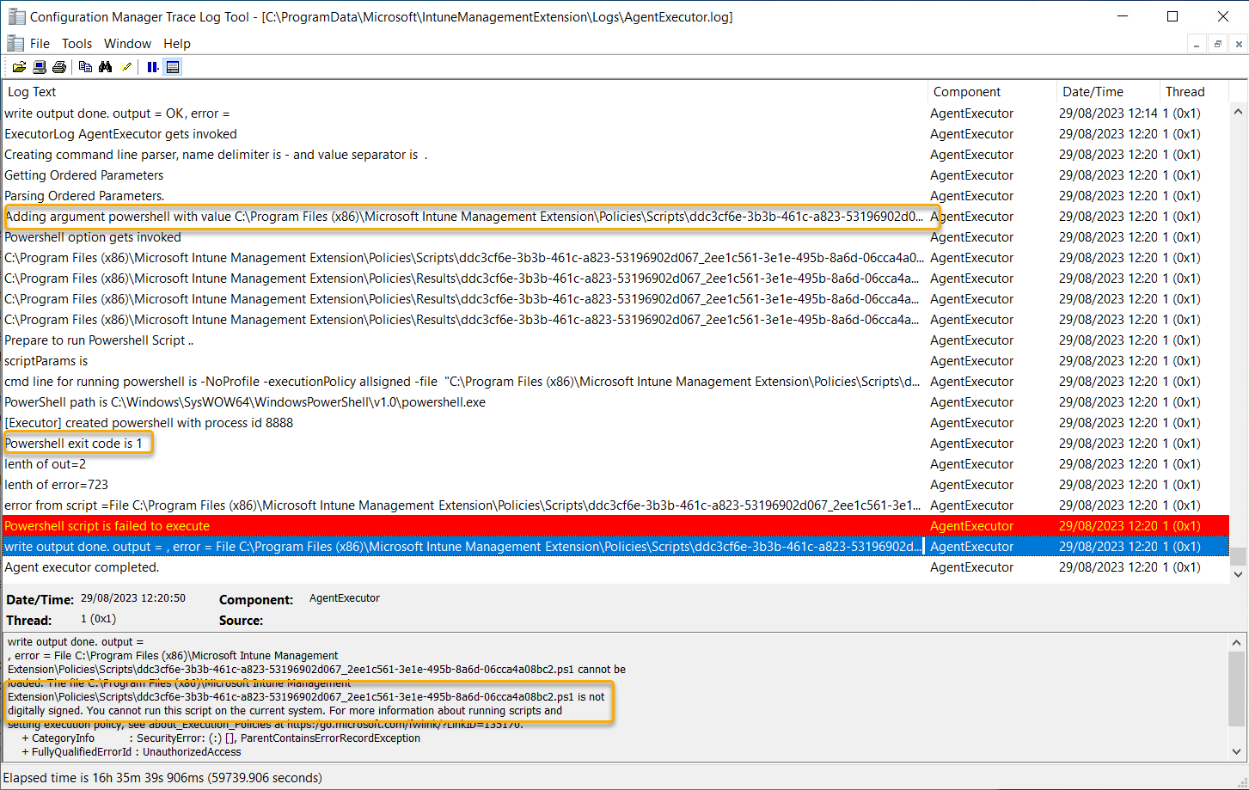
How does the IME process scripts?

Slide 24
How does the IME process scripts?
Enforce script signature is now enabled by default

Slide 25
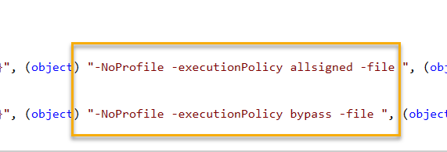
How does the IME process scripts?
Agent Executor
Invokes PowerShell to run scripts and sets the PowerShell policy to allsigned/bypass as necessary

Slide 26
Digging into Win32 app policy state messages

Slide 27
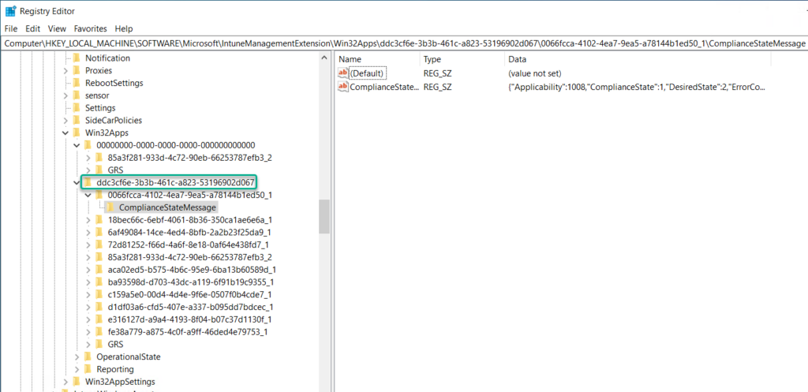
Digging into win32 app policy event state messages
Win32 app policy events are stored in the registry
Apps deployed to the device
Apps deployed to the User (EntraID Object GUID)
HLKM:SOFTWARE\Microsoft\IntuneManagementExtension\Win32Apps

Slide 28
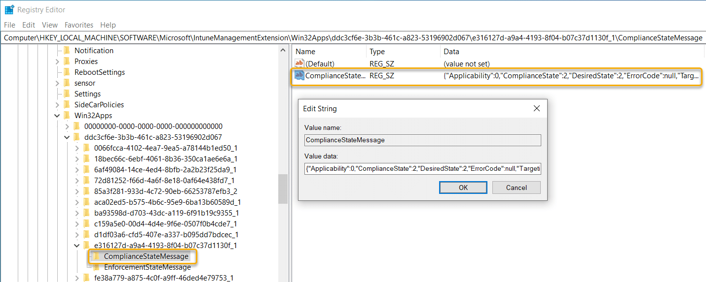
Digging into win32 app policy event state messages
Win32 app policy events are stored in the registry

Slide 29
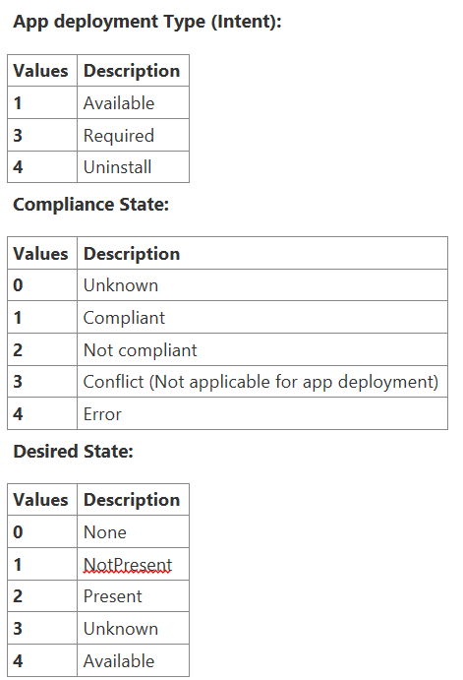
Digging into win32app policy event state messages
State Message

Slide 30
Digging into win32app policy event state messages
State Message Magic
$stateMessageComplianceState = @{
1 = "Installed"
2 = "NotInstalled"
4 = "Error"
5 = "Unknown"
100 = "Cleanup"
}

Slide 31
Digging into win32app policy event state messages
State Message Magic

Slide 32
Digging into win32app policy event state messages
LAB Time
BB-W10-5
Registry State messages
PowerShell

Slide 33
Try again. When will my app install and how does the IME handle failures and retries

Slide 34
Try again. How the IME handles failures and retries
Failed app retry every 24 hours if they are required and the installer exits with a failure or unknown exit code
Failed apps retried every 3 times every 5 minutes and then every 24 hours if they are required and the installer exits with a known retry code
Notes:
App Management simplified with a built-in app experience, including app deployment, updates, and removal.
Policy Deployment can be done for apps, devices, security, and more – Devices only need to be connected to the INTERNET to be managed
User Self-Servicing of passwords, apps, and groups can be done via the company portal
Mobile Threat Defense services such as Microsoft Defender for Endpoint can be connected to monitor devices security levels provide risk analysis and push automated remediations to the devices.
Access from any device with an internet connection to manage these workloads and monitor reports

Slide 35
Try again. How the IME handles failures and retries
%programdata%\Microsoft\IntuneManagementExtension\Logs\IntuneManagementExtension.log
When a new app is assigned, it is evaluated as a first step
Time Column is local | Time in the low row is UTC
Two components:
Reevaluation Schedule Manager – expires every 8 hours
Global Retry Schedule (GRS) - expires every 24 hours; it controls when a failed app install is retried.
Notes:
App Management simplified with a built-in app experience, including app deployment, updates, and removal.
Policy Deployment can be done for apps, devices, security, and more – Devices only need to be connected to the INTERNET to be managed
User Self-Servicing of passwords, apps, and groups can be done via the company portal
Mobile Threat Defense services such as Microsoft Defender for Endpoint can be connected to monitor devices security levels provide risk analysis and push automated remediations to the devices.
Access from any device with an internet connection to manage these workloads and monitor reports

Slide 36
Try again. How the IME handles failures and retries
Policy is processed and GRS key is set
Notes:
App Management simplified with a built-in app experience, including app deployment, updates, and removal.
Policy Deployment can be done for apps, devices, security, and more – Devices only need to be connected to the INTERNET to be managed
User Self-Servicing of passwords, apps, and groups can be done via the company portal
Mobile Threat Defense services such as Microsoft Defender for Endpoint can be connected to monitor devices security levels provide risk analysis and push automated remediations to the devices.
Access from any device with an internet connection to manage these workloads and monitor reports

Slide 37
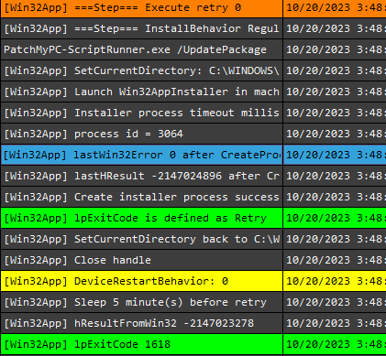
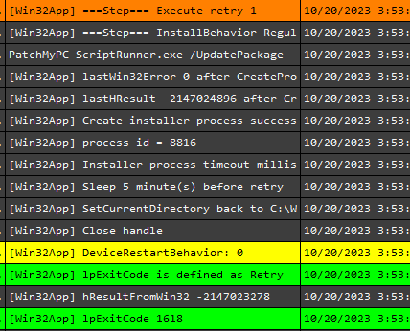
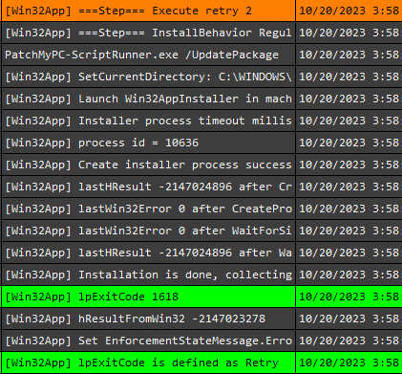
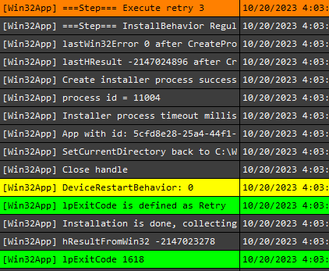
Try again. How the IME handles failures and retries
In this example, the app installer terminated with a known retry code and tried 3 more times to attempt the installation (5 minute intervals)
Initial Install
Notes:
App Management simplified with a built-in app experience, including app deployment, updates, and removal.
Policy Deployment can be done for apps, devices, security, and more – Devices only need to be connected to the INTERNET to be managed
User Self-Servicing of passwords, apps, and groups can be done via the company portal
Mobile Threat Defense services such as Microsoft Defender for Endpoint can be connected to monitor devices security levels provide risk analysis and push automated remediations to the devices.
Access from any device with an internet connection to manage these workloads and monitor reports

Slide 38
Try again. How the IME handles failures and retries
After 3 failed retries, the policy will be tried again in 24 hours time when the GRS value expires
Notes:
App Management simplified with a built-in app experience, including app deployment, updates, and removal.
Policy Deployment can be done for apps, devices, security, and more – Devices only need to be connected to the INTERNET to be managed
User Self-Servicing of passwords, apps, and groups can be done via the company portal
Mobile Threat Defense services such as Microsoft Defender for Endpoint can be connected to monitor devices security levels provide risk analysis and push automated remediations to the devices.
Access from any device with an internet connection to manage these workloads and monitor reports

Slide 39
Try again. How the IME handles failures and retries
GRS Summary
Policy evaluated and installation begins
If the install fails, does the exit code indicate “Retry”? If so, retry 3 more times every 5 minutes
If the installation is failed (still), add the app to the GRS
Evaluate a sub graph every 8 hours to check when 24 hours have passed since the app was added to GRS
After 24 hours, retry the installation.
If failed, update GRS check-in time value.
Repeat forever until successful
Notes:
App Management simplified with a built-in app experience, including app deployment, updates, and removal.
Policy Deployment can be done for apps, devices, security, and more – Devices only need to be connected to the INTERNET to be managed
User Self-Servicing of passwords, apps, and groups can be done via the company portal
Mobile Threat Defense services such as Microsoft Defender for Endpoint can be connected to monitor devices security levels provide risk analysis and push automated remediations to the devices.
Access from any device with an internet connection to manage these workloads and monitor reports

Slide 40
Win32 app assignments with a schedule. What happens on my device?

Slide 41
Try again. How the IME handles failures and retries
Win32 apps can be assigned as:
Available
Required
Can be configured to install asap
Can be scheduled when to install
Available date
Deadline date
Notes:
App Management simplified with a built-in app experience, including app deployment, updates, and removal.
Policy Deployment can be done for apps, devices, security, and more – Devices only need to be connected to the INTERNET to be managed
User Self-Servicing of passwords, apps, and groups can be done via the company portal
Mobile Threat Defense services such as Microsoft Defender for Endpoint can be connected to monitor devices security levels provide risk analysis and push automated remediations to the devices.
Access from any device with an internet connection to manage these workloads and monitor reports

Slide 42
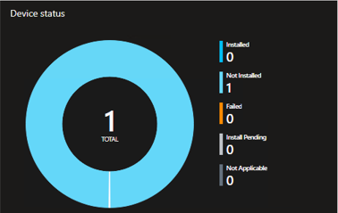
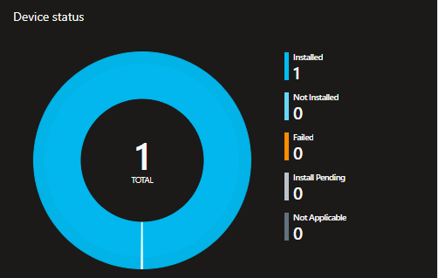
Try again. How the IME handles failures and retries
In some cases, assignments with a start and deadline date can be slightly misleading, because:
Even before the start date, IME evaluates the policy for that app. It also runs detection!
If detected = Installed - can be misleading
If not detected = Not installed
Notes:
App Management simplified with a built-in app experience, including app deployment, updates, and removal.
Policy Deployment can be done for apps, devices, security, and more – Devices only need to be connected to the INTERNET to be managed
User Self-Servicing of passwords, apps, and groups can be done via the company portal
Mobile Threat Defense services such as Microsoft Defender for Endpoint can be connected to monitor devices security levels provide risk analysis and push automated remediations to the devices.
Access from any device with an internet connection to manage these workloads and monitor reports

Slide 43
Try again. How the IME handles failures and retries
Here we have a win32 app:
Start time = 12 hours later
Deadline = 1 day later
Notes:
App Management simplified with a built-in app experience, including app deployment, updates, and removal.
Policy Deployment can be done for apps, devices, security, and more – Devices only need to be connected to the INTERNET to be managed
User Self-Servicing of passwords, apps, and groups can be done via the company portal
Mobile Threat Defense services such as Microsoft Defender for Endpoint can be connected to monitor devices security levels provide risk analysis and push automated remediations to the devices.
Access from any device with an internet connection to manage these workloads and monitor reports

Slide 44
Try again. How the IME handles failures and retries
Even though IME processes the policy before the start date, it evaluates policy, runs detection and reports the results back to Intune.
No other actions are taken.
Notes:
App Management simplified with a built-in app experience, including app deployment, updates, and removal.
Policy Deployment can be done for apps, devices, security, and more – Devices only need to be connected to the INTERNET to be managed
User Self-Servicing of passwords, apps, and groups can be done via the company portal
Mobile Threat Defense services such as Microsoft Defender for Endpoint can be connected to monitor devices security levels provide risk analysis and push automated remediations to the devices.
Access from any device with an internet connection to manage these workloads and monitor reports

Slide 45
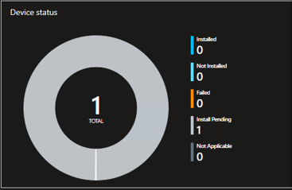
Try again. How the IME handles failures and retries
Past the start date and before the deadline, the content is downloaded and cached in preparation.
The app is still Not Detected, but Applicable. Install will be pending.
Notes:
App Management simplified with a built-in app experience, including app deployment, updates, and removal.
Policy Deployment can be done for apps, devices, security, and more – Devices only need to be connected to the INTERNET to be managed
User Self-Servicing of passwords, apps, and groups can be done via the company portal
Mobile Threat Defense services such as Microsoft Defender for Endpoint can be connected to monitor devices security levels provide risk analysis and push automated remediations to the devices.
Access from any device with an internet connection to manage these workloads and monitor reports

Slide 46
Try again. How the IME handles failures and retries
After the Deadline is hit, the app is installed. The content download is skipped, as it was downloaded after the Available start date.
Notes:
App Management simplified with a built-in app experience, including app deployment, updates, and removal.
Policy Deployment can be done for apps, devices, security, and more – Devices only need to be connected to the INTERNET to be managed
User Self-Servicing of passwords, apps, and groups can be done via the company portal
Mobile Threat Defense services such as Microsoft Defender for Endpoint can be connected to monitor devices security levels provide risk analysis and push automated remediations to the devices.
Access from any device with an internet connection to manage these workloads and monitor reports

Slide 47
Try again. How the IME handles failures and retries
LAB Time
IME win32 app failures and retries
+
IME win32 app scheduled assignments

Slide 48
Invoking IME Actions
Like a Boss

Slide 49
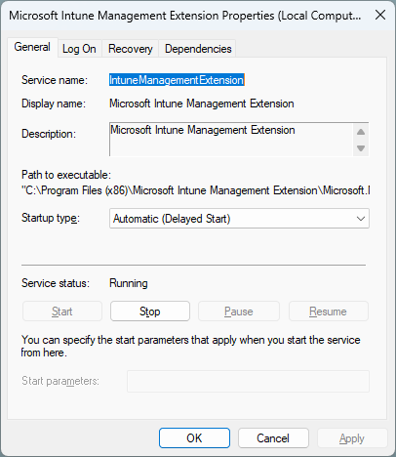
Invoking Intune Management Extension Actions
Process and Re-process of Policy – What Options do you Have?
When does the IME process policy?
When the service starts
Every 60 minutes
Can you invoke the policy on-demand?
Oh yeah! (cont.)

Slide 50
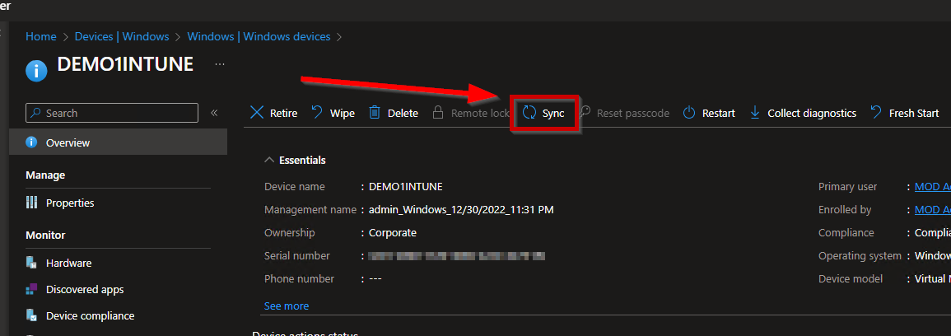
Invoking Intune Management Extension Actions
Perform a sync from the Intune Admin Center:

Slide 51
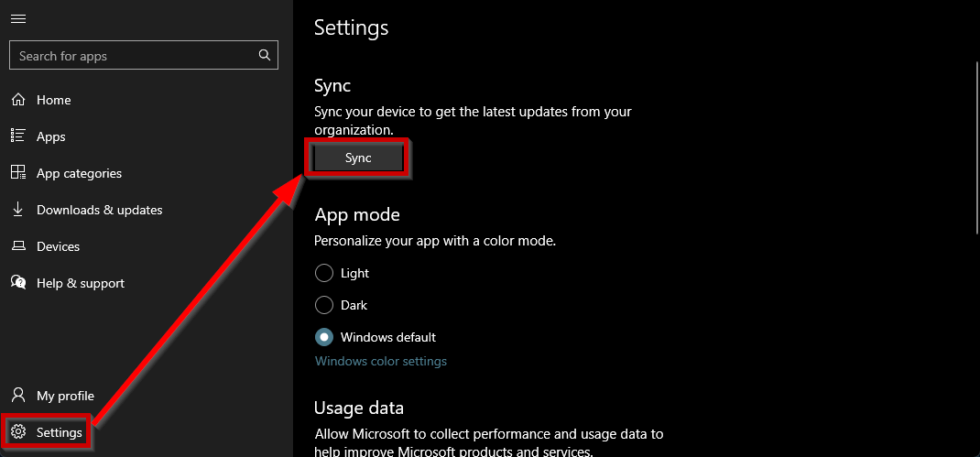
Invoking Intune Management Extension
Perform a sync from the Company Portal

Slide 52
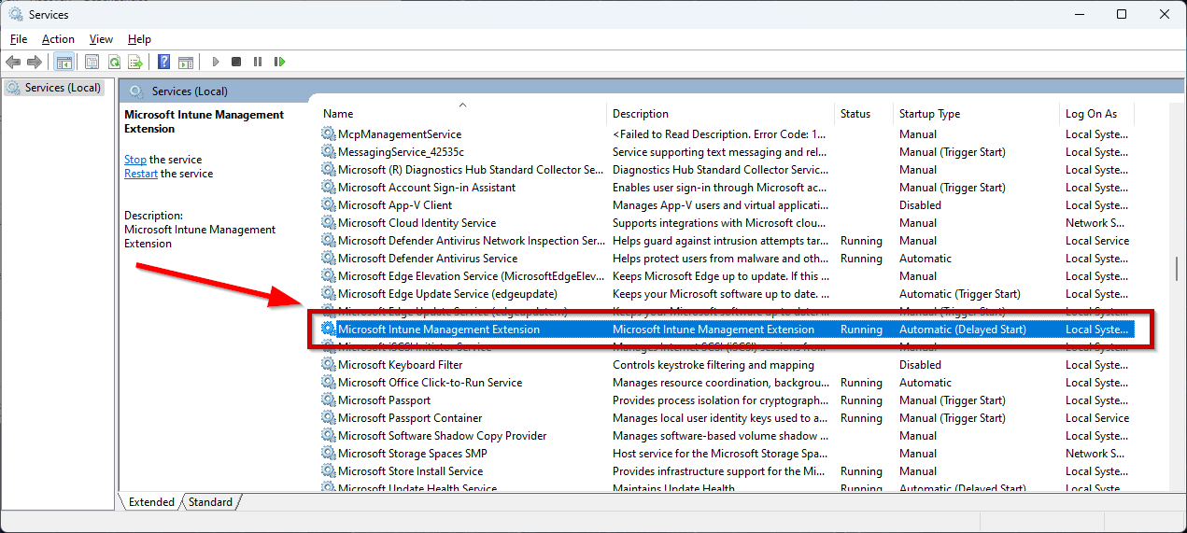
Invoking Intune Management Extension
Restart the IME Windows Service

Slide 53
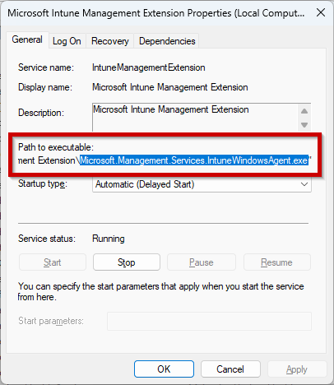
Invoking Intune Management Extension
What’s that service running anyway?
Can I just run that thing?
No
But maybe… (cont.)

Slide 54
Invoking Intune Management Extension
Strings to the rescue! (Strings - Sysinternals | Microsoft Learn)
strings "C:\Program Files (x86)\Microsoft Intune Management Extension\Microsoft.Management.Services.IntuneWindowsAgent.exe“ | findstr /i sync

Slide 55
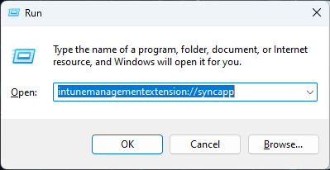
Invoking Intune Management Extension
Perform a sync from the Start Menu (app policy only) URL Moniker: intunemanagementextension://syncapp
Trigger a sync from PowerShell (app policy only)

Slide 56
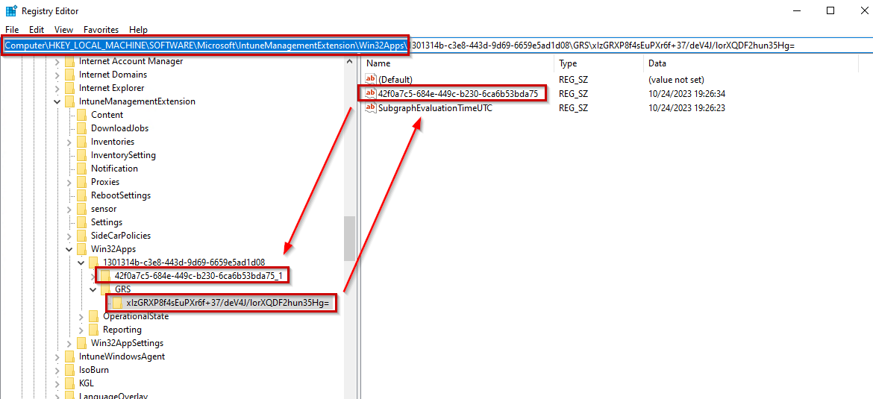
Invoking Intune Management Extension
Q: What if you wanted to invoke a policy evaluation immediately for a failed app? A: Wait 24hrs – Ain’t nobody got time for that!
*Delete the app key
and the GRS key
from the registry*

Slide 57
Invoking Intune Management Extension
LAB Time
The Ripley Maneuver:
Deleting App and GRS Registry Keys to force a quicker retry

Slide 58
Inventory

Slide 59
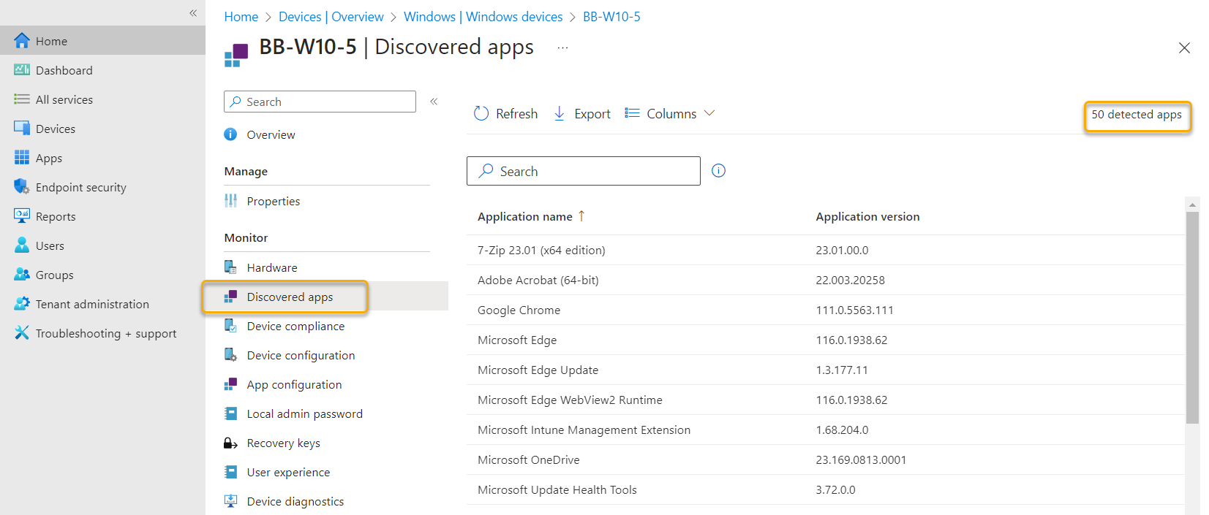
Inventory
The IME will inventory installed applications. The results are sent to the Intune service and are visible in two endpoints

Slide 60
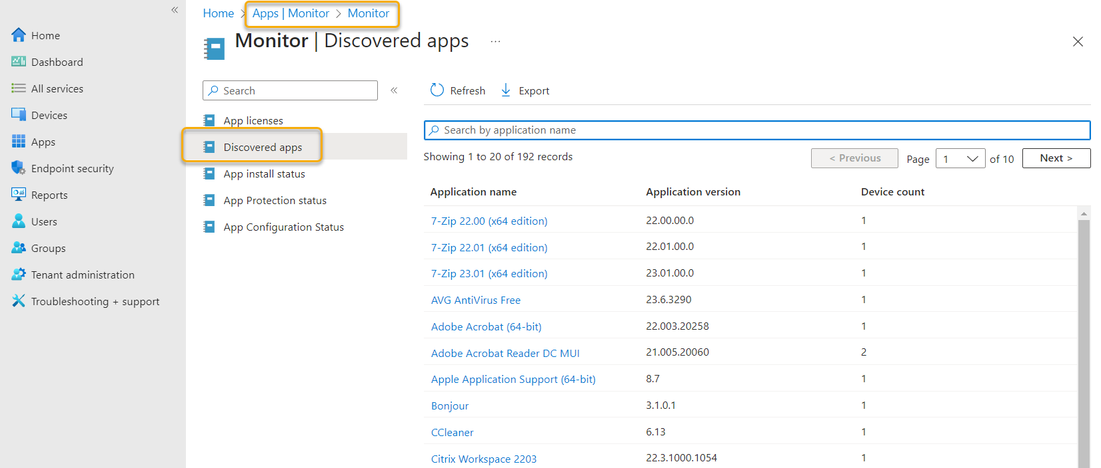
Inventory
Aggregated report for all devices is under Apps > Monitor > Discovered Apps

Slide 61
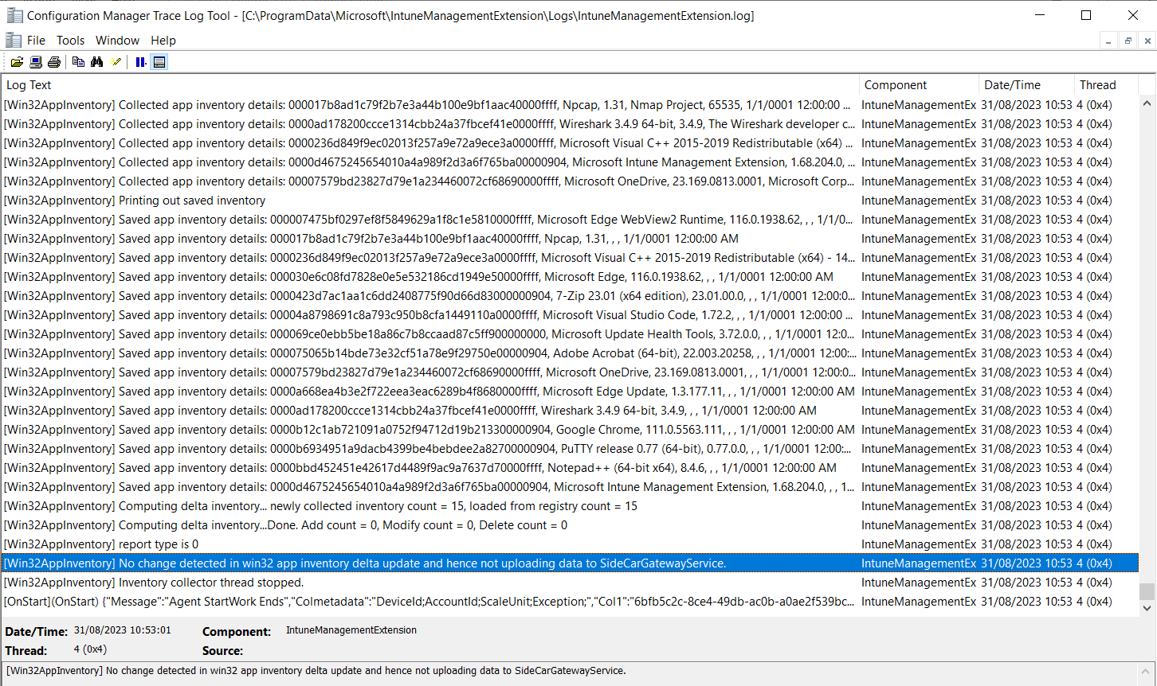
Inventory
The IME performs a delta inventory every 24hrs and/or when the IME service starts. A full inventory is taken every 7 days and the first time the IME is installed
Remember .NET disassemblers!

Slide 62
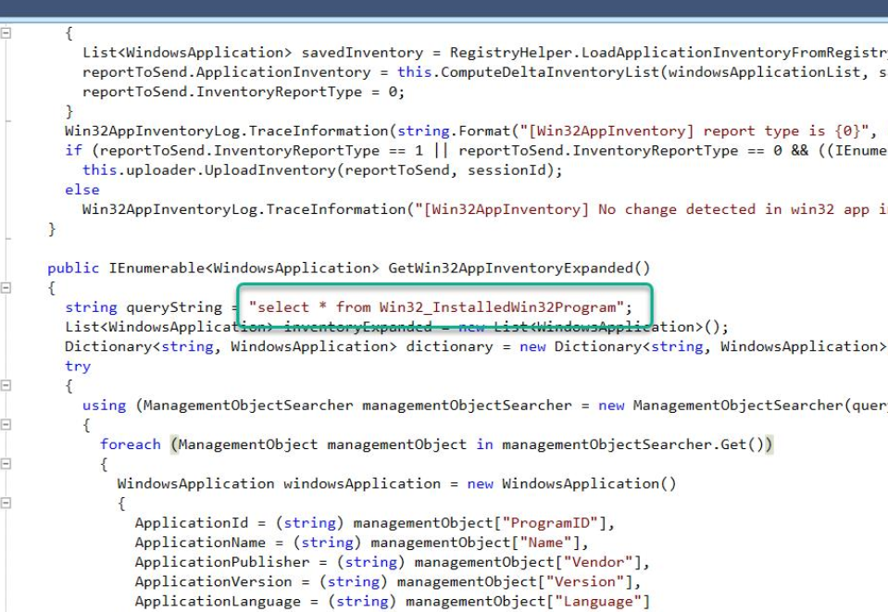
Inventory
The IME uses a specific WMI class to query installed software
Remember .NET disassemblers!
Win32_ InstalledWin32Program

Slide 63
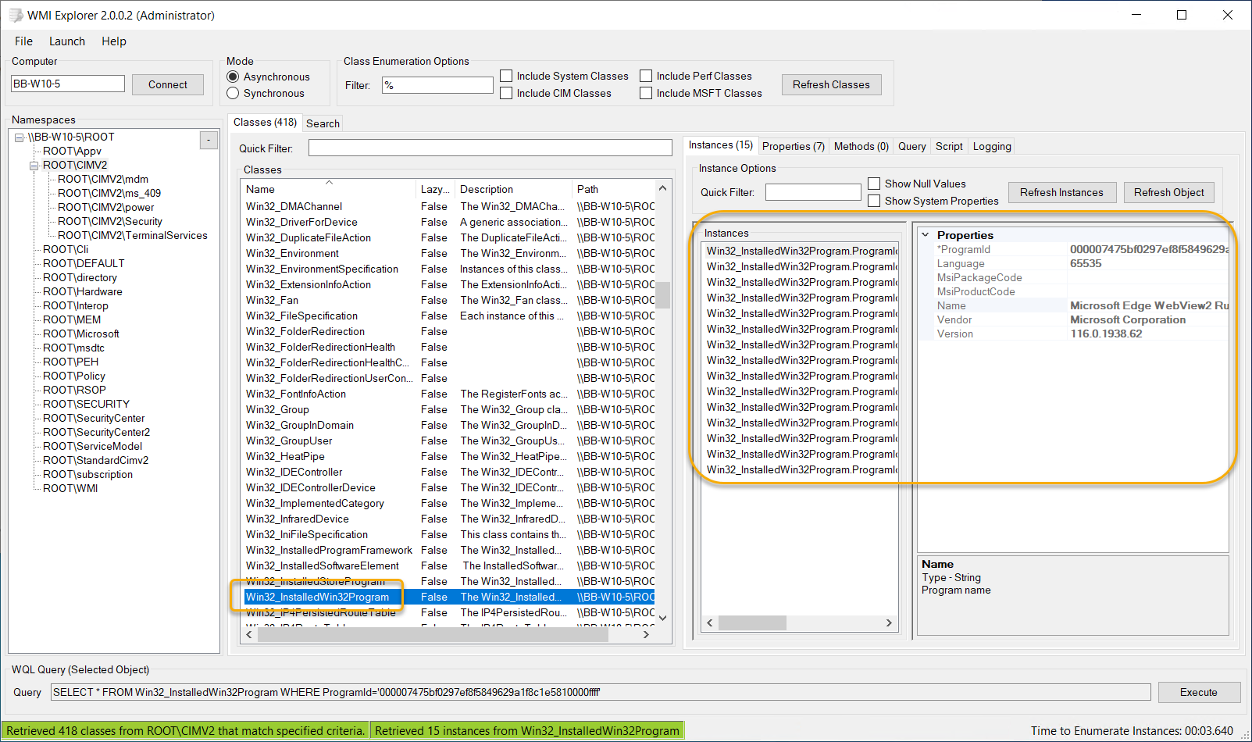
Inventory

Slide 64
Inventory
Inventory is saved in the registry so a delta can be performed on the next scan
HKEY_LOCAL_MACHINE\SOFTWARE\Microsoft\IntuneManagementExtension\Inventories

Slide 65
Digging into win32app policy event state messages
LAB Time
BB-W10-5
Force Delta Inventory and Full Inventory

Slide 66
Inventory
Inventory Summary
New apps appear in Intune reports fairly quickly
It can take up to 7 days for delta changes (removes) to be reflected in Intune reports
Inventory is run every 24 hours
A full inventory is run the first time and every 7 days, a delta inventory occurs subsequent runs
Delete FirstTimeRun key to force a full inventory

Slide 67
Questions and Answers from the Crowd
Notes:
Show general ADR
Focus on Patch My PC Updates, but discuss Windows Update Deployment

Slide 68
Thank you for attending!

