Slide 1
Ask Us Anything
With the Patch My PC Team

Slide 2
Pre-Submitted Questions – SaaS/Scappman
Are you able to elaborate on the details of the Scappman acquisition? If so, what are the improvements or changes PMPC will see in the application? Cloud support? Anything else both companies are excited to share? Thank you
- DJAM / others

Slide 3
Pre-Submitted Questions – SaaS/Scappman
Will we see any features from Scappman rolled into PMPC
Any ETA on a web client for the management console?
Is there something on the roadmap to have a cloud version of PMPC?
Is there a web interface coming to the product so multiple users can view/edit the console without having to login to a central server?
- DJAM / others

Slide 4
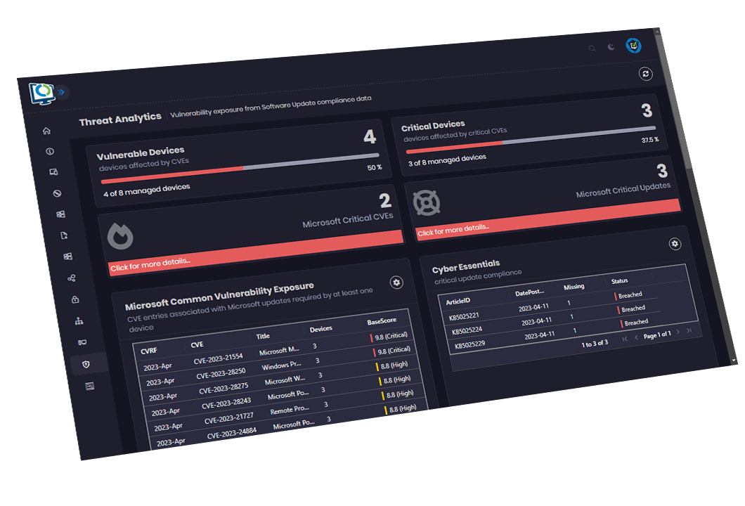
Pre-Submitted Question:
Reporting/Callisto question(s)

Slide 5
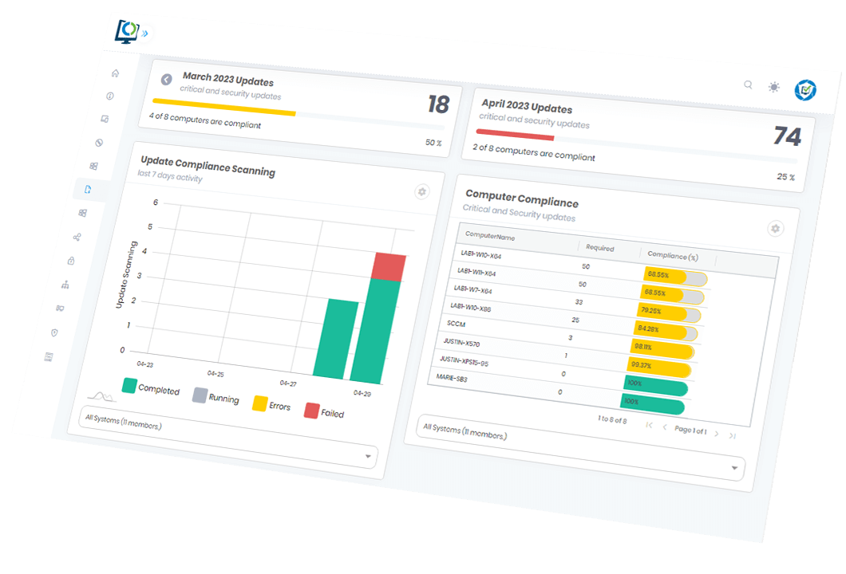
Pre-Submitted Question:

Slide 6
Pre-Submitted Reporting Question:
Will there be an Advanced Insights roadmap made available like there is for Publisher? Advanced Insights implementation?
No specific question but interested in hearing more about the Advanced Analytics offering since our company currently subscribes to Callisto.
I saw it mentioned that you guys have acquired Callisto. Is this true and how will the licensing work under PMPC?
Justin/John/Others

Slide 7
More Reporting Questions
interested in reporting and monitoring - we are using WSUS for monitoring currently, which is, well, ok, but not the best that could be imagined.
My biggest interest is in reporting. Our environment may just be too big but the only report I've been able to use consistently is 04 - All Software Updates Missing By Collection.
Does Patch My PC provide any reporting or monitoring capabilities for software updates?
John/Justin/Others

Slide 8
Pre-Submitted Question – Custom Apps
When can we expect custom apps?
How to create or customize a package and deploy through SCCM Patch MY PC
"The option to create are own applications via PMPC, now we use psappdeploy.
I know that you guys are working on it, can you give an update on this?"
I'm interested in knowing more about uploading custom packages.
When we will be able to start building packages with PatchMyPC.
DJAM/Andrew/Cody/Others

Slide 9
Pre-Submitted Question:
How often do you update the catalog and how is it done?
https://patchmypc.com/category/catalog-updates
- Adam

Slide 10
Pre-Submitted Question:
I just started a new position where one of the programs that are used is Patch My PC. Is there a resource that I can use or documentation that I can follow that walks me through an overview on how Patch My PC works?
- https://docs.patchmypc.com/
https://patchmypc.com/environment-review-call
Mona/Others

Slide 11
Pre-Submitted Question:
Do you recommend controlling update groups via patch my pc or Intune , as in when patch my pc adds an app or update to Intune , then add group to the app or do it via patch my pc?
-This is dependent on your desired deployment strategy
If you want to do phased deployments we suggest using our Manage Assignments option so new apps/updates get the correct Availability/Deadline date
-Jake

Slide 12
Pre-Submitted Question:
How would you go about requesting an app for PMPC patching?
- https://ideas.patchmypc.com/
- Andrew

Slide 13
Pre-Submitted Question:
With Adobe Acrobat Reader and Pro now being the same base app, can the Acrobat Reader 64-bit detection method be marked as successful when Acrobat Pro 64-bit is installed. Specifically for Intune installs, where it is not easy to create groups based on whether or not Acrobat Pro is installed. If nothing done on PMPC or Adobe's side, I will likely have to create a custom requirement script OR setup automated groups based on install via a scheduled Azure runbook or PS script.
- We've created a community requirement script to address this! Community-Scripts/Install/Requirement at main · PatchMyPCTeam/Community-Scripts · GitHub
- Jake

Slide 14
Pre-Submitted Question:
Do you plan to support the ability to set application installations to "run in foreground" and "run in background"?
Right now, we can only do this in Intune, but not from Patch My PC.
It would be nice to have control over the priority of app installs instead of defaulting to "run in background", especially for apps configured to run during the Enrollment Status Page and immediately after enrollment (once the user reaches the desktop for the first time).
- Cody

Slide 15
Pre-Submitted Question:
Possibility to trigger a sync for just a single product?
https://ideas.patchmypc.com/ideas/PATCHMYPC-I-468
Work in progress, and we have a functioning version in dev.
- Cody

Slide 16
Pre-Submitted Question:
How do you identify when updates are available for applications and what's the process for testing the updates before making available for customers?
We monitor download URLs and webpages for new versions. If a new version is available, we aim to release it to our catalogue the same working day, failing that, the following day.
We already release a catalogue update multiple times a day, but we are working to streamline this process to release catalogue updates faster.
Our testing and validation process in summary:
Recording the hash of the installer, observing the digital signature, scan against VirusTotal (Jordan can more to this in another question)
Install/update testing automation (measuring exit code and detection/applicability)
- Adam

Slide 17
Pre-Submitted Question:
How can we be sure that the files are safe to distribute?
- Deep Dive Into Security Validation of Updates and Applications - Patch My PC
Jordan / Djam

Slide 18
Pre-Submitted Question:
Any plans to enter the macOS world?
Is MAC support on the table?
Is there anything on the roadmap to support Intune app deployment for other platforms, specifically macOS?
Tell us more about your needs here….

Slide 19
Pre-Submitted Question:
Is it possible to automatically choose software in update tab by default? We never opt-out, but always have to opt-in. And sadly, often forget it.

Slide 20
Pre-Submitted Question:
"Would it be possible to have multiple versions of an application?
App ver. 1: requirement of primary device
App ver. 2: no requirements on the app"
Cody / Andrew

Slide 21
Pre-Submitted Question:
When applications are no longer supported, does your professional support actively search for alternatives as replacement?
Andrew

Slide 22
Pre-Submitted Question:
The app scan reports 4 different install types for each app. There may only be one installed though, so how can we decide and consolidate to just one version?
- Adam

Slide 23
Pre-Submitted Question:
Compatibility with autopilot and Intune.
How can we deploy 3rd party app patches from Intune without slowing down other win32 app package installs?
- Jake / Ben

Slide 24
Pre-Submitted Question:
When (if not already possible) will Patch My PC be able to remove older versions of an App in my InTune console after during an update for an App.
I'm going in each month and removing older versions after Patch does an update to any apps

Slide 25
Thank you for attending!

