Slide 1
Co-Management
Moving Workloads to Intune
With the Patch My PC Team

Slide 2
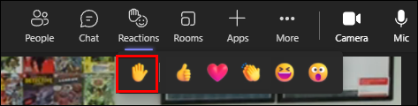

Please Use the Raise Hand Feature
  We will periodically switch between live Q&A and the slides/labs
  If we have time for live questions, please use the raise hand feature and we will unmute you

Slide 3
Co-management
Agenda
What is Co-management
Immediate Value
Workloads “Measure twice, cut once”…plan, plan, plan
Paths to Co-management & Prerequisites
Moving Workloads
Q and A

Slide 4
Co-Management
What is Co-management?

Slide 5

A feature that attaches Configuration Manager clients to the Microsoft cloud
A way to prevent policy conflict when the floodgates are opened as devices enroll to Intune by managing which agent policy is enforced from

Slide 6


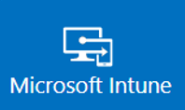






MDM Agent
Windows 10/11
ConfigMgr Client
Configuration Manager
GPO ?

Slide 7

Is it Tenant Attach?
No. Tenant attach sets up synchronization between your Configuration Manager site and your Intune tenant so you can see Configuration Manager devices in the Microsoft Intune admin center.
Takeaway Knowledge
Co-management connects devices to Intune/ConfigMgr
Tenant attach connects ConfigMgr to Intune

Slide 8
Co-Management
Immediate Value

Slide 9
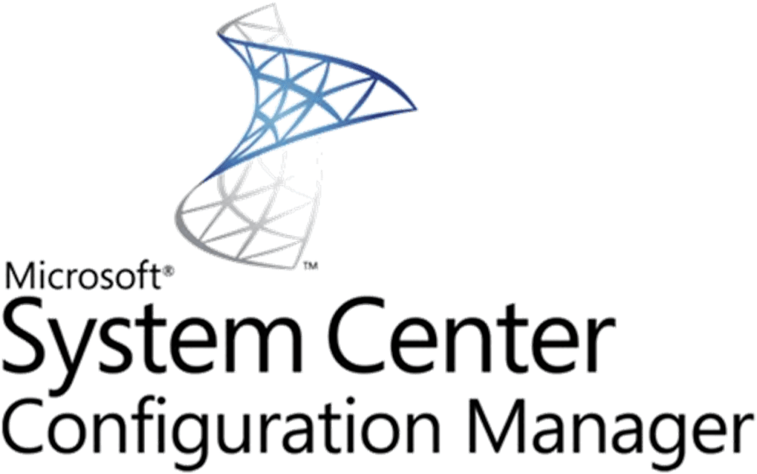
Immediate Value
For existing ConfigMgr clients
Conditional access with device compliance
  Include Configuration Items and Baselines in CA
Intune-based remote actions, for example: restart, remote control, or factory reset
Centralized visibility of device health
Modern provisioning with Windows Autopilot
Remote actions
Intune Scripts *
* W10 1903+ even without Client apps workload

Slide 10
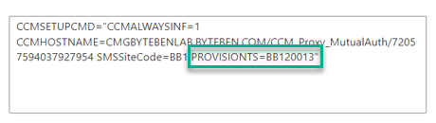
Immediate Value
For existing Intune enrolled devices
Rich inventory using ConfigMgr HINV
Better reporting?
Windows Autopilot Task Sequences (PROVISIONTS)
Leverage advanced compliance tests using ConfigMgr baselines for AAD compliance evaluation

Slide 11
Co-Management
Workloads
“Measure twice, cut once”
…plan, plan, plan

Slide 12

Co-management supports the following workloads:-
Compliance policies
Windows Update policies
Endpoint Protection
Device configuration
Office Click-to-Run apps
Client apps
Resource Access Policies
Wanna be a pilot?

Slide 13
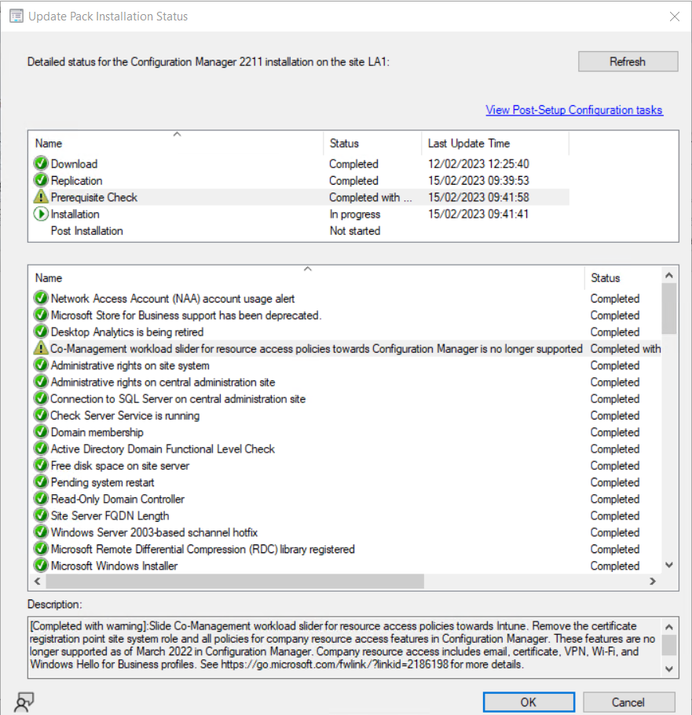
Resource access policies (deprecated in 2203)

Slide 14

Planning is the most important thing you should do!
ConfigMgr Collections (Pilot)
Policy Conflict – CSP Matching?
Existing Policy dangers
Client apps might catch you!

Slide 15
Co-Management
Paths to Co-management & Prerequisites

Slide 16
Paths to Co-management & Prerequisites
There are two main paths to reach Co-management:-
Existing Configuration Manager clients
Windows 10/11 devices already managed by Configuration Manager
Internet Born Clients
Windows 10/11 devices that are Azure AD Joined and managed by Intune

Slide 17
Paths to Co-management & Prerequisites
Existing Configuration Manager clients
Hybrid Azure AD
  One of the following Azure AD hybrid identity options:
    Password hash synchronization with Seamless Single Sign-on (SSO)
    Pass-through authentication with Seamless Single Sign-on (SSO)
    Federated SSO (with Active Directory Federation Services (AD FS))
  Azure AD Connect
  Azure AD Premium license (EMS? ADP1 + Intune)
  Configure hybrid Azure AD-join (choo+se one option):
    For managed domains
    For federated domains
  Client agent setting for hybrid Azure AD-join
  Configure auto-enrollment of devices to Intune
  Enable co-management in Configuration Manager

Slide 18
Paths to Co-management & Prerequisites
Existing Configuration Manager clients
Devices need line of sight, in the SYSTEM context *
  device.login.microsoftonline.com (443)
  enterpriseregistration.windows.net (443)
  Login.microsoftonline.com (443)
Global Administrator (to configure the co-management service)
ADDS Enterprise Administrator (to setup SCP for Hybrid AAD during AAD Connect Setup Wizard)
ConfigMgr Administrator (with all roles in scope)
MDM User Scope set to All/Some
* Authenticated proxy could mean issues for you

Slide 19
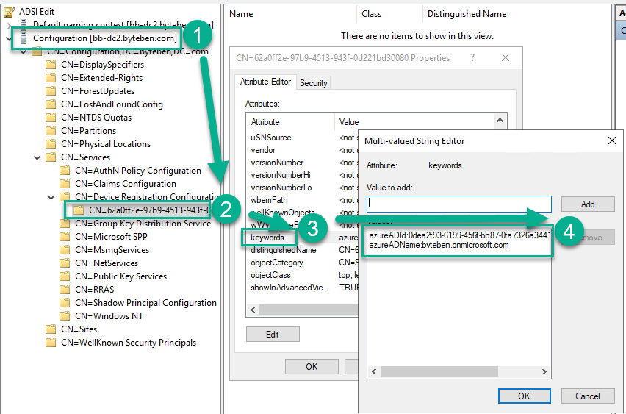
Paths to Co-management & Prerequisites
Hybrid Azure AD Join
HAAD Join wizard in AAD Connect publishes the AAD tenant information to a Service Connection Point (or SCP) in ADDS
CN=62a0ff2e-97b9-4513-943f-0d221bd30080
Domain Joined Windows 10 clients will query this information and automatically register with Azure AD

Slide 20
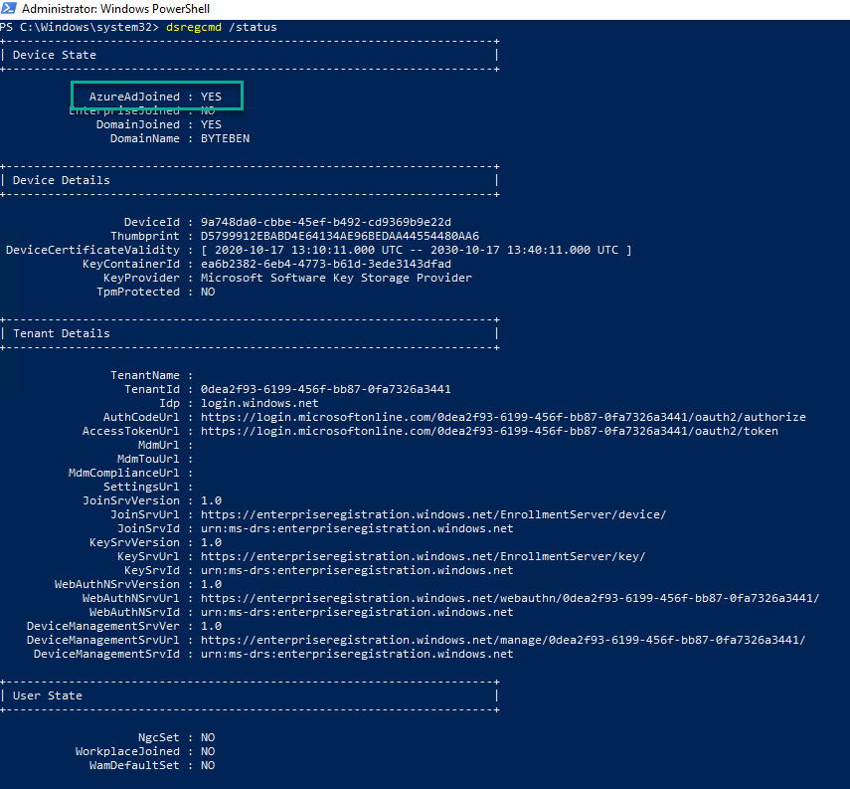
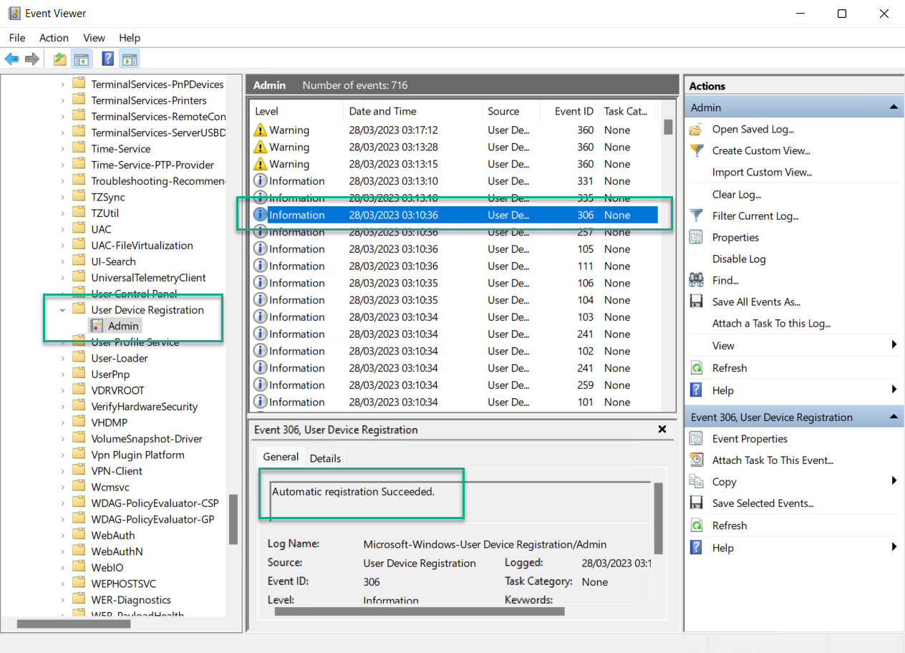
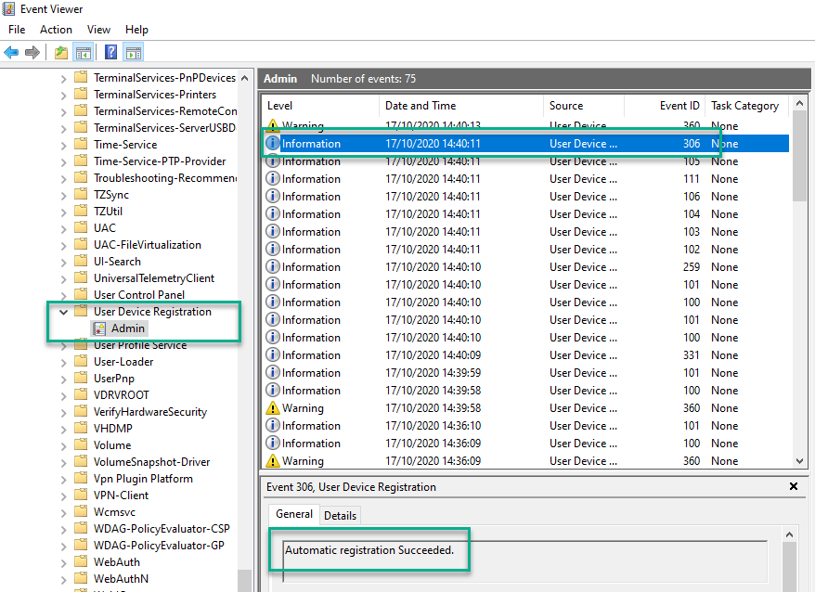
Paths to Co-management & Prerequisites
dsregcmd /status

Slide 21
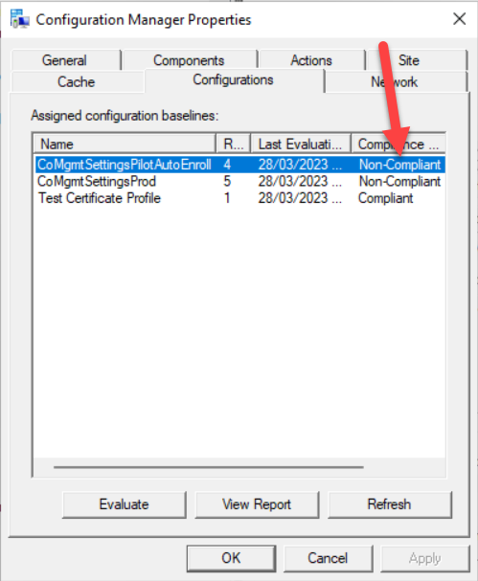
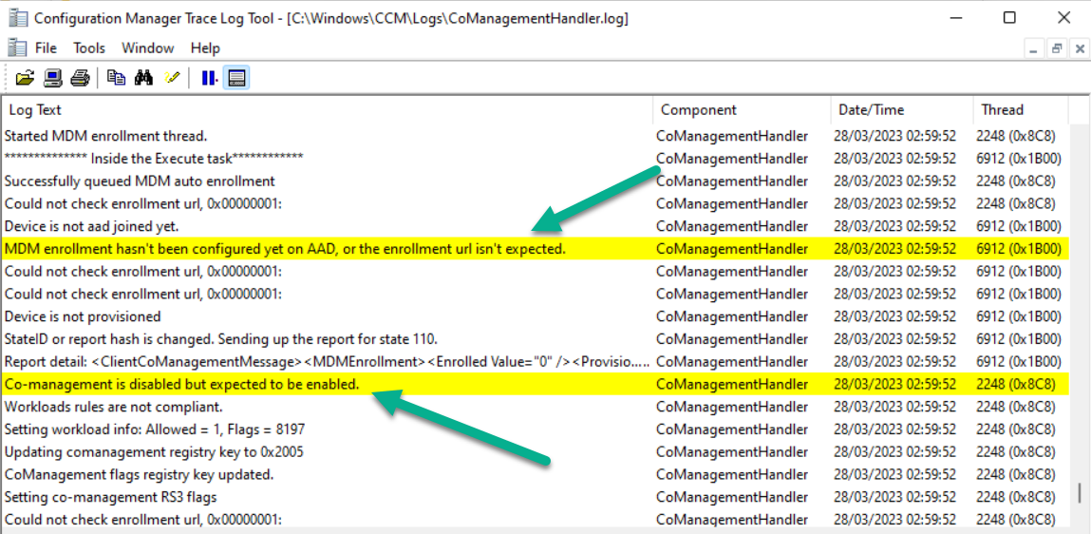
Paths to Co-management & Prerequisites
Intune Enrolment
When the co-management is enabled, the Comanagement policy will hit the device and Intune enrolment is checked

Slide 22
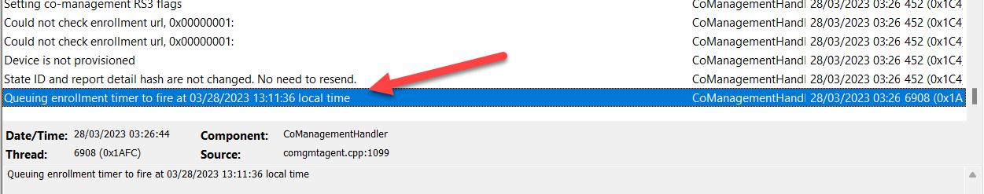
Paths to Co-management & Prerequisites
Intune Enrolment
Enrolment is scheduled and staggered across devices across the organisation
Devices are enrolled into Intune based on their Azure AD device token, and not a user token. This means only the default Intune enrollment restriction will apply to the enrollment.

Slide 23
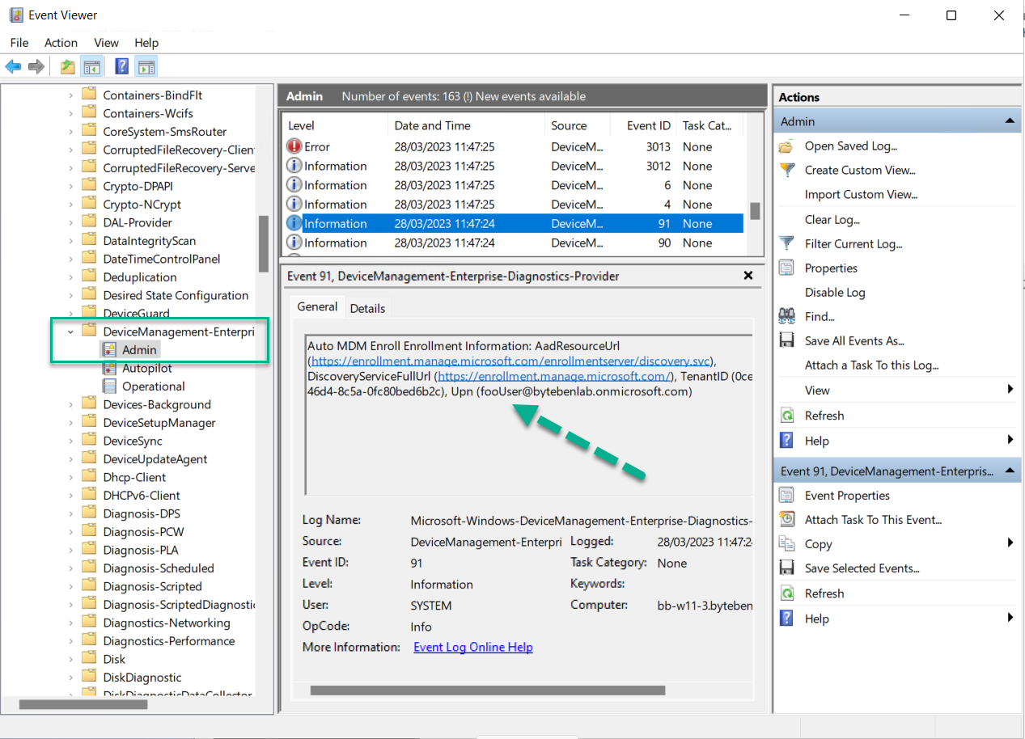
Paths to Co-management & Prerequisites
Intune Enrolment
Device enrolled with AAD Device Credential
UPN: foouser@tenant.onmicrosoft.com

Slide 24
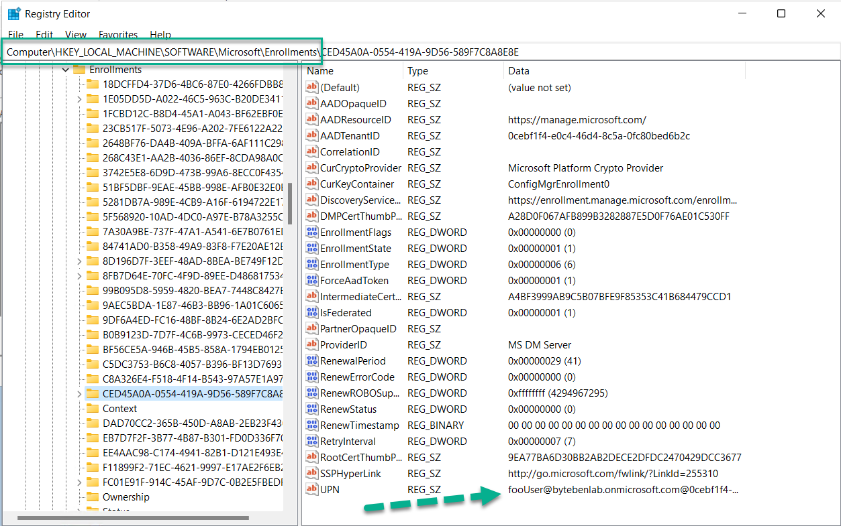
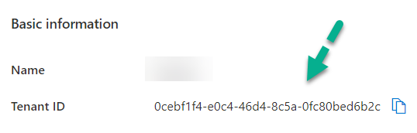
Paths to Co-management & Prerequisites

Slide 25




Paths to Co-management & Prerequisites
Internet “Born” Clients
Line of sight to Configuration Manager
  Cloud Management Gateway?
  VPN? (hands up who still uses a VPN)
  Intranet connected
How do ConfigMgr clients authenticate to the management point?
  Certificates (PKI)
  Certificates (EHTTP)
  AAD Authentication (Token)

Slide 26
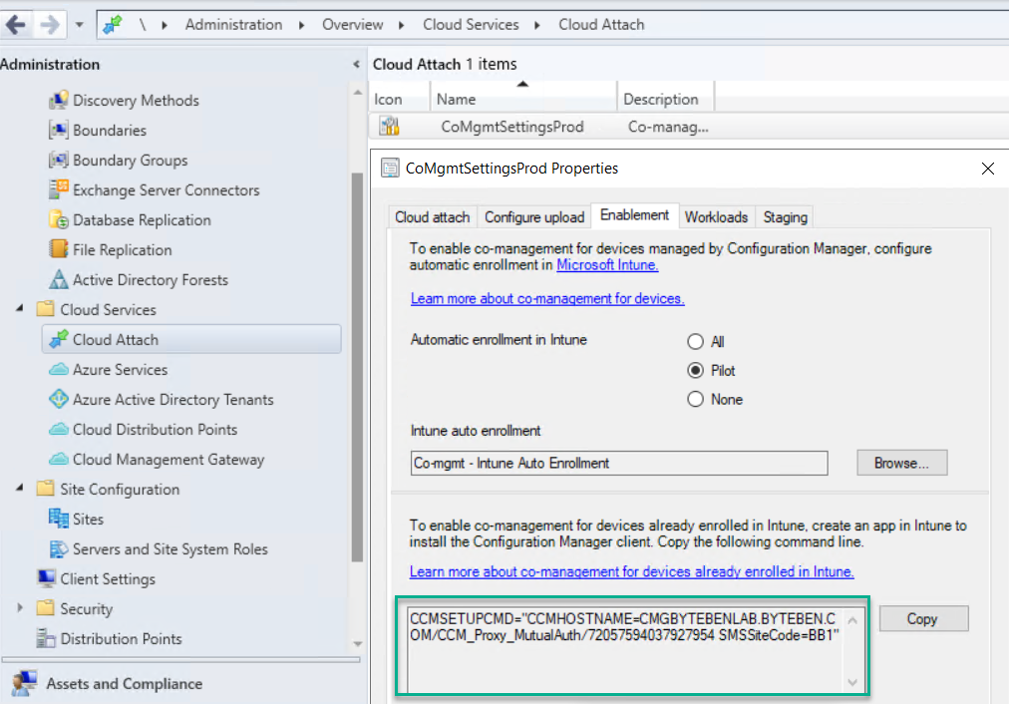
Paths to Co-management & Prerequisites

Slide 27
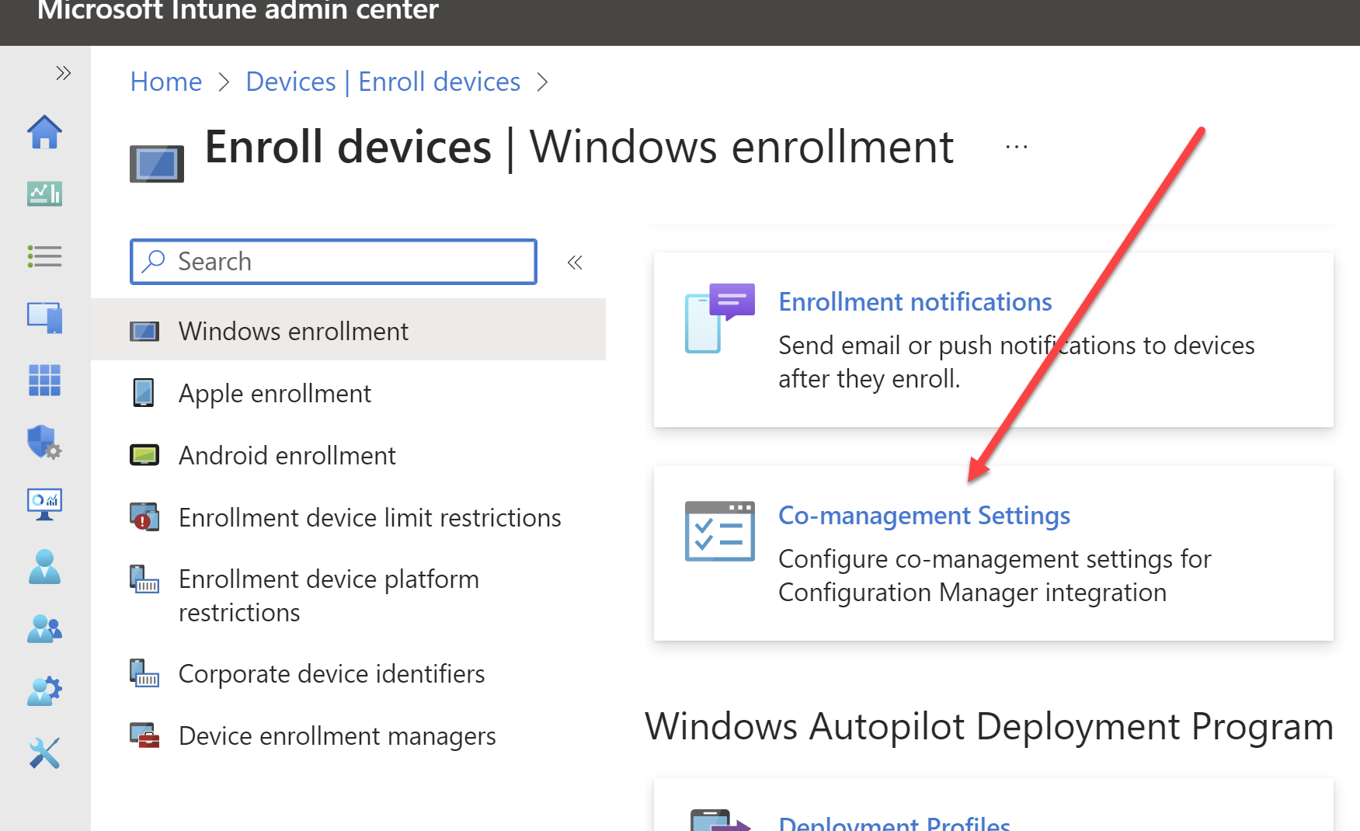
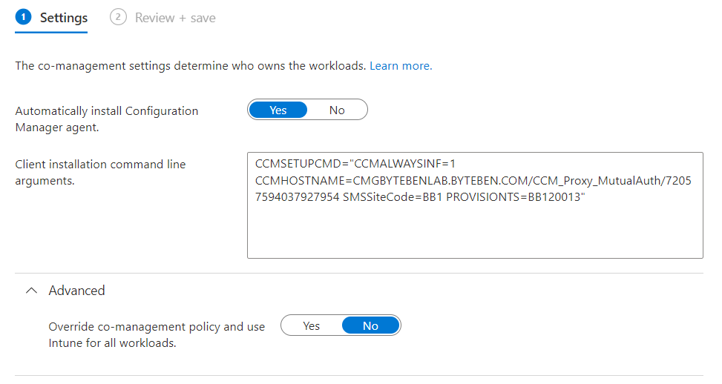
Paths to Co-management & Prerequisites
Internet Born Clients
Stop deploying the ConfigMgr client as a LOB or Win32 app – there is a better way
The co-management policy automatically installs the ConfigMgr client as a first-party app during Autopilot Enrollment Status page (ESP) phase of the first run experience.

Slide 28
Co-Management
Moving Workloads

Slide 29
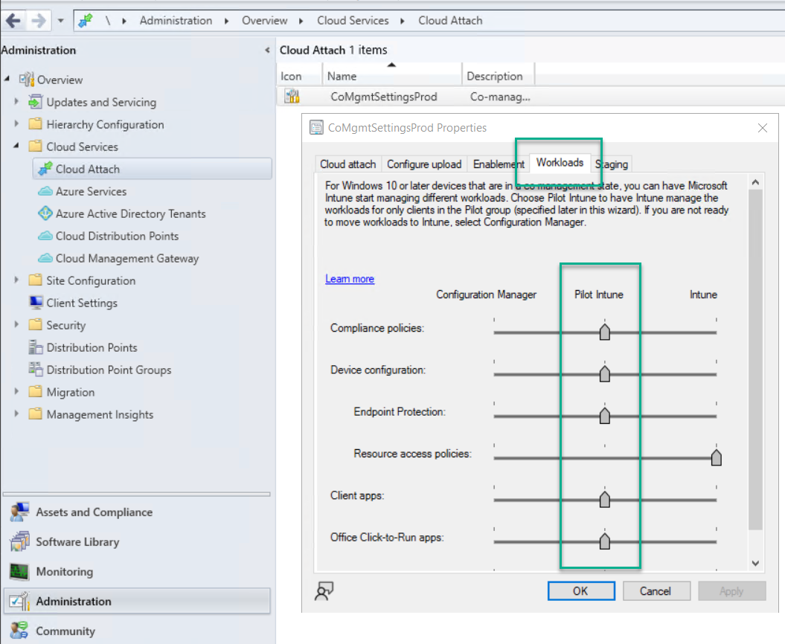

Moving Workloads
Workloads can be moved to Intune using the workload sliders
A phased approach can work by moving the slider to the Pilot Intune setting
March 2022 - Resource Access Policies: Company resource access includes email, certificate, VPN, Wi-Fi, and WHfB profiles
https://go.microsoft.com/fwlink/?linkid=2186198
Notes:
https://go.microsoft.com/fwlink/?linkid=2186198

Slide 30
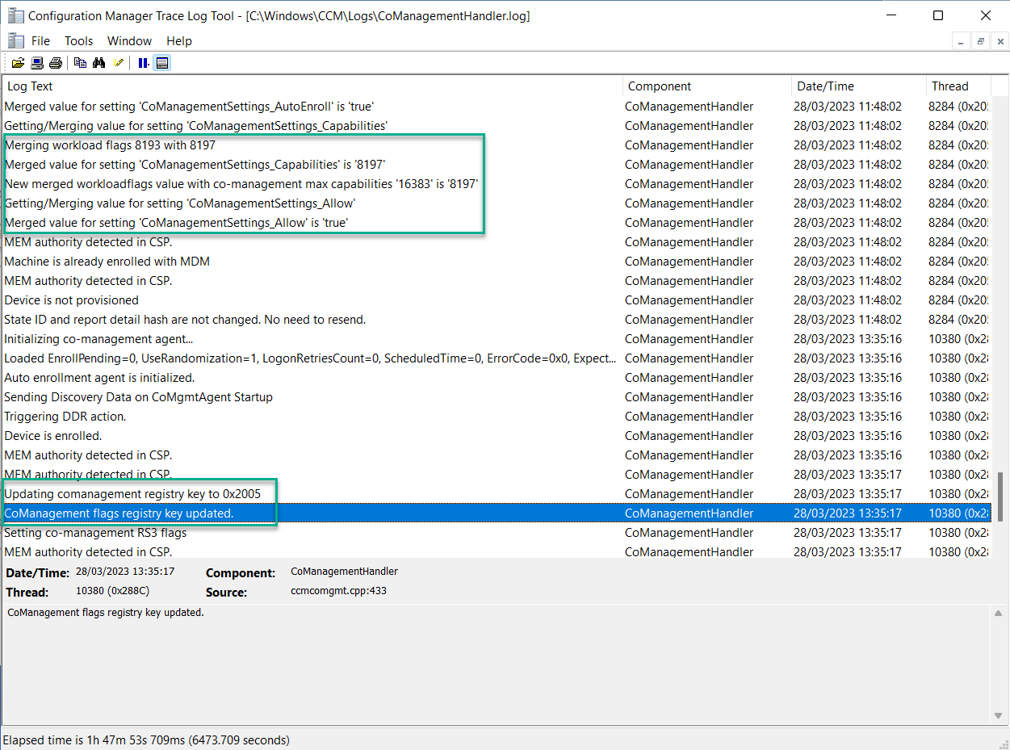
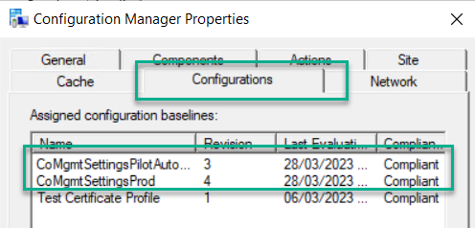
Moving Workloads
Workloads are calculated on the Client by merging a unique capability number which represents each workload
Notes:
https://go.microsoft.com/fwlink/?linkid=2186198

Slide 31
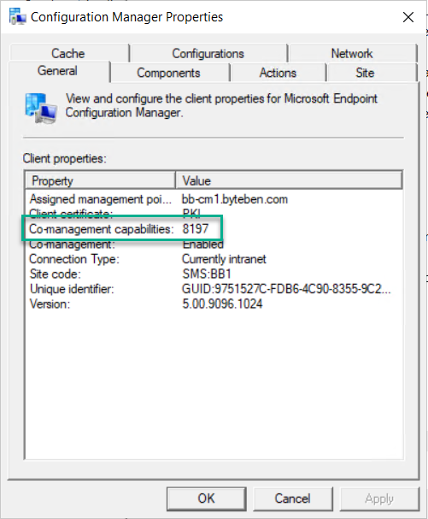
Moving Workloads
Workloads are calculated on the Client by merging a unique capability number which represents each workload
Notes:
https://go.microsoft.com/fwlink/?linkid=2186198

Slide 32
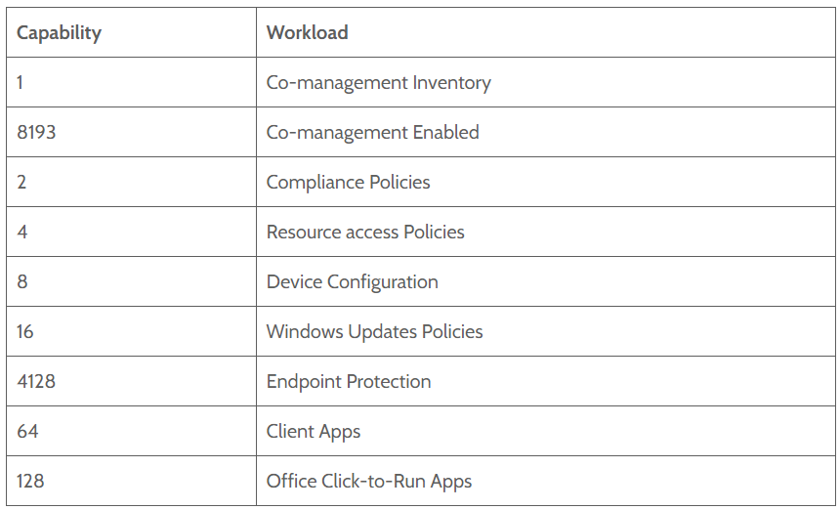
Moving Workloads
Workload values changed in ConfigMgr 2111
Where do those numbers mean?
Notes:
https://go.microsoft.com/fwlink/?linkid=2186198

Slide 33
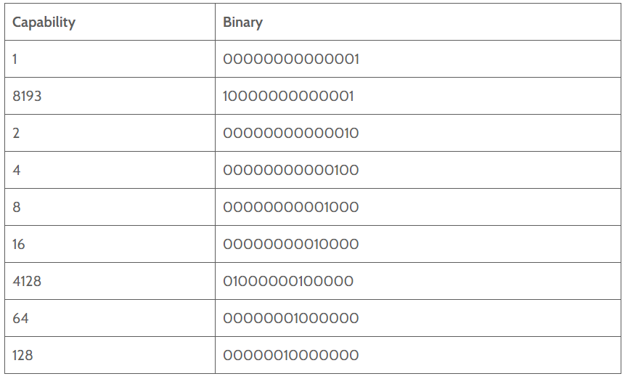
Moving Workloads
Bitwise Operations
Notes:
https://go.microsoft.com/fwlink/?linkid=2186198

Slide 34
Moving Workloads
We can perform a bitwise operation on multiple capability values to get a new capability value. What happens when we have “Co-management Enabled” (8193) and the “Compliance” (2) workload moved to Intune?
10000000000001 -bor 00000000000010 = 10000000000011
If we look at the bitwise calculation below, we are actually returning 1 when either one or both bits, in each corresponding column, equals 1
10000000000001
00000000000010
10000000000011 = 8195
Notes:
https://go.microsoft.com/fwlink/?linkid=2186198

Slide 35
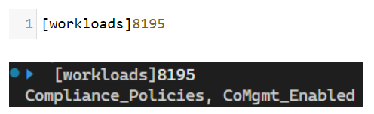
Moving Workloads
PowerShell is cool!
[flags()] Enum workloads {
CoMgmt_Enabled = 8193
Compliance_Policies = 2
Resource_Access_Policies = 4
Device_Configuration = 8
Windows_Update_Policies = 16
Client_Apps = 64
Office_Click2Run_Apps = 128
Endpoint_Protection = 4128
}
Notes:
https://go.microsoft.com/fwlink/?linkid=2186198

Slide 36
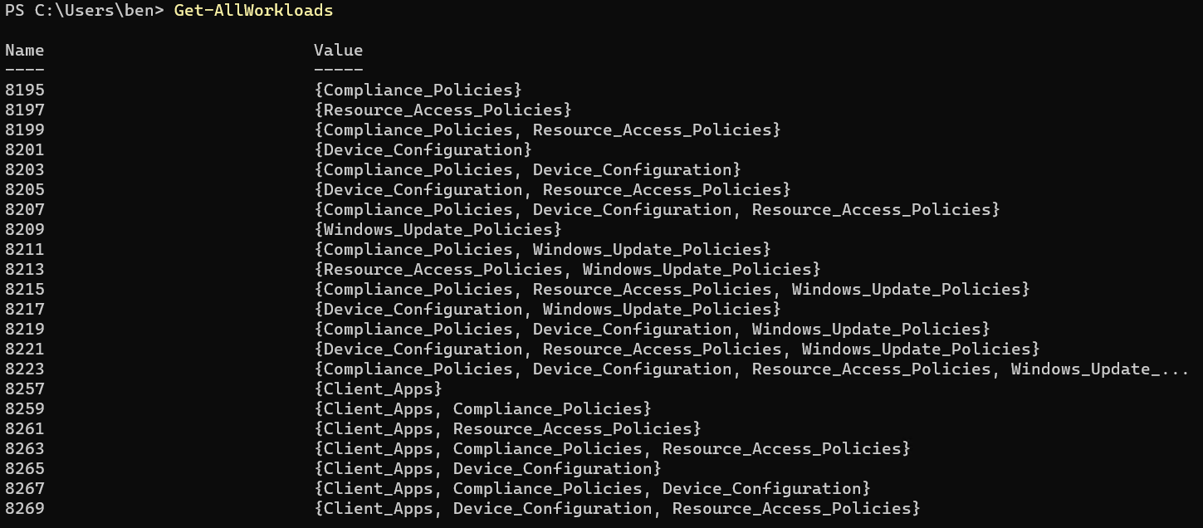
Moving Workloads
https://MSendpointMgr.com/2023/02/04/co-management-workloads-capabilities/
Notes:
https://go.microsoft.com/fwlink/?linkid=2186198

Slide 37
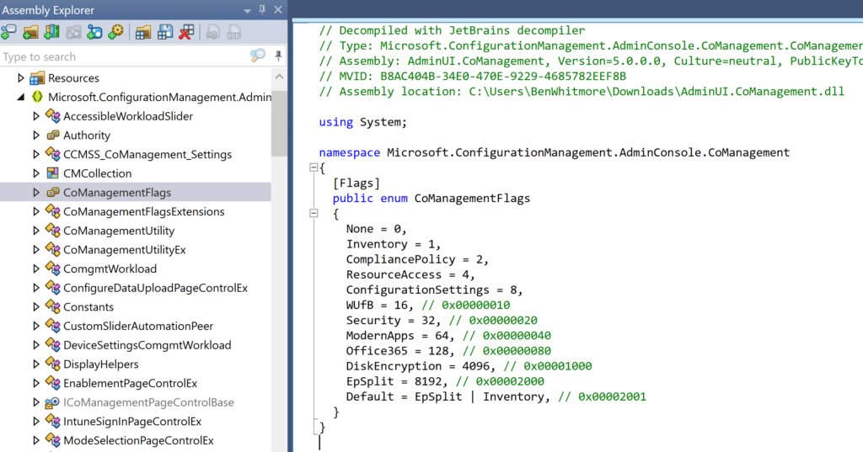

Moving Workloads
AdminUI.CoManagement.dll
Notes:
https://go.microsoft.com/fwlink/?linkid=2186198

Slide 38
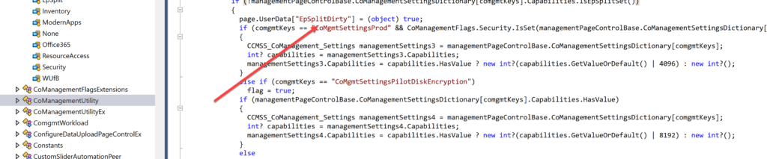
Moving Workloads
The Endpoint Protection split in ConfigMgr 2111+ is made up from Disk Encryption (4096) and Security (32). There is some masking of the split in the code, we can still not see the Endpoint Protection / Disk Encryption split in the Workload sliders in ConfigMgr UI
Notes:
https://go.microsoft.com/fwlink/?linkid=2186198

Slide 39
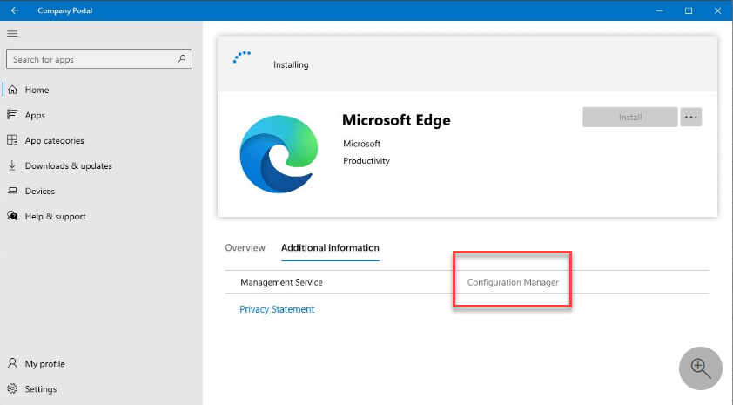

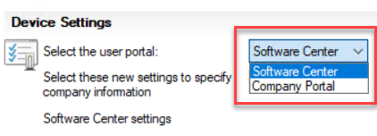
Moving Workloads
App Workloads
Notes:
https://go.microsoft.com/fwlink/?linkid=2186198

Slide 40
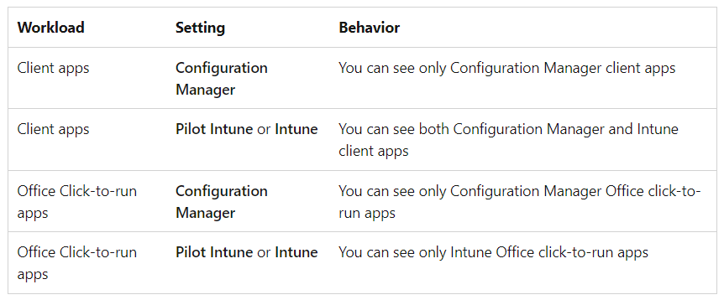
Moving Workloads
Notes:
https://go.microsoft.com/fwlink/?linkid=2186198

Slide 41
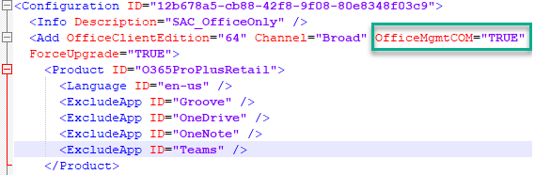
Moving Workloads
Office C2R Apps
OfficeMgmtCOM = True means updates are coming from ConfigMgr
Notes:
Office 365 updates stop working when workloads are switched to Intune (byteben.com)

Slide 42
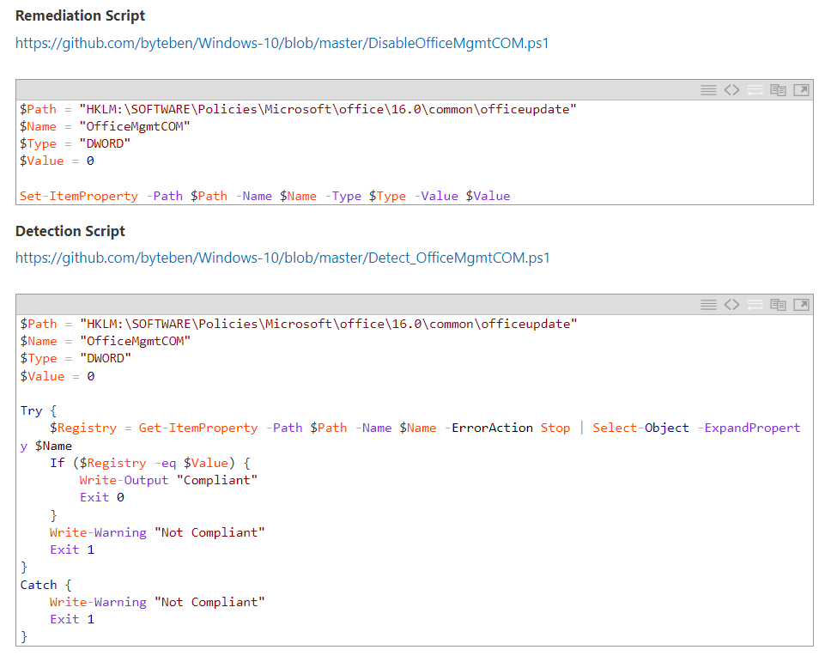
Moving Workloads
Office C2R Apps (Fix)
Reinstall with a new XML or update the registry
https://byteben.com/bb/office-365-updates-stop-working-when-workloads-are-switched-to-intune/
Notes:
Office 365 updates stop working when workloads are switched to Intune (byteben.com)

Slide 43
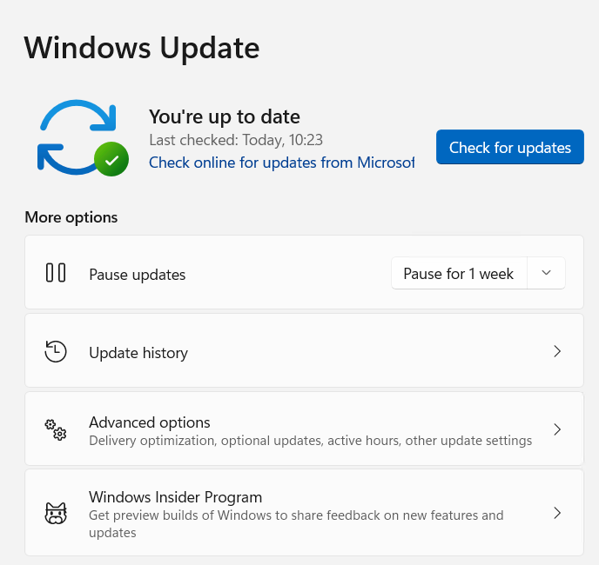
Moving Workloads
Windows Updates
Notes:
https://go.microsoft.com/fwlink/?linkid=2186198

Slide 44
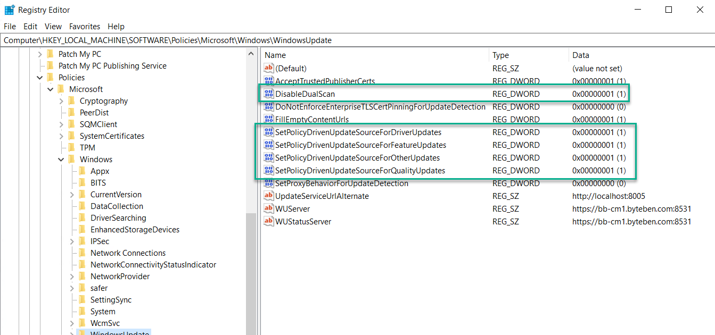
Moving Workloads
Windows Update – Registry before a workload move
Notes:
https://go.microsoft.com/fwlink/?linkid=2186198

Slide 45
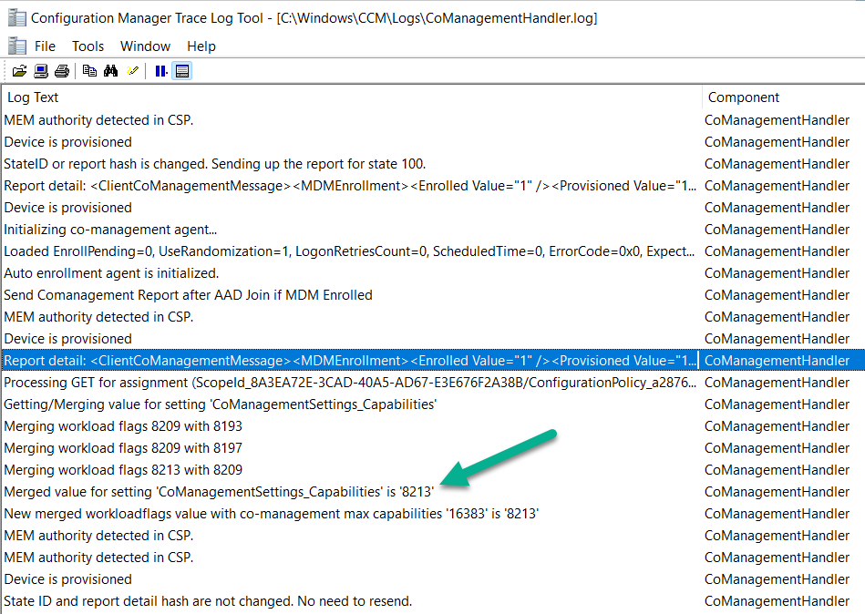
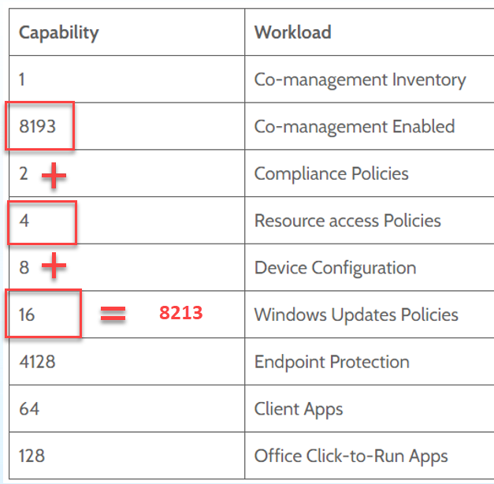
Moving Workloads
Windows Update – Workload Move
Notes:
https://go.microsoft.com/fwlink/?linkid=2186198

Slide 46
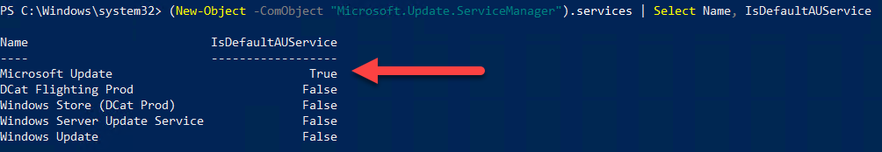
Moving Workloads
Windows Update – Workload Move Windows 10
Did it work?
(New-Object -ComObject "Microsoft.Update.ServiceManager").services | Select Name, IsDefaultAUService
Notes:
https://go.microsoft.com/fwlink/?linkid=2186198

Slide 47
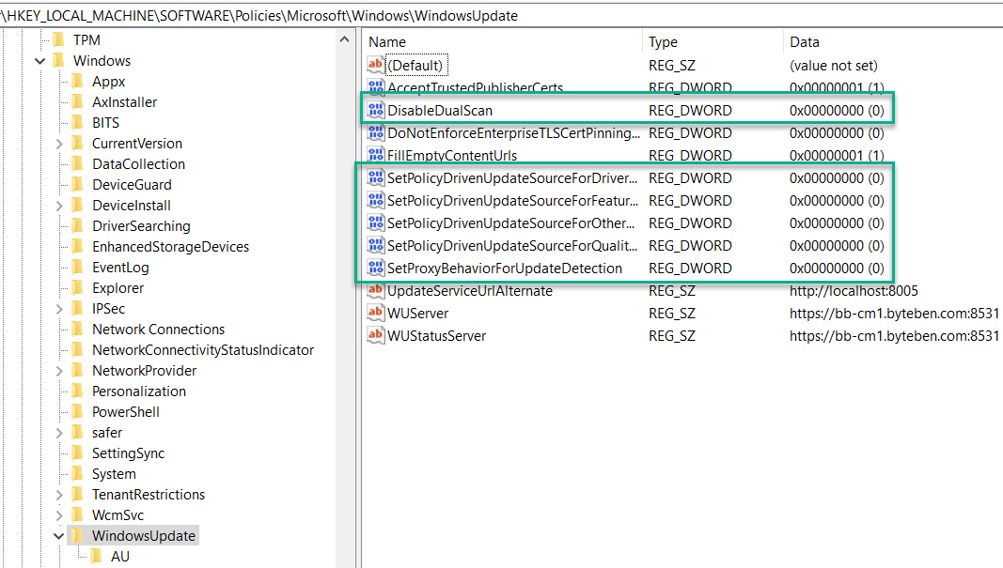
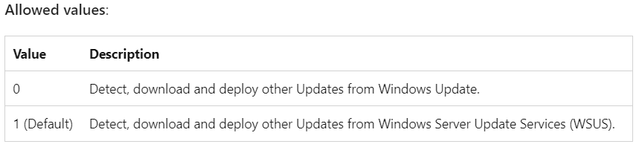
Moving Workloads
Windows 10
Workloads are moved to WU, DualScan is enabled so my expectation is I can install 3rd party updates from WSUS
DualScan appears to override Scan Source on W10 (which is still set to 0)
Notes:
https://go.microsoft.com/fwlink/?linkid=2186198

Slide 48
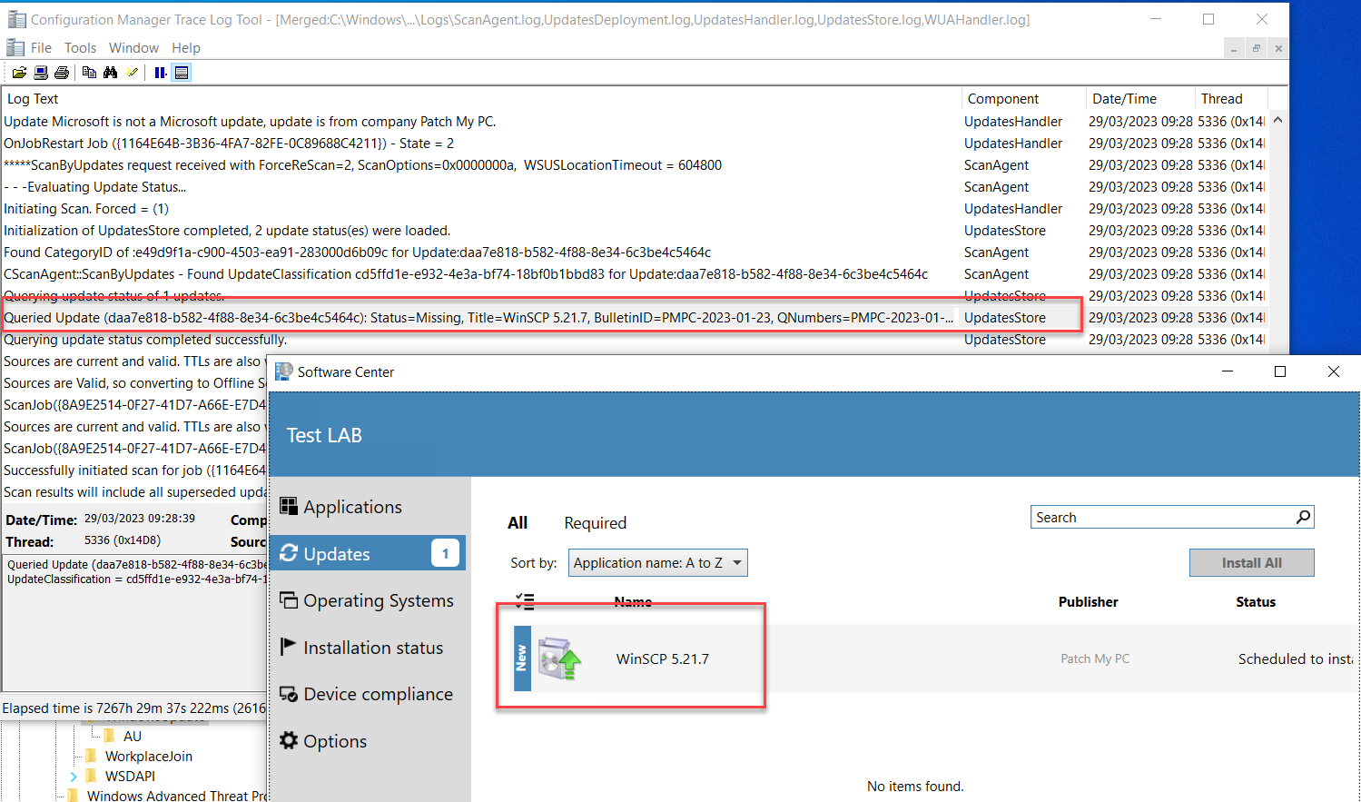
Moving Workloads
Notes:
https://go.microsoft.com/fwlink/?linkid=2186198

Slide 49
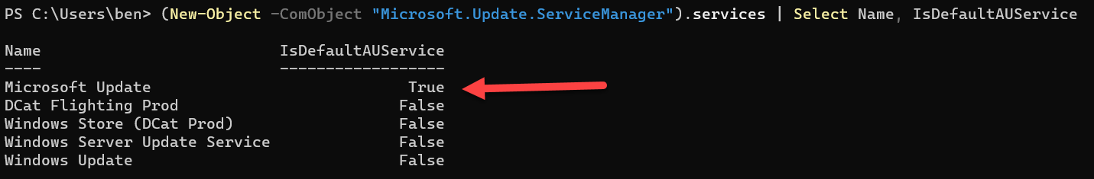
Moving Workloads
Windows Update – Workload Move Windows 11
Did it work?
(New-Object -ComObject "Microsoft.Update.ServiceManager").services | Select Name, IsDefaultAUService
Notes:
https://go.microsoft.com/fwlink/?linkid=2186198

Slide 50
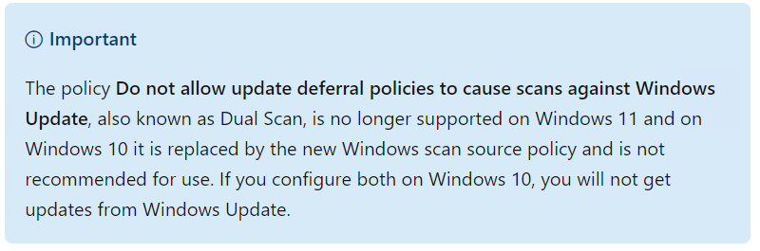
Moving Workloads
Windows 11
DualScan is enabled so my expectation is I can install 3rd party updates from WSUS
But the docs say DualScan is not supported in Windows11?
Notes:
https://learn.microsoft.com/en-us/windows/deployment/update/wufb-wsus

Slide 51
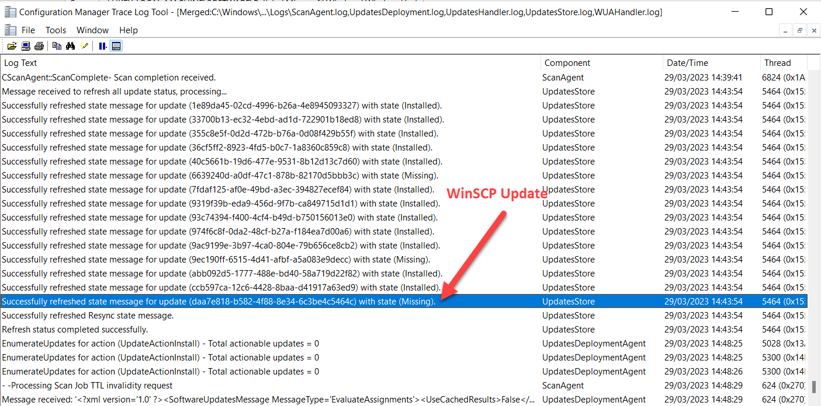
Moving Workloads
Windows 11
3rd party updates are scanning against WSUS as expected
Notes:
https://go.microsoft.com/fwlink/?linkid=2186198

Slide 52
Moving Workloads
More Insight
Some legacy settings can prevent Windows Updates from working when the WU workload is moved
Registry Key | Registry Setting
Software\Policies\Microsoft\Windows\WindowsUpdate | DisableDualScan
Software\Policies\Microsoft\Windows\WindowsUpdate | DoNotConnectToWindowsUpdateInternetLocations
Software\Policies\Microsoft\Windows\WindowsUpdate\AU | NoAutoUpdate
Notes:
https://go.microsoft.com/fwlink/?linkid=2186198

Slide 53
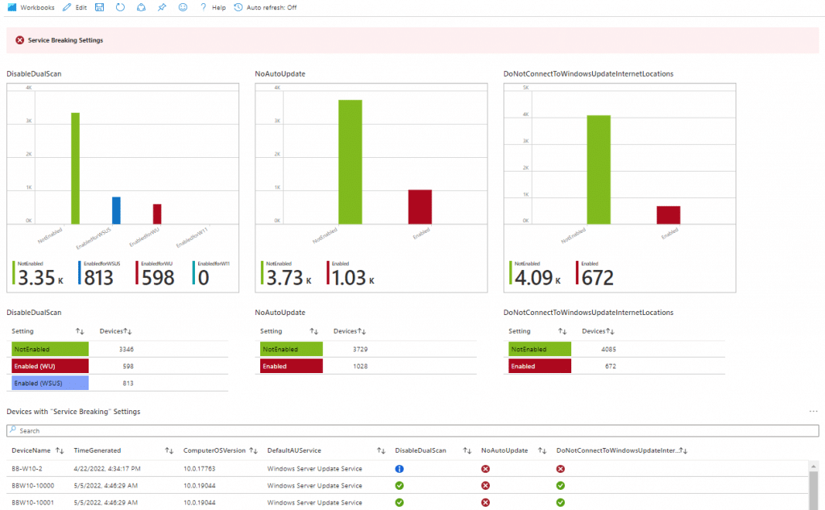
Moving Workloads
More Insight
Some legacy settings can prevent Windows Updates from working when the WU workload is moved
https://MSEndpointMgr.com/2022/05/13/windows-update-settings-compliance/
Notes:
https://go.microsoft.com/fwlink/?linkid=2186198

Slide 54
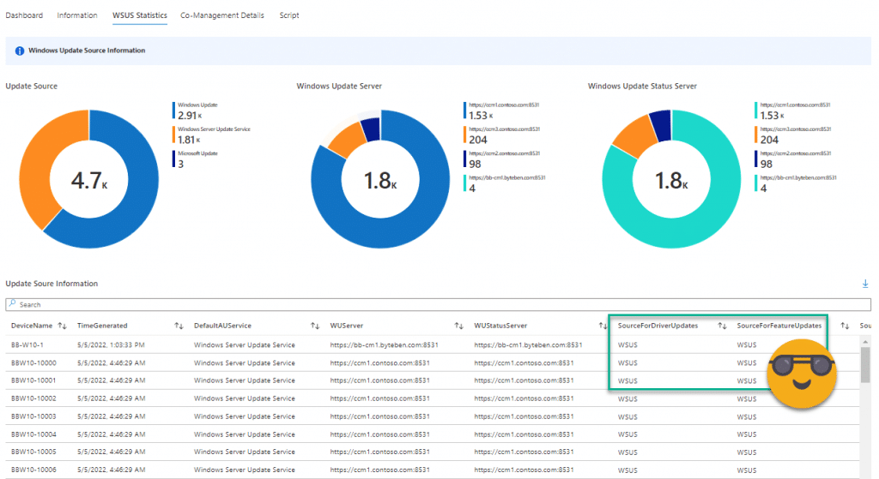
Moving Workloads
https://MSEndpointMgr.com/2022/05/13/windows-update-settings-compliance/
Notes:
https://go.microsoft.com/fwlink/?linkid=2186198

Slide 55
Moving Workloads
Autopatch
Windows Autopatch fully supports co-management. The following co-management requirements apply:
ConfigMgr must be cloud-attached with Intune (co-management) and must have the following co-management workloads enabled:
  Set the Windows Update policies workload to Pilot Intune or Intune
  Set the Device configuration workload to Pilot Intune or Intune
  Set the Office Click-to-Run apps workload to Pilot Intune or Intune
https://learn.microsoft.com/en-us/windows/deployment/windows-autopatch/prepare/windows-autopatch-prerequisites

Slide 56
Q and A

